Slide 1
ca. 1.87-1.89 Ga igneous rocks in Lithuania
L. Šiliauskas, G. Skridlaite
2026

Slide 2
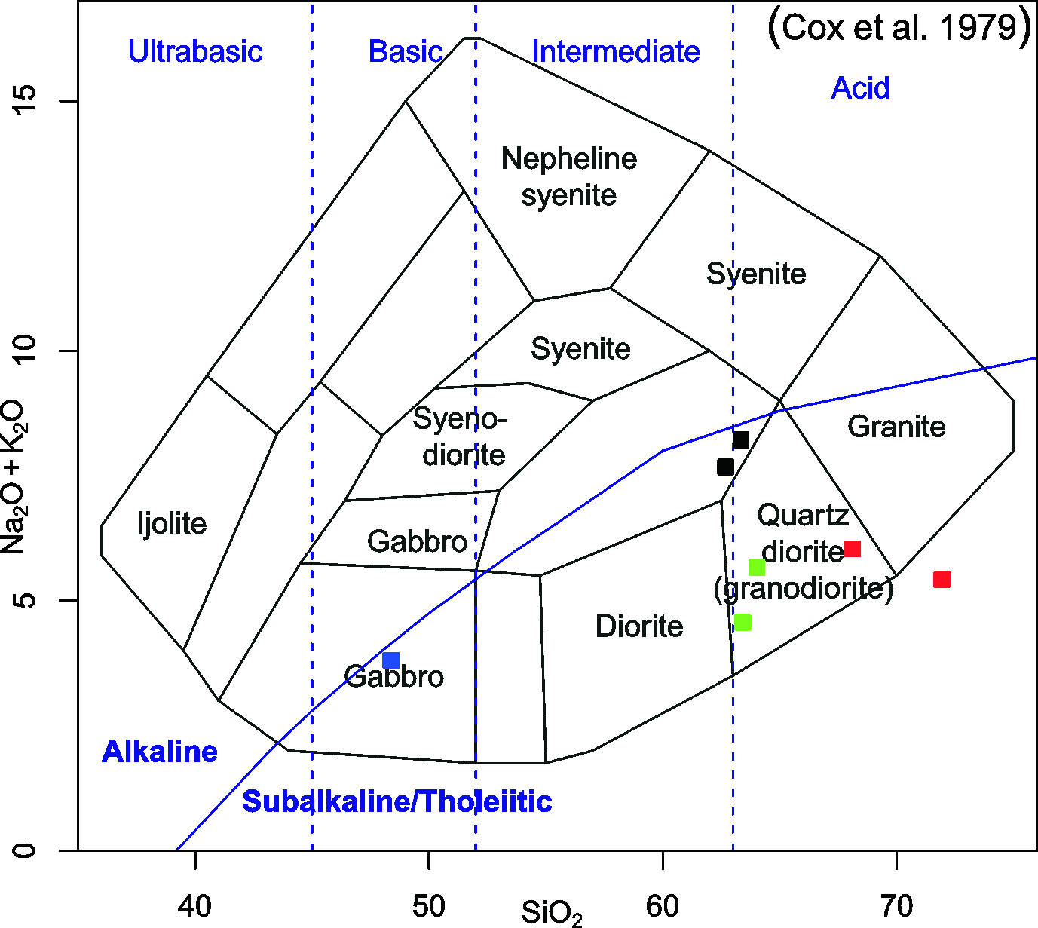
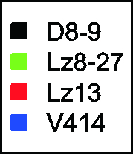
What we dated so far?
Rock type | Drill ID | Depth, m | Igneous age, Ma | Method | Avg εHfT | Metamorphic age, Ma | Method | Avg εHfT | Metamorphic age, Ma | Method
Metadiorite | Lz8 | 682 | 1887±9 | U-Pb, SIMS, zircon | -0.7
Metarhyolite | Lz13 | 598.9 | 1898±8 | U-Pb, SIMS, zircon | 3.1
Metagranodiorite | Lz27 | 543.5 | 1876±5 | U-Pb, SIMS, zircon | 2.9
Metagranodiorite | D8 | 844.6 | 1894±6 | U-Pb, SIMS, zircon | -0.8 | 1755-1770 | U-Pb, SIMS, zircon | -3.5 | 1491±6 | U-Pb, LA-ICPMS, ttn
Metagranodiorite | D9 | 1124 | 1894±7 | U-Pb, SIMS, zircon | -0.5 | 1790±8 | U-Pb, SIMS, zircon | -2.1
Metagabbro | 414 | 454 | 1897±4 | U-Pb, SHRIMP, zircon |  | 1817±6 | U-Pb, SHRIMP, zircon |  | 1784±10 | U-Pb, SHRIMP, zircon

Slide 3
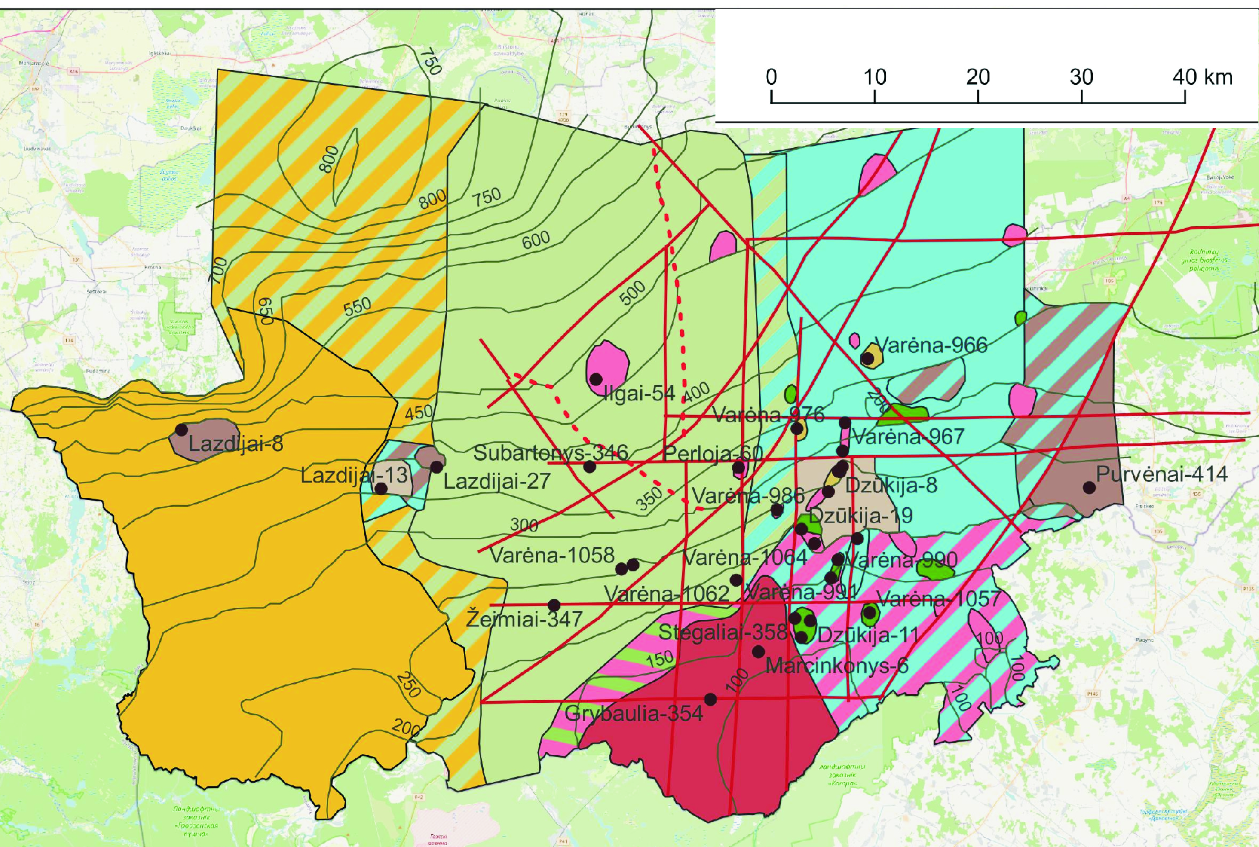

Slide 4
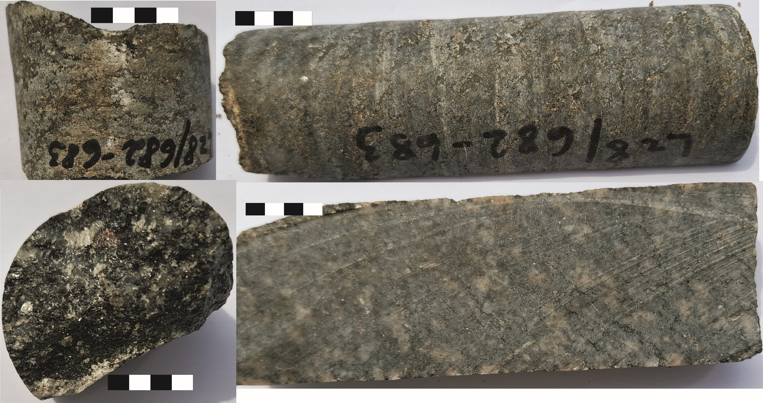
Lz8
Grt
Pl An₄₆₋₅₄ ~ 40-50 %, Qtz ~20 %, Bt Mg# 32-40 ~20 %, Amf Mg# 34-40 ~15 %, Grt ~5%.
Kfs, Chl, Ilm, Mag, Ap, Zr, Ttn <1%

Slide 5
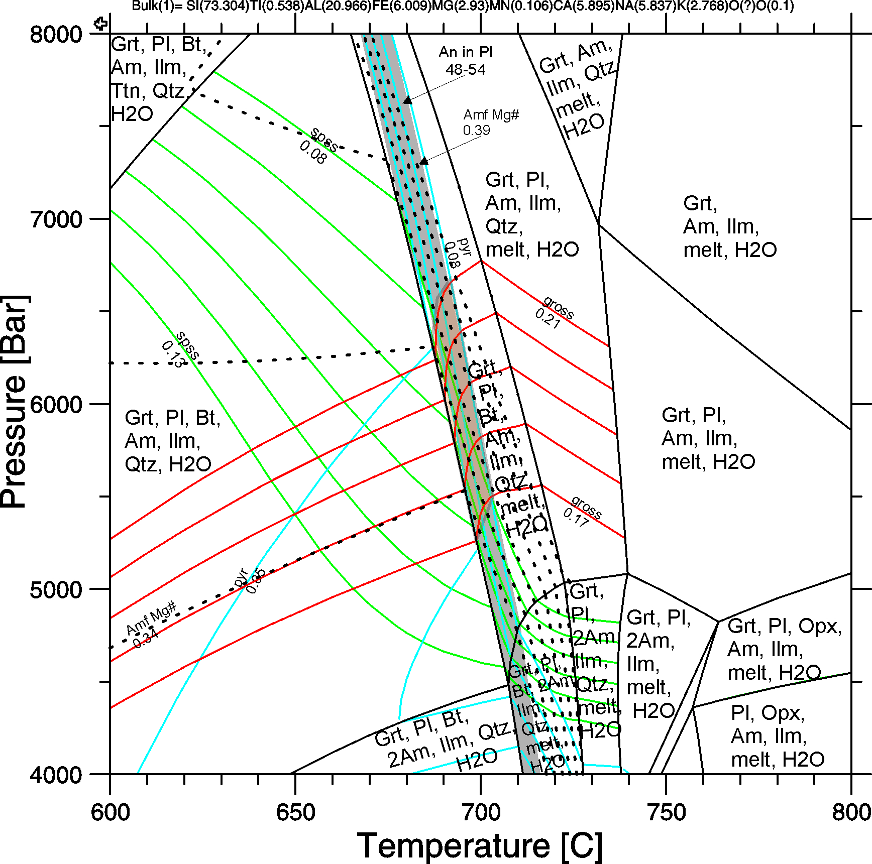
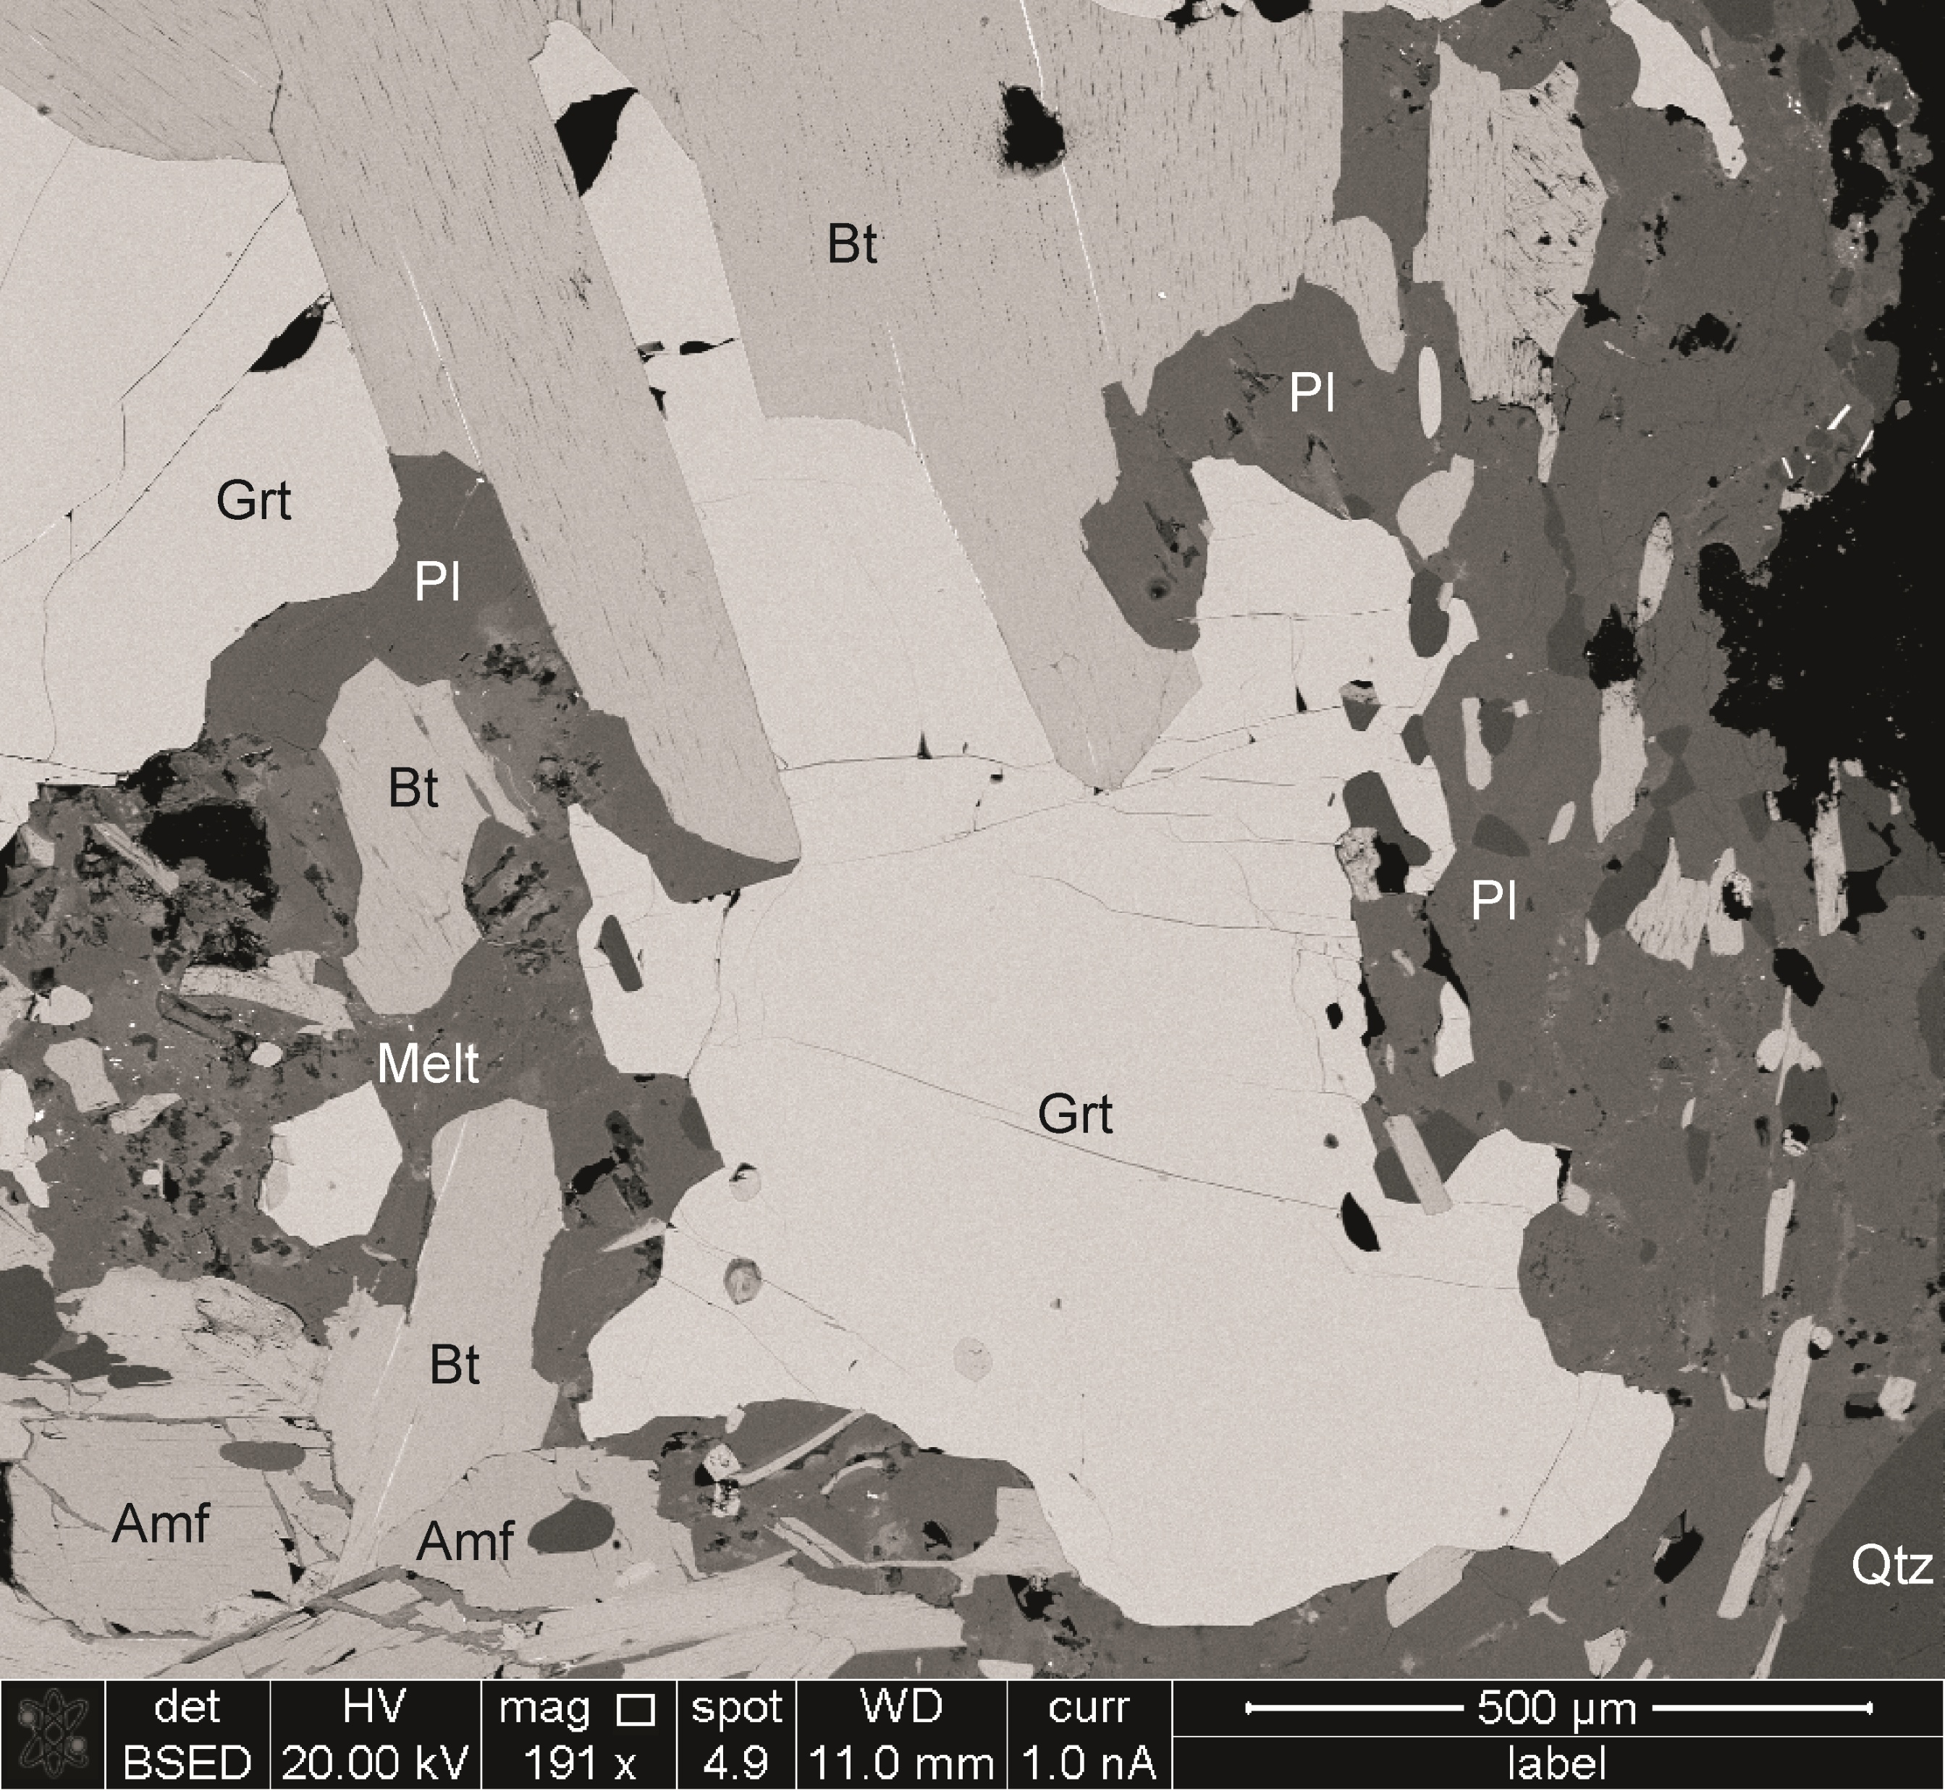
Lz8
Garnet isopleths: 690-710 °C, 5.5-6.5 kbar
Amp-Pl: 695-730 °C, 6-7 kbar (Holland and Blundy, 1994)

Slide 6
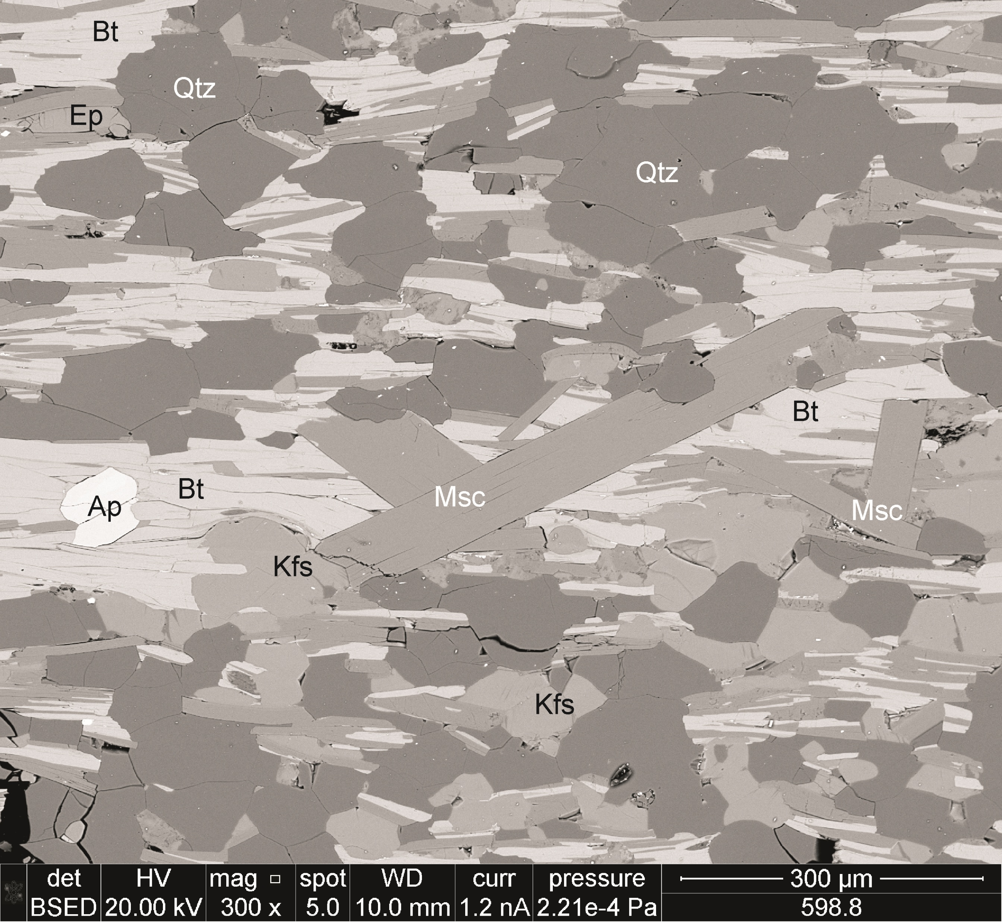
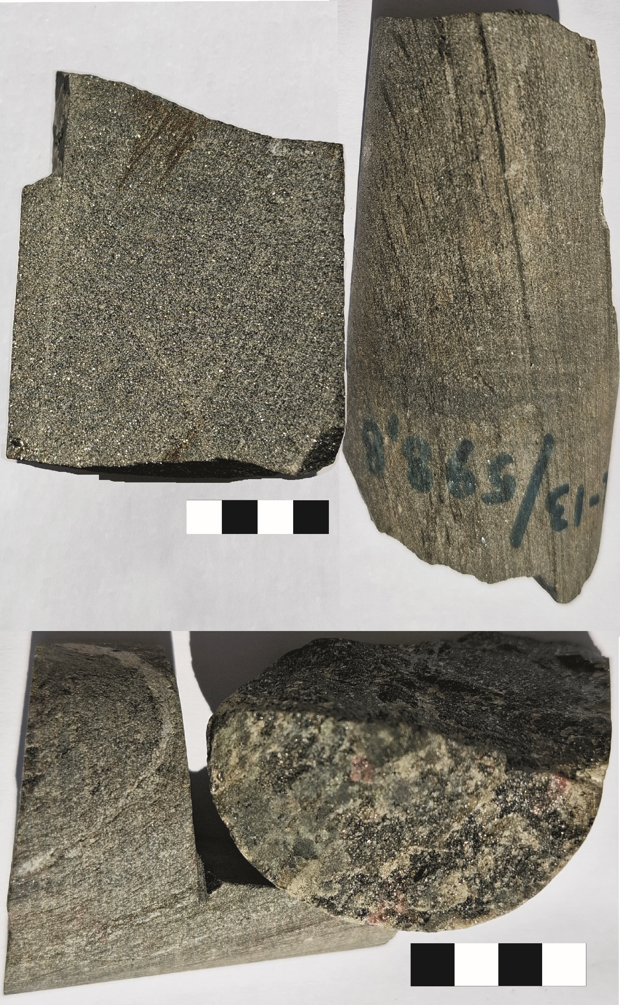
Lz13
Pl An₄₂₋₄₆ ~5 %,
Kfs ~20-30 %
Qtz ~30%
Bt Mg# 50-53~20 %
Msc Mg# 32-40~10%
Chl ~4%
Mag ~1%
Grt, Ep, Ap, Turm, Mnz, Zr <1%
PT is done… but in the ca. 1.83 Ga metavolcanic rocks above it…
Peak: 630 °C, 7 kbar at ca. 1.73 Ga
Reheating: 640 °C, ~4 kbar, at ca. 1.47 Ga

Slide 7
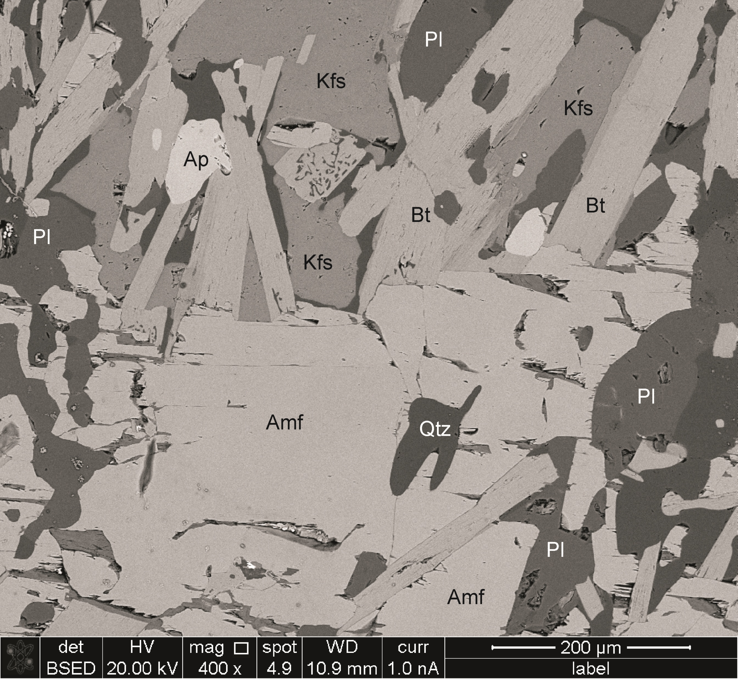
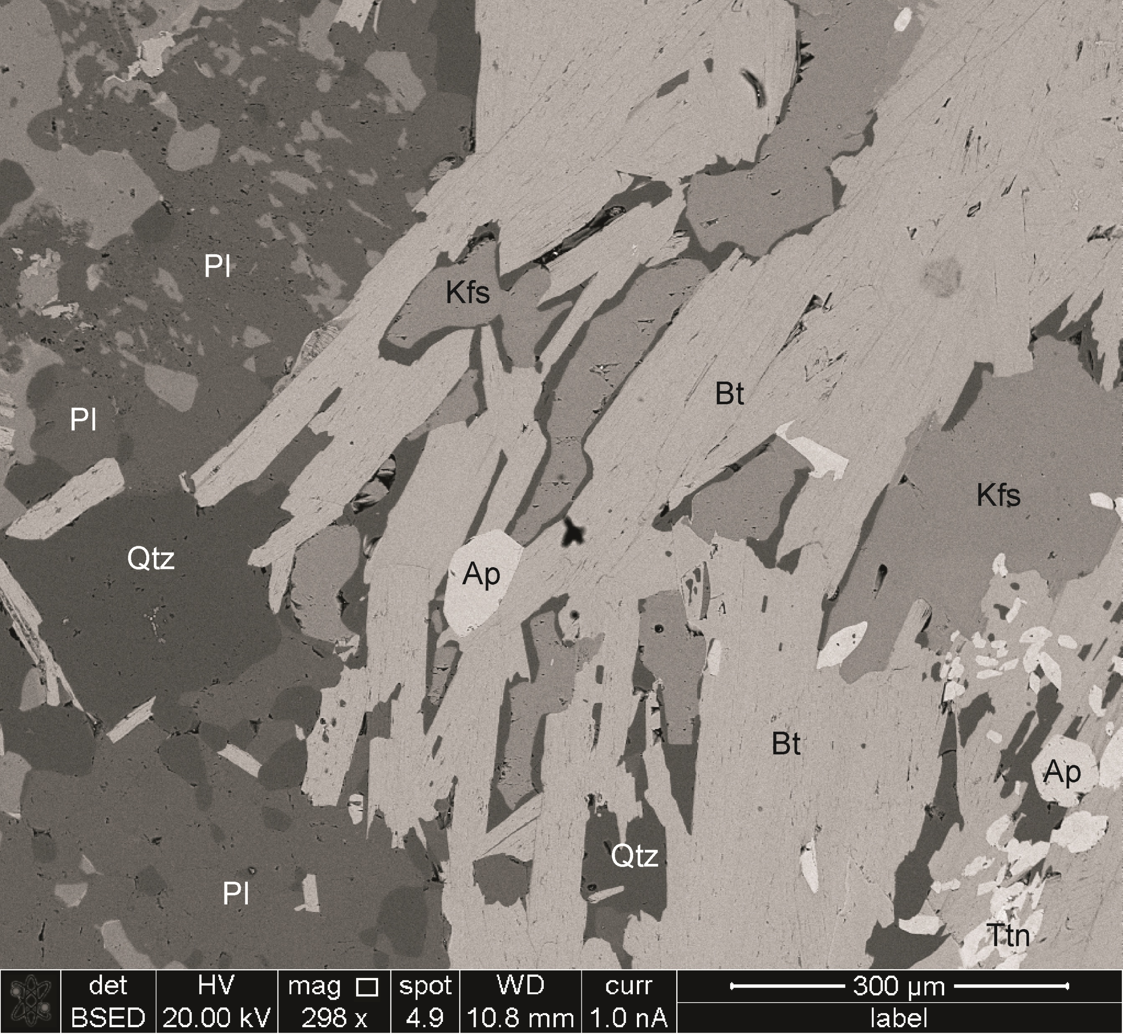
Lz27
Pl An₂₆₋₃₇ ~ 35 %, Kfs ~15%, Qtz ~20 %, Bt Mg# 51-60 ~15 %, Amf Mg# 47-53 ~15 %.
Ep, Chl, Ilm, Mag, Ap, Zr, Ttn <1%
Amph-Pl: 675-725 °C, 5.0-6.4 kbar

Slide 8
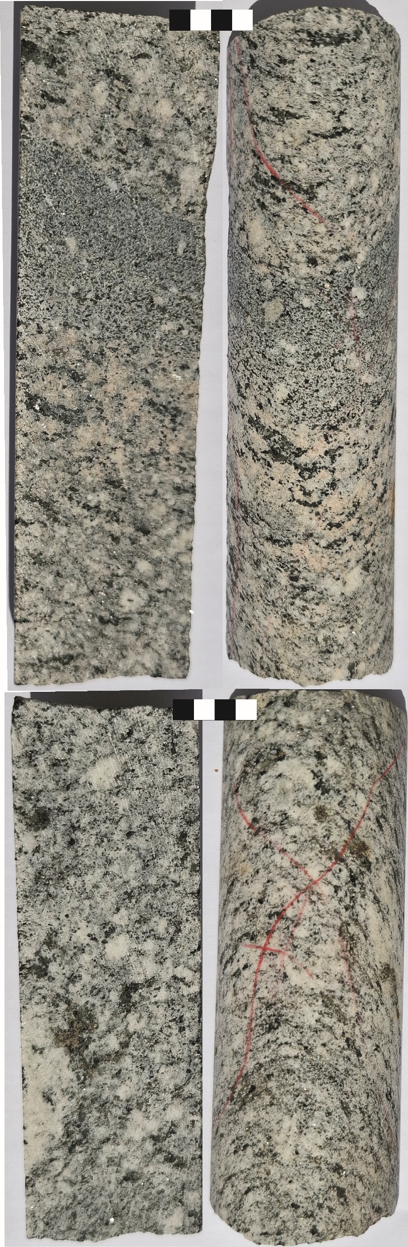
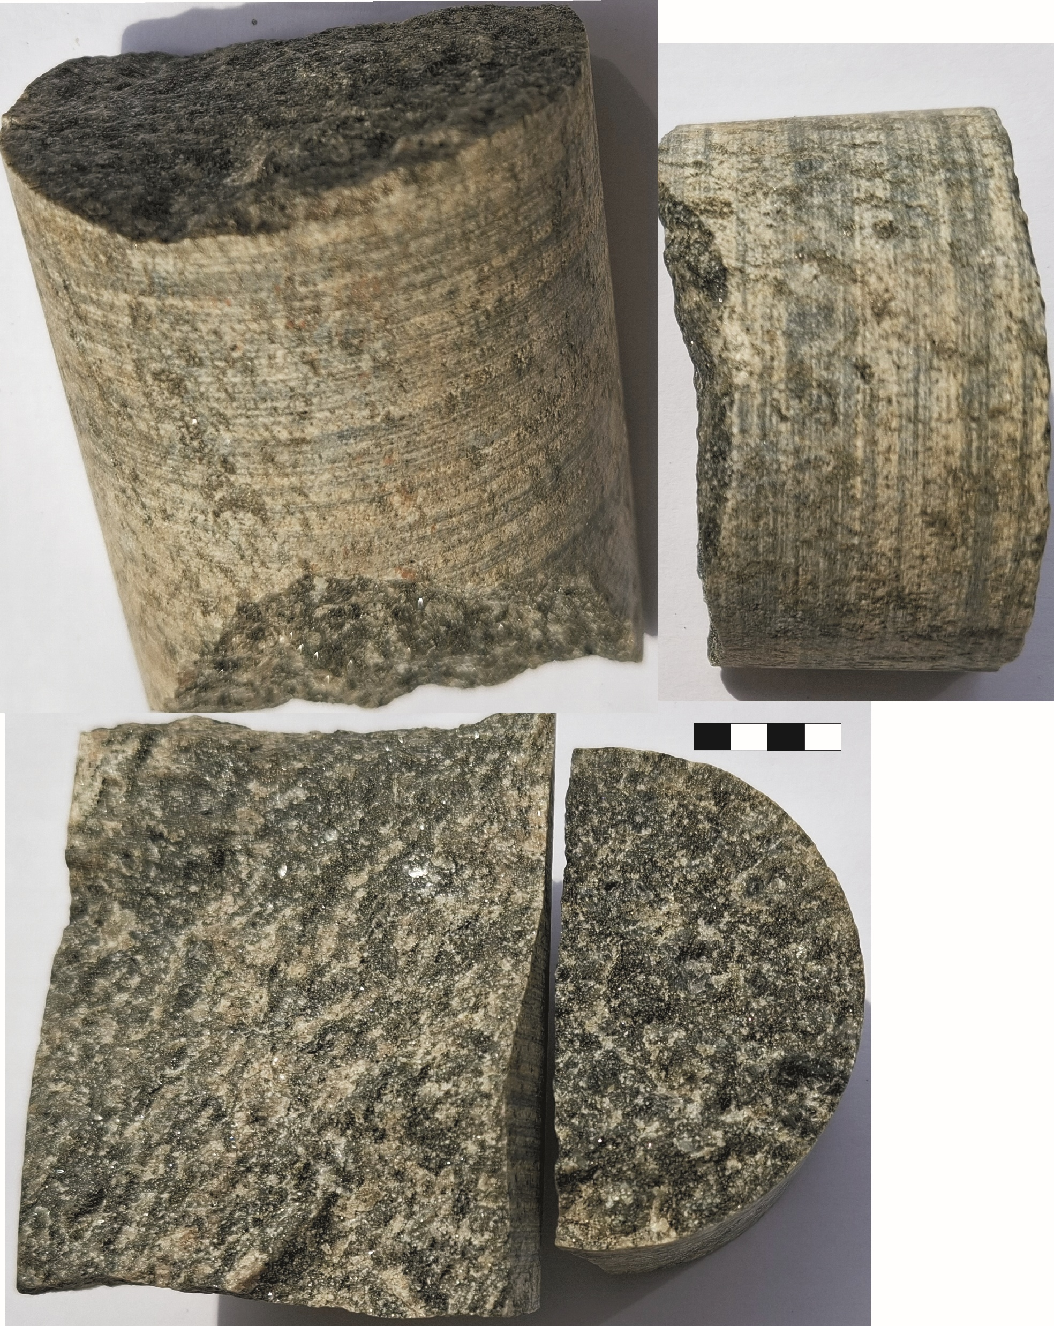
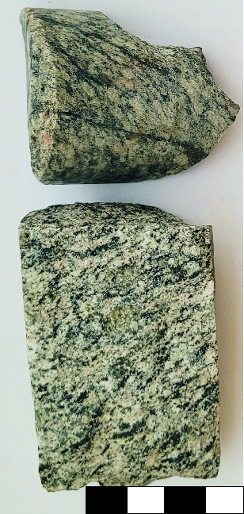
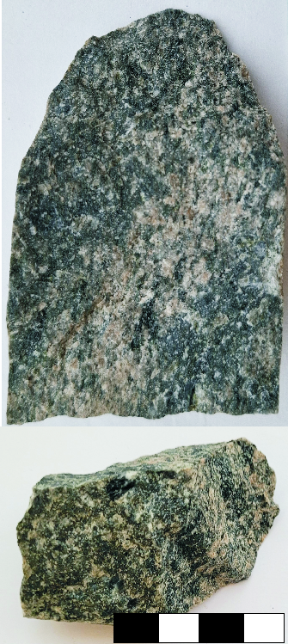
D8
D8
Pl An₀₁₋₅₂ ~30%
Kfs ~5-10%
Qtz ~5-10%
Scp Me₂₄₋₃₆ X_{Cl} 0.8-1, ~5%
Cpx Mg#65-70 ~15%
Amf Mg#09-72 ~25%
Bt Mg#42-51 ~5%
Chl ~5%
Ilm, Mag, Ttn, Ap, Aln, Zr, Py <1%
D9
D9
Pl An₀₀₋₅₉ ~25-30%
Kfs ~5%
Qtz ~5-10%
Scp Me₃₀₋₅₅ X_{Cl} 0.4-0.9, ~10-15%
Cpx Mg#67-70 <1%
Amf Mg#00-71 ~35%
Bt Mg#43-60 ~3%
Chl ~2%
Ilm, Mag, Ttn, Ap, Zr, Py,ChPy, Cal <1%

Slide 9
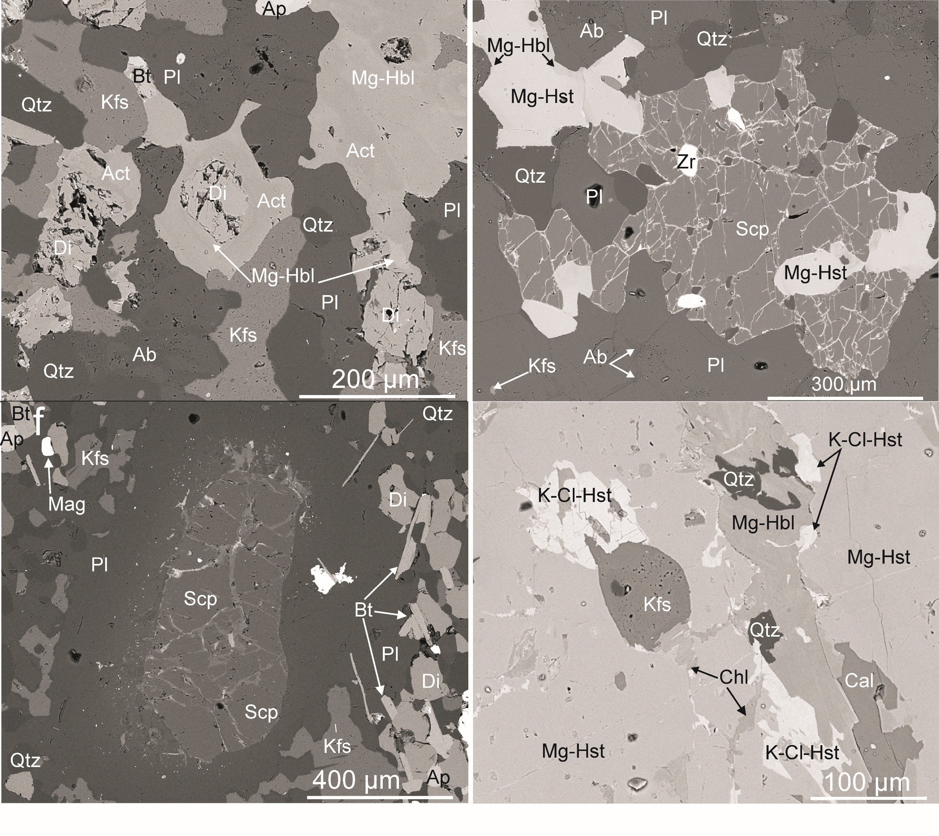
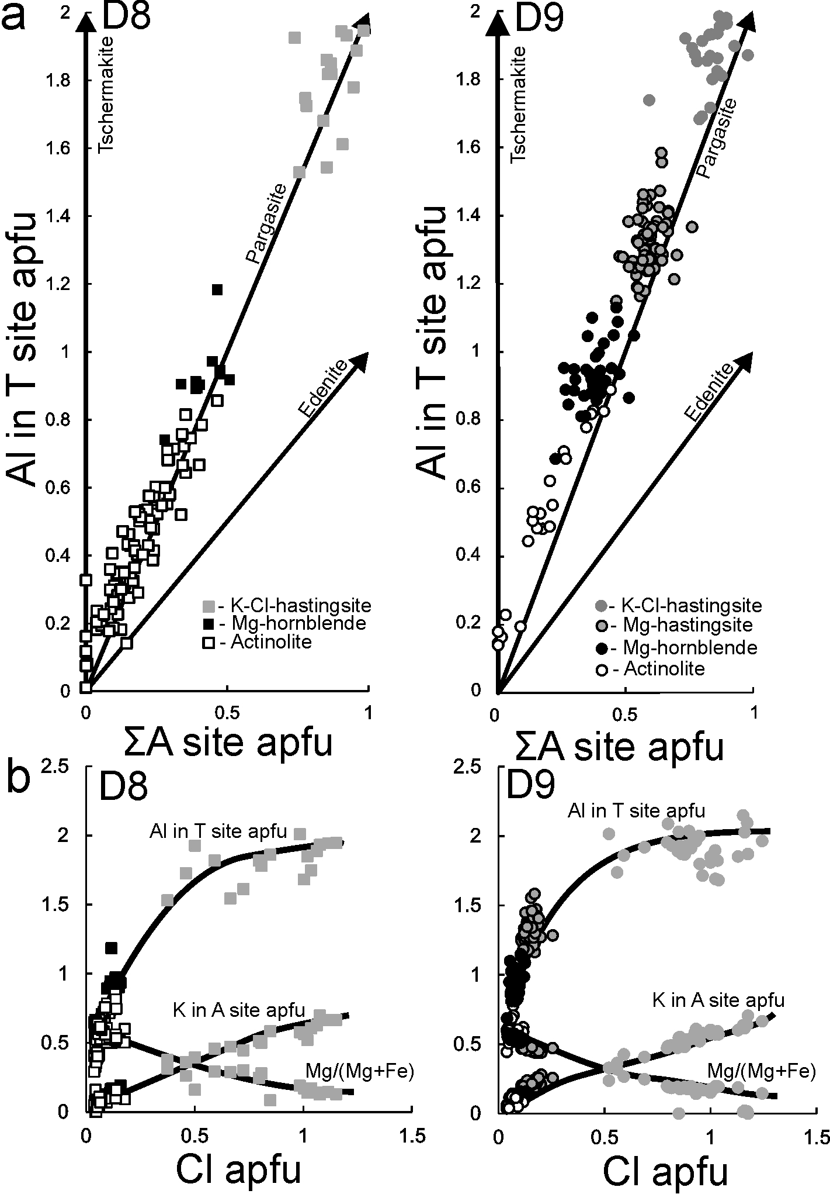
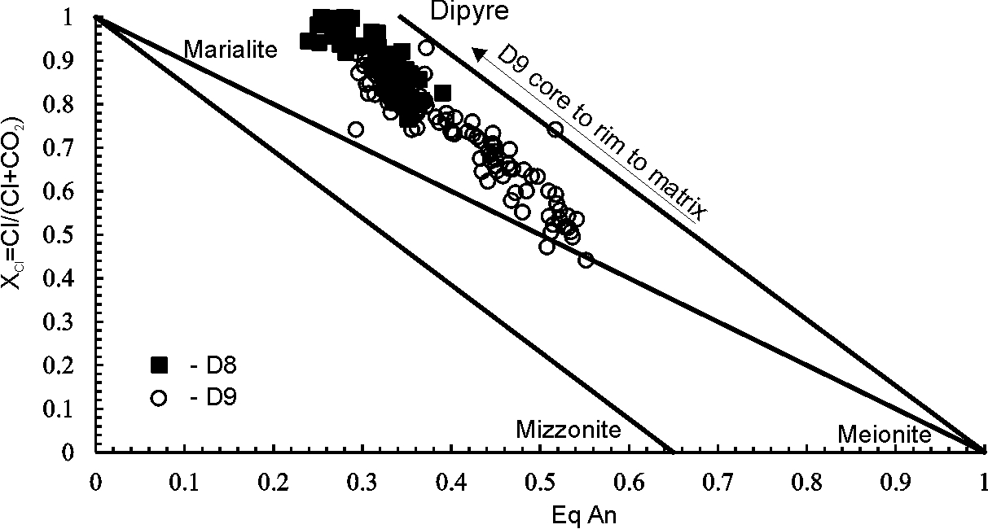
D8
D9
D8
D9
Peak to early retrograde: 640-770 °C, at ca. 1.75-1.79 Ga (Ti-in Amph, Bt, Bt-Ap)
Reheating: 480-660 °C at ca. 1.49-1.52 Ga (Ti-in Amph, Bt)

Slide 10
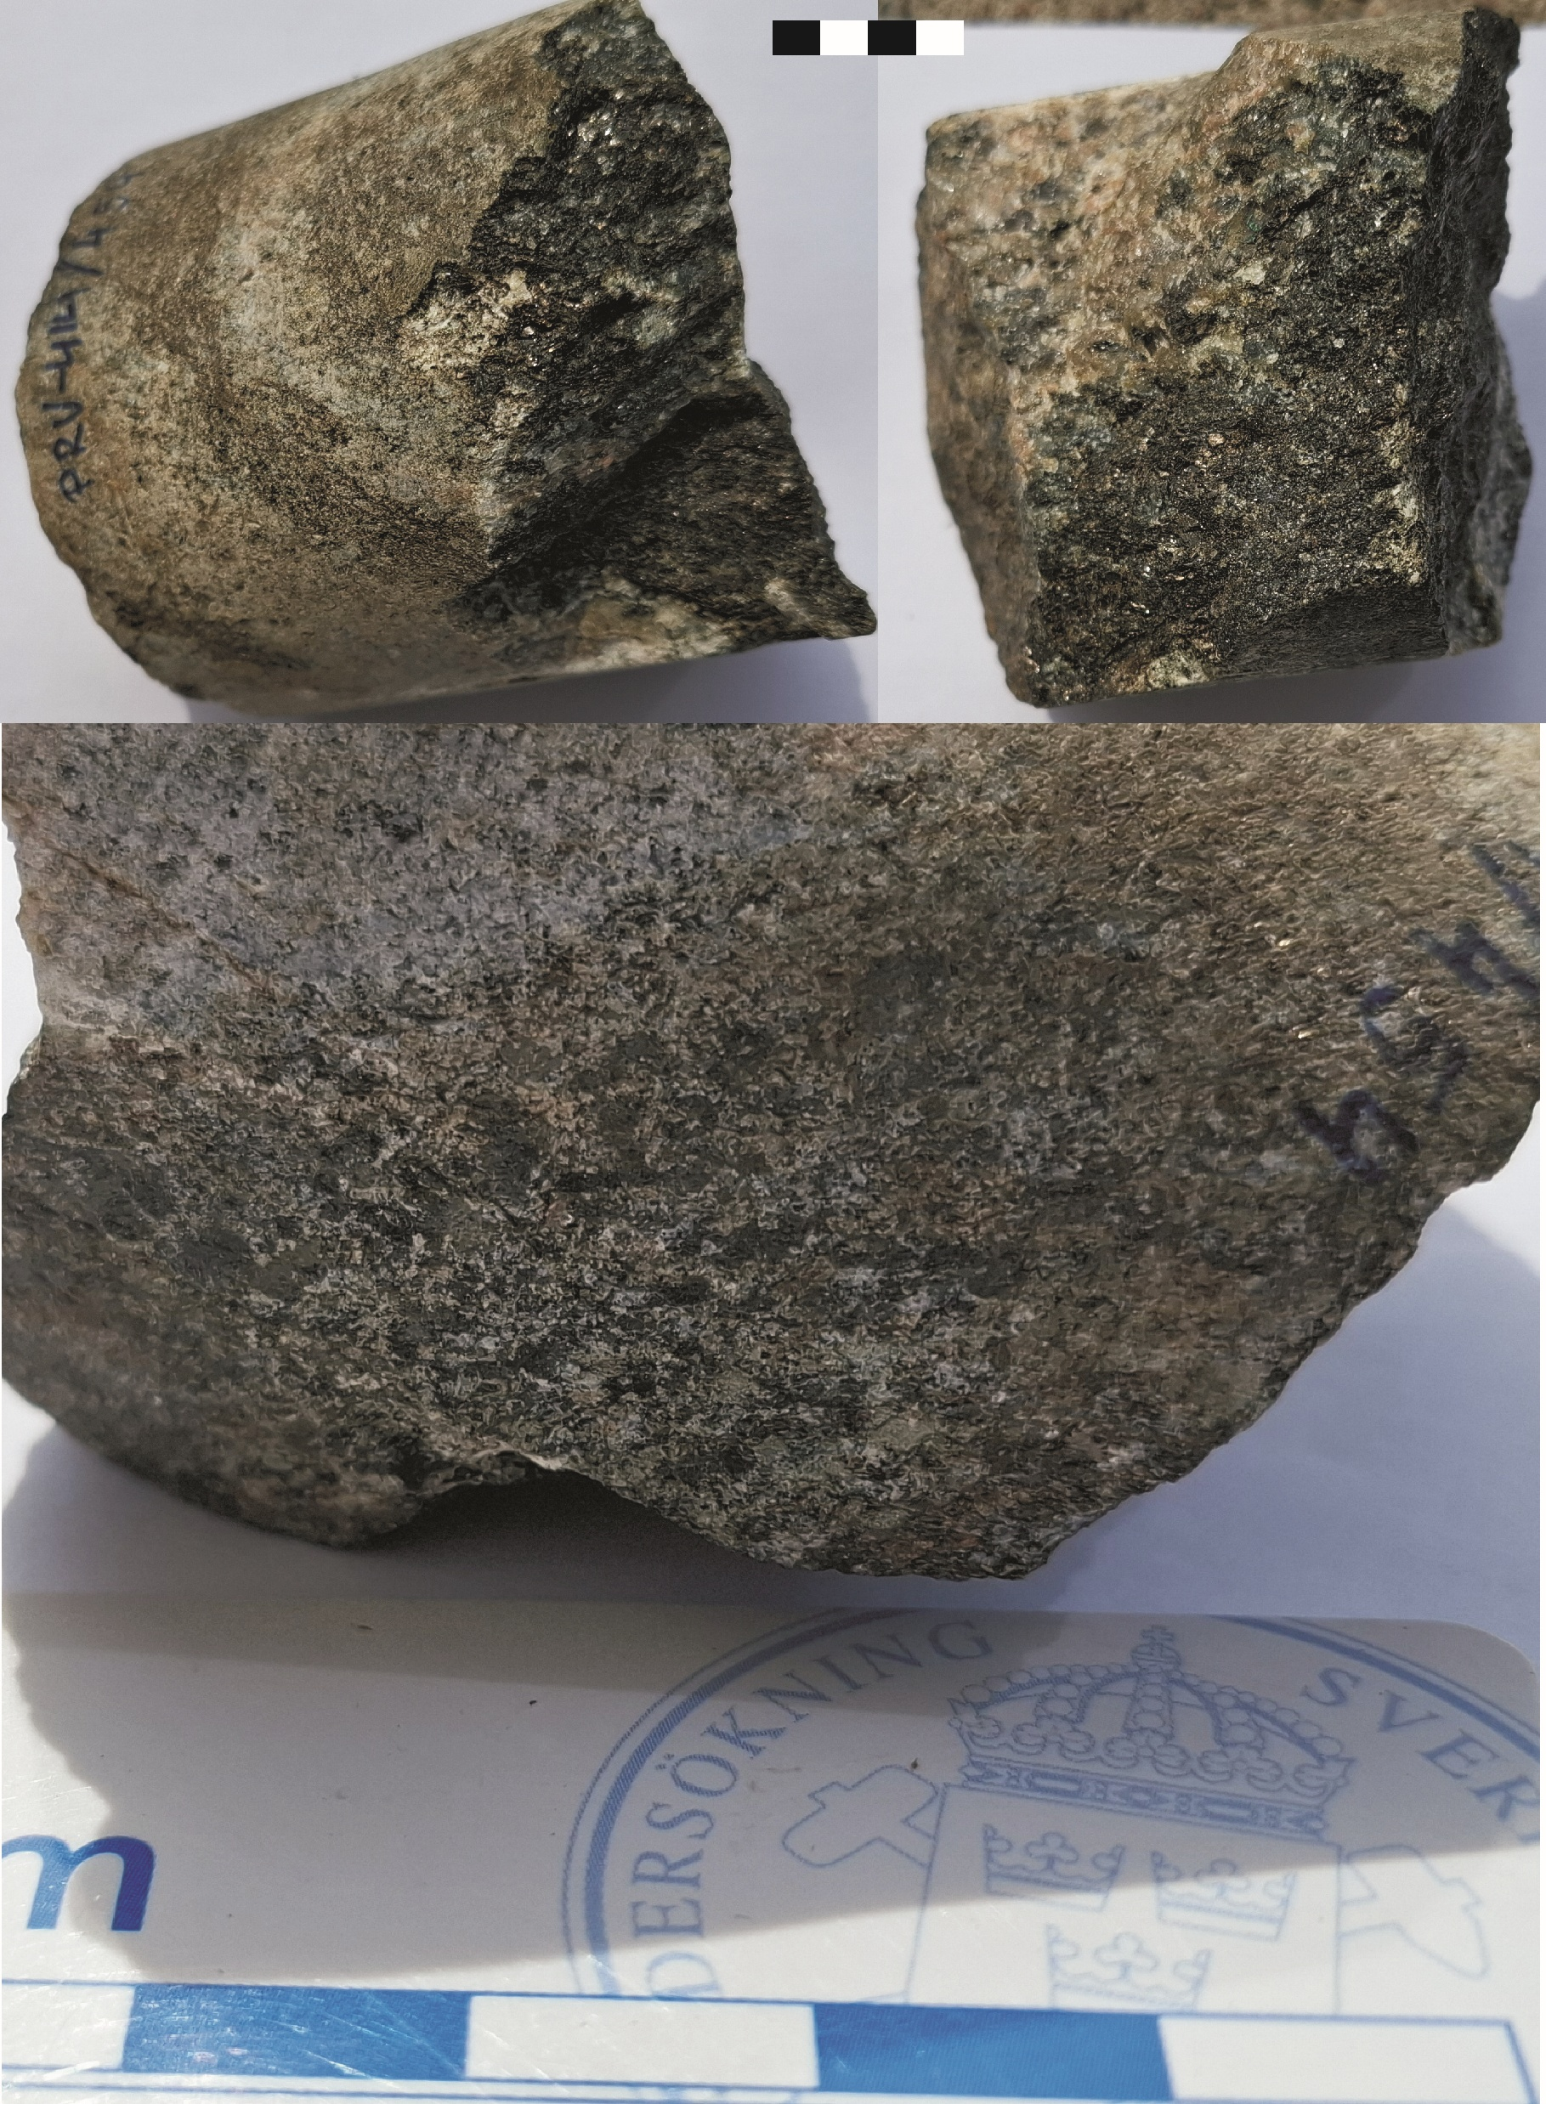
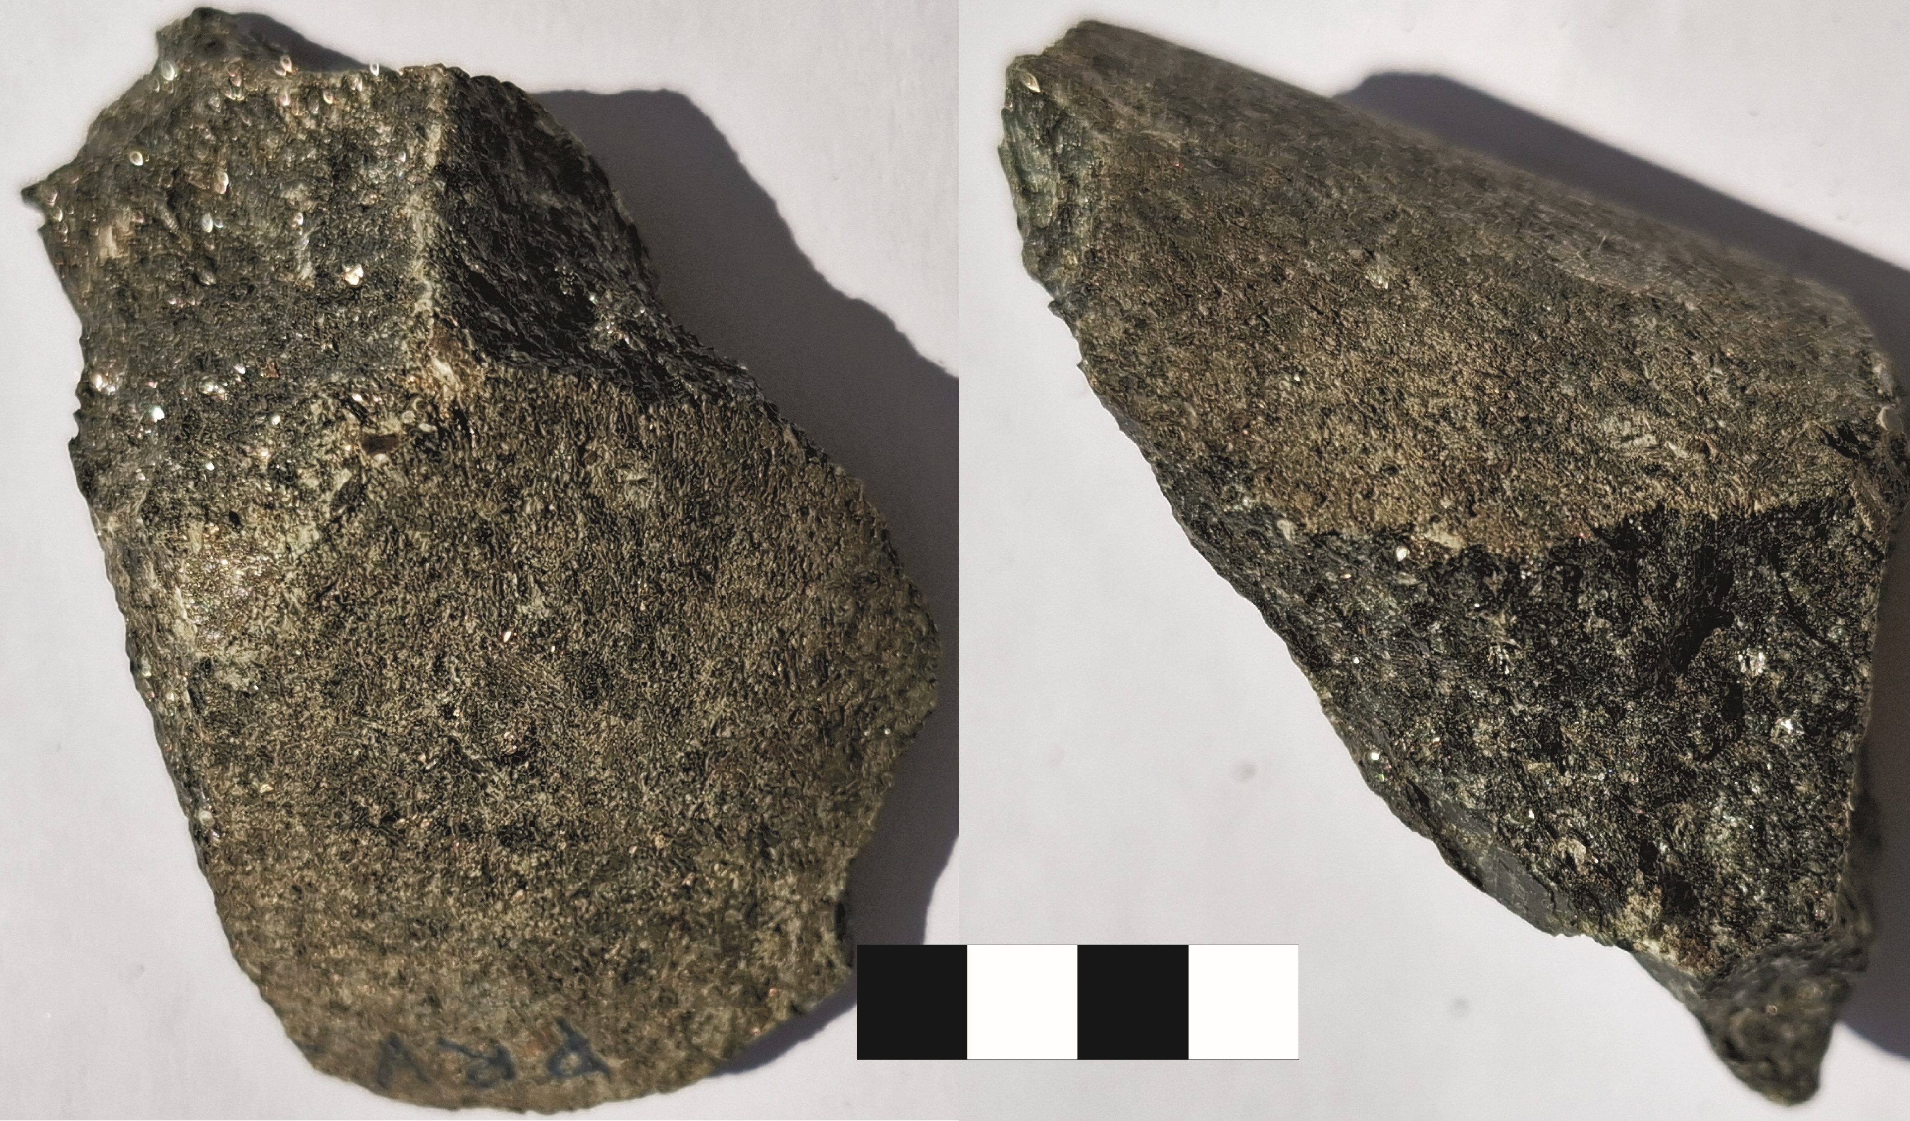
414

Slide 11
690-730° C
5.5-7 kbar
675-725° C
5-6.4 kbar
630° C
7 kbar
640-770° C

Slide 12
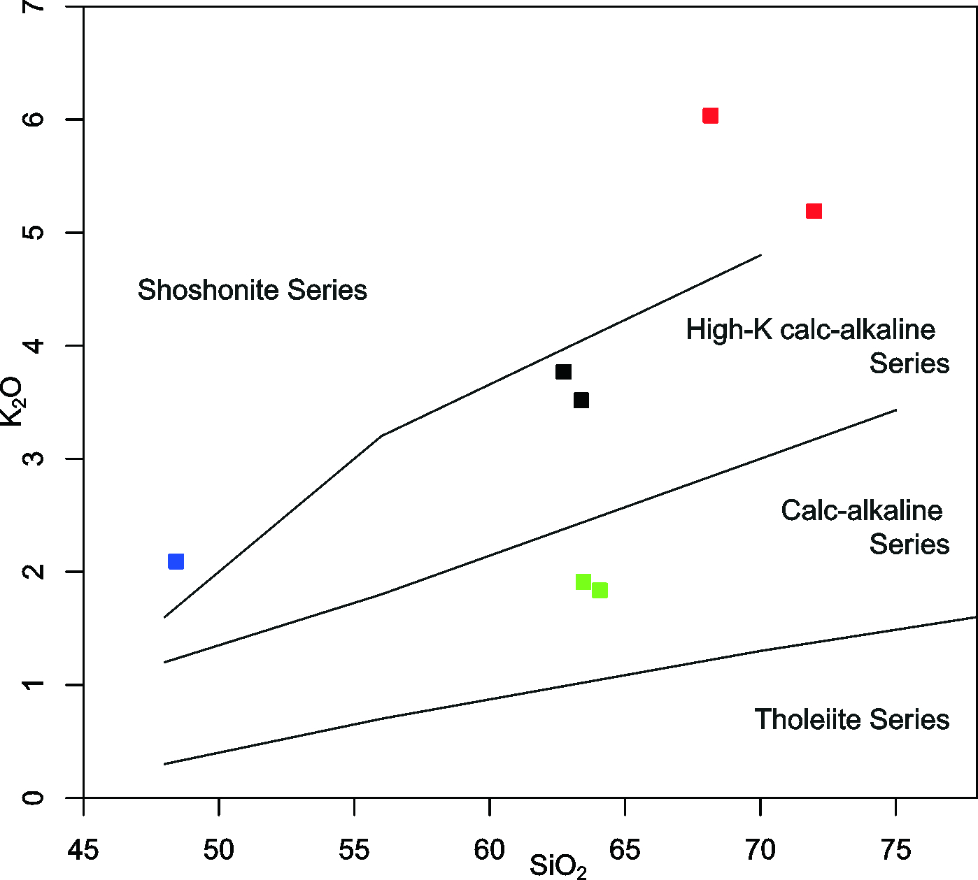
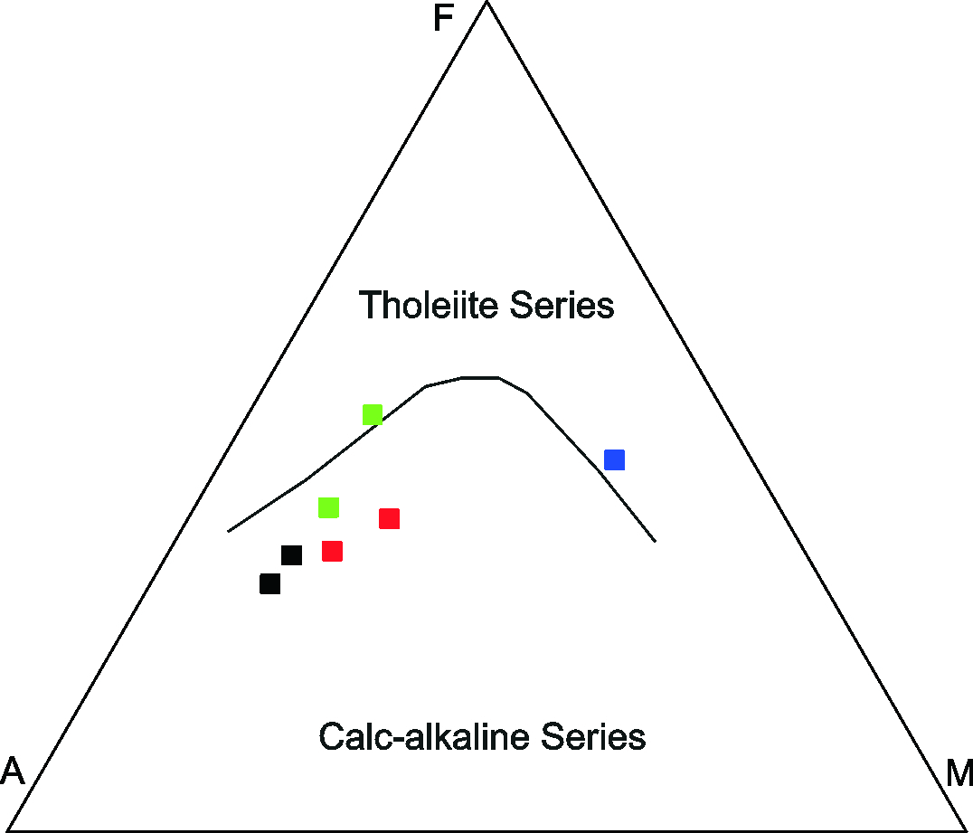
Whole-rock chemistry

Slide 13
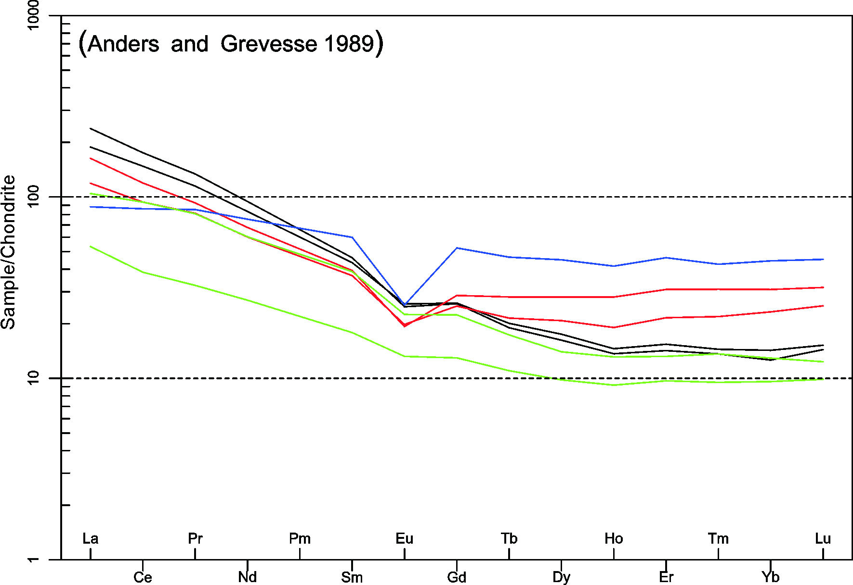
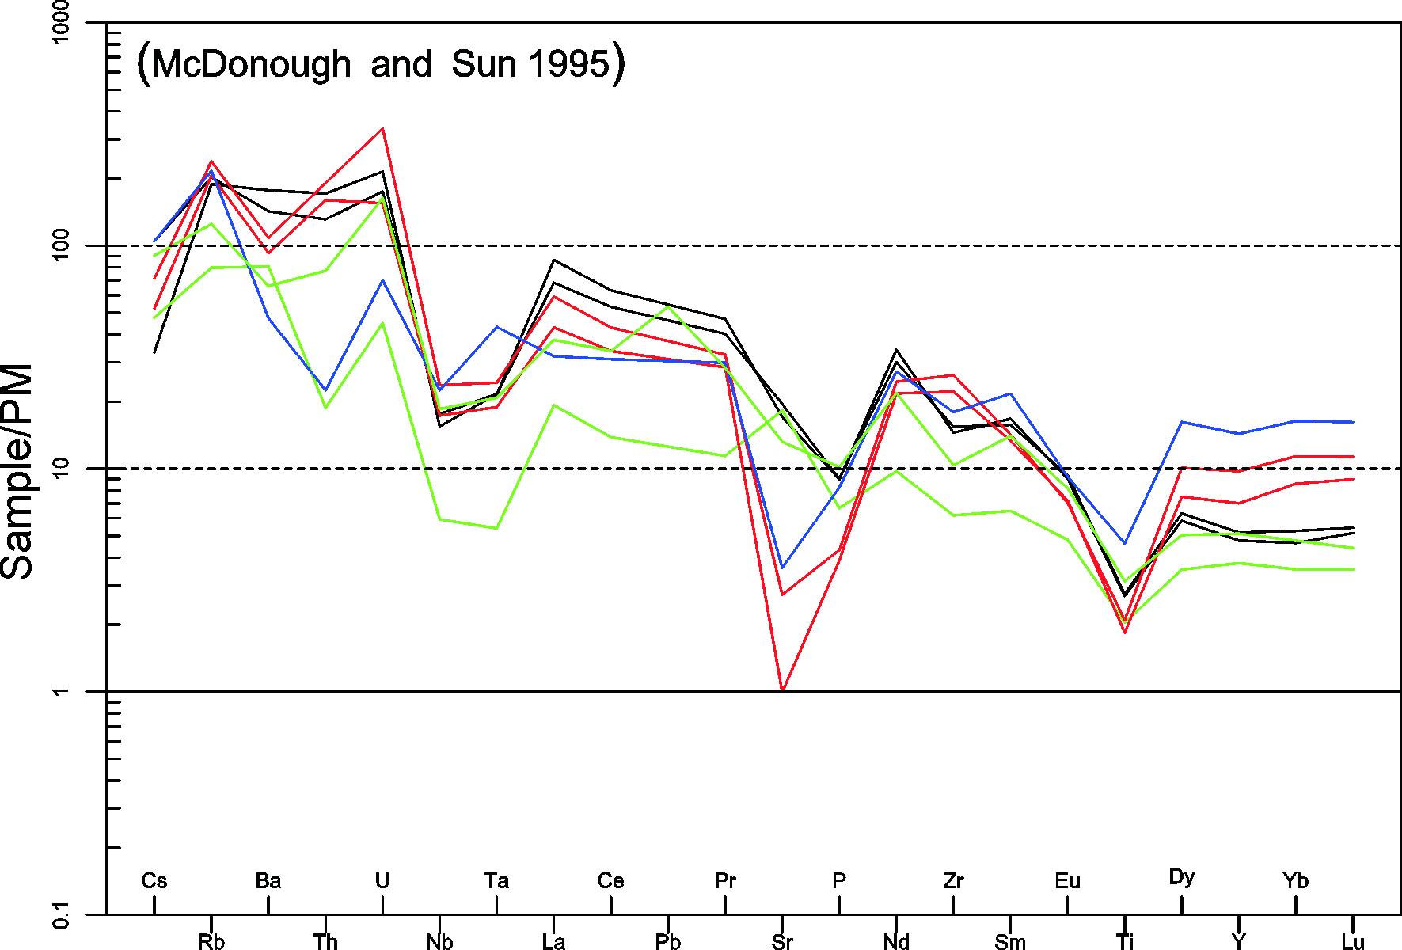

Slide 14
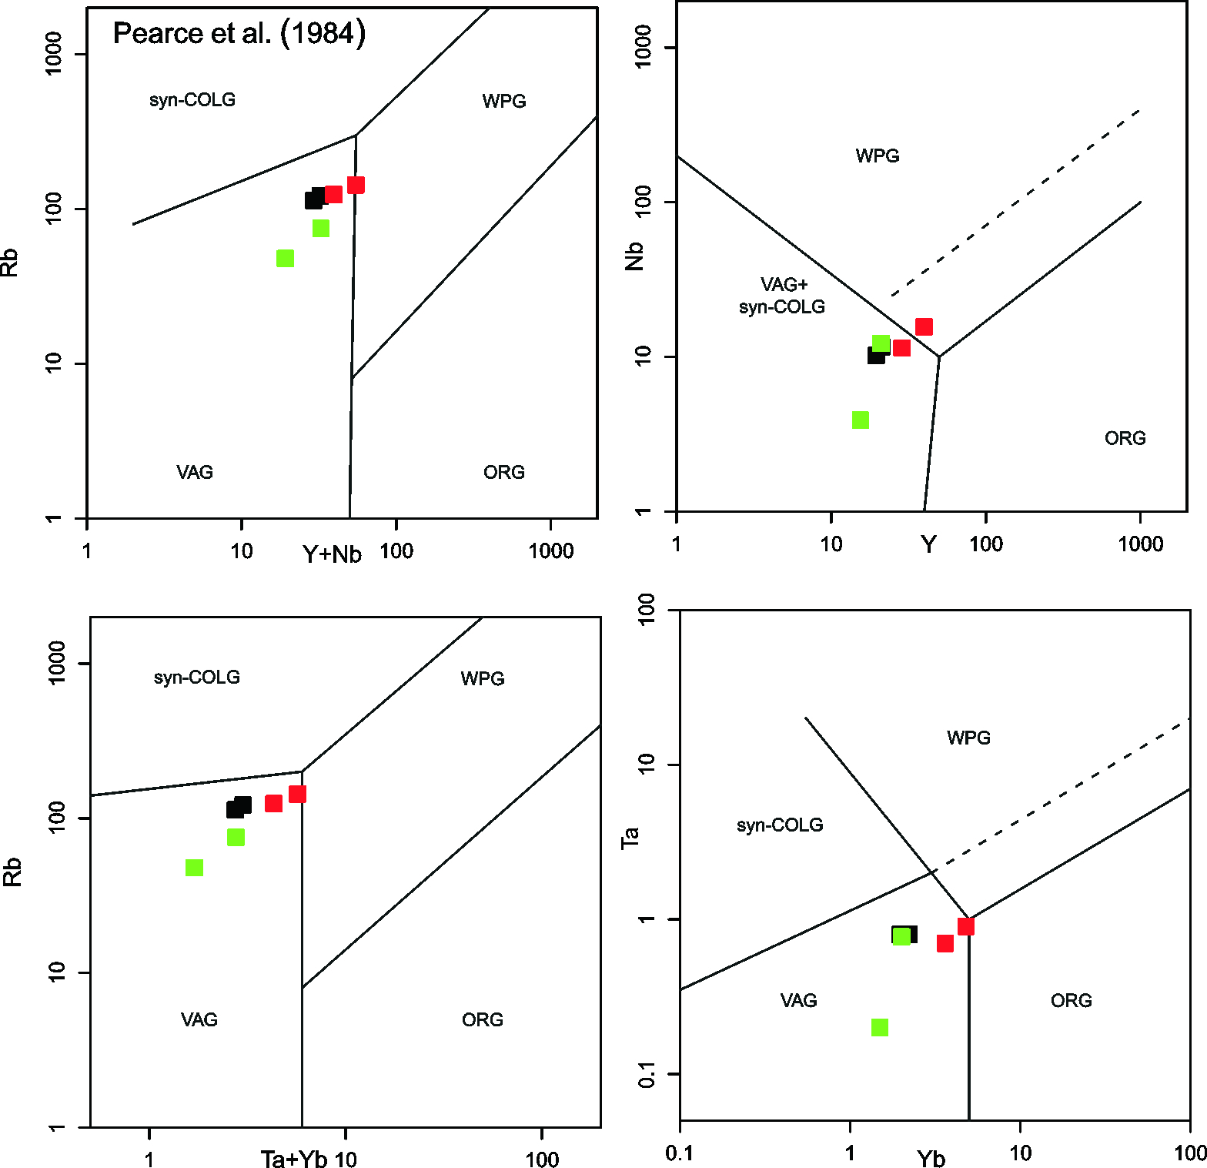
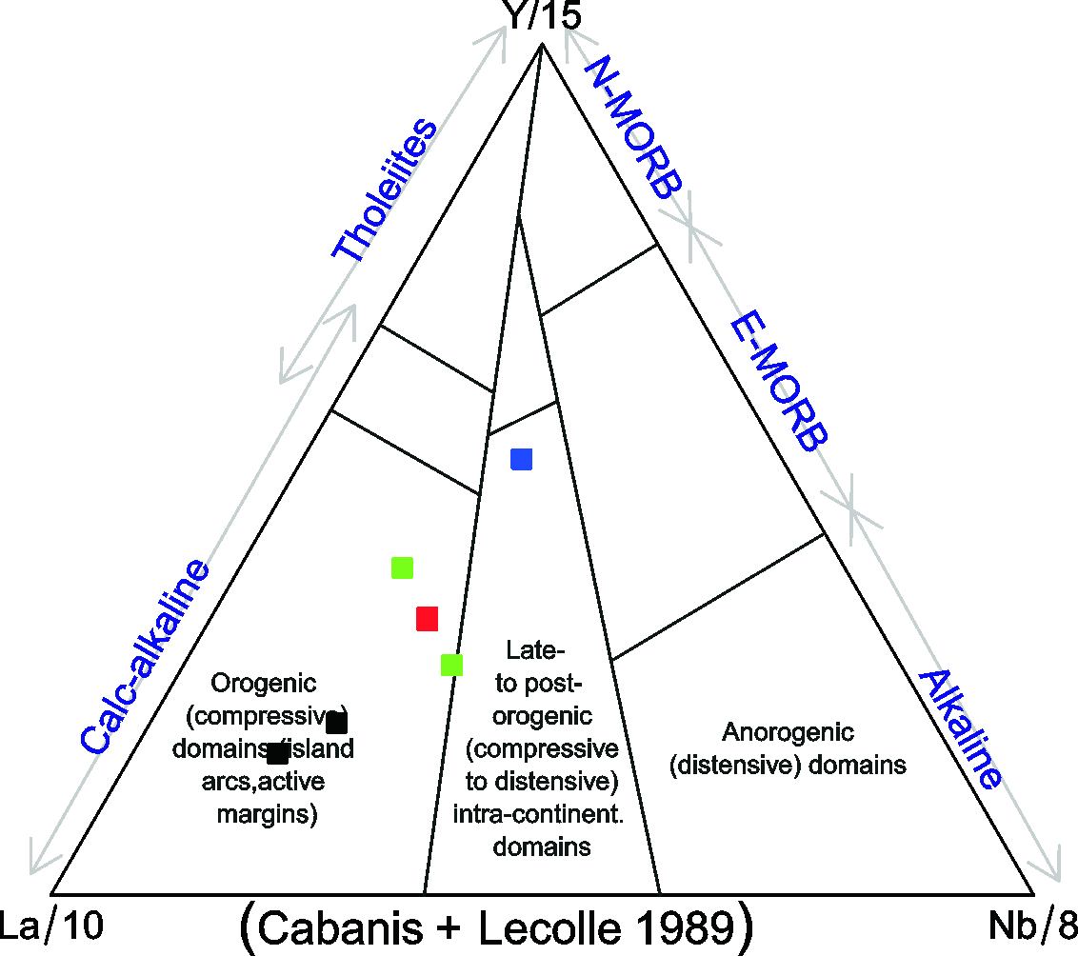
Felsic rocks

Slide 15
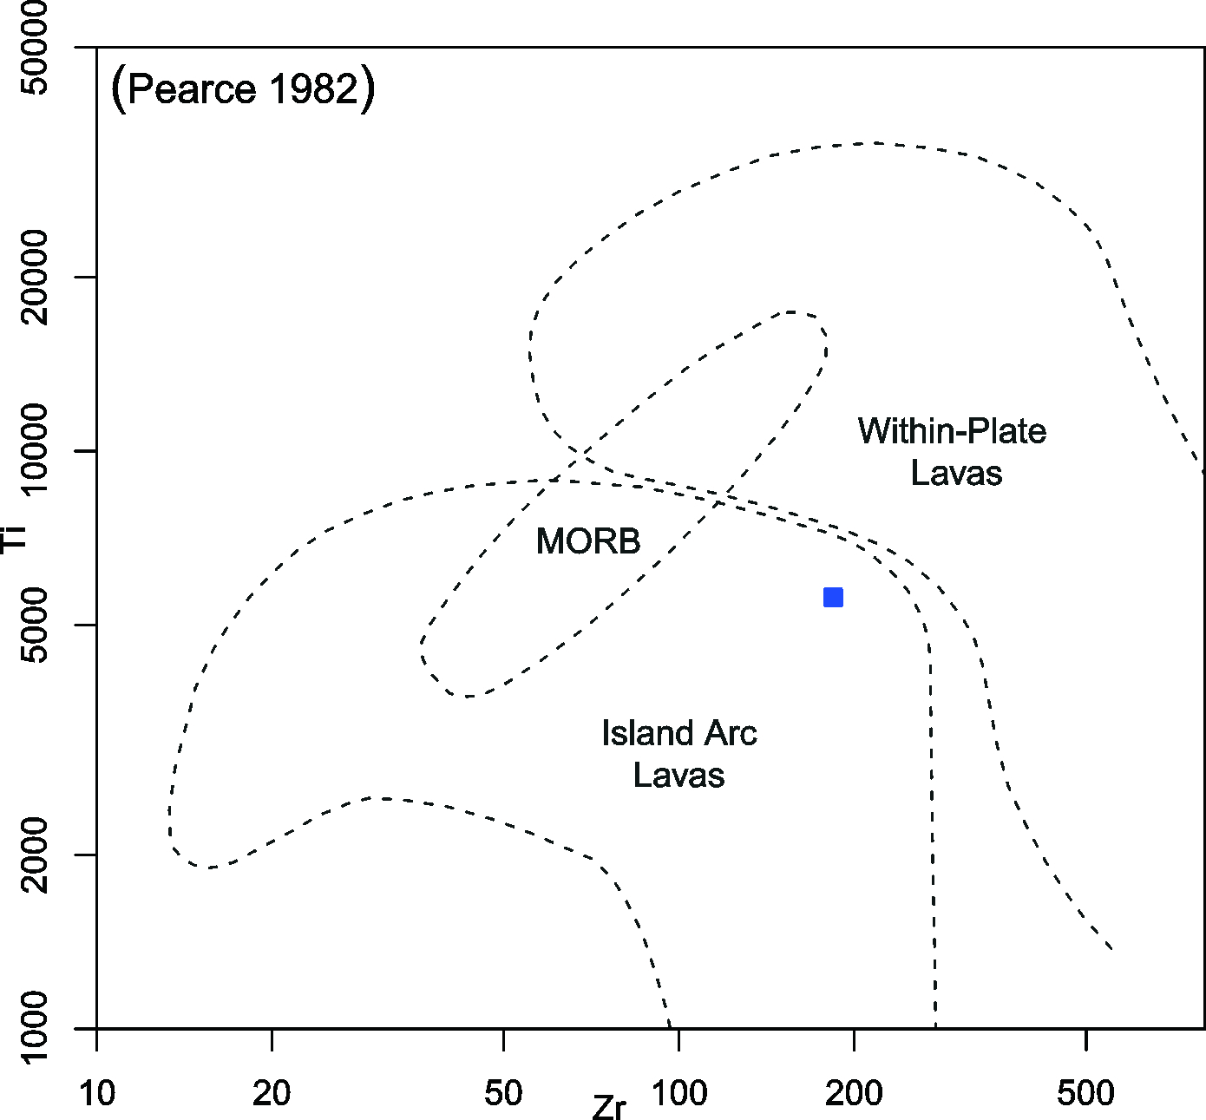
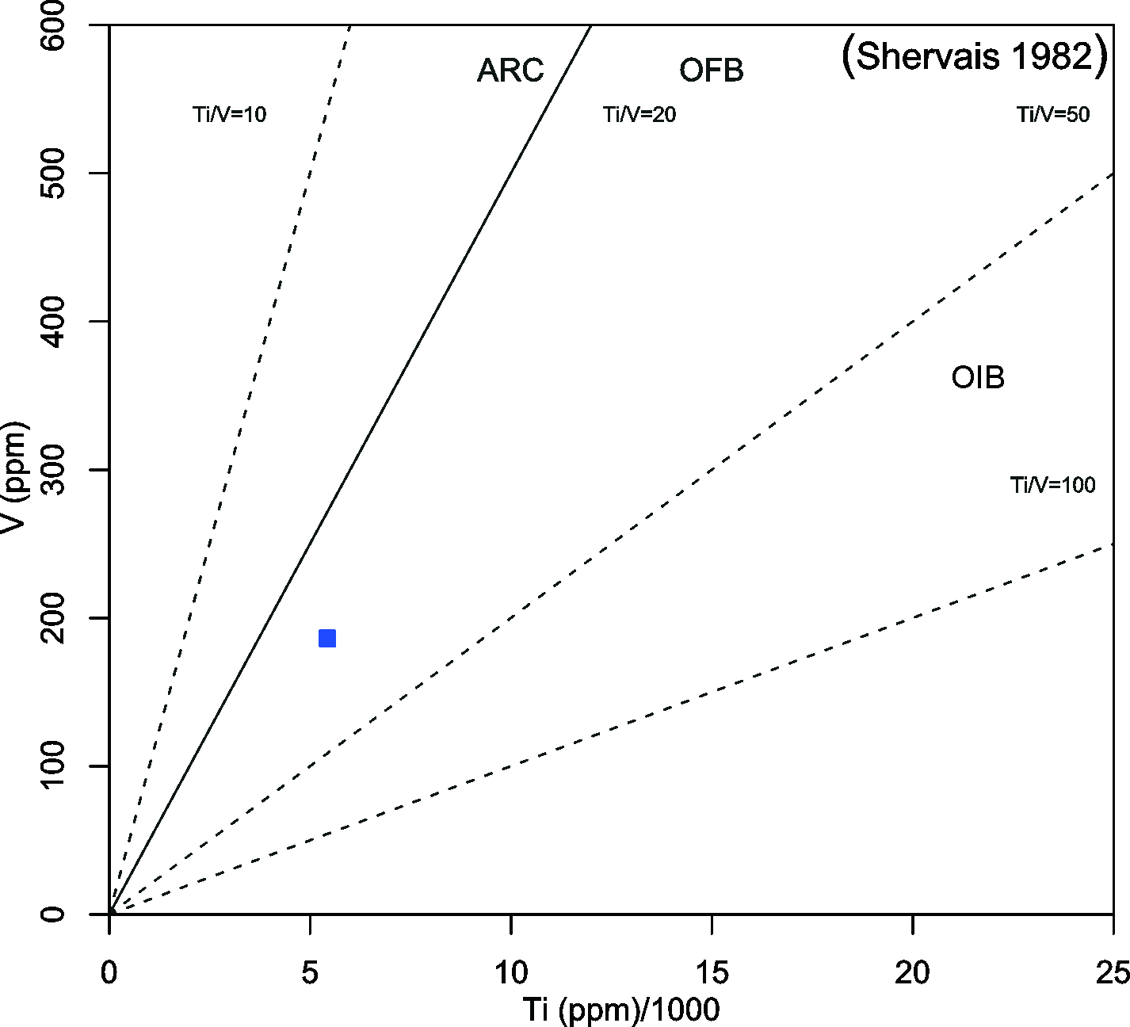
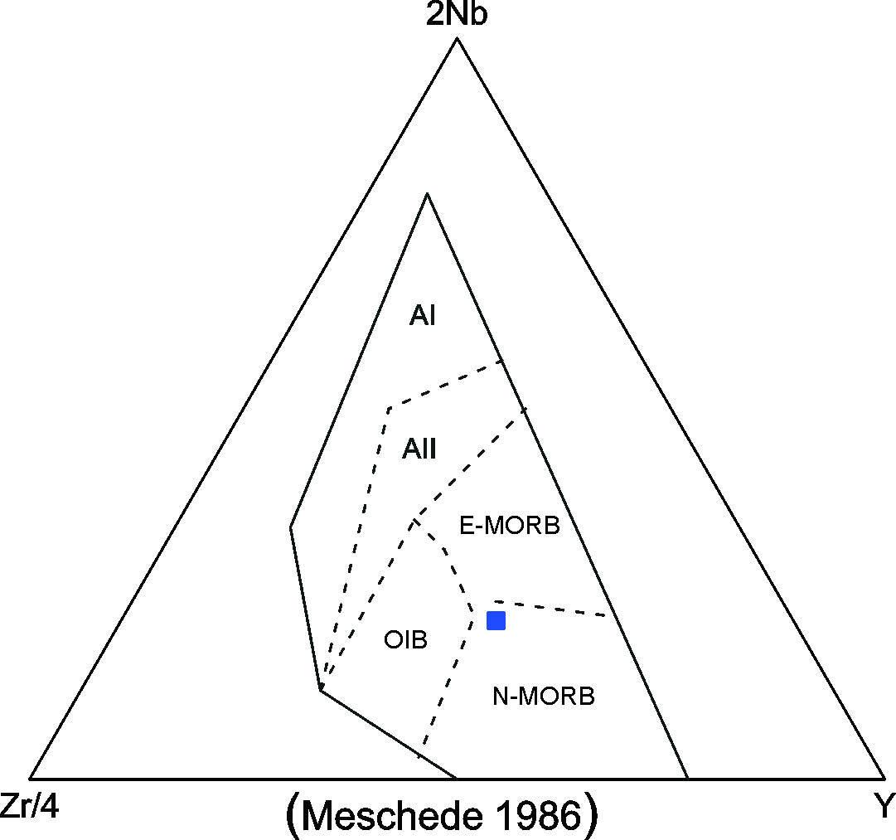
Mafic rock (414)

Slide 16
