Slide 1

Practical Application of U-Pb zircon geochronology: sample selection and preparation, equipment/method choice, results and preliminary interpretation
Grazina SKRIDLAITE and Laurynas SILIAUSKAS
State Scientific Research Institute Nature Research Centre, Lithuania; grazina.skridlaite@gamtc.lt,

Slide 2
We will talk about:
1. What is Secondary Ion Mass Spectrometry (SIMS) and why is highly recommended to apply for rock dating?
2. Sample choice and preparation.
3. Zircon mounting and further treatment
4. Zircon study and implications
5. Zircon analysis
6. Dating results
7. Interpretation of the results

Slide 3
What is Secondary Ion Mass-Spectrometry?
The Sensitive High-Resolution Ion Microprobe (SHRIMP) and Secondary Ion Mass Spectrometry (SIMS) are powerful techniques used for in situ isotopic and elemental analysis, particularly in U-Pb geochronology, light isotopes and trace element studies. These methods allow researchers to analyse mineral domains at high spatial (a micrometre-scale) resolution, providing precise age determinations and geochemical insights into Earth’s history.

Slide 4
The SHRIMP Advantage
The Sensitive High-Resolution Ion Microprobe (SHRIMP) is a specialised SIMS instrument designed specifically for U-Pb geochronology. It uses a large-radius electrostatic-magnetic sector analyser, allowing for precise age determination of accessory minerals like zircon, monazite, titanite, and baddeleyite.
Why Use SHRIMP (SIMS)?
High spatial resolution – Enables in situ analysis of mineral domains as small as 10–30 µm.
Minimal sample destruction – No need for bulk chemical dissolution, preserving the sample structure.
High mass resolution – Effectively separates Pb isotopes from molecular interferences.
Fast U-Pb dating – Provides direct zircon age determinations without extensive chemical processing.

Slide 5
Data Reduction & Interpretation
The data obtained from SIMS and SHRIMP require careful corrections and calibrations to ensure accuracy:
Background subtraction – Corrects for detector noise and instrumental signals.
Interference corrections – Adjusts for molecular interferences affecting Pb isotopes.
Fractionation correction – Accounts for instrumental biases in U/Pb ratios.
Normalisation – Uses reference materials (e.g., zircon standards) to calibrate age determinations.
Error propagation analysis – Evaluate analytical uncertainties to enhance precision.
These steps ensure high-accuracy age models, typically visualised using Concordia diagrams and probability density plots.

Slide 6
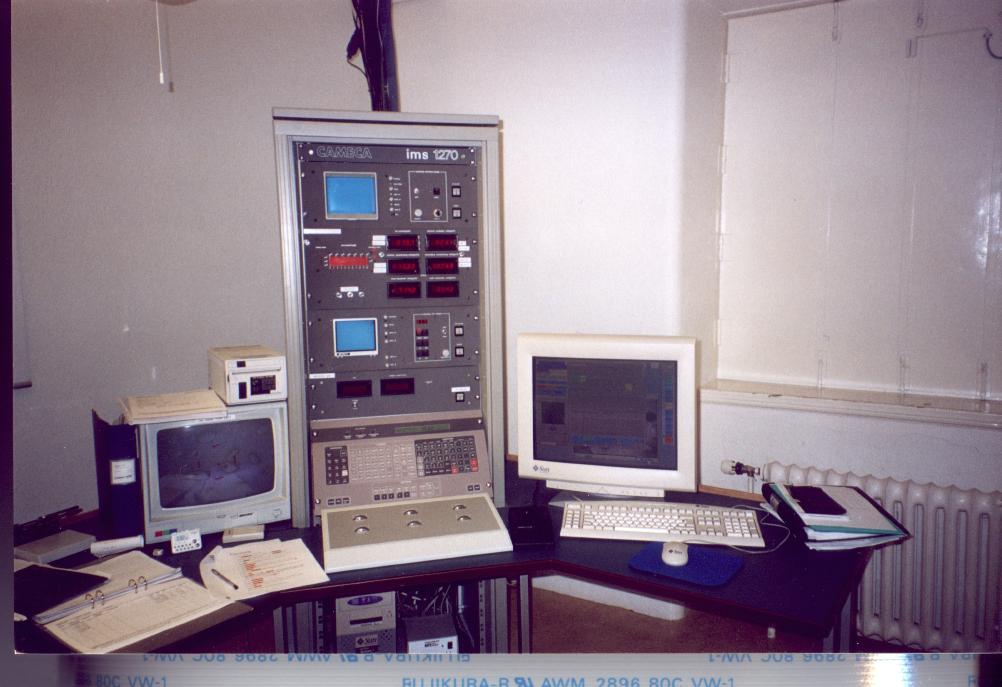
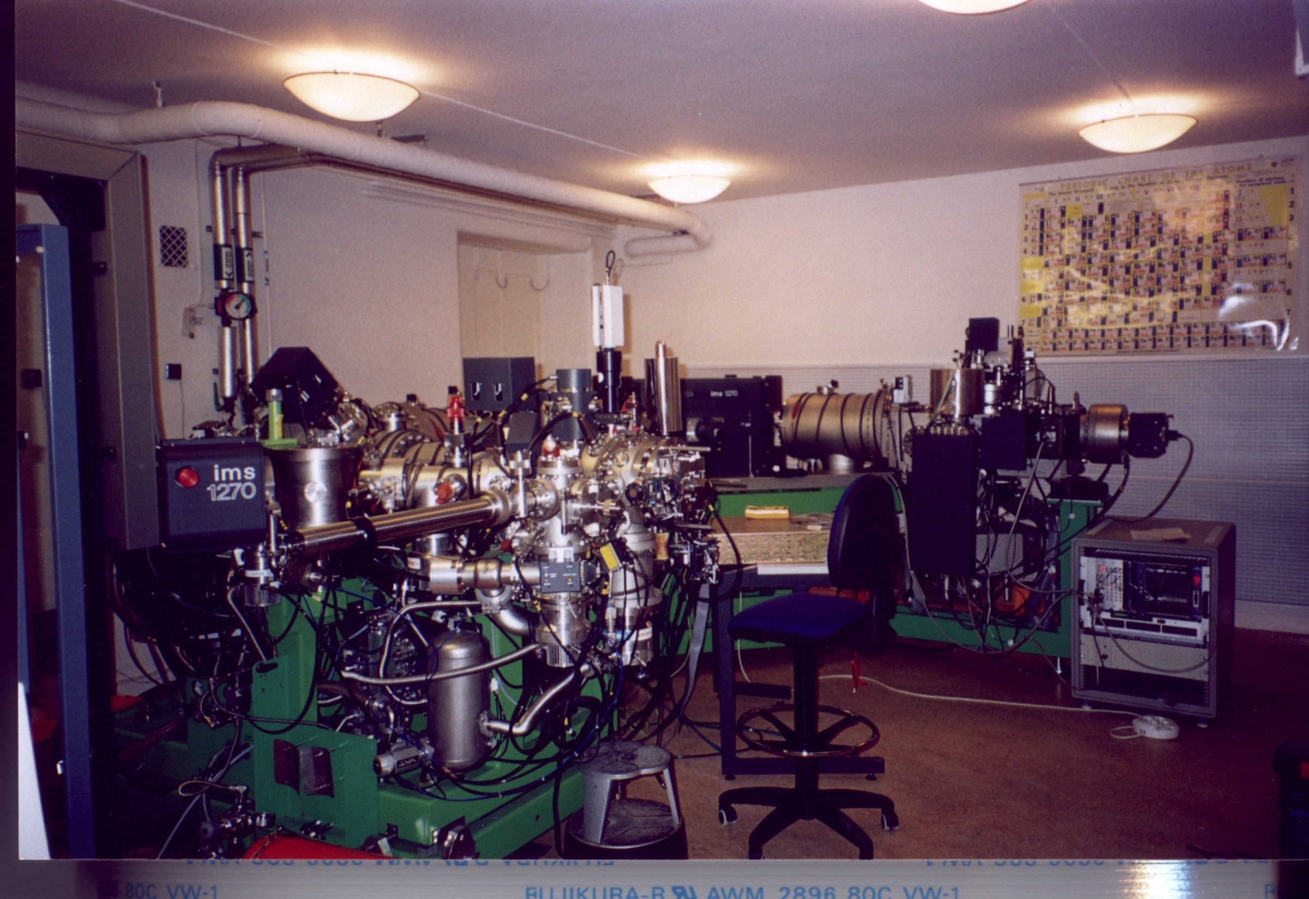
RECOMMENDED EQUIPMENT
SIMS is particularly useful for studying small-scale variations in minerals, making it ideal for zoned crystals, REE-rich minerals, and low-concentration isotopic studies.
1) NordSIMS at the Museum of Natural History, Stockholm, Sweden,
CAMECA ims1280 ion microprobe, an advanced high-sensitivity mass spectrometer

Slide 7
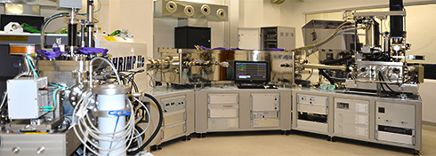
2) SHRIMP IIe/MC sensitive and high-resolution ion microprobe with multicollector at the Polish Geological Institute in Warsaw manufactured by Australian Scientific Instruments (ASI), with cooperation of the Australian National University in Canberra, where the ion microprobe was first designed and developed. The PGI ion microprobe is the fourth of the SHRIMP instruments in the world designed to a new enhanced configuration with two interchangeable primary sources: a duoplasmatron, for analyzing positive ions, and a Cs gun, for analyzing negative ions.

Slide 8
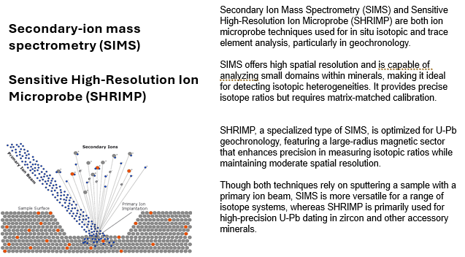
How does SIMS work?
Secondary Ion Mass Spectrometry (SIMS) operates by bombarding a sample with a focused primary ion beam (e.g., O²⁻ or Cs⁺), which causes the ejection of secondary ions from the sample surface. These ejected ions are then analysed in a mass spectrometer, allowing the measurement of isotopic ratios and elemental compositions with high sensitivity.

Slide 9
How does SIMS work?
Key Steps in SIMS Analysis
Primary Ion Beam Generation – A finely focused ion beam (e.g., oxygen or cesium) is directed onto the sample.
Sputtering Process – The interaction between the ion beam and the sample surface releases secondary ions.
Mass Spectrometry – The secondary ions are separated and analysed based on their mass-to-charge ratio (m/z).
Data Interpretation – Isotopic compositions and elemental abundances are quantified for geological dating and geochemical fingerprinting.

Slide 10
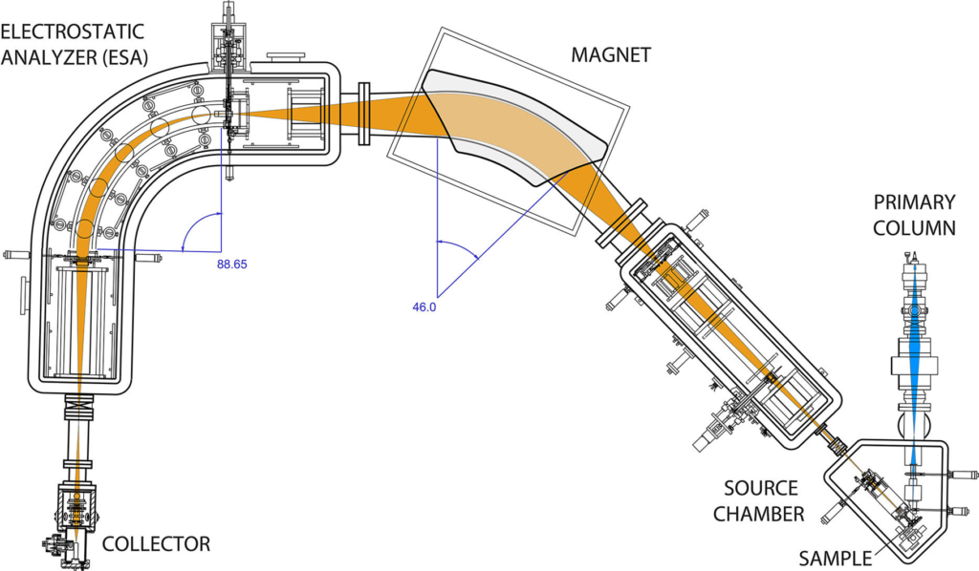
The image illustrates the internal structure and ion optics of the Sensitive High-Resolution Ion Microprobe (SHRIMP), a specialised SIMS instrument designed for precise U-Pb geochronology and isotopic analysis.
Primary Ion Column: A focused primary ion beam (e.g., O₂⁻ or Cs⁺) bombards the sample, sputtering secondary ions.
Source Chamber: The sputtered secondary ions are extracted and accelerated into the mass spectrometer.
Magnetic Sector Analyser: The ion beam is separated based on mass-to-charge ratio (m/z) using a high-resolution magnet.
Electrostatic Analyser (ESA): Further refines the mass separation by filtering ions based on their energy, improving precision.
Collector System: The selected isotopes are measured in the detector array, providing high-accuracy age determinations.

Slide 11
The SHRIMP (SIMS) system enables in situ isotopic analysis of individual zircon, monazite, and other U-bearing minerals, allowing for high-resolution dating of geological materials while preserving spatial context.
SIMS was used for:
- Igneous emplacement, crystallization ages,
- Metamorphic ages,
- Sediment provenance ages

Slide 12
SAMPLE COLLECTION
1. Find a rock interval you want to date. Choose the most uniform rock sample of at least several cm long. Sample size depends on amount of zircon in it.
Therefore,
2. THIN SECTION EXAMINATION is useful prior to sample collection:
By Scanning Electron Microscope (with Backscattered electron (BSE, SE or Cathodoluminescence (CL) detectors,
By polarizing microscope.

Slide 13
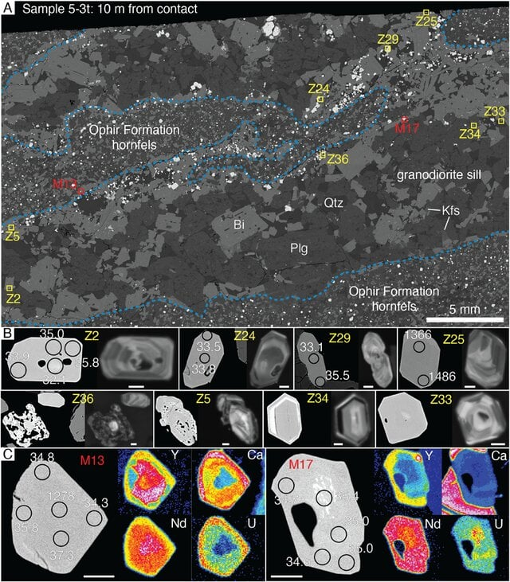
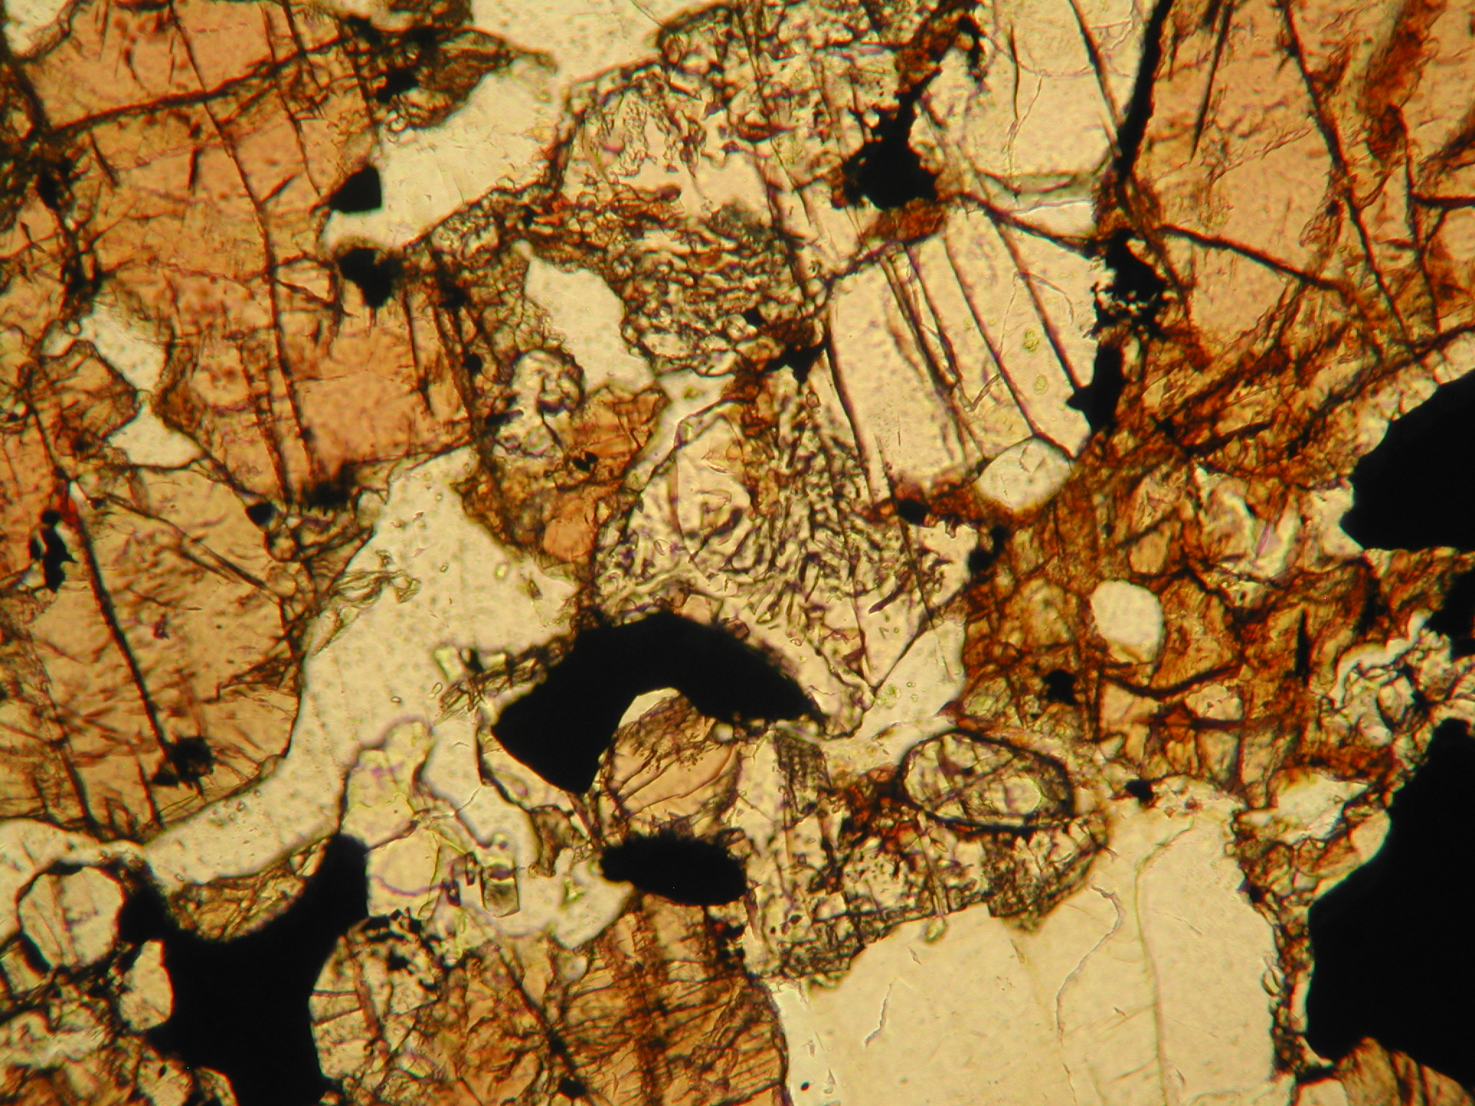
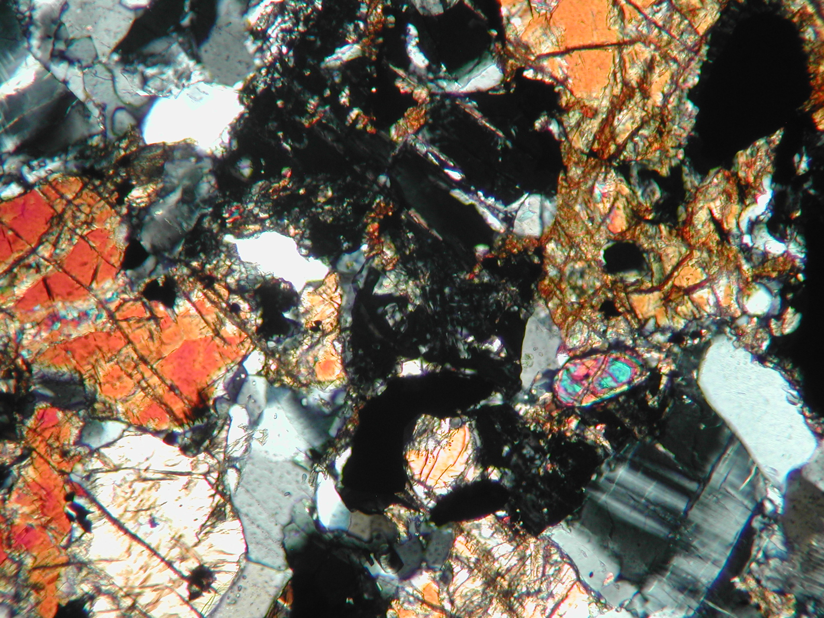
THIN SECTION EXAMINATION
1) By Scanning Electron Microscope (with Backscattered electron (BSE) or Cathodoluminescence (CL) detector
Beno et al., 2025, Geochemistry, Geophysics, Geosystems
2) By polarizing microscope

Slide 14
Crossed nicols (XPL)
THIN SECTION EXAMINATION:
2) Via polarizing microscope
Plain polarised light (PPL)

Slide 15
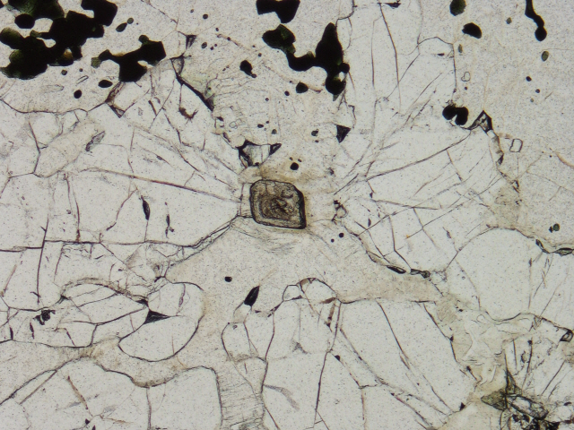
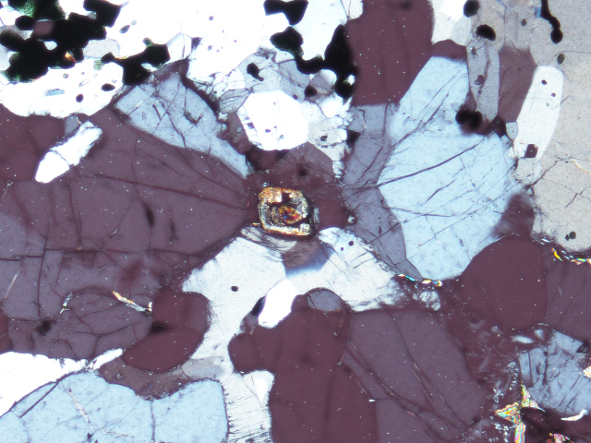
THIN SECTION EXAMINATION:
2) Via polarizing microscope
Plain polarised light (PPL)
Crossed nicols (XPL)
THE RESULT: RIGHT SIZE SAMPLE CONTAINING ENOUGH ZIRCON GRAINS (tens and hundreds of g if zircon grains are abundant, or 1-2 kg if not)

Slide 16
One possibility is to send the chosen sample to special laboratory for zircon grain picking
or
directly to the SIMS lab you apply if they provide such services
If not – proceed with sample preparation

Slide 17

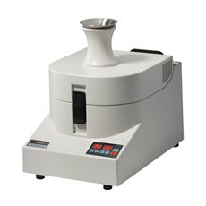
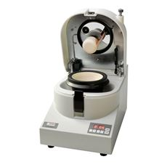
SAMPLE PREPARATION:
1) The collected piece of rock sample (from hundreds of g to several kg) has to be crushed, grinded and milled to powder of several hundreds of micrones particle size (ca. 300-500 µm or 0.3-0.5 mm).
Fritsch variable speed rotor mill
Fritsch mortar grinder
Jaw crusher

Slide 18


SAMPLE PREPARATION
2) Sieving helps to achiece the right particle size in powder
3) Magnetic separation using variable magnets is needed to remove magnetic minerals
Telescopic rotational magnetic separators MSR-MC

Slide 19
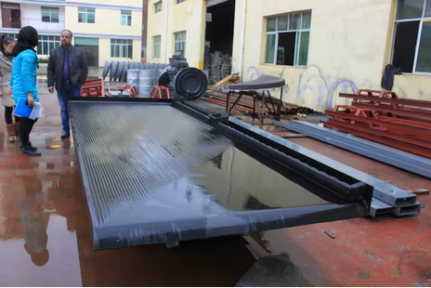
SAMPLE PREPARATION
4) Mineral Separation Shaking Table for Gravity Concentration Treatment

Slide 20
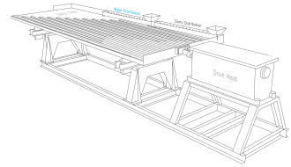
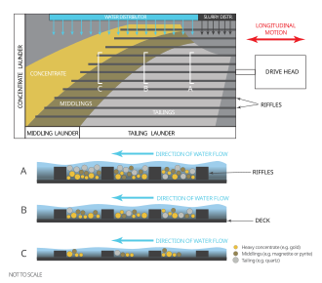
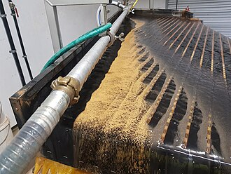
SAMPLE PREPARATION
4) Mineral Separation Shaking Table for Gravity Concentration Treatment
Oblique section of modern Wilfley (wet) table

Slide 21
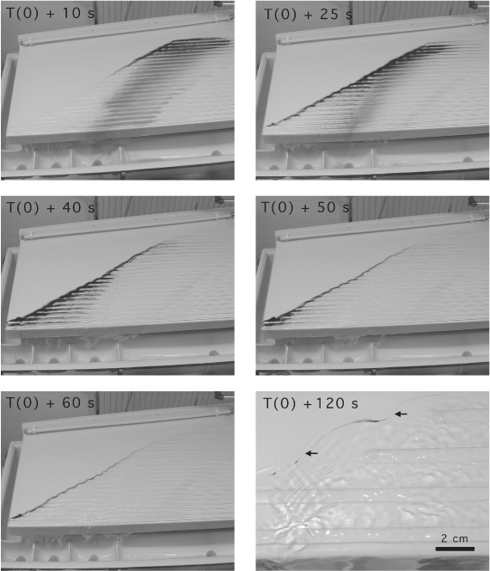
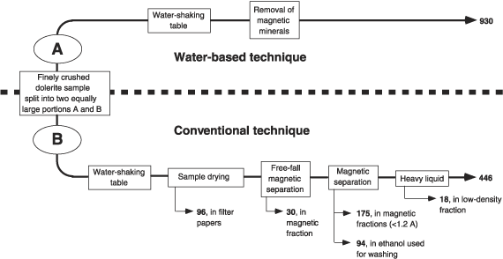
4) Mineral Separation Shaking Table for Gravity Concentration Treatment
Simplified procedure for baddeleyite (and zircon) separation proposed by Ulf Soderlund and Leif Johansson (2002).
THE RESULT: THE ZIRCON GRAIN SEPARATE CONTAINING 30-100 ZIRCON GRAINS

Slide 22
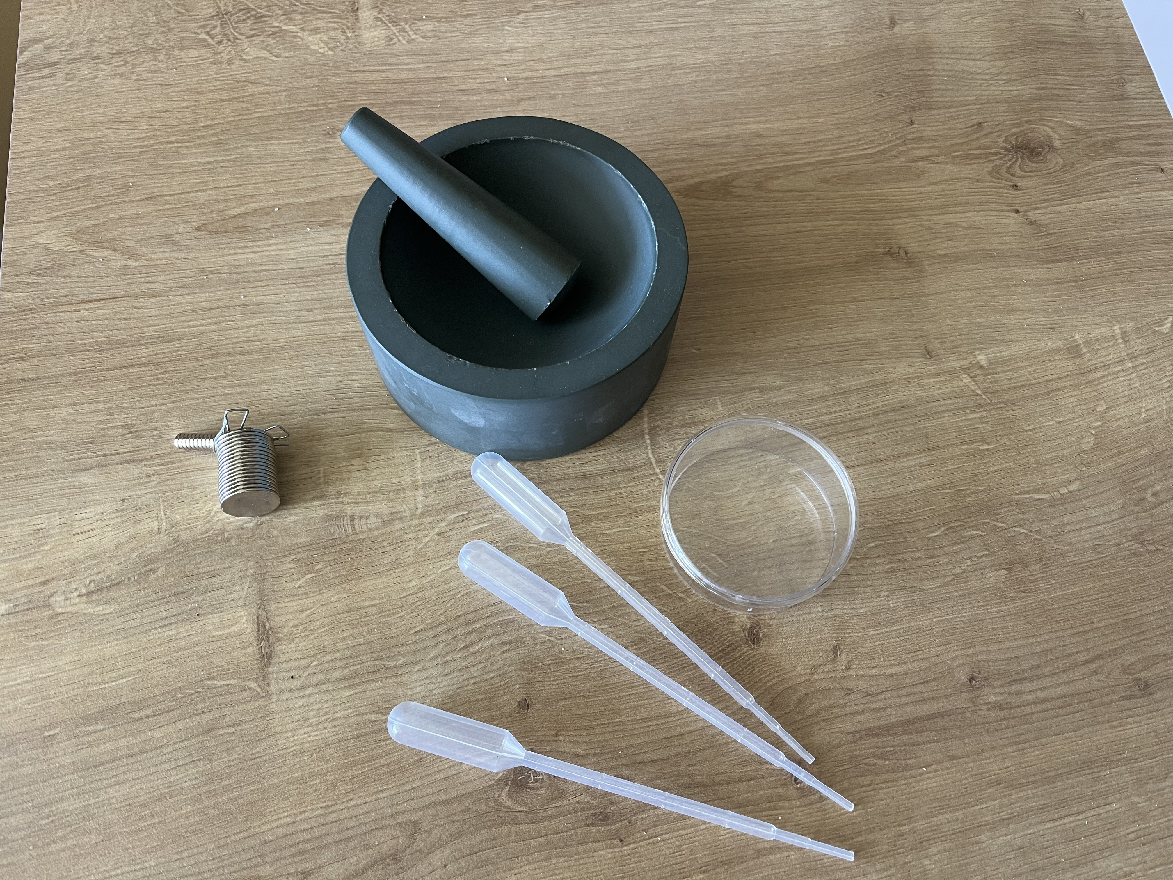
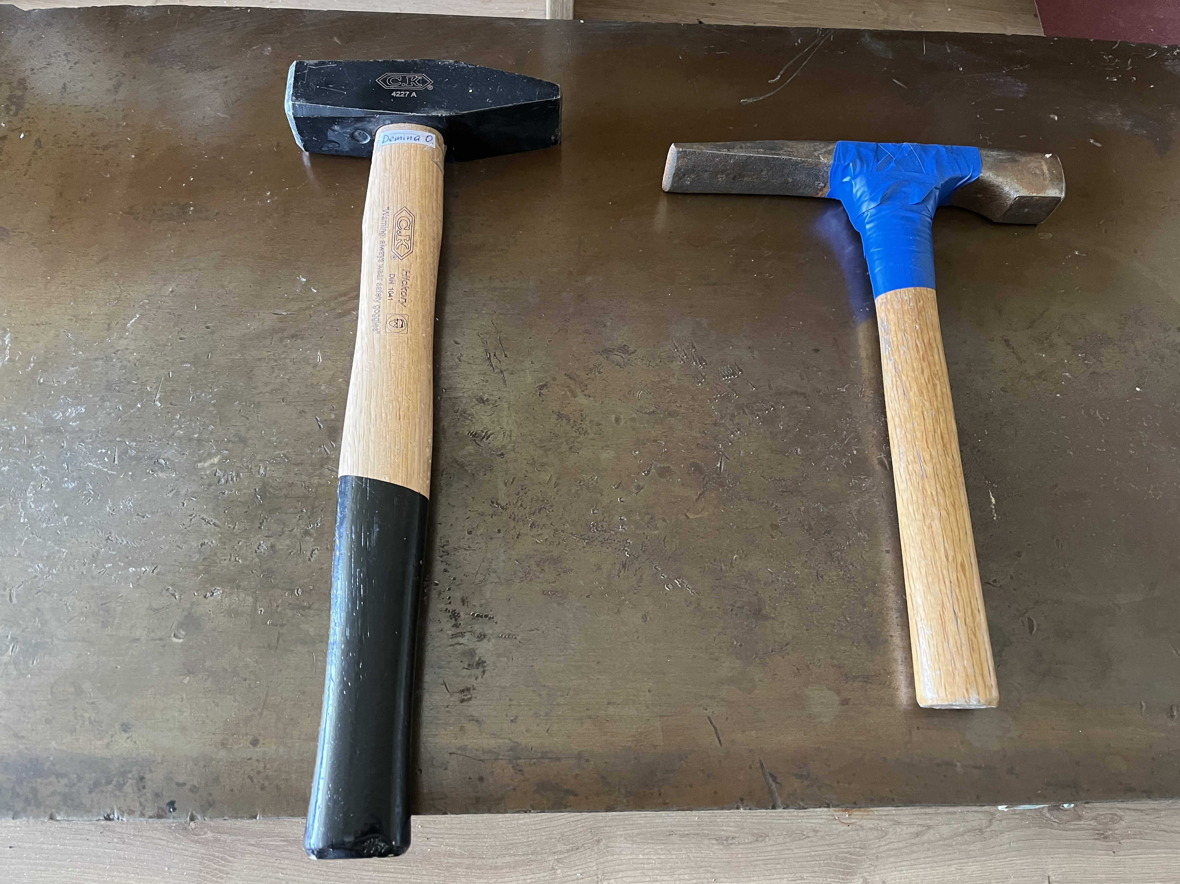
“Economic” sample preparation equipment kit
Grinding/milling: agate grinder
Magnetic
separation
“Water table”: gravimetric separation
Crushing: hammer
THE RESULT: ZIRCON GRAIN SEPARATE CONTAINING 30-100 ZIRCON GRAINS, READY TO SEND FOR DATING

Slide 23
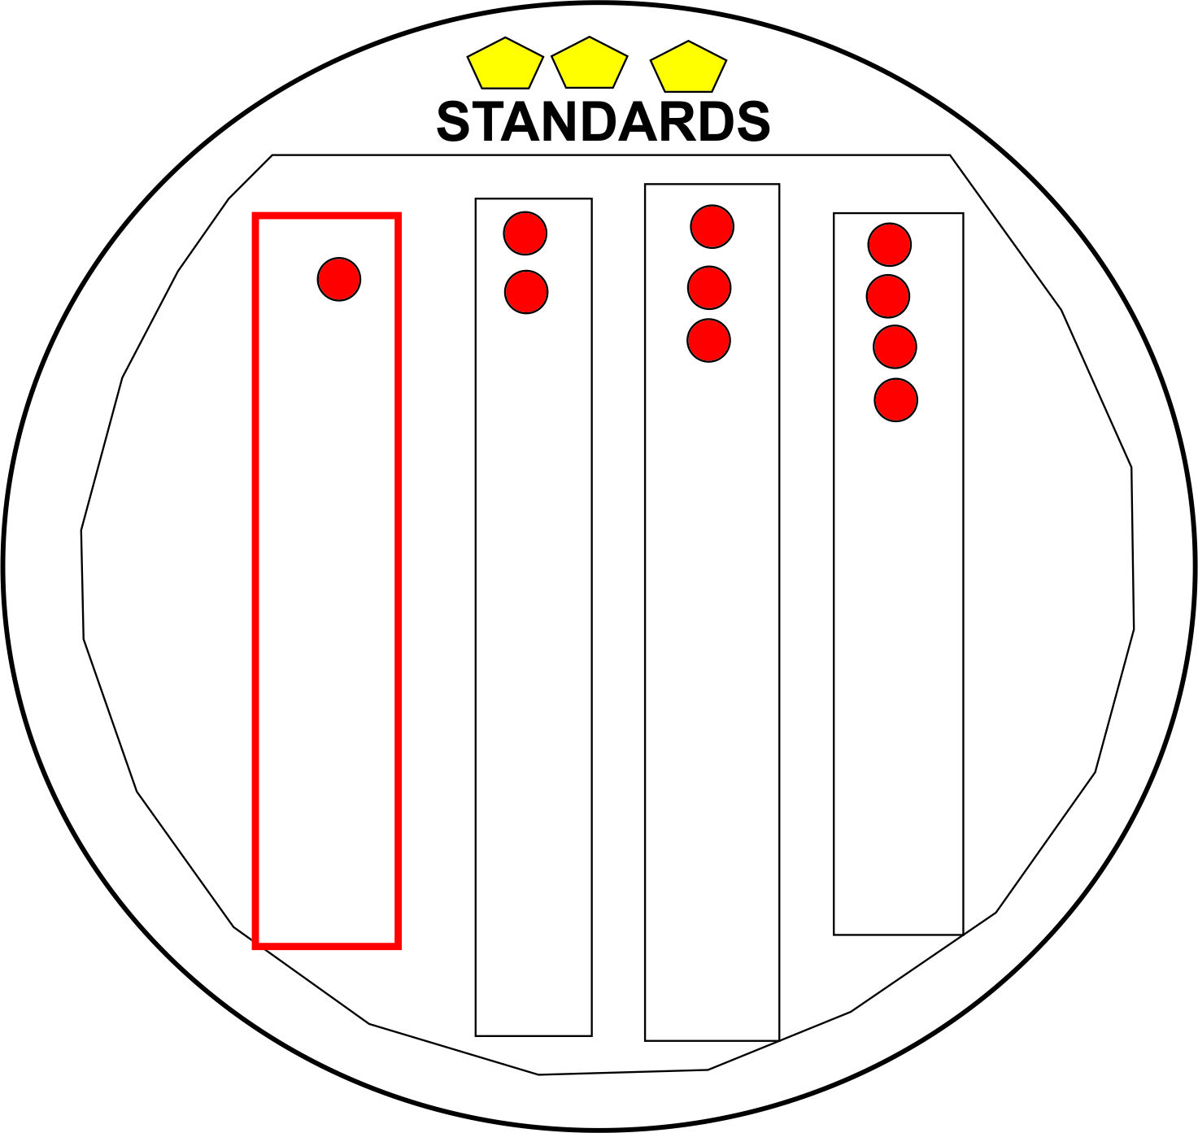
ZIRCON CRYSTAL MOUNTING (AT THE SIMS LABORATORIES)
Zircon grains from the separates must be mounted on a special tape. For one mount, usually, zircon grains from 4 samples are displayed in 4 lines, leaving some space for standards.
MOUNT PREPARATION
When zircon grains for the mount are all displayed on the tape, the tape is covered with a cylinder and gradually filled with liquid epoxy. After epoxy dries, the cylinder is removed. Epoxy mounts are polished, covered and photographed by SEM BSE and/or CL detectors.

Slide 24
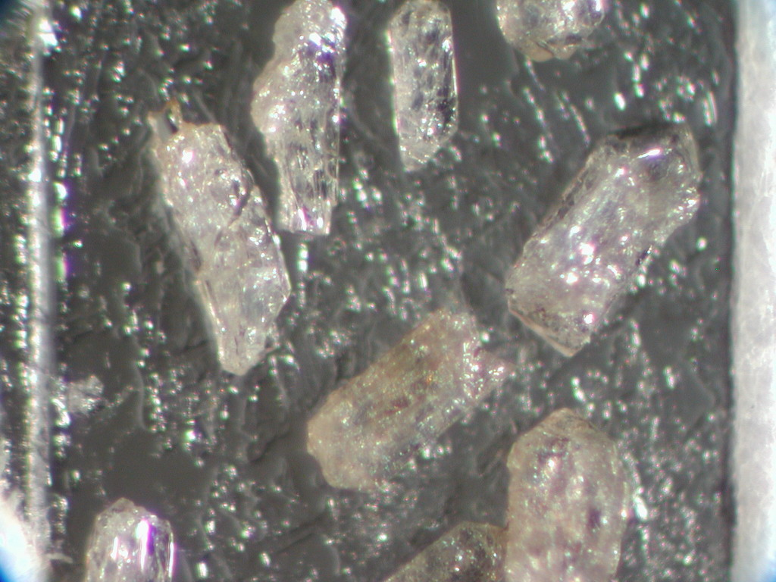
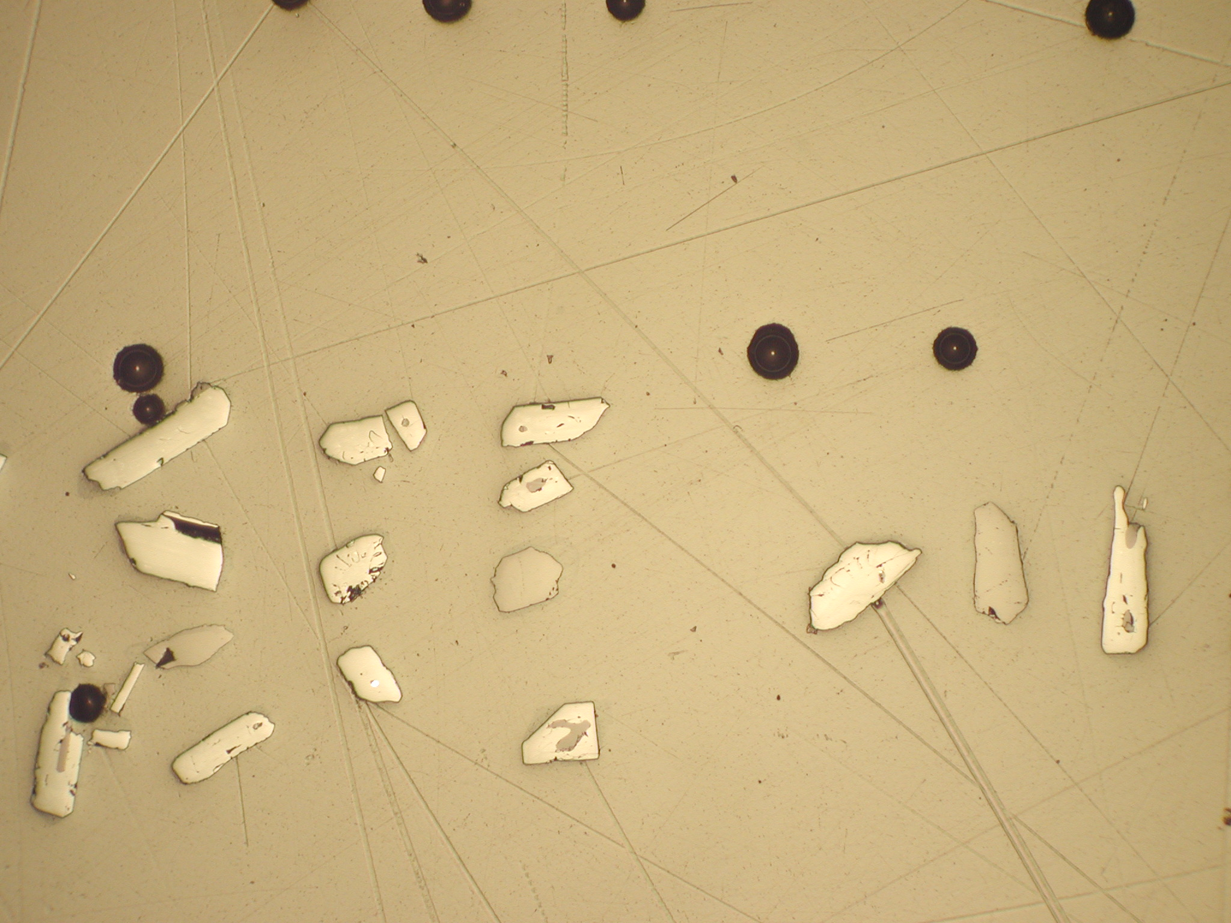
MOUNT IMAGING
Zircon grains in transparent light
SEM SE images
Reflected light images
CL images

Slide 25
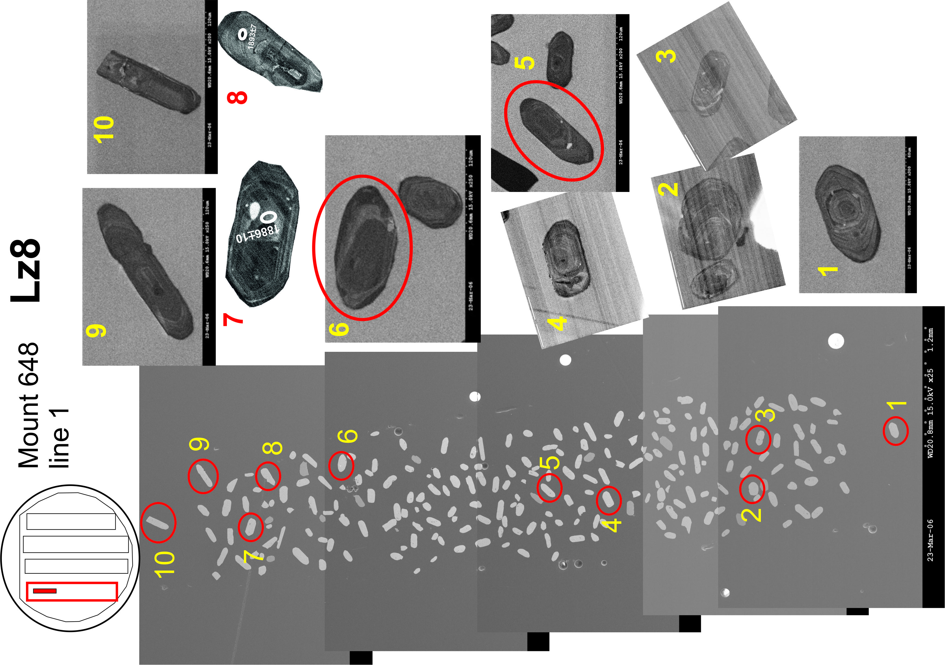
SPOT SELECTION
THE RESULT: MARKED SPOTS FOR THE ANALYSIS

Slide 26
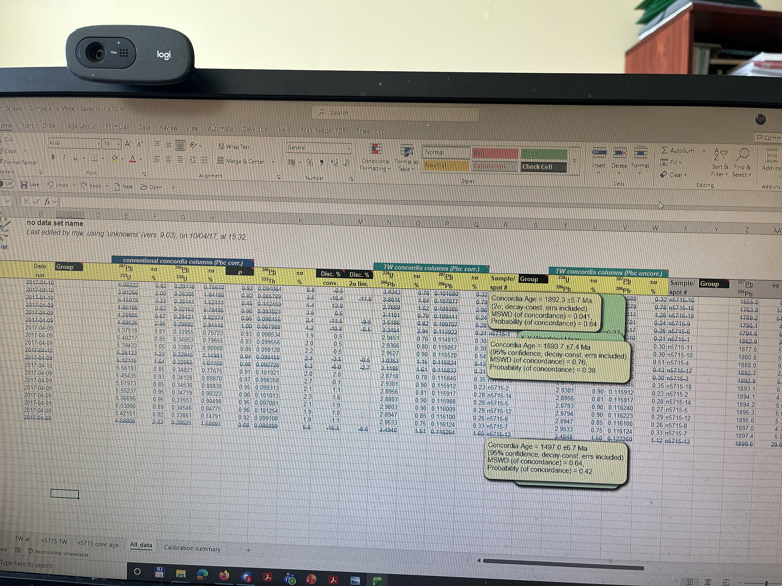
THE ANALYSED DATA:

Slide 27

THE ANALYSED DATA:
Sample/
spot #
n5713-16
n5713-17
n5713-18
n5713-14
n5713-3
n5713-1
n5713-11
n5713-10
n5713-2
n5713-6
n5713-9
n5713-13
n5713-12
n5713-8
n5713-4
n5713-5
n5713-15
n5713-7
TW concordia columns (Pbc corr.)
²³⁸U | ±s | ²⁰⁷Pb | ±s
²⁰⁶Pb | % | ²⁰⁶Pb | %
3.2314 | 1.46 | 0.105098 | 0.79
3.0520 | 1.63 | 0.109133 | 1.29
2.9236 | 1.44 | 0.110309 | 1.00
3.0107 | 1.47 | 0.110602 | 0.91
2.9223 | 1.36 | 0.110675 | 0.61
2.9946 | 1.20 | 0.110798 | 0.44
2.9858 | 1.25 | 0.111310 | 0.44
2.9661 | 1.40 | 0.111433 | 0.70
2.9823 | 1.21 | 0.111585 | 0.49
2.9823 | 1.27 | 0.111827 | 0.67
2.9574 | 1.27 | 0.111841 | 0.58
2.9384 | 1.59 | 0.112072 | 0.58
2.9990 | 1.42 | 0.112116 | 0.75
2.9672 | 1.35 | 0.112250 | 0.68
3.0149 | 1.26 | 0.112333 | 0.63
2.9536 | 1.20 | 0.112814 | 0.29
2.9529 | 1.47 | 0.113519 | 0.78
2.9745 | 1.50 | 0.113524 | 0.72
²⁰⁶Pb/²⁰⁴Pb
common
n/a
18.703
18.703
n/a
n/a
n/a
n/a
n/a
n/a
n/a
18.703
n/a
18.703
n/a
n/a
n/a
n/a
n/a
²⁰⁷Pb | ±s
²⁰⁶Pb
1716.0 | 14.6
1785.0 | 23.5
1804.5 | 18.2
1809.3 | 16.5
1810.5 | 11.0
1812.5 | 8.0
1820.9 | 8.1
1822.9 | 12.7
1825.4 | 8.9
1829.3 | 12.1
1829.5 | 10.5
1833.3 | 10.4
1834.0 | 13.6
1836.2 | 12.3
1837.5 | 11.4
1845.2 | 5.3
1856.5 | 14.1
1856.6 | 13.1
[U] | [Th] | [Pb] | Th/U | Th/U
ppm | ppm | ppm | calc | meas
225.3 | 133.5 | 87.6 | 0.52 | 0.59
311.1 | 99.0 | 121.4 | 0.28 | 0.32
363.9 | 208.5 | 156.5 | 0.51 | 0.57
211.5 | 101.2 | 86.6 | 0.42 | 0.48
214.6 | 110.7 | 91.8 | 0.48 | 0.52
392.5 | 123.5 | 156.7 | 0.29 | 0.31
487.5 | 3.4 | 181.7 | 0.01 | 0.01
212.8 | 105.5 | 89.3 | 0.46 | 0.50
323.5 | 49.6 | 125.1 | 0.14 | 0.15
170.1 | 78.9 | 70.5 | 0.43 | 0.46
265.5 | 118.4 | 110.3 | 0.40 | 0.45
331.5 | 203.1 | 143.6 | 0.56 | 0.61
267.3 | 60.9 | 104.3 | 0.20 | 0.23
302.6 | 64.3 | 119.3 | 0.20 | 0.21
315.6 | 175.0 | 132.4 | 0.53 | 0.55
1104.1 | 457.6 | 458.7 | 0.40 | 0.41
190.6 | 109.7 | 81.6 | 0.52 | 0.58
191.1 | 85.3 | 79.6 | 0.43 | 0.45
²⁰⁶Pb/²⁰⁴Pb
measured
56896
1060
1403
44763
54100
265186
>1e6
38423
72418
>1e6
20071
286771
4529
183177
37273
>1e6
>1e6
218244
The data can be processed using ISOPLOT 4.15 or ISOPLOT R installed in Excel program (Microsoft EXCEL Add-In).

Slide 28
Tera Wasserburg concordia diagram
Weighted mean averages diagram

Slide 29
ZIRCON SIZE, SHAPE, INTERNAL TEXTURE
Oscillatory zoned zircon grains from igneous felsic/
intermediate
intrusive rocks
From igneous basic intrusive rocks (irregular shape and zoning)

Slide 30
ZIRCON SIZE, SHAPE, INTERNAL TEXTURE
Metamorphic zircons:
(a) Thick overgrowth on the zircon core (“granulitic zircon”)
(b) Sectorial growth of metamorphic zircon
Bogdanova et al., 2015

Slide 31
ZIRCON SIZE, SHAPE, INTERNAL TEXTURE
Hydrothermally altered
zircon crystal

Slide 32
ZIRCON SIZE, SHAPE, INTERNAL TEXTURE
Bogdanova et al., 2015
Zircon grains in sedimentary rock
Zircon grains in igneous rock

Slide 33
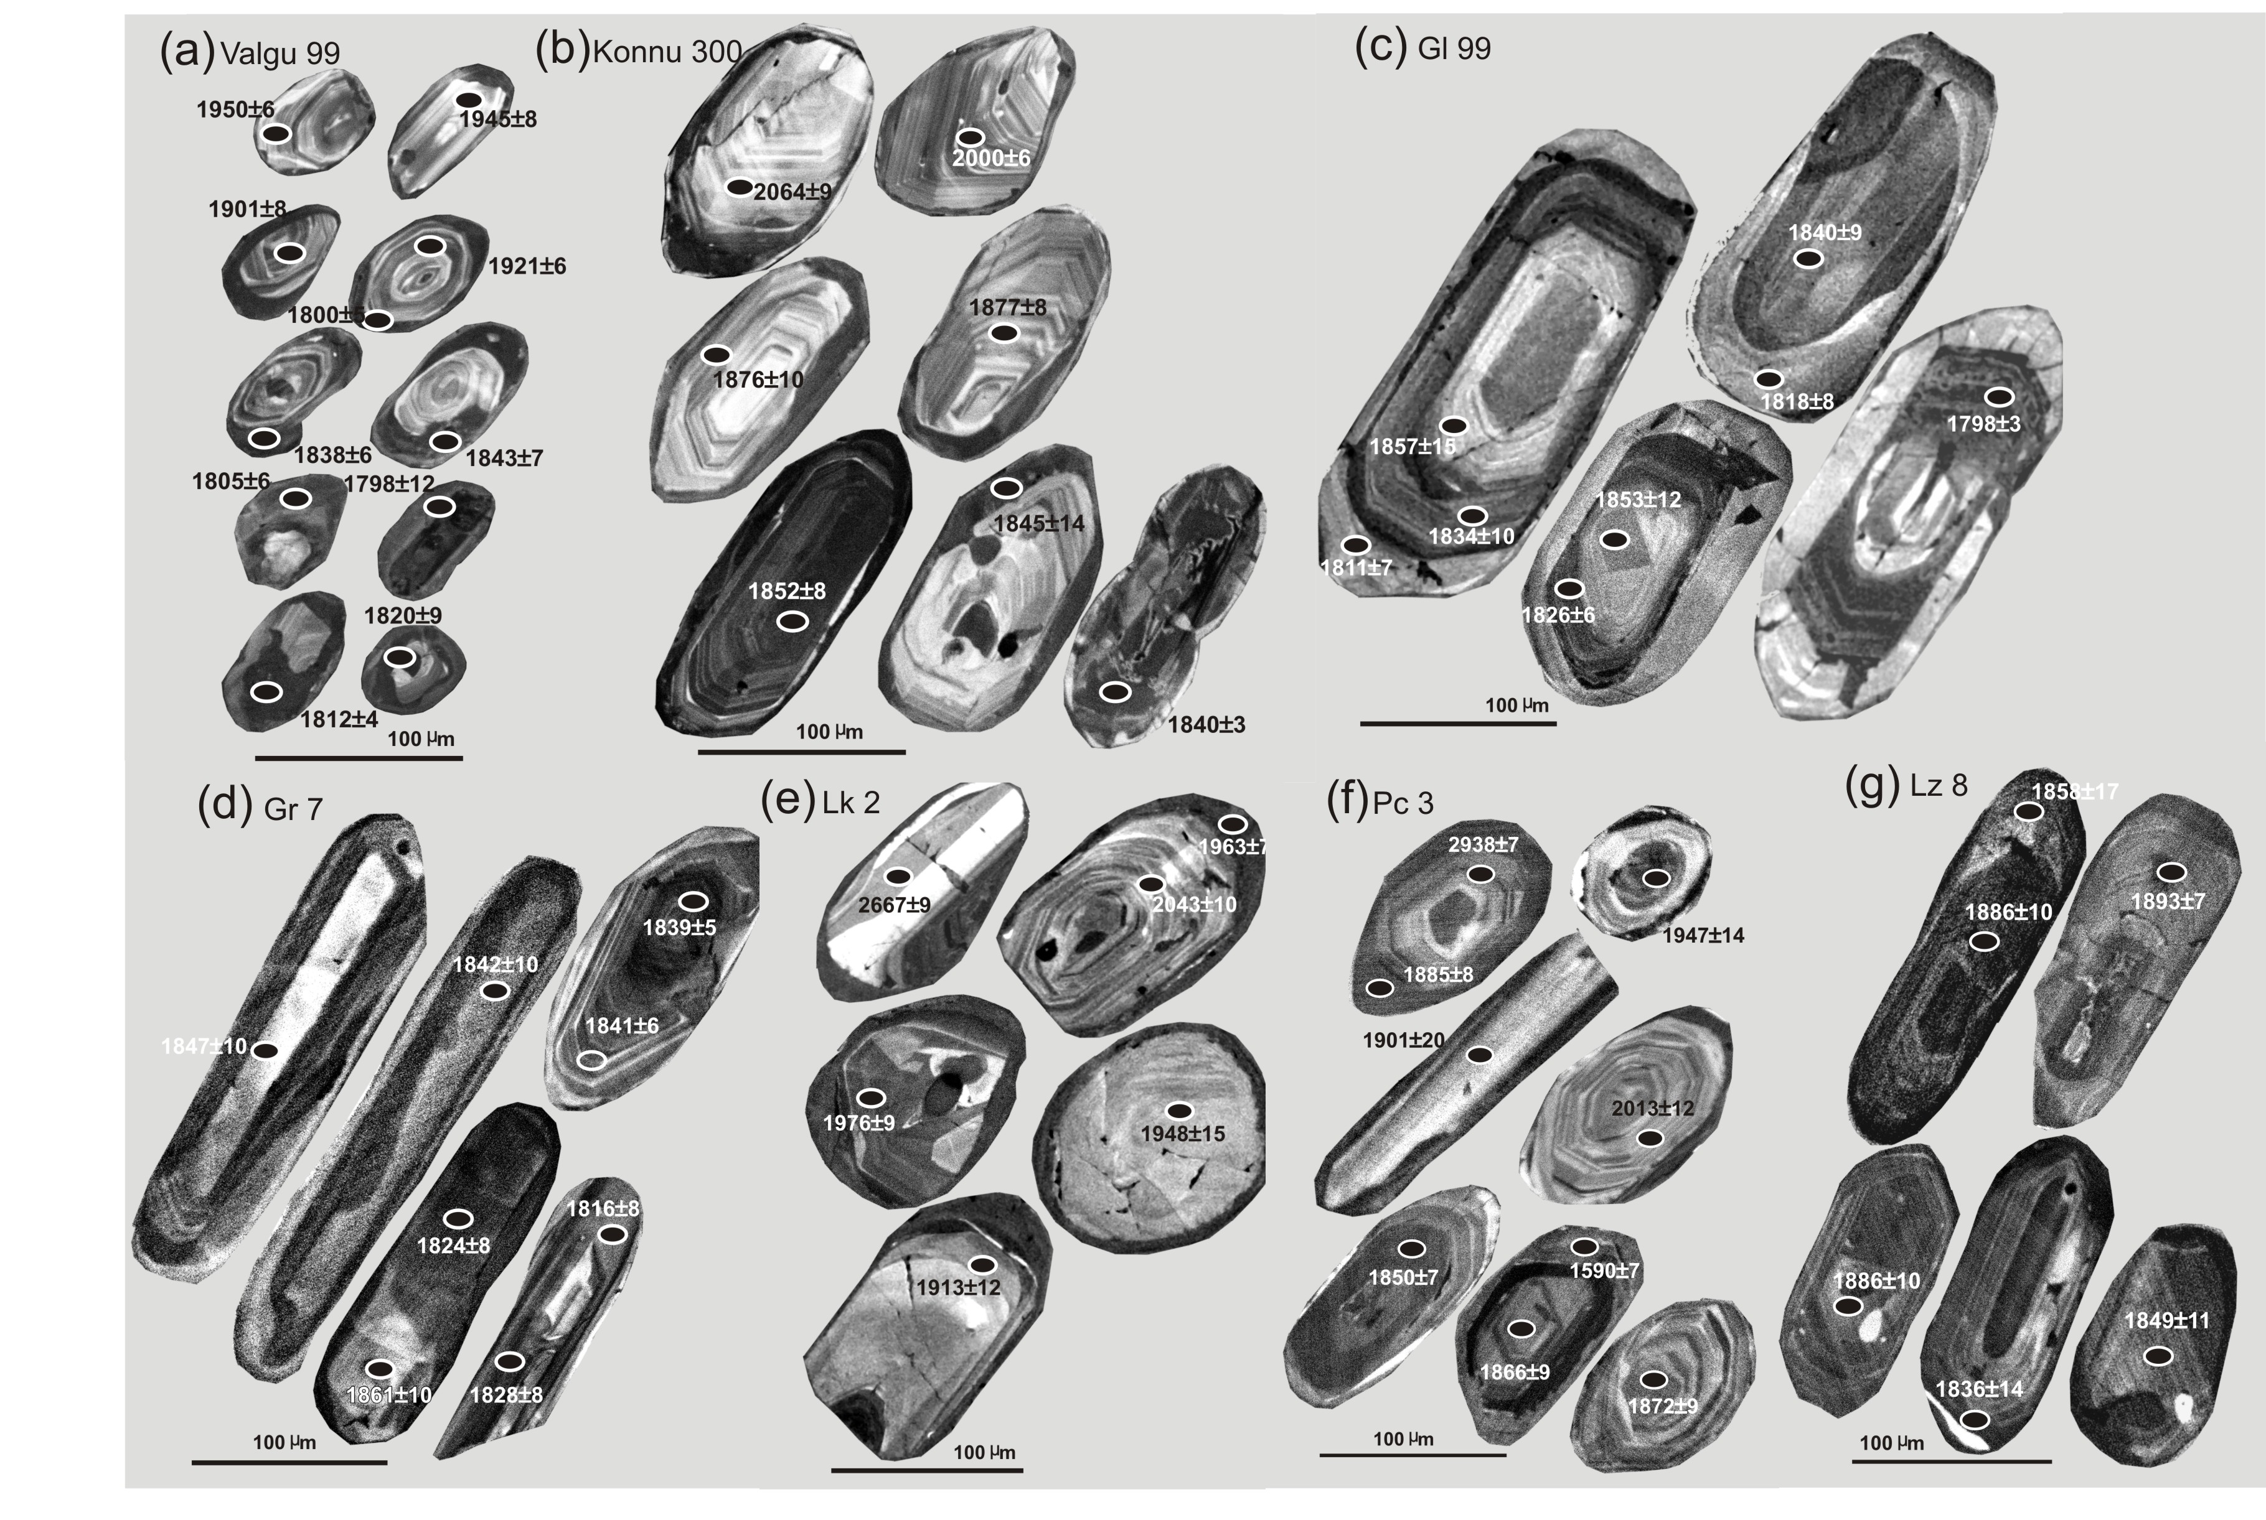
Igneous
Igneous
Zircon grains in igneous and sedimentary rocks
Sedimentary
Igneous
Igneous
Sedimentary
Sedimentary
Bogdanova et al., 2015

Slide 34
DATA INTERPRETATION:
Valgu 99, sedimentary, metamorphic
(TW concordia diagrams and Probability
density plots)
Age ±2s fraction ±2s
1896.5 2 0.50 0.33
1930.4 5.3 0.11 0.16
1945 3.1 0.27 0.25
1972.6 4.8 0.11 ---
relative misfit = 0.109
Age ±2s fraction ±2s
1798.2 2.4 0.56 0.50
1842.1 2.9 0.44 ---
relative misfit = 0.124
Bogdanova et al., 2015

Slide 35
DATA INTERPRETATION:
Konnu 300, igneous, metamorphic,
(TW concordia diagram, probability density and weighted
averages plots)
Age ±2s fraction ±2s
1891 2.5 0.53 0.41
1857.5 3.5 0.31 0.31
1997 6.3 0.08 0.15
2063.9 9.3 0.08 ---
relative misfit = 0.049
Bogdanova et al., 2015

Slide 36
DATA INTERPRETATION:
Lazdijai 8 (igneous)
Bogdanova et al., 2015

Slide 37
CONCLUSIONS/RECOMMENDATIONS
SIMS is a powerful technique for in-situ dating at high resolution, providing precise age determinations;
None-destructive (requires small amount of a sample), simple preparation;
It provides information on origin (variability, shape of zircon crystals, their internal texture, overgrowths, quality of zircon grains etc.)
Allows for the dating of major igneous, high-grade metamorphic and sedimentation events as well as some secondary alterations;
The SIMS analysing labs usually make all the necessary corrections, process the data and provide it in tables and variable diagrams.
For more interpretation details, the best way is to address the SIMS labs employees and attend special courses.

Slide 38


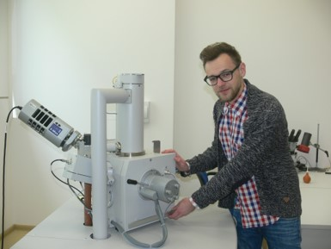
Thank you for attention

Slide 39
PUBLICATIONS
Bogdanova, S., Gorbatschev, R., Skridlaite, G., Soesoo, A., Taran, L., Kurlovich, D., 2015. Trans-Baltic Palaeoproterozoic correlations towards the reconstruction of supercontinent Columbia/Nuna. Precambrian Res. 259, 5–33.
Johansson, A., Bingen, B., Huhma, H., Waight, T., Vestergaard, R., Soesoo, A., Skridlaitė, G., Krzeminska, E., Shumlyanskyy, L., Holland, M.E., Holm-Denoma, C., Teixeira, W., Faleiros, F.M., Ribeiro, B.V., Jacobs, J., Wang, C.C., Thomas, R.J., Macey, P.H., Kirkland, C.L., Hartnady, M.I.H., Eglington, B.M., Puetz, S.J., Condie, K.C., 2022. A geochronological review of magmatism along the external margin of Columbia and in the Grenville-age orogens forming the core of Rodinia</p>. Precambrian Research, 371: art. no. 106463. https://doi.org/10.1016/j.precamres.2021.106463
Siliauskas, L., Skridlaite, G., Baginski, B., Whitehouse M. & Prusinskiene, S., 2018. What the ca. 1.83 Ga gedrite-cordierite schists in the crystalline basement of Lithuania tell us about the late Palaeoproterozoic accretion of the East European Craton, GFF, 140:4, 332-344, DOI: 10.1080/11035897.2018.1544588
Soderlund, U., and L. Johansson, 2002. A simple way to extract baddeleyite (ZrO2), Geochem. Geophys. Geosyst., 3(2), 10.1029/
2001GC000212, 2002.10.1029/2001GC000212
https://www.air.app.br/shrimp-sims/

