Slide 1
Introduction to GCD Tool Kit
Laurynas Šiliauskas
2026

Slide 2
Content
Why GCD Tool kit?
Data format
Running GCD Tool kit
Uploading data
Grouping/sorting data
Calculations
Plotting
Plug-ins
Plot editing
Small exercise

Slide 3
Why GCD Tool kit?
Specialized software
  Igpet – paid license
  PetroGram – Excel-based software. Slow, not very stable. Limited plots. Still, worth taking a look!
  Igor Pro – paid license, but highly versatile if you know C or C++
… or you can use hundreds of Excel templates!

Slide 4
Data format
The Excel table must include:
Whole-rock composition in the columns
Samples in rows
No spaces between columns and rows (reading will terminate at an empty column/row)
Unique sample ID
Unique column labels

Slide 5
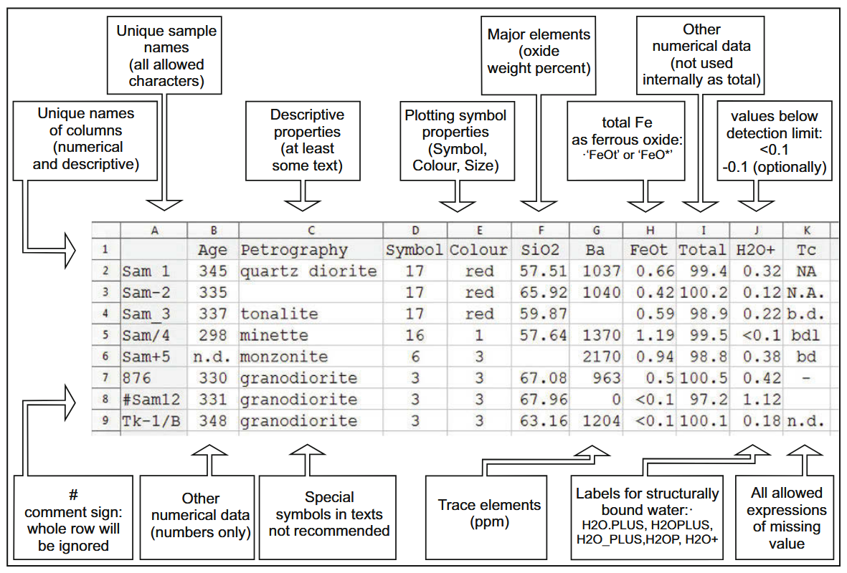

Slide 6
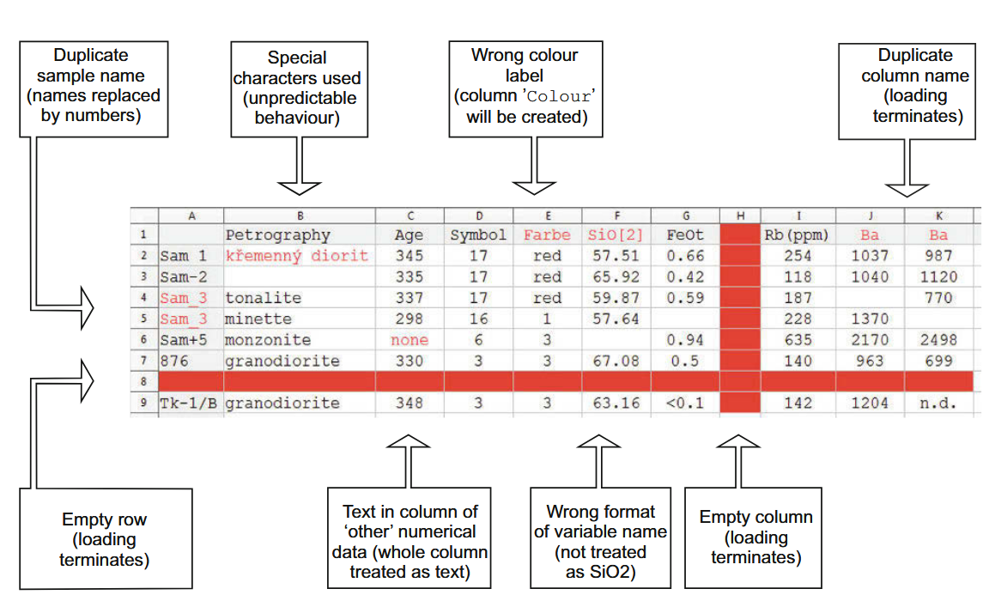

Slide 7

Running GCD Tool kit
Step 1

Slide 8
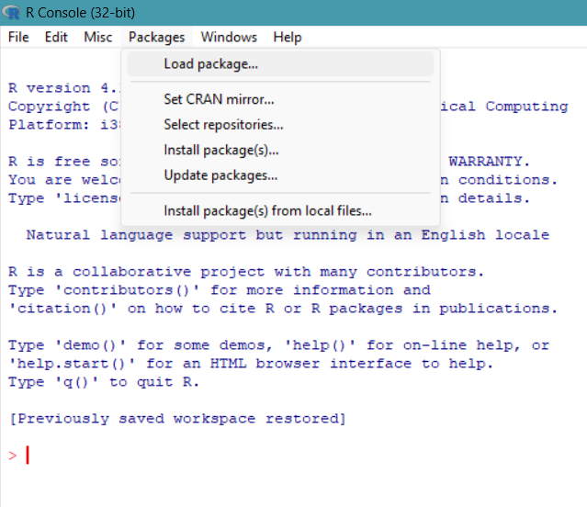
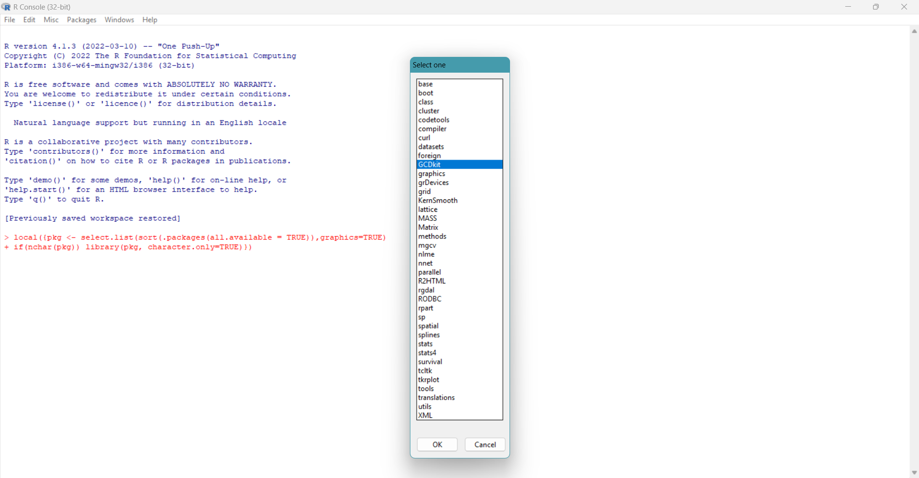
Running GCD Tool kit
Step 2
Step 3

Slide 9
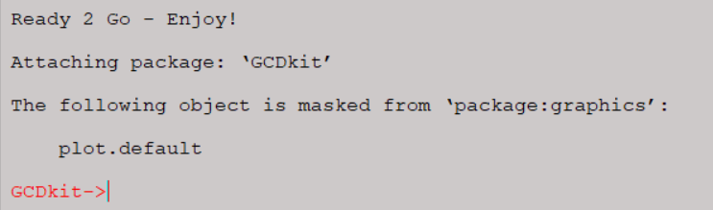
And you are done!

Slide 10
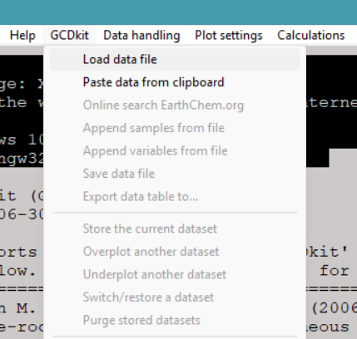
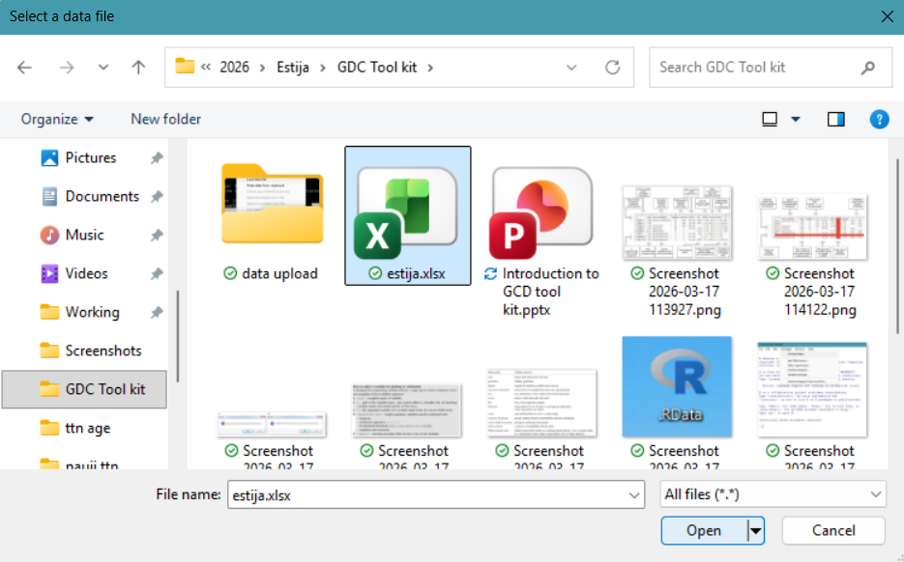
Uploading data
Step 1
Step 2

Slide 11
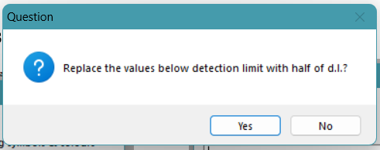
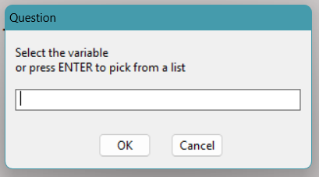
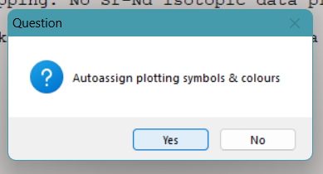
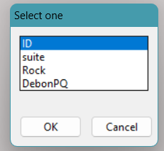
Uploading data
Step3
Step4
Step5
Step6
If you select no, all the data will be labeled in the same way
Type in the name of the column, or press ok to proceed to step 6…
…this is much easier!

Slide 12
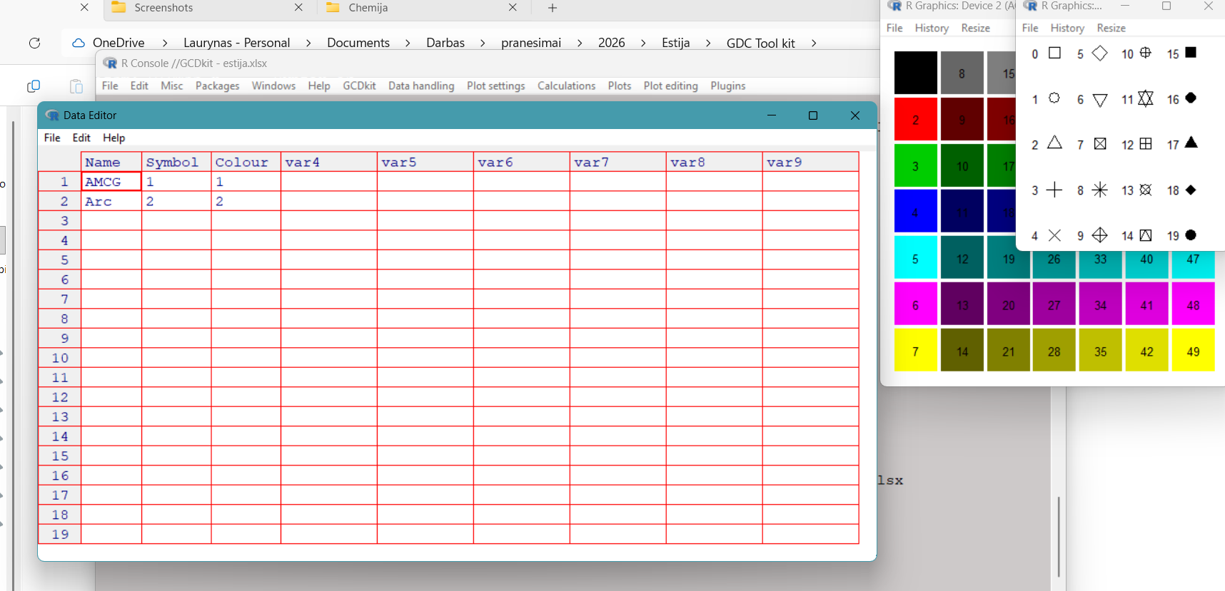
Uploading data
Step 7
You can change the symbol/colour combo as you like in the table by changing the numbers

Slide 13
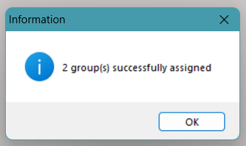
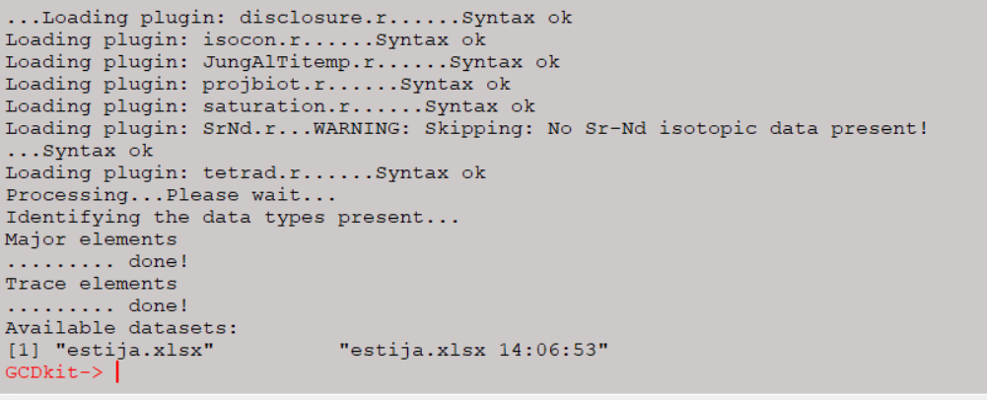
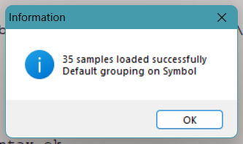
Uploading data
…and it is done!

Slide 14
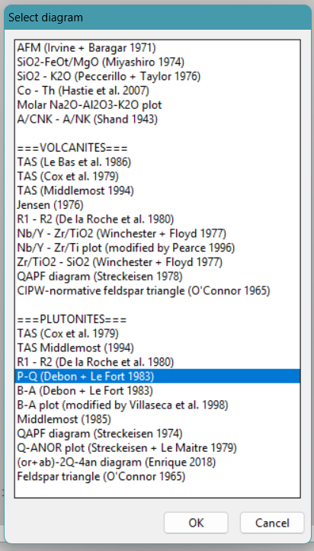
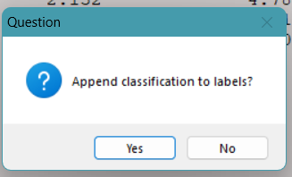
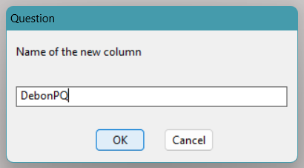
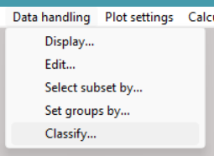
Grouping/sorting data
Step2
Step3
Step4
Step1

Slide 15
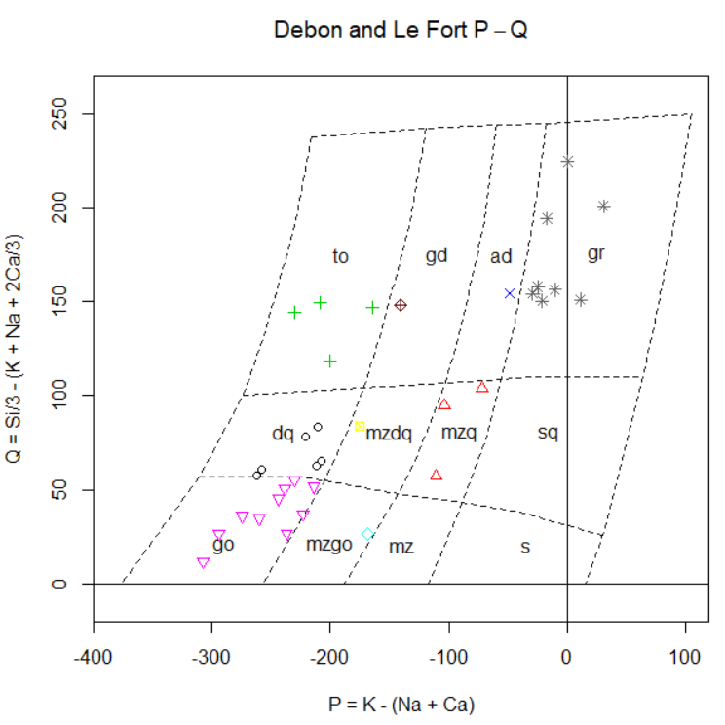
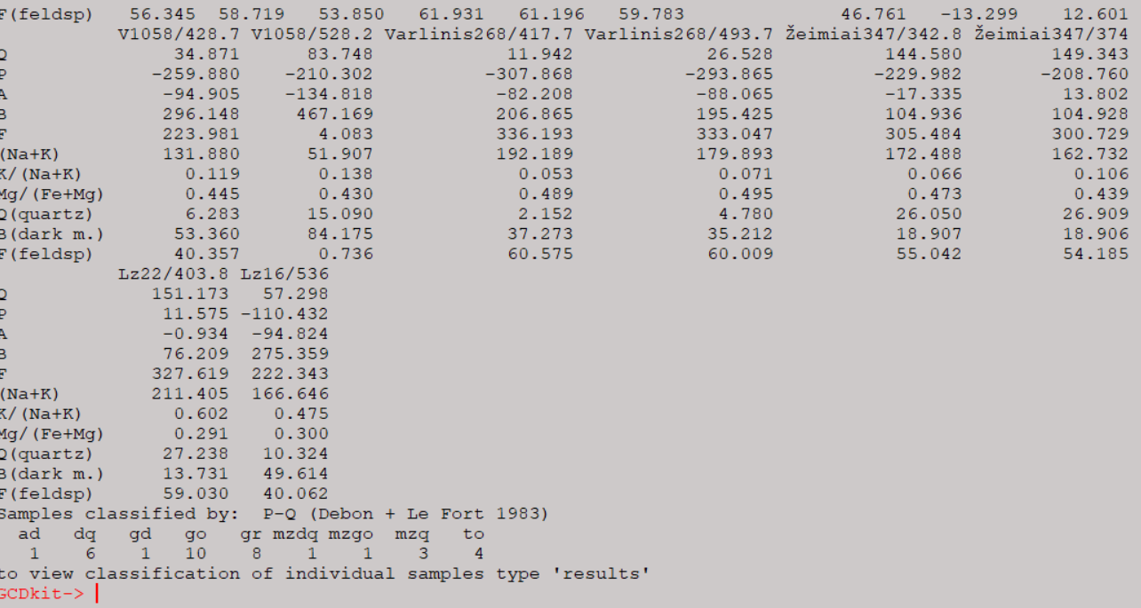
Grouping/sorting data
You can go two ways from here…

Slide 16
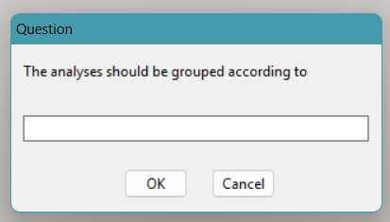
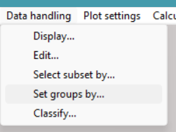
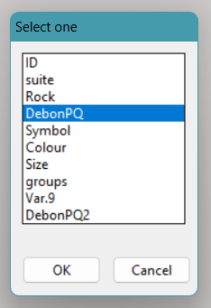
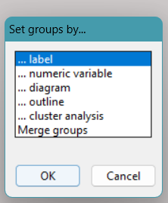
Grouping/sorting data
Classification within GCDTool kit
Step 1
Step 3
Step 2
Step 4

Slide 17
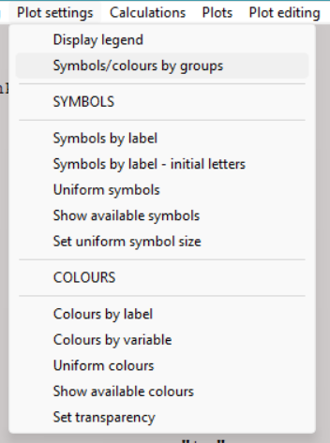
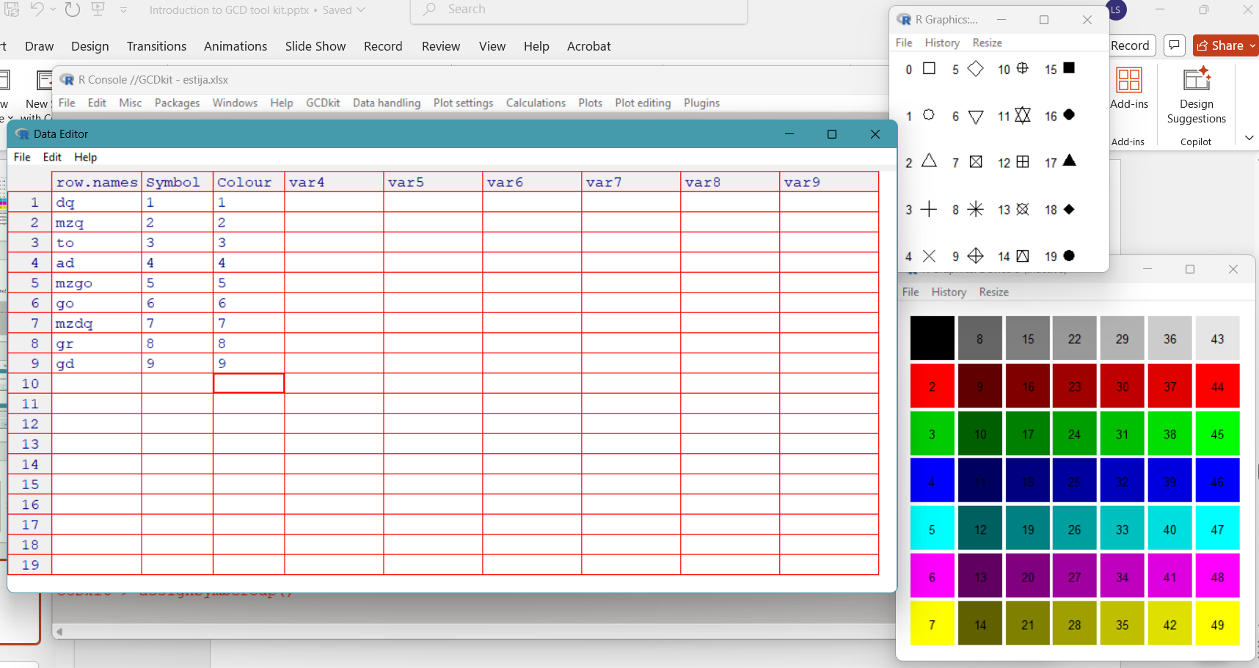
Grouping/sorting data
Classification within GCDTool kit
Step 5
Step 6

Slide 18
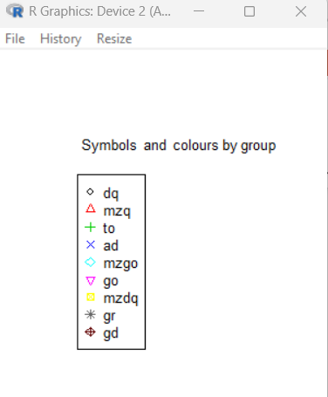
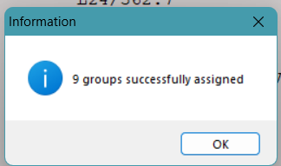
Grouping/sorting data
Classification within GCDTool kit
This will change the legend accordingly to the label/color combos you select

Slide 19
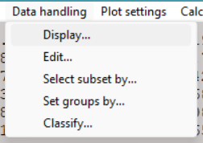
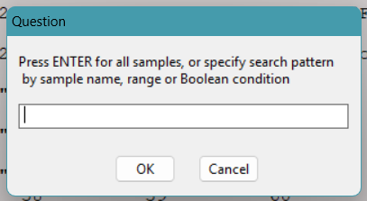
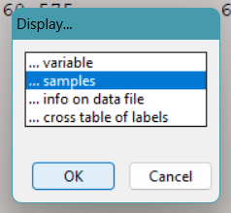
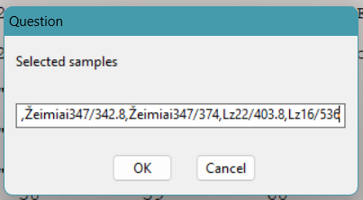
Grouping/sorting data
Importing the classification into excel
Step1
Step3
Step2
Step4

Slide 20
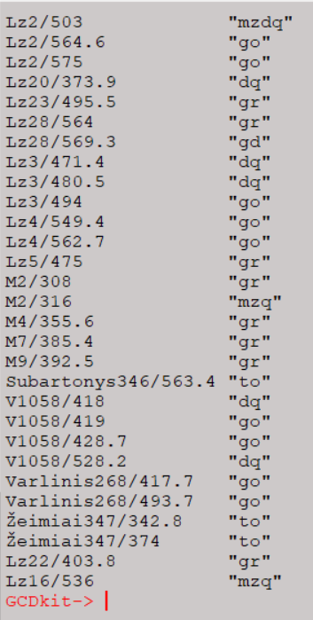
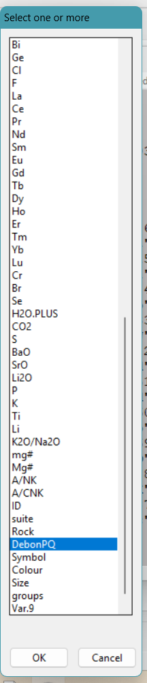
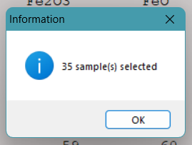
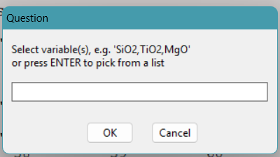
Grouping/sorting data
Importing the classification into excel
Step7
Step6
Copy/paste it into excel. The order is the same
Step5

Slide 21
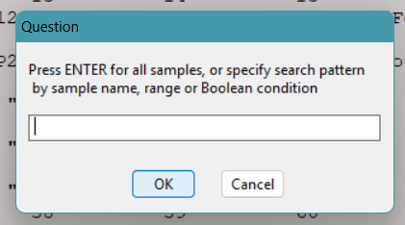
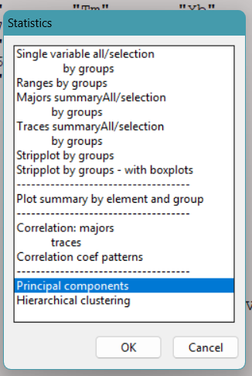
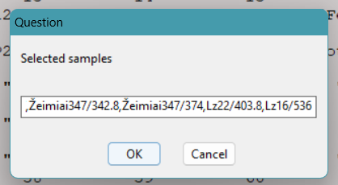
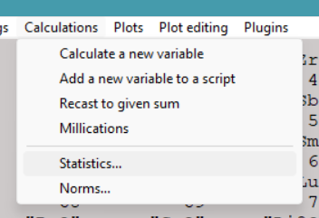
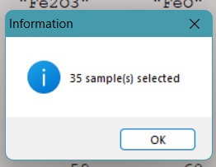
Calculations: statistics
Step3
Step2
Step1

Slide 22
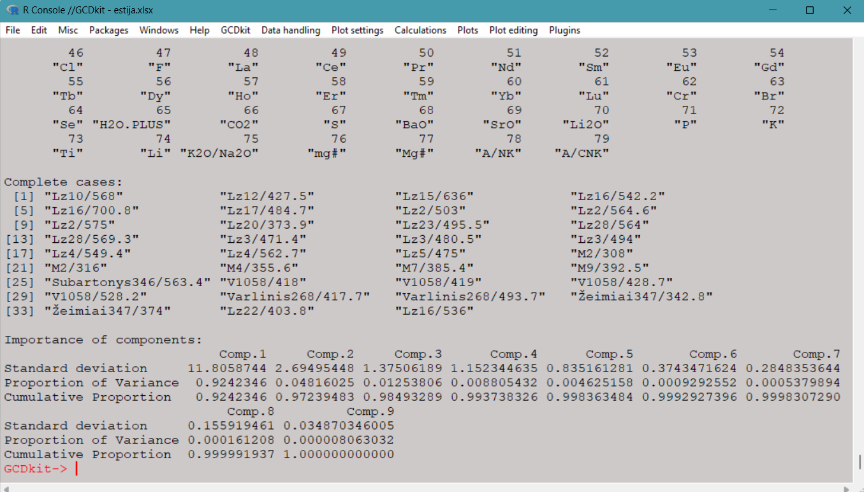
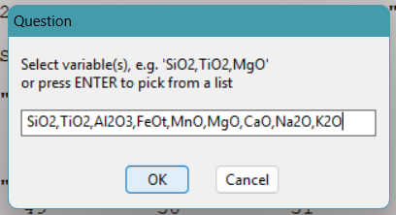
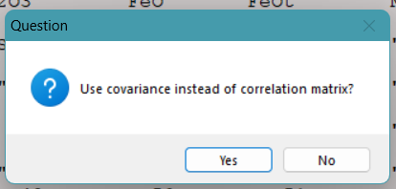
Calculations: statistics
Results
Step4
Step5

Slide 23
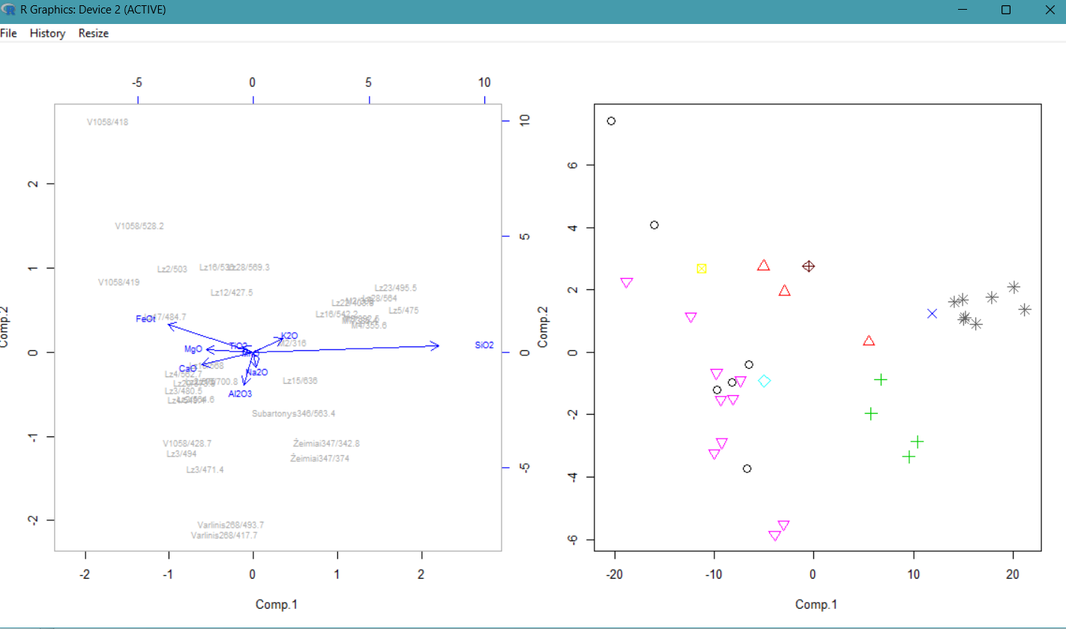
Calculations: statistics

Slide 24
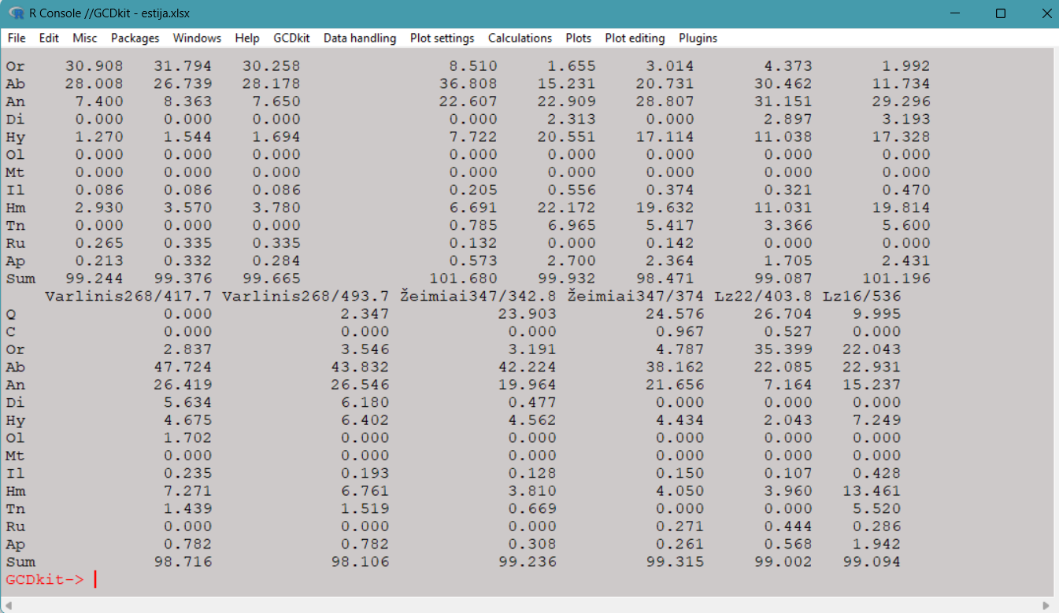
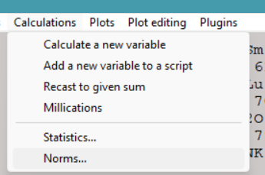
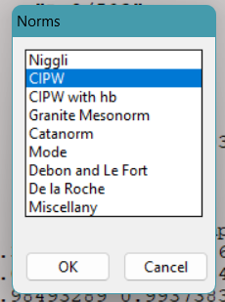
Calculations: norms
Step1
Step2
You can copy and paste it to Excel. The order of the columns is the same as the order of the rows in the original file. Very useful if you are dealing with granitoids!

Slide 25
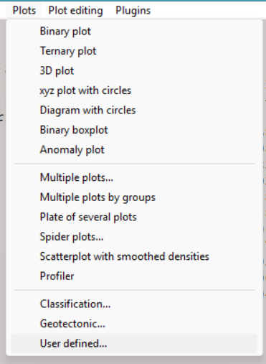
Plotting
User-defined plots
Multiple plots
Pre-defined plots from literature

Slide 26



Plotting: User-defined plots
Binary
Ternary
3D
Slab input
Decompression melting
Degree of melting

Slide 27




Plotting: Harker
Step 2
Step 3
Step 1
Step 4

Slide 28




Plotting: Harker
Step 5
Step 7
Step 6
Step 8

Slide 29



Harker: major elements
Harker: trace elements

Slide 30



Spider plots
Step 3
Step 1
Step 2

Slide 31






Spider plots
Step 6
Step 8
Step 4
Step 7
Step 9
Step 5

Slide 32



Spider diagrams
REE/Chondrite (Boynton 1984)
Gabbro
Quartz diorite
Tonalite

Slide 33



Spider diagrams: primitive mantle
Gabbro
Quartz diorite
Tonalite

Slide 34

Spider diagrams: always check the log for useful info!

Slide 35

Spider diagrams: be creative!
Just because the GCD toolkit is designed for igneous rocks, that does not mean it does not work on other data. Here, for example, is a titanite REE plot done by O. Demina, using the GCDTool kit!

Slide 36





Pre-defined plots: classification
Same drill after that
Step 2
Step 1

Slide 37


Pre-defined plots: classification

Slide 38


Pre-defined plots: classification

Slide 39





Pre-defined plots: Geotectonic
Same drill after that
Step 1
Step 2

Slide 40


Pre-defined plots: Geotectonic

Slide 41
Pre-defined plots: Geotectonic
Caution!
For felsic rocks, do not use tectonic diagrams designed for basic rocks and vice versa.
Intermediate composition rocks should be treated as evolved felsic rocks.
Be wary of element mobility after the rock has formed (high-grade metamorphism, partial melting, hydrothermal alteration).
Do not rely too much on the tectonic diagrams when working with Paleoproterozoic rocks: they are often based on modern rocks.
Don’t be lazy: always go back to the source and check what the plots discriminate, and what the logic is behind the defined fields.

Slide 42



Plug-ins: isocon
Step3
Select first unaltered rock, then altered rock.
Step1
Step2

Slide 43



Plug-ins: isocon
The histogram and table can help you select immobile elements, but you should consider the system you are working with. Pure mathematical solution is not necessarily correct.

Slide 44

Plug-ins: isocon

Slide 45

Plug-ins: isocon
Check the console log:
The slopes of the red and green lines define the area with negligible mobility (isocon fit).
The table below presents the numerical expression of the mass transfer (using the assumptions of certain element immobility).
Copy/paste!

Slide 46

Plug-ins: isocon
Examples of calculated isocons for the ca. 1.89 Ga igneous rocks from sodic alteration zones in VIOD. Since the alteration was caused by Cl-rich fluid, Al2O3 and Ga were considered as immobile.
a, b: least altered scapolite-bearing rocks with recognizable igneous textures.
c: nearly monomineralic scapolite rock isocon shows leaching of most components, safe for Al2O3 and Ga which are conserved in plagioclase and scapolite.
d: using least altered samples, and the least enriched elements in tectonic discrimination diagram.

Slide 47



Plug-ins: saturation temperatures
Step 1
Step 3
If you have an independent temperature estimate, you can use it here, otherwise, guestimate.
Step 2

Slide 48

Plug-ins: saturation temperatures
Watson and Harrison (1983)
Boehnke et al (2013)
…useful for checking if there is a lot of zircon inheritance. Best used on granitoids.

Slide 49

Plug-ins: REE tetrad effect
REE grouping in an arc-like pattern (by four REEs)
Most often causes:
Analytically, if REE content is low
Hydrothermal alteration
Takahashi et al., 2002

Slide 50


Plug-ins: REE tetrad effect

Slide 51

Plug-ins: REE tetrad effect
Ce/Cet=0.87
Not the best example, but they are not very common

Slide 52





Plot editing
Here you can select specific samples, identify specific points from the plot, and use the plot for a new classification setup.
Saving graphs in different formats. Pdf gives the best quality, though it can mess up the symbols and labels.

Slide 53



Plot editing: adding reservoirs and minerals
Isotope reservoirs

Slide 54


Plot editing: adding reservoirs and minerals

Slide 55


You can add reservoir chemical and isotopic composition and ideal mineral chemistry to the plots
Arc array

Slide 56
Little exercise
You should have an Excel file “Estija” that contains a dataset of whole rock and trace element concentrations from two distinct units. One of them is a volcanic arc suite, which I used as an illustration here. The main task is to use the GCD toolkit to distinguish and identify the other unit.
Group the data according to the P-Q classification
Use the SiO2-K2O plot to separate rocks according to their potassium content into two groups
Inspect each group in the spider diagram to identify outliers (plot editing, then identify points)
Fully separate the two suites
Classify the other suite using the SiO2-K2O, AFM, TAS, etc. diagrams
Create Harker-type diagrams
Create a separate spider diagram for the suite (trace and REE)
Calculate the CIPW norms for granitic rocks
Use the norms to classify granitoids according to the QAP classification
Use granitic rock chemistry to determine its tectonic setting.

