Slide 1


Comparison of Soviet- era and modern multi-digestion rock geochemical and mineralogical methods for vectoring toward mineralising systems
Charlie Moon

Slide 2
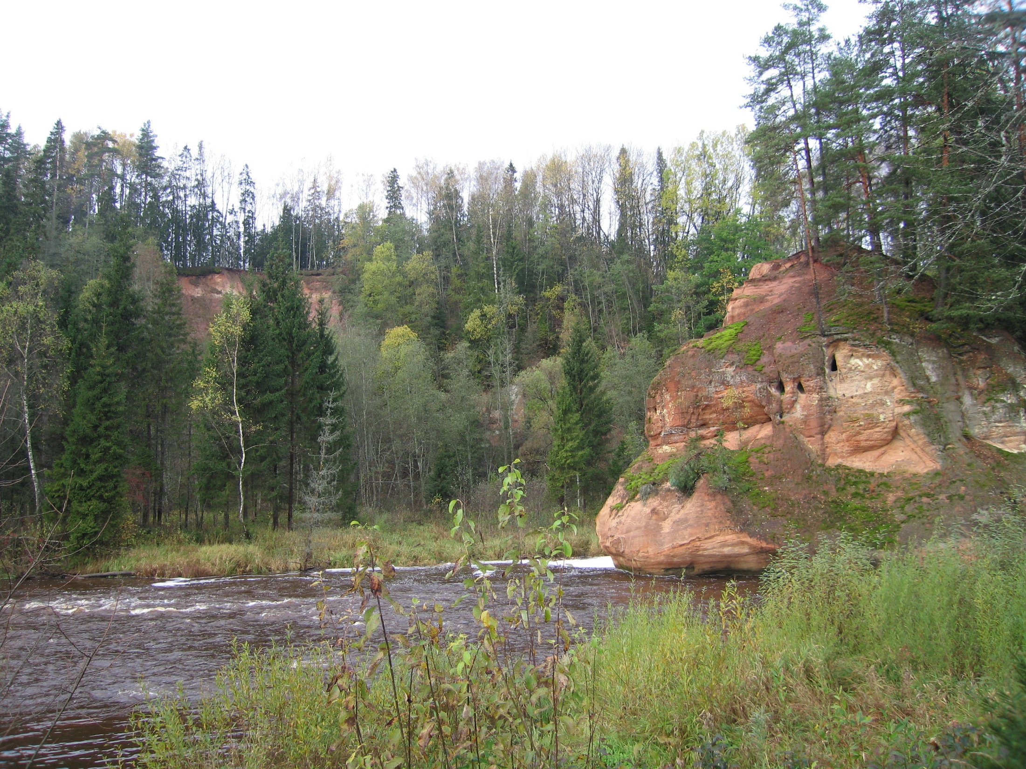

Slide 3
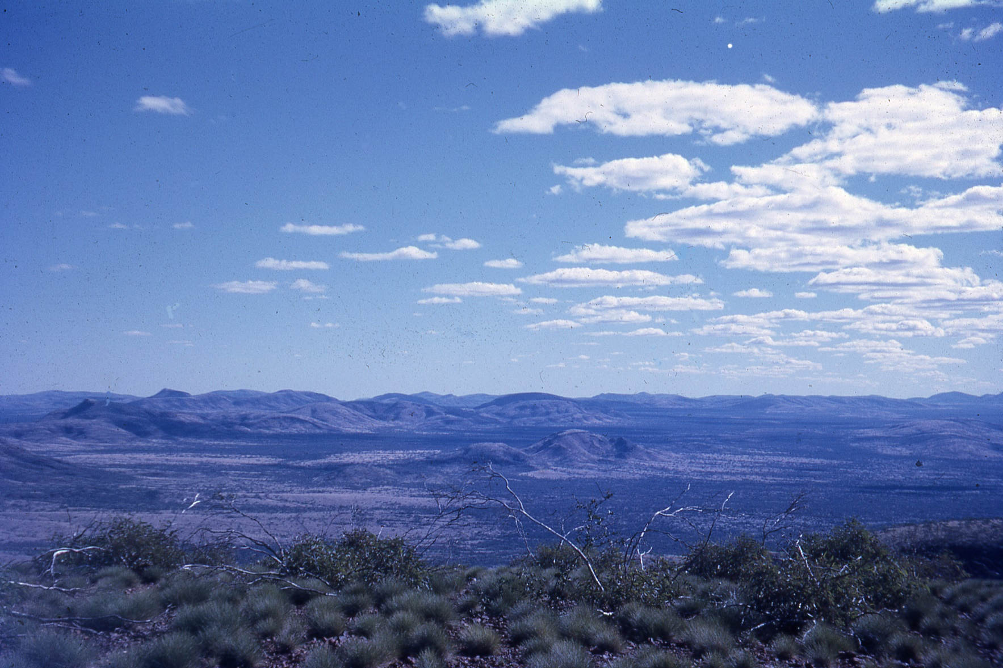
Mining Area C
Originally Mt Goldsworthy JV (Consolidated Gold Fields (33%) Utah Cyprus 1964
Now BHP 85%, Mitsui 8%, Itochu 7%
CGF exited 1977
First production 2003
Current production 62 Mt, costs 1-2nd quartile
Royalty $A60-80 M (2022) previously to Iluka (CGF residue)

Slide 4
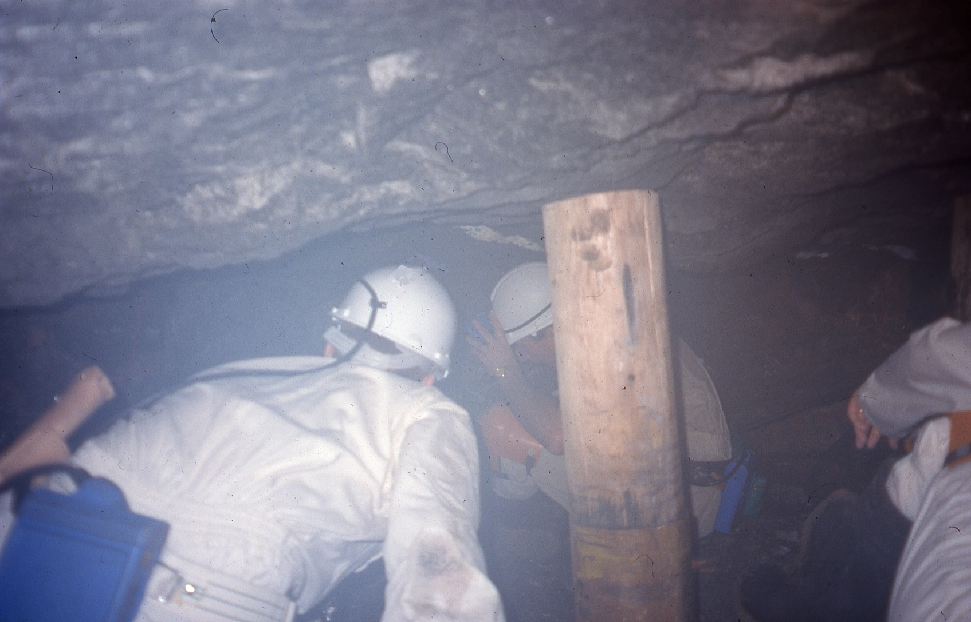
South Deep (30-50 Moz)

Slide 5
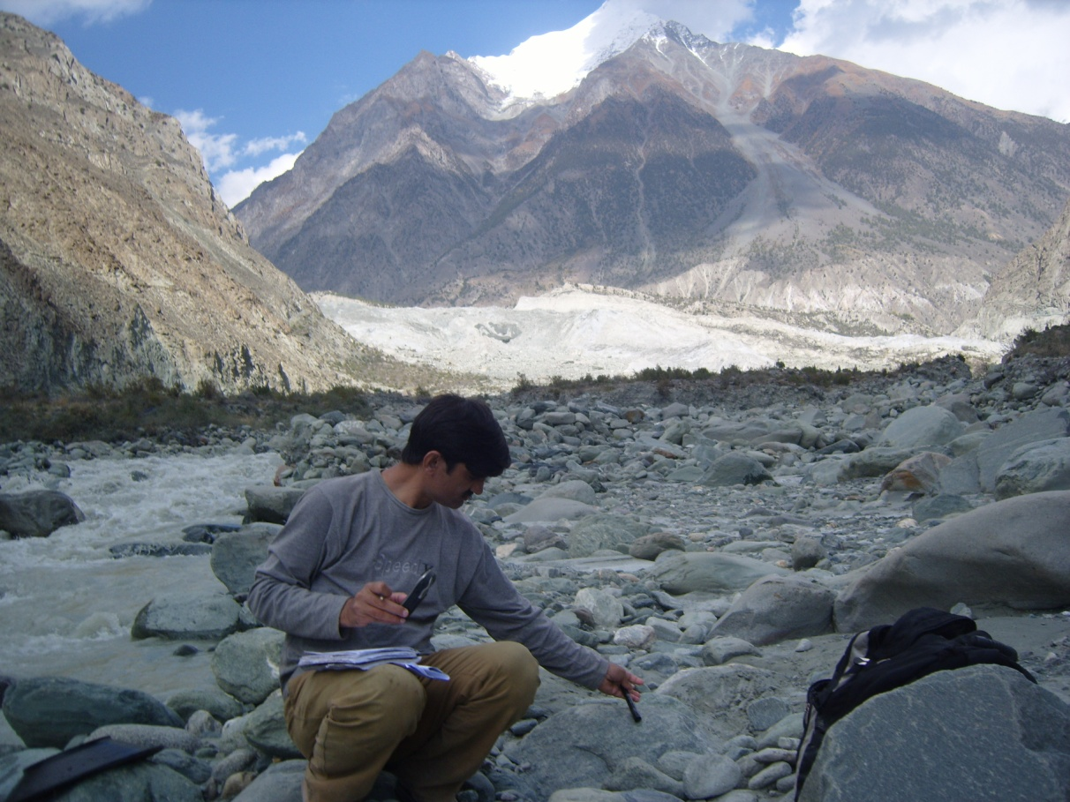
Pakistan

Slide 6
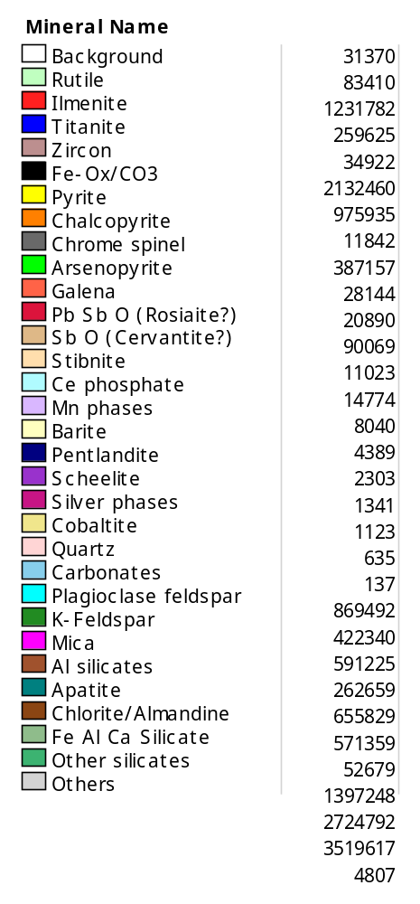

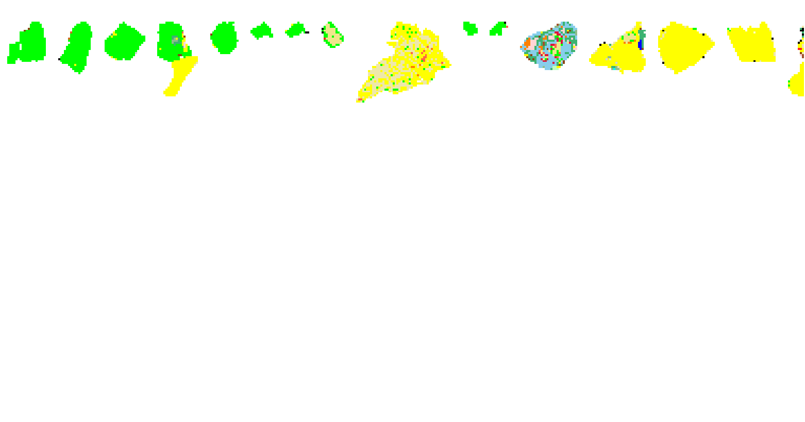
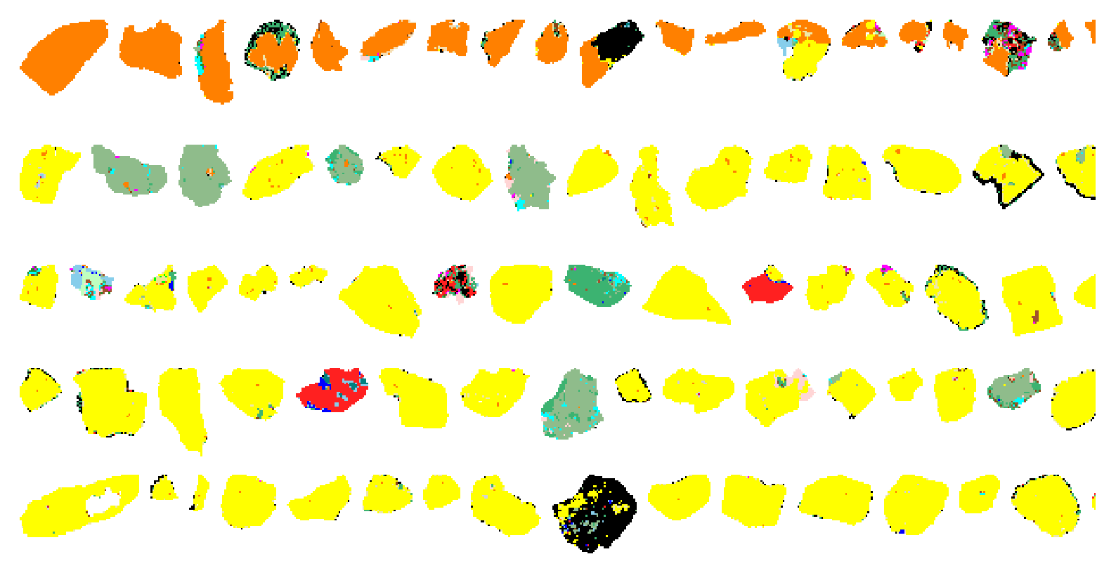
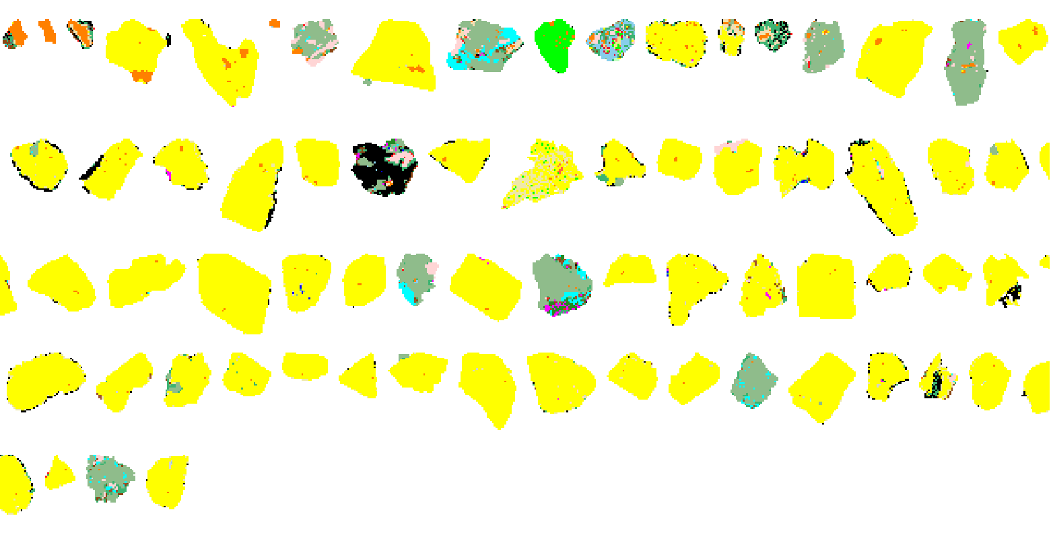
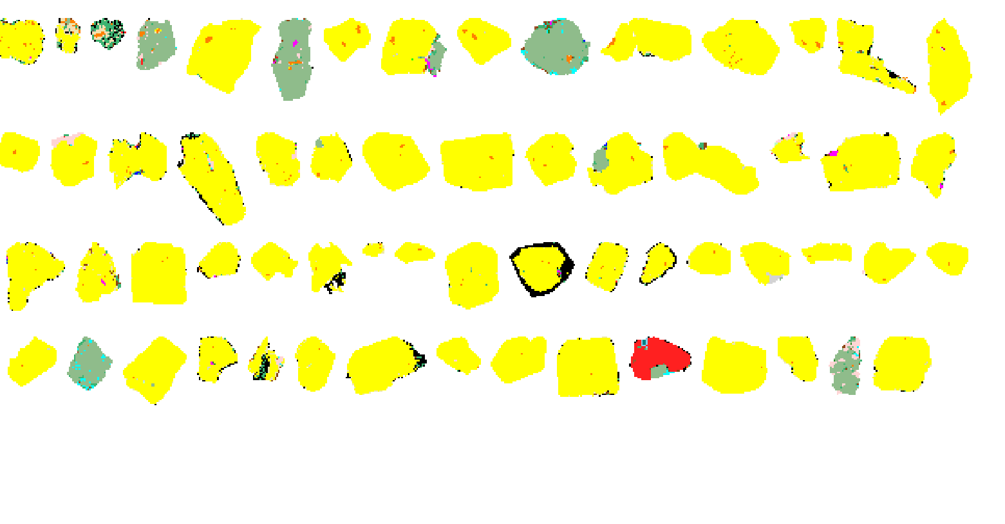
Examples of Detail
Bagrot
HMC
Arsenopyrite
Chalcopyrite

Slide 7

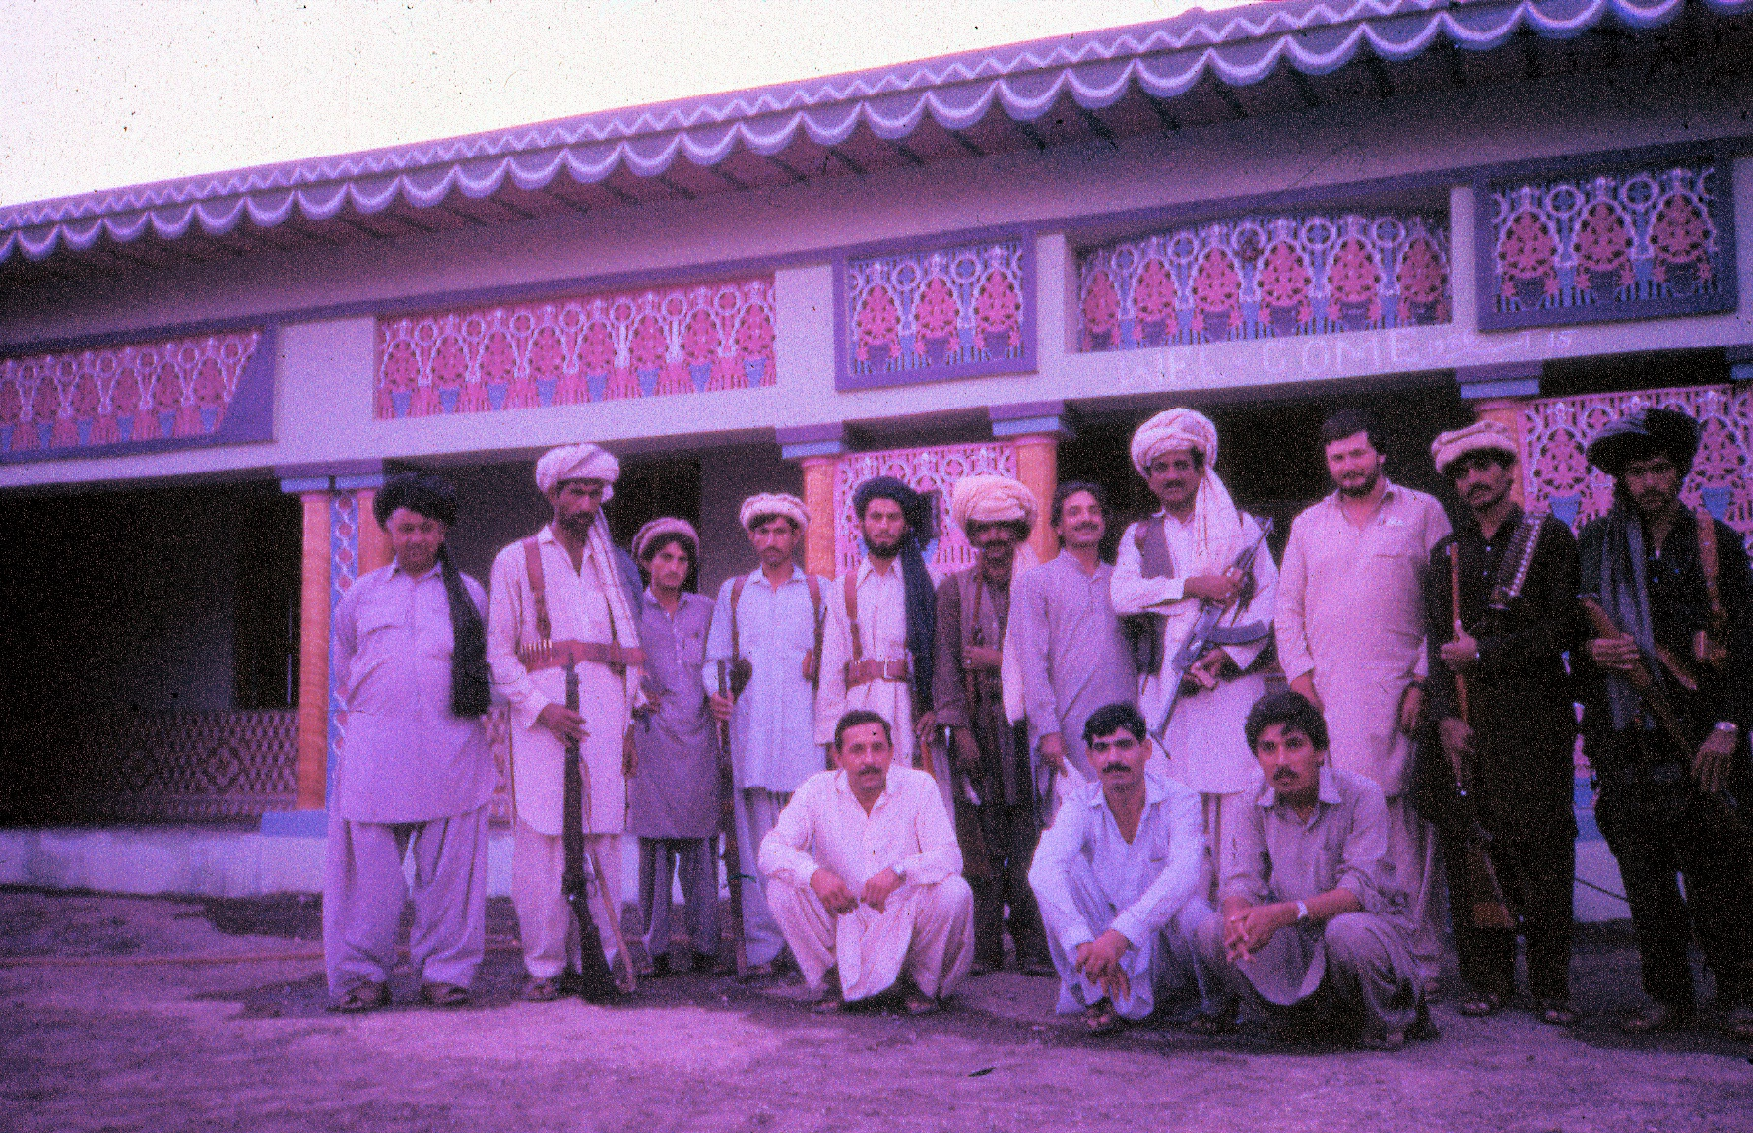
Waziristan

Slide 8
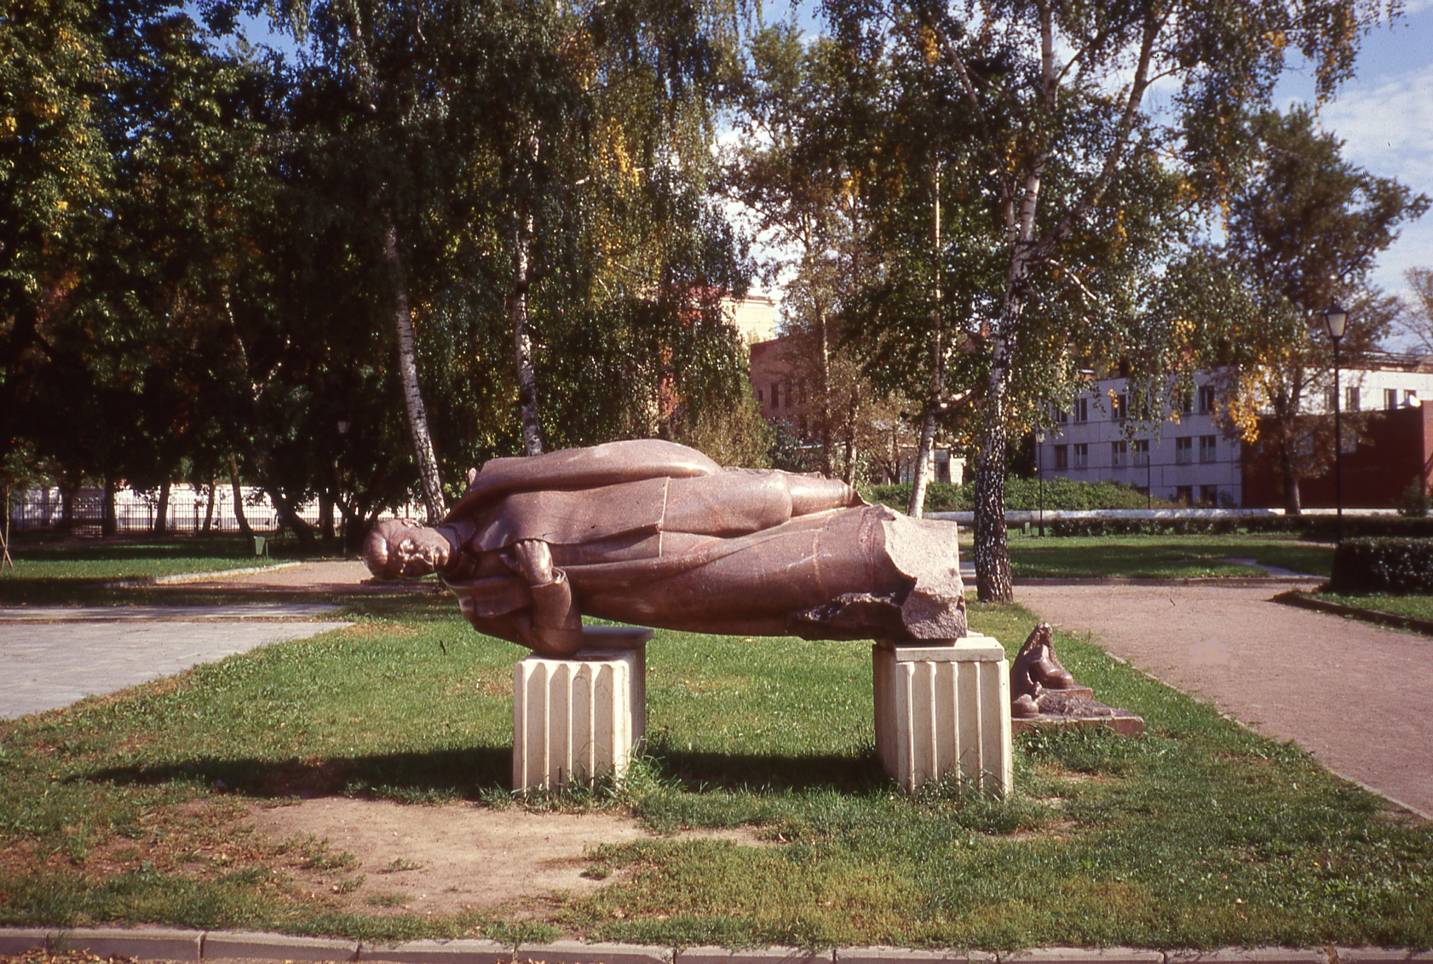
Former Soviet Union

Slide 9
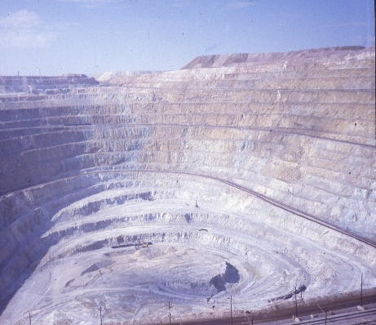
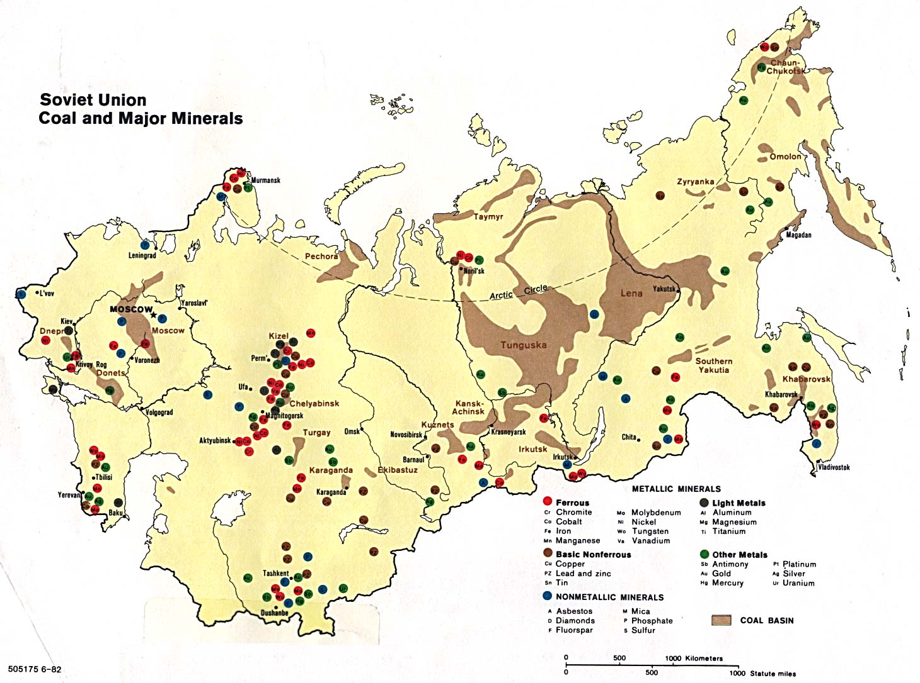
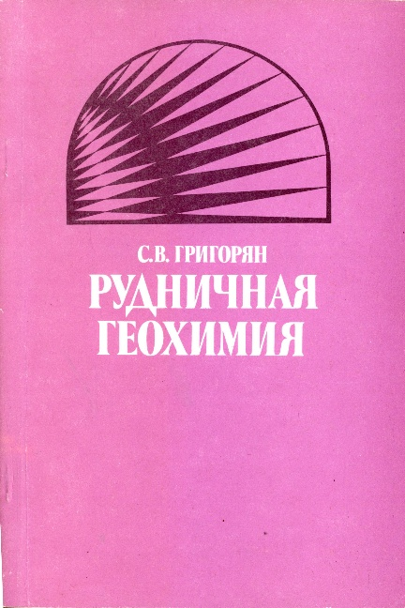
Soviet Union
Kounrad- Kazakhstan

Slide 10
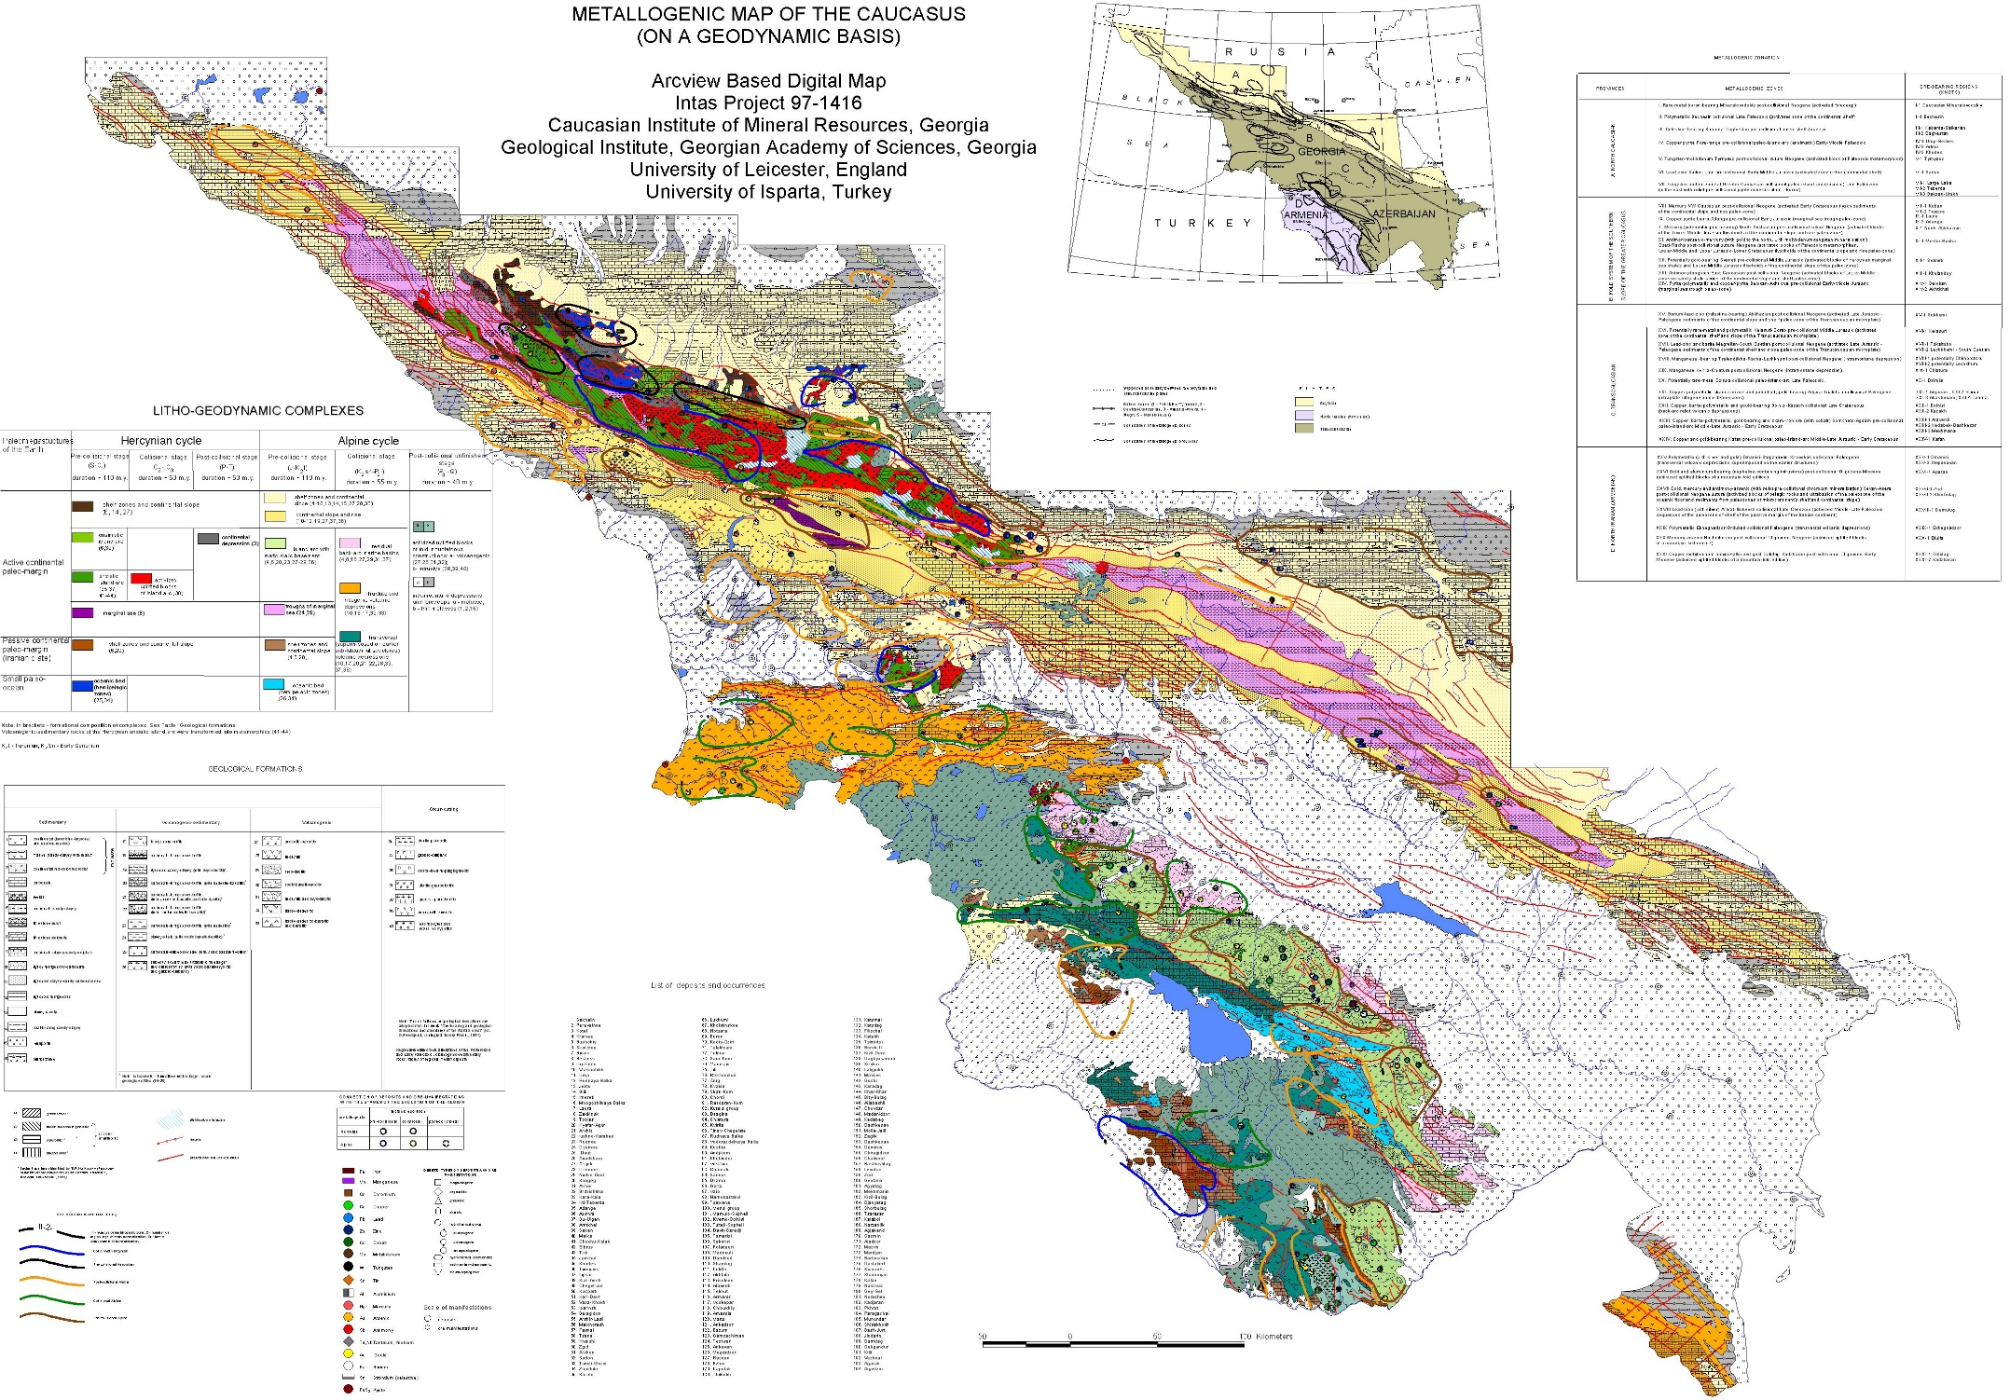

Slide 11
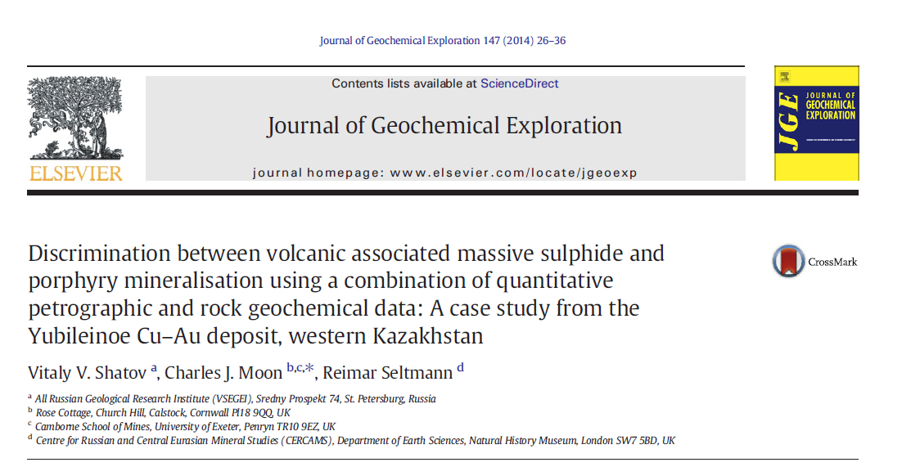

Slide 12
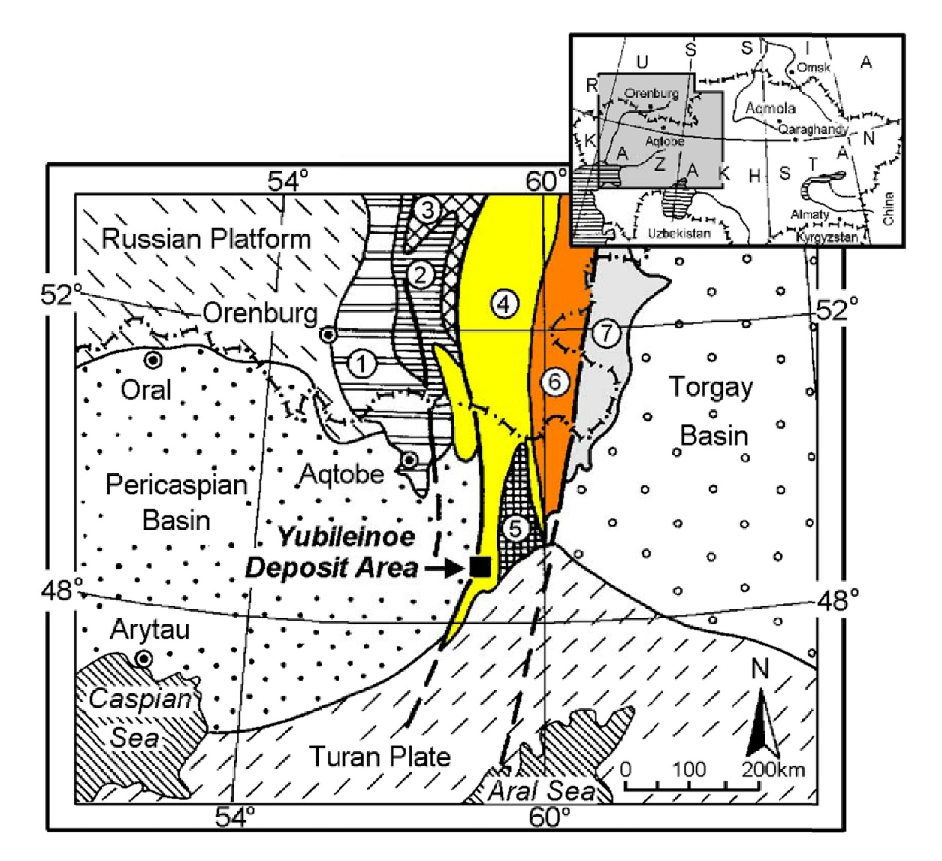

Slide 13
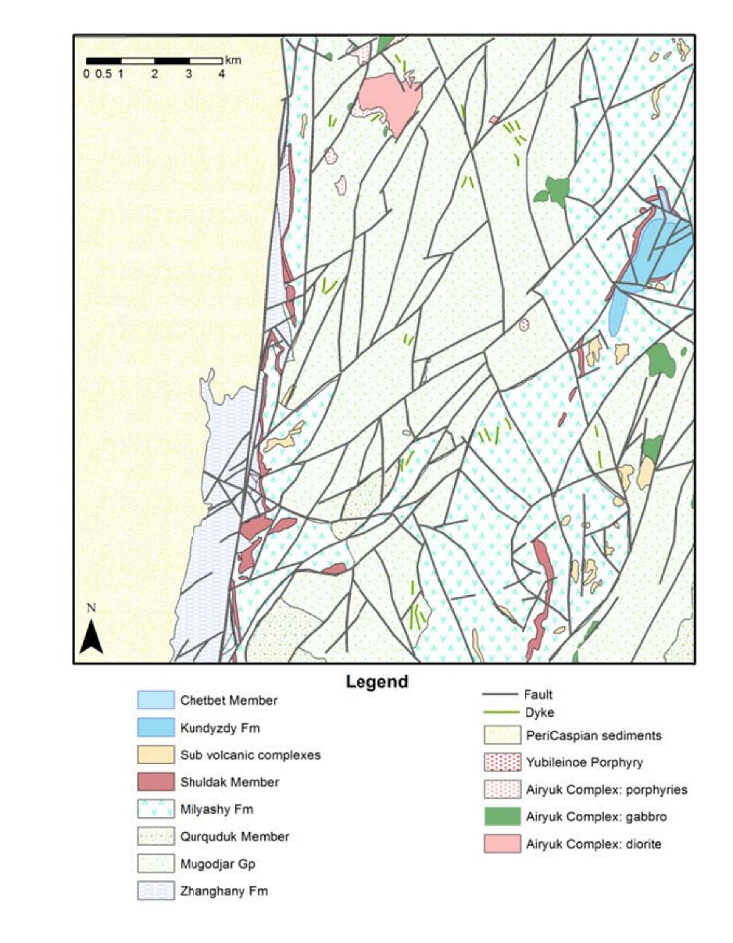
Cu Pb Zn Mo Ag As Co Ni Cr V Mn Ti Zr Sc Li BeP Ba W Sn Bi Sb Ge Y Au
DC arc spectrometry
+ thin section (point counted)

Slide 14
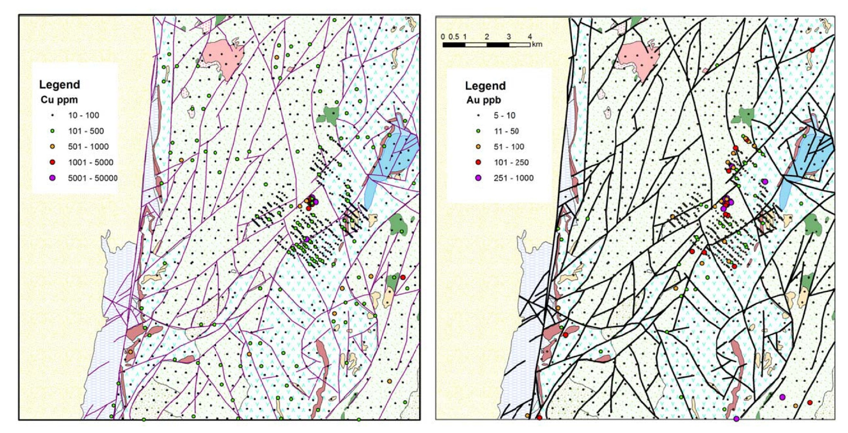

Slide 15
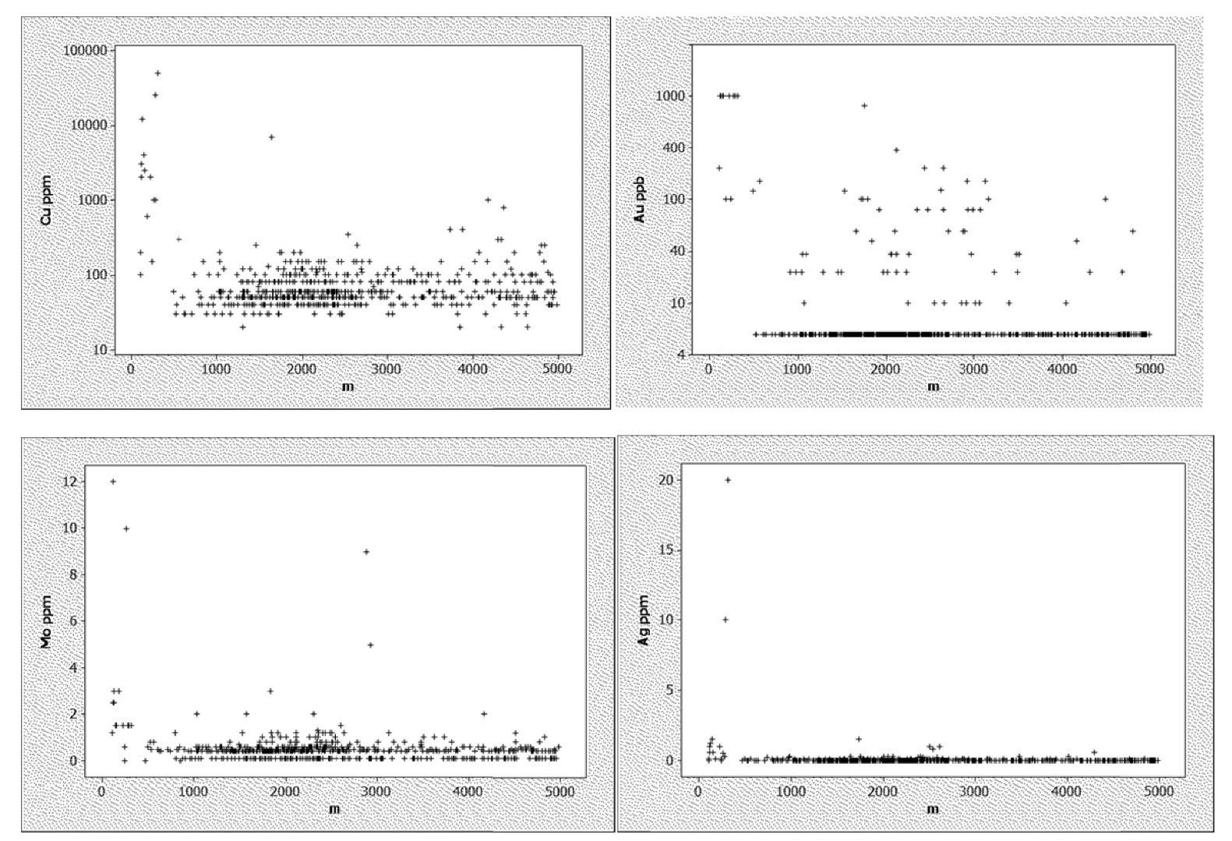
Distance from Yubileinoe centre

Slide 16
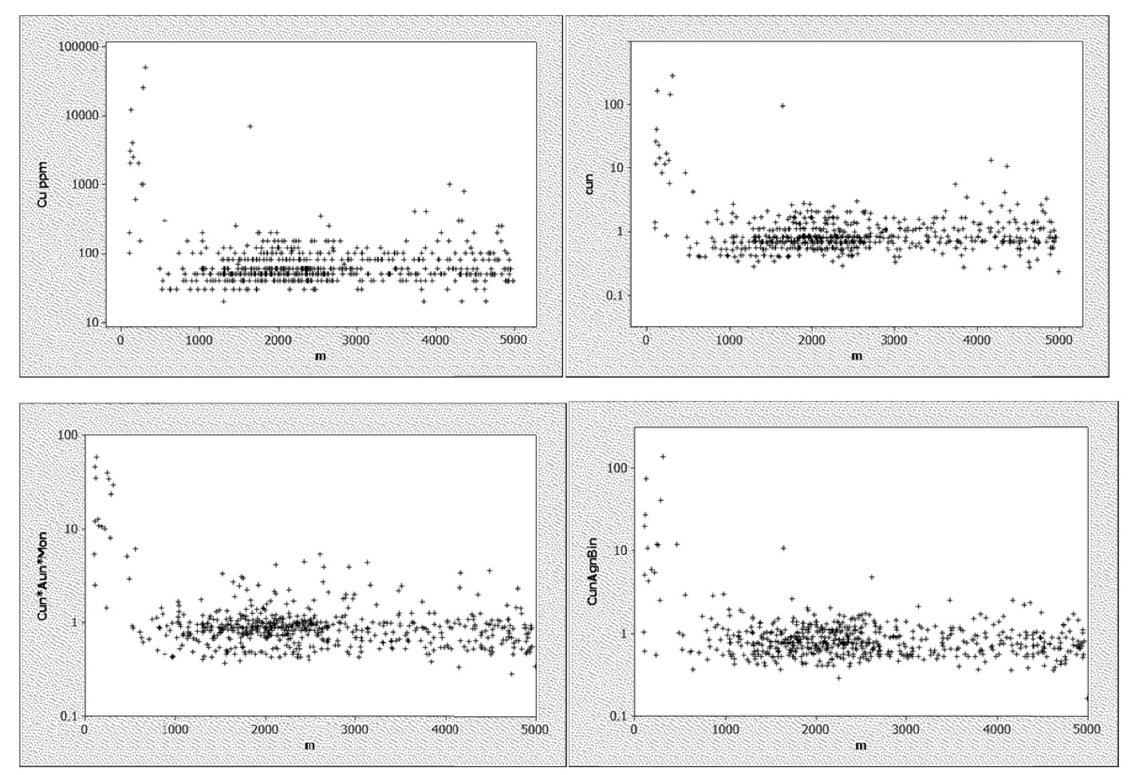
Distance from Yubileinoe centre normalised
Cu_{n}
Cu
Cu_{n} *Au_{n}*Mo_{n}
Cu_{n} *Ag_{n}*Bi_{n}

Slide 17
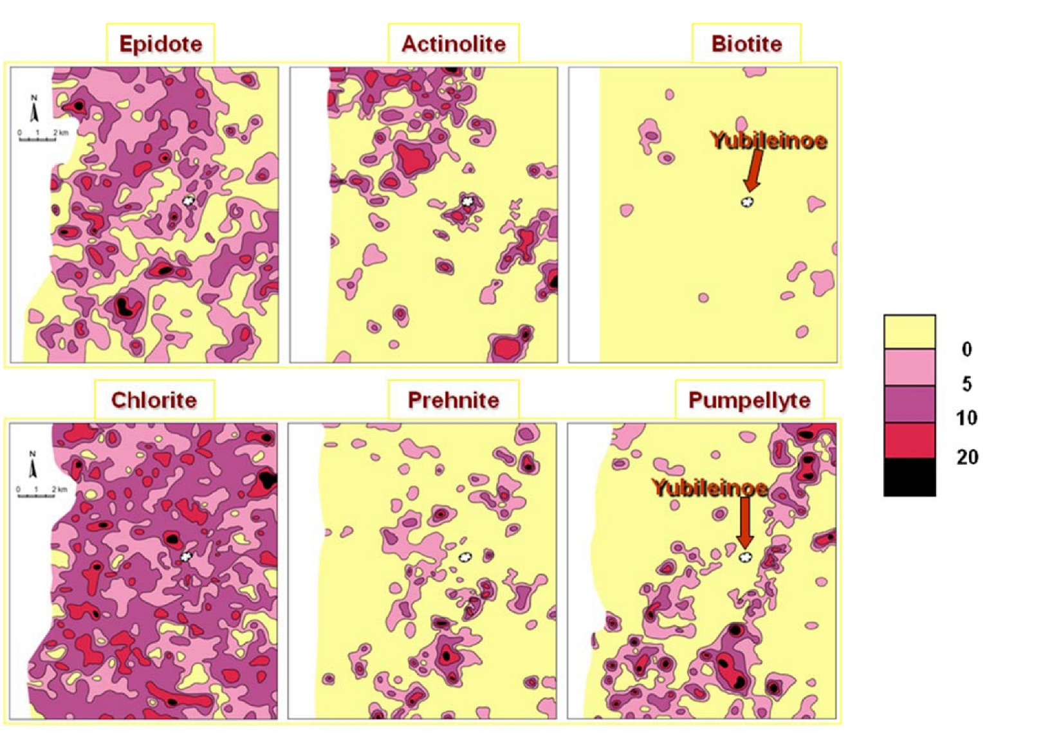
%

Slide 18
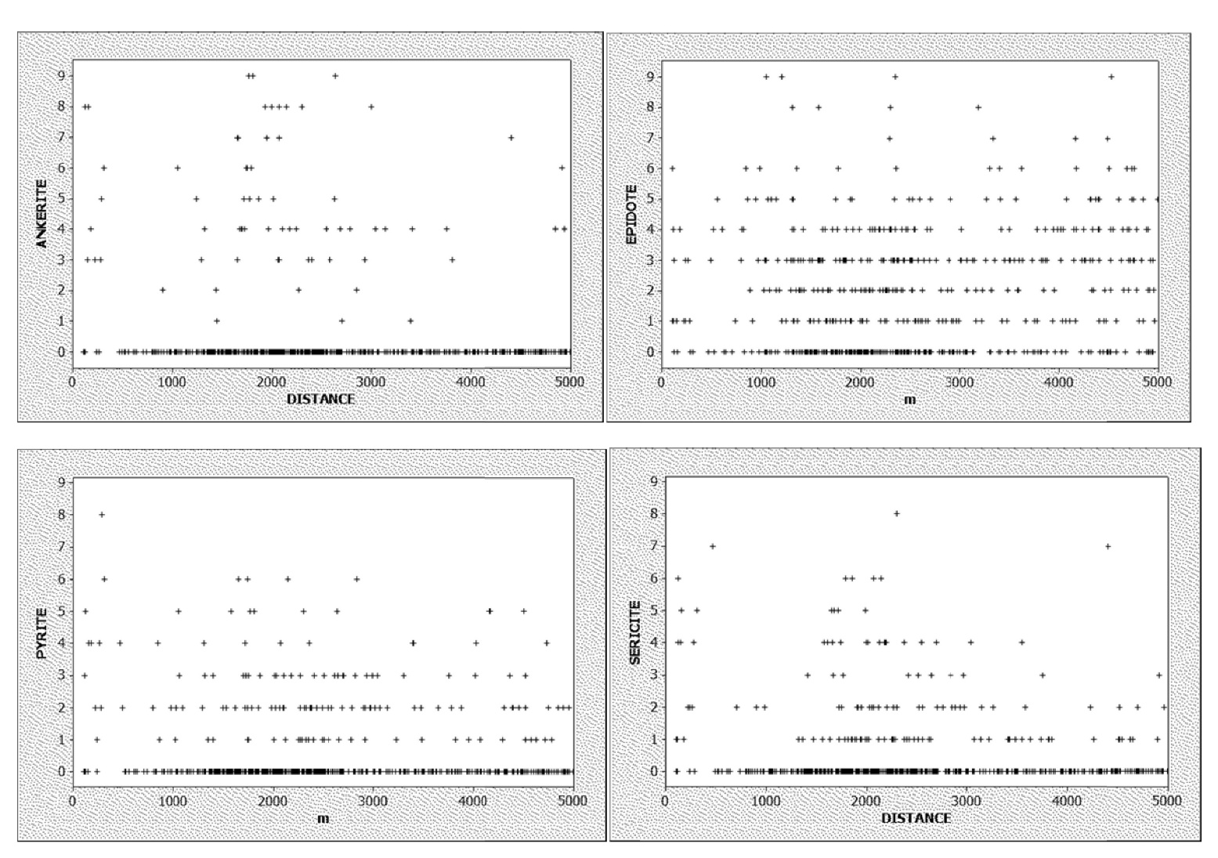
Distance from Yubileinoe centre

Slide 19
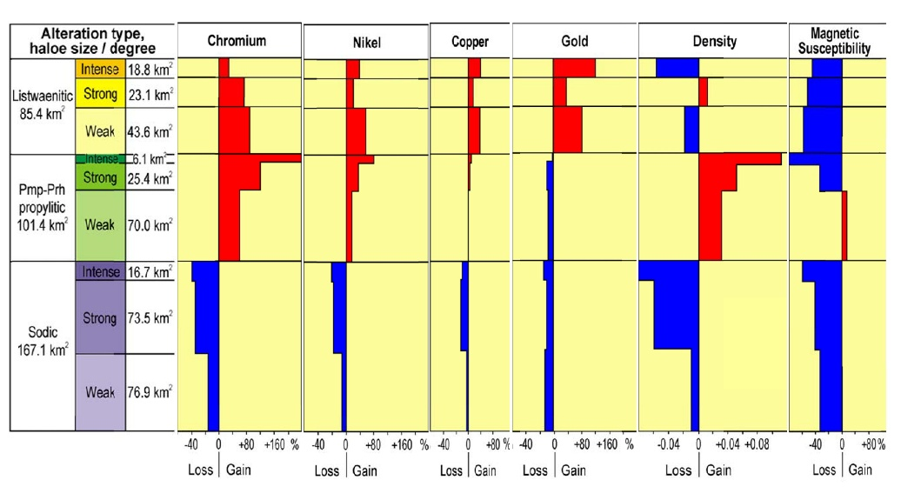
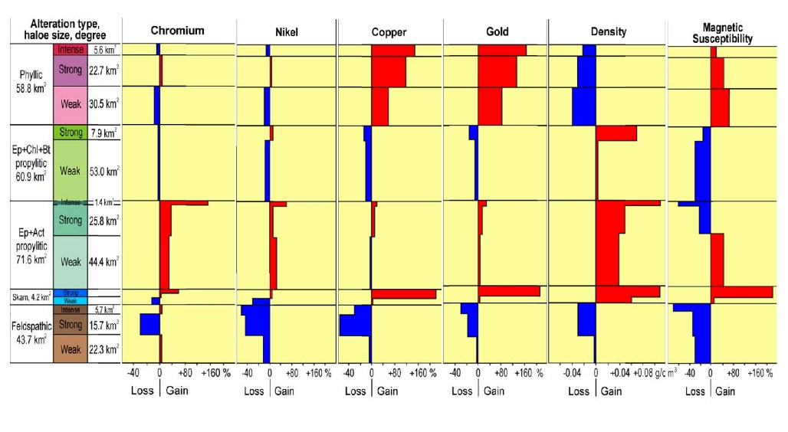

Slide 20
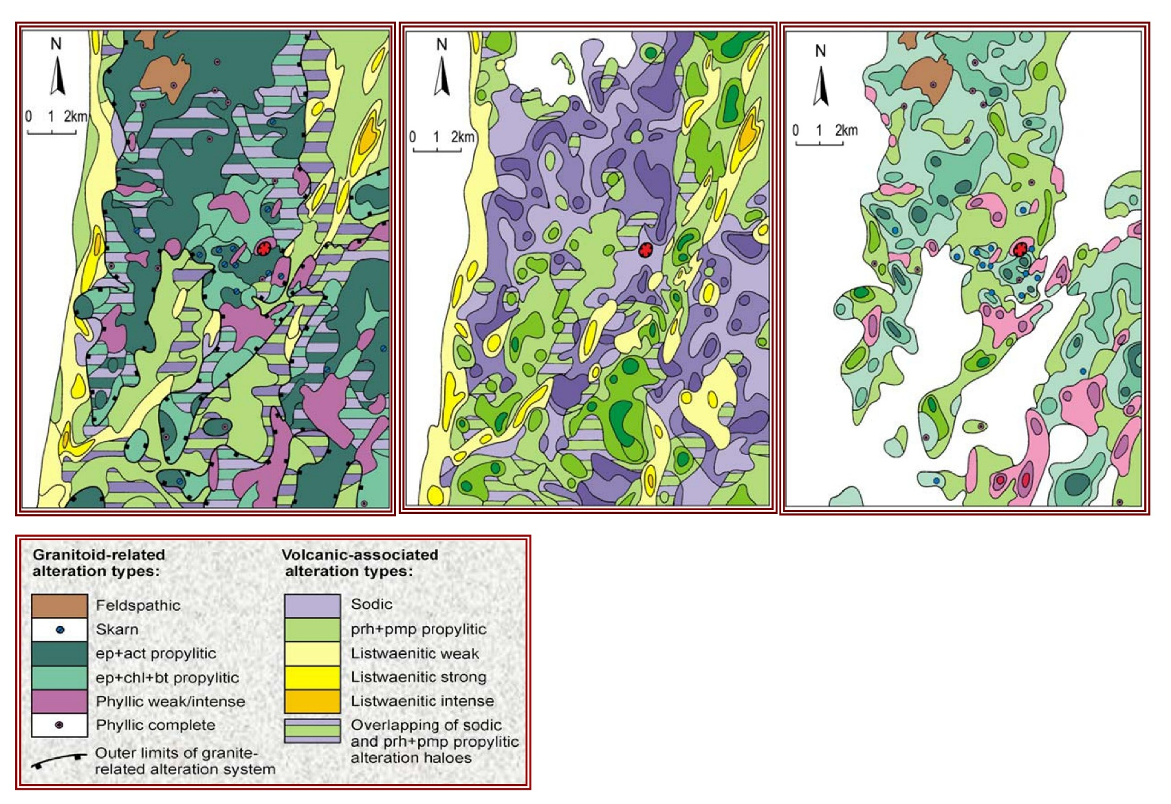
Total
Volcanic
Granitoid

Slide 21
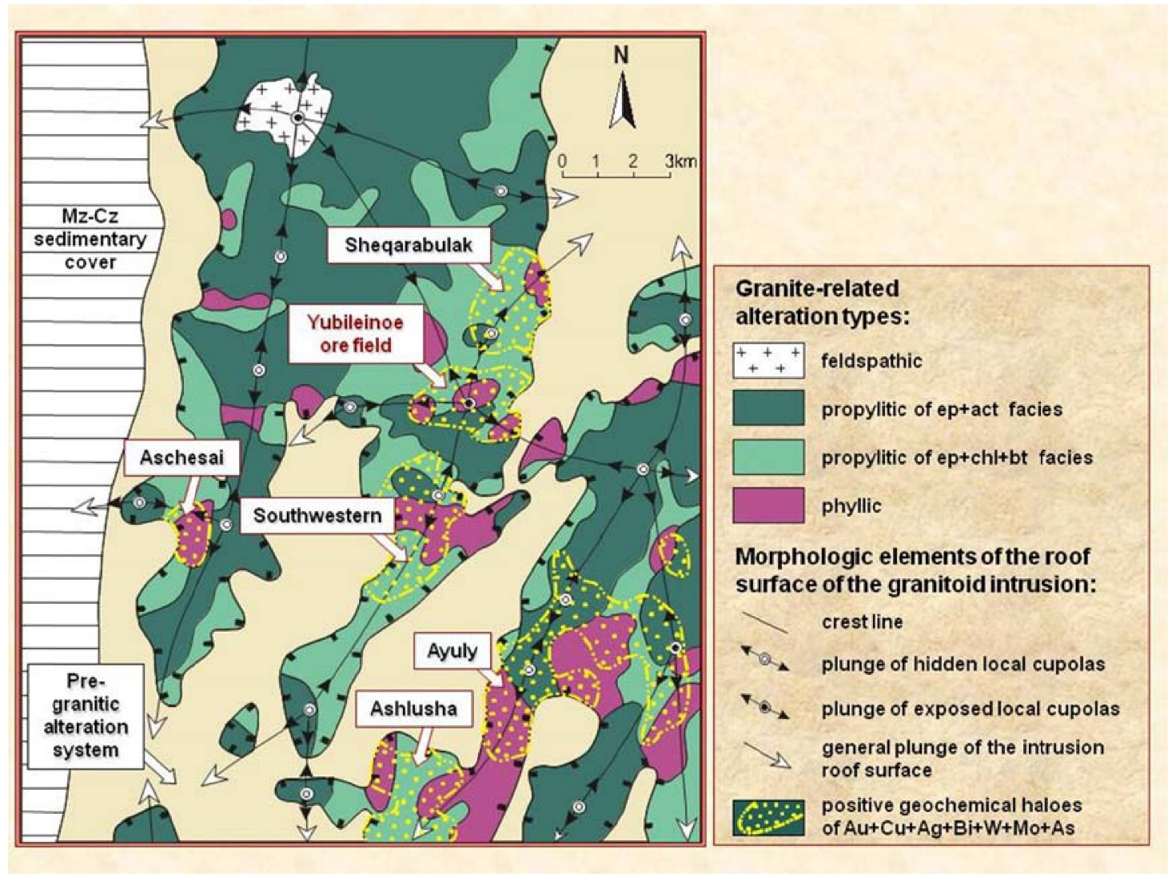

Slide 22

What has changed since 1990s?

Slide 23
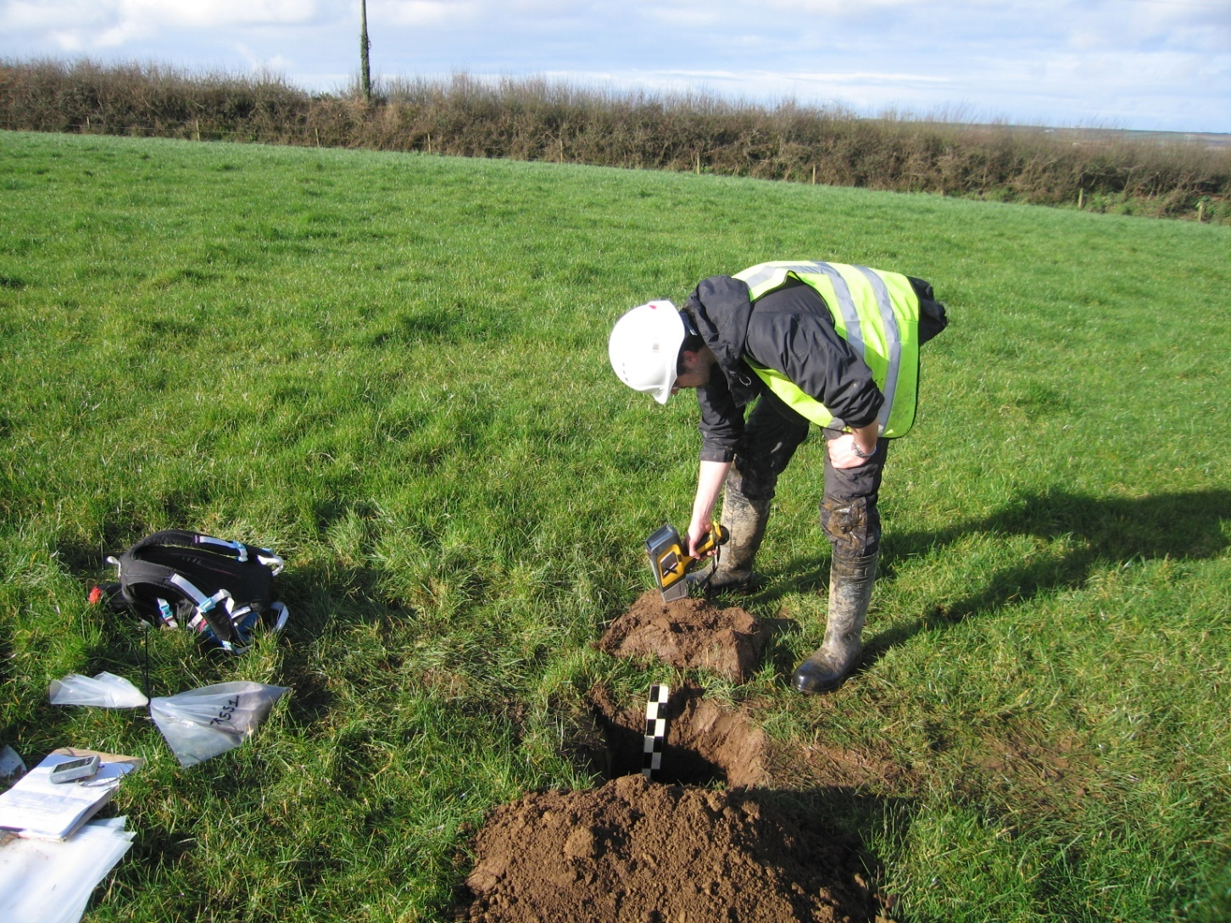
pXRF
2011 Rovaniemi demonstration

Slide 24
2020s Analytical Methods
Granites
Acme XRF and CSM ICP-MS
SiO₂ TiO₂ Al₂O₃ Fe₂O₃ MnO MgO CaO Na₂O K₂O P₂O₅ XRF beads (LOI Total)
Ba Cr Cs Cu Ga Ni Pb Rb Sc Sr Th U V Y Zn Zr. (La Sn Nb As) XRF pellets
Ce Dy Er Eu Gd Ho La Lu Nb Nd Pr Sm Sn Ta Tm W Yb Zr Ge In Li Pb Zn As Bi Sb Tl Be
4 acid (HF) digestion ICP-MS +aqua regia
Cl F KOH fusion Ion Chromatography DL 25ppm; OL 2% Loughrea ALS
B Na₂O₂ ICPMS glass free Vancouver ALS
Elvans (Dykes)
ALS majors mostly ICP-ES Li metaborate fusion, some XRF, traces fusion + 4 acid + aqua regia + F Ion Chromatography
Initial +OL Sn pXRF
Additional cost B F Cl ~50% ϵ 180
QA/QC 10%

Slide 25
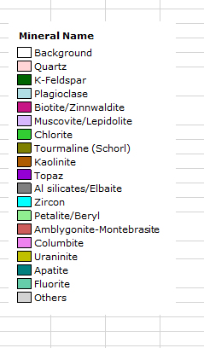
RS12 width 2cm
Volume %
Quartz | 19.875
K-Feldspar | 29.026
Plagioclase | 23.536
Biotite/Zinnwaldite | .473
Muscovite/Lepidolite | 8.296
Chlorite | 0.029
Tourmaline (Schorl) | 1.529
Kaolinite | 0.073
Topaz | 1.013
Al silicates/Elbaite | 0.237
Zircon | 0.001
Petalite/Beryl | 14.766
Amblygonite-Montebrasite | 0.001
Columbite | 0.005
Uraninite | 0.000
Apatite | 0.131
Fluorite | 0.001
Others | 0.009
Automated Mineralogy QEMSCA, MLA, LA-ICPMS

Slide 26
Critical Minerals

Slide 27
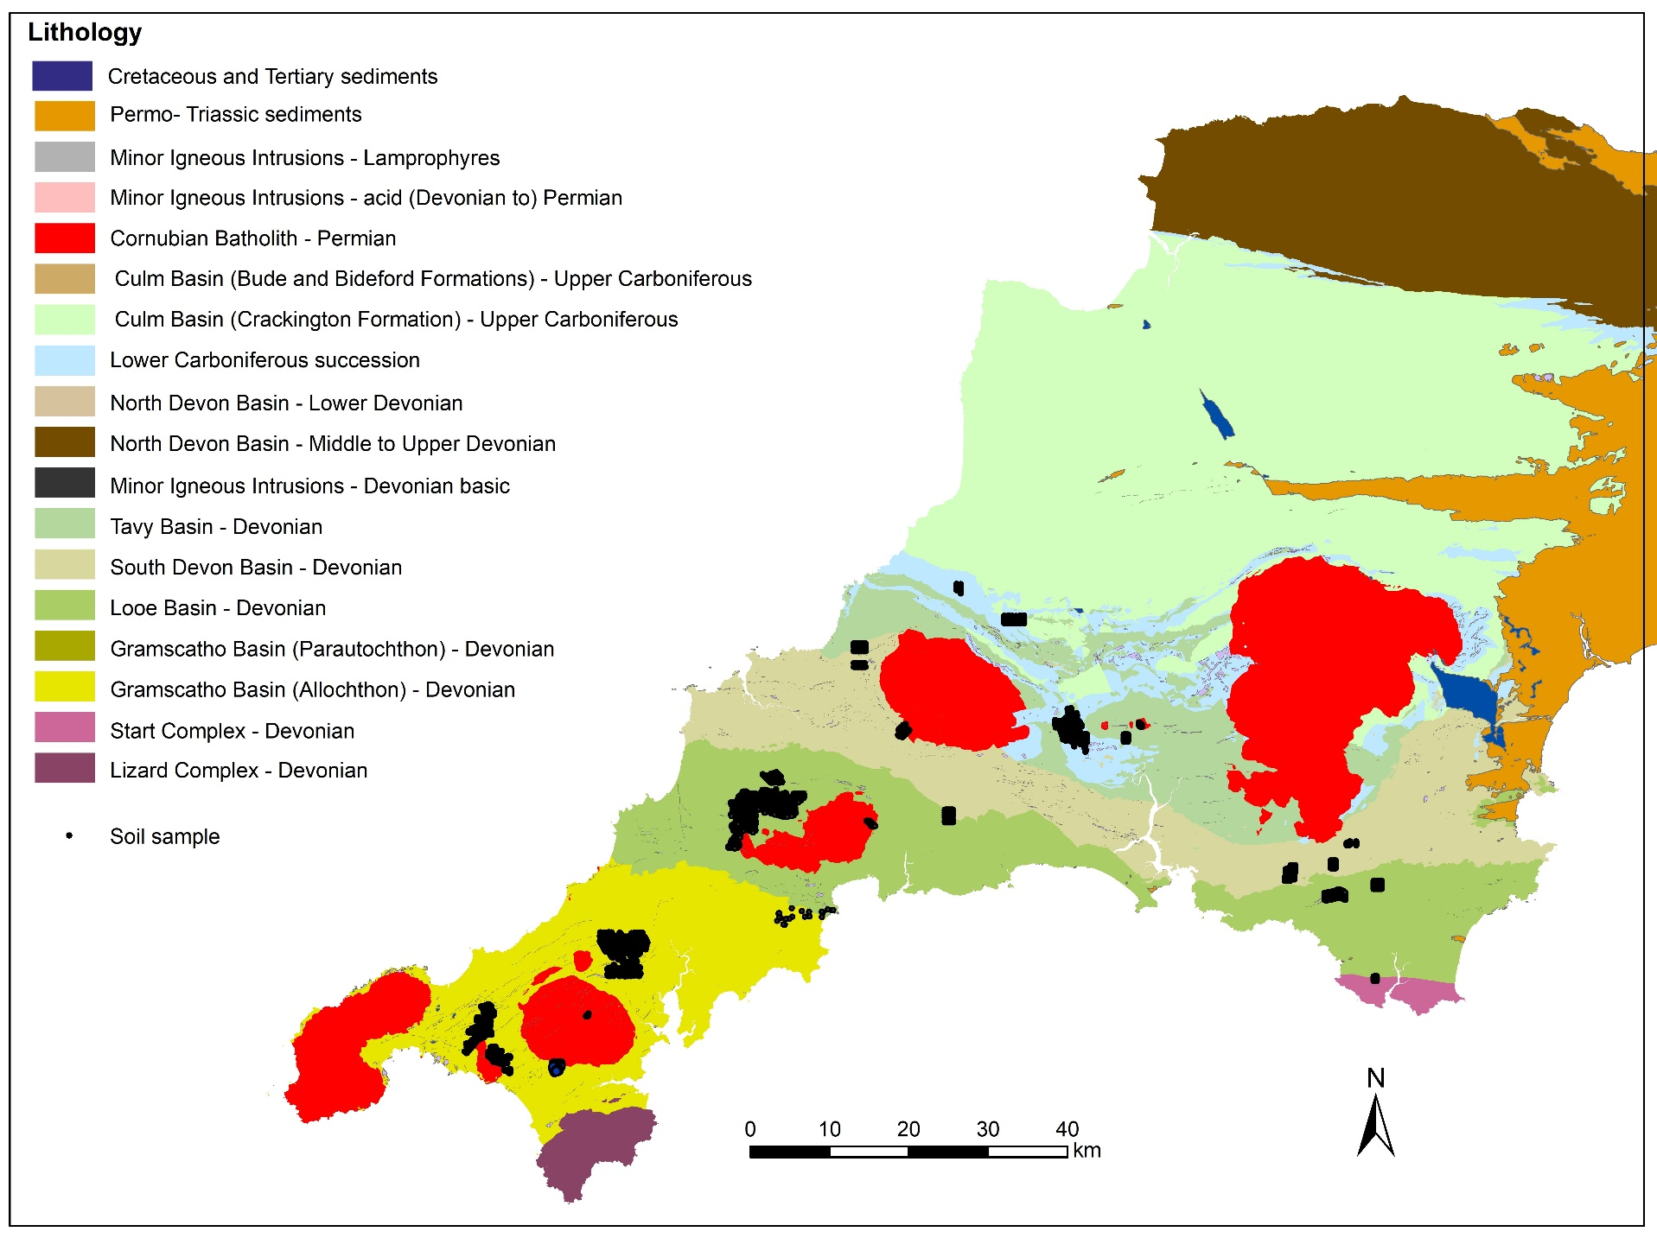

Slide 28
New Airborne Survey
Datasource: www.tellusgb.ac.uk
200m X 80 m

Slide 29
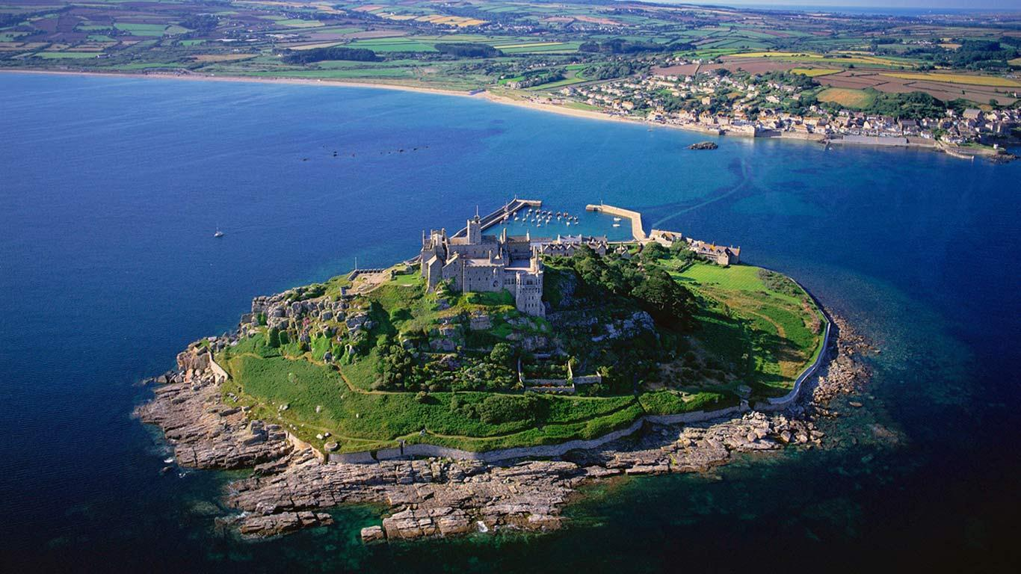
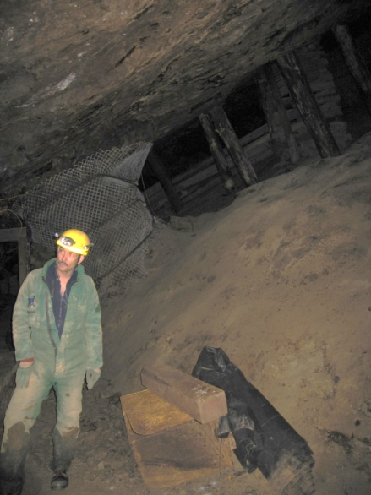
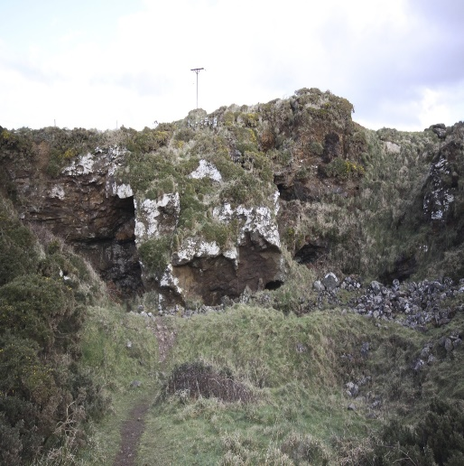
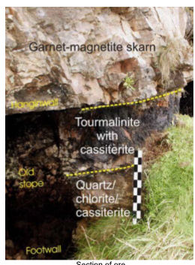
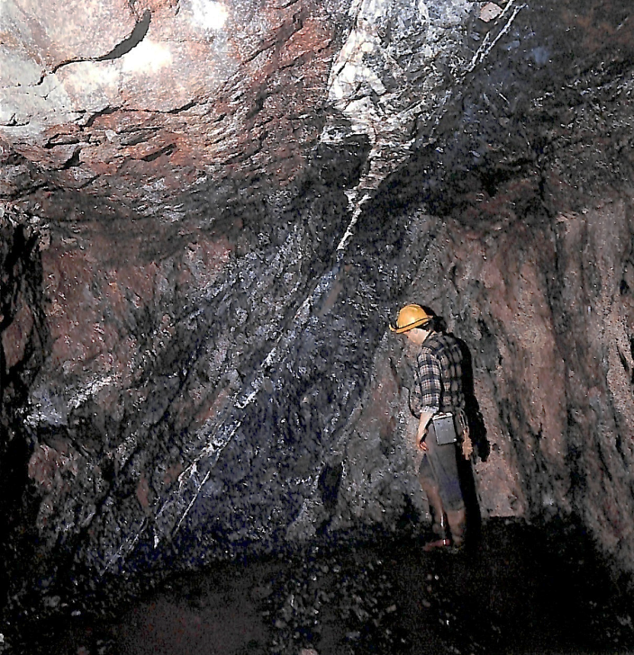
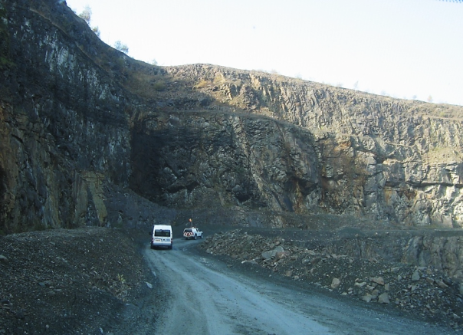
Main phase lode
Pryces Lode
Sheeted vein greisen
Tourmaline
Veins
Skarns
Roskear A lode
South Crofty
~2% Sn
Deakin et al., 1995
Crosscourses
Main Styles of Metallic Mineralisation

Slide 30
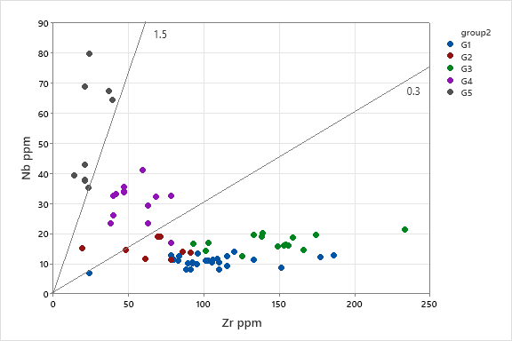
Rock Geochemistry
Manning et al., 1996
Bromley et al., 1989

Slide 31
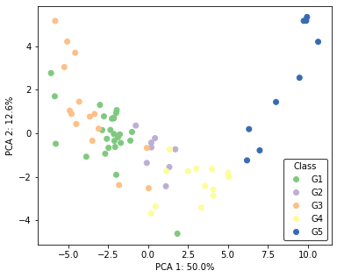
Principal components analysis (PCA)
PCA comparison shows:
  Clear geochemical evolution trend for G1-G4 granites
  Distinct G5 granite region
  Samples in Simons et al. (2016) classification requiring potential reinterpretation
NB: Meldon Aplite (G5) sample removed from these results
Distinct G5 granite
Increasingly evolved granites?

Slide 32
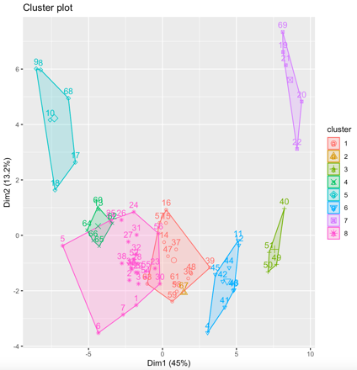
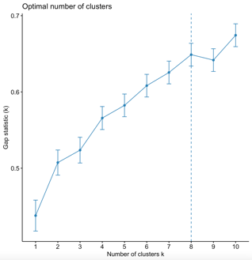
Unsupervised machine learning (k-means clustering method) on transformed data
8-cluster solution plot
8-cluster solution plot shows the detailed subdivisions of the granites by type and location quite well suggested from Gap Statistic in k-means clustering analysis
Tregonning G5 Topaz and aplites
Land’s End G3 granites
Carnmenellis and Bodmin G1 granites
G2 granites
Dartmoor G3 granites
St. Austell G5 Topaz
Scilly G1 granites
St. Austell G4 granites

Slide 33
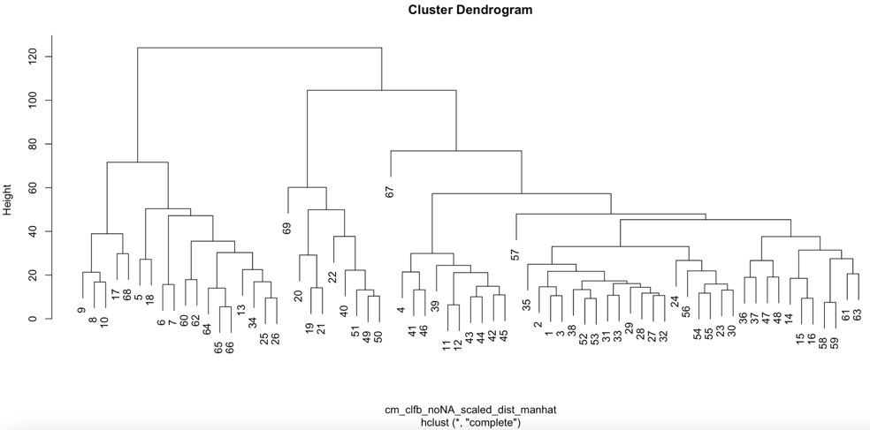
Cluster determination from hclust manhattan distances in a dendrogram
Where do interpreted G1 and G3 granite samples come from that sit in hclust method cluster 1?
(i.e., samples that may be more evolved than previously interpreted)
Distance cutoff to distinguish 3 clusters
Distance cutoff to distinguish 8 clusters
Cluster 2 = G1 & G3 granites (i.e., less evolved granites)
Cluster 1 = G2 & G4 granites, with some G1 & G3 granites (i.e., more evolved granites)
Cluster 3 = G5 granite

Slide 34
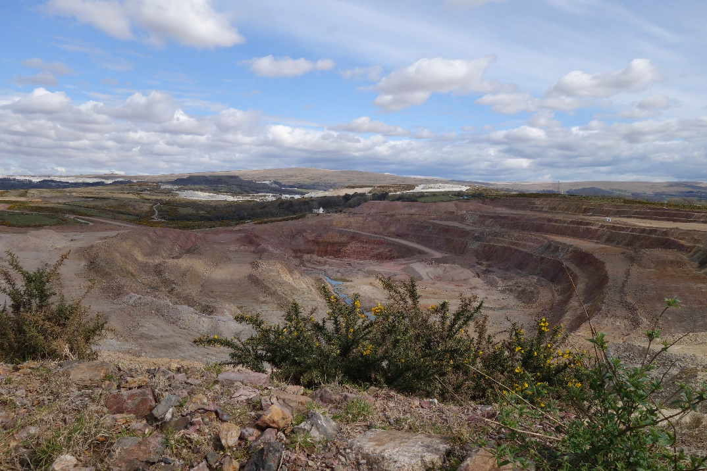
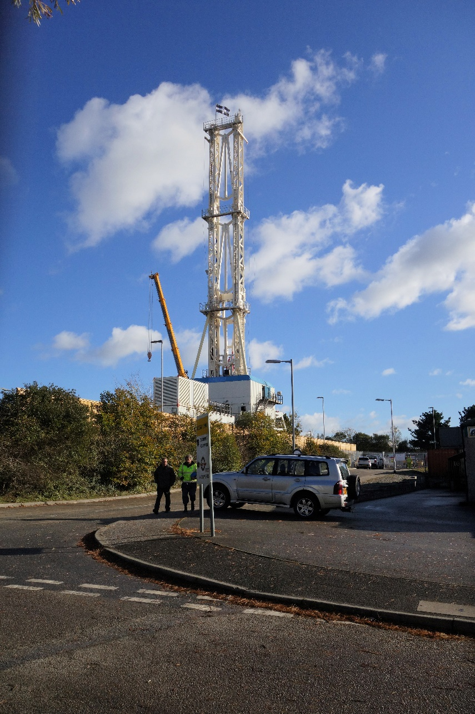
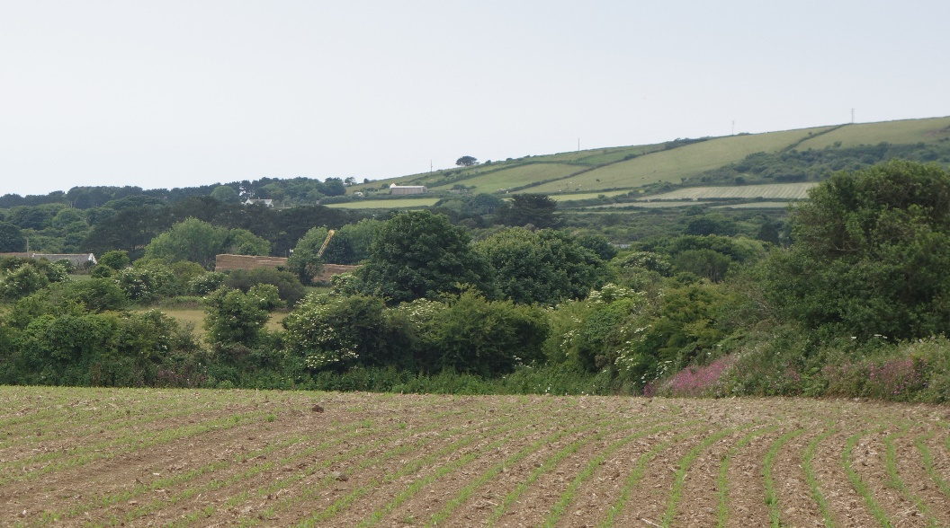
Hemerdon
Wheal Vor
Cornish Tin
United Downs

Slide 35
Conclusions from Arbavere
Moving Forward: coherent Baltics
Archive data need digitising and web release
New drilling encouraging
Thanks to organisers

Slide 36
Granite Conclusions
Multivariate methods confirm Simons et al classification with minor tweaks
Very strong correlation of F and Li-W-Ta in G4/5
G2 granites have lower but significant F
B enriched in G2, G4 (strongly) but not G5
F but not B enriched in lamprophyres
Cl depleted in early and altered granites
Sn not enriched in early granites: Sn mineralisation formed by leaching by Cl from micas or rutile by hydrothermal fluid Or concentrated in elvans then leached by greisenisation (Cl). Weak Sn in G5
F, B and lesser extent Cl aid in granite classification

Slide 37
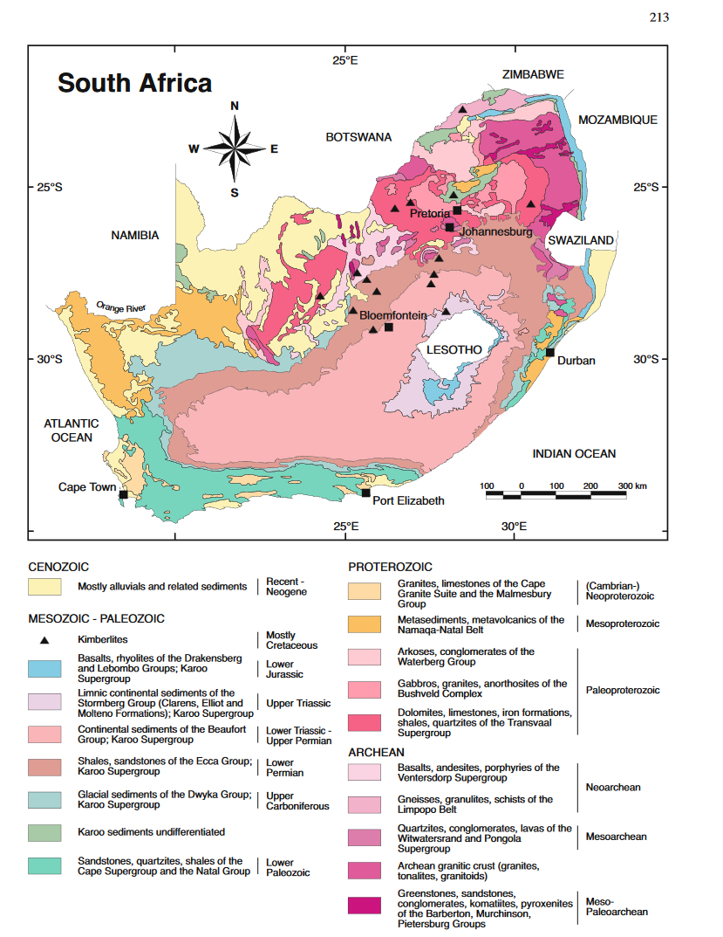
South Africa
Schlüter 2006

Slide 38
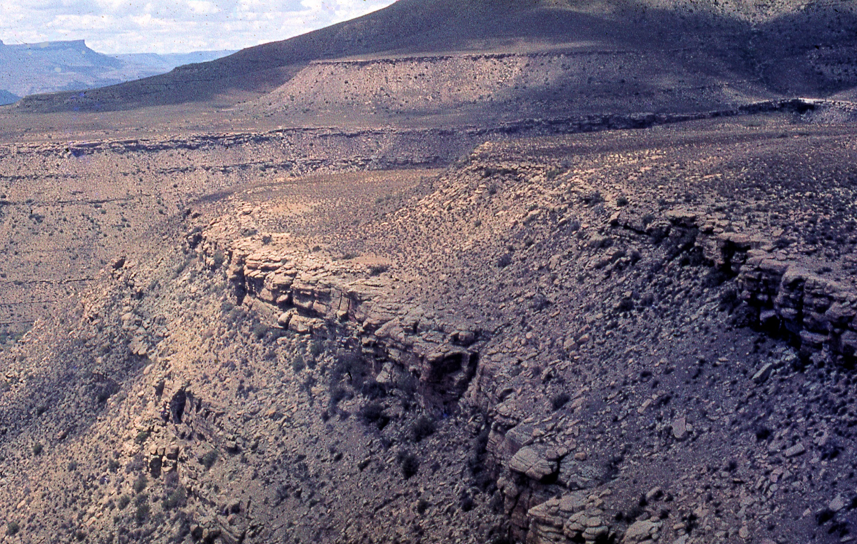
Rondom

Slide 39
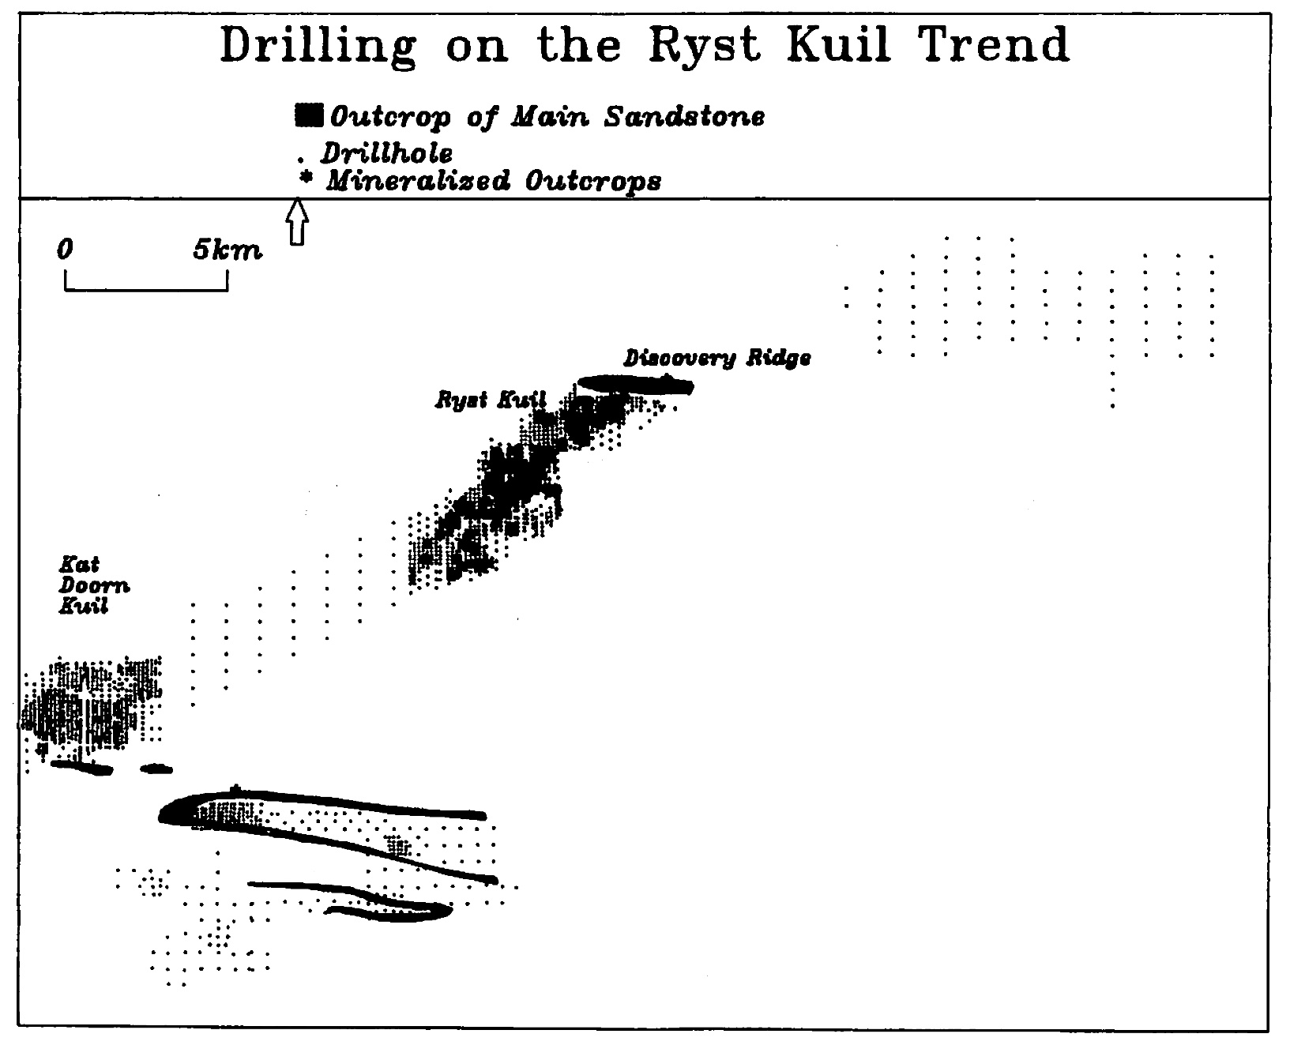
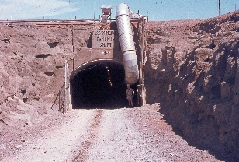
Resource 10.9 Mt at 0.104 % U₃O₈ at 80-130 $/kg
25 m centres 100-200 m depth, percussion
400 m centres to define geology
Esso Minerals ~860,000 m drilling, R20.6 M

Slide 40
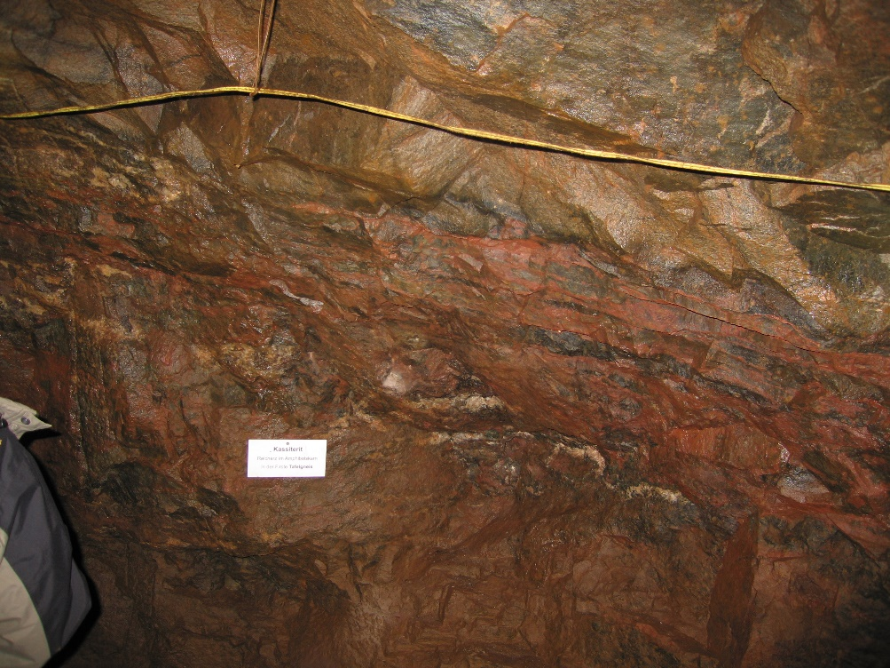
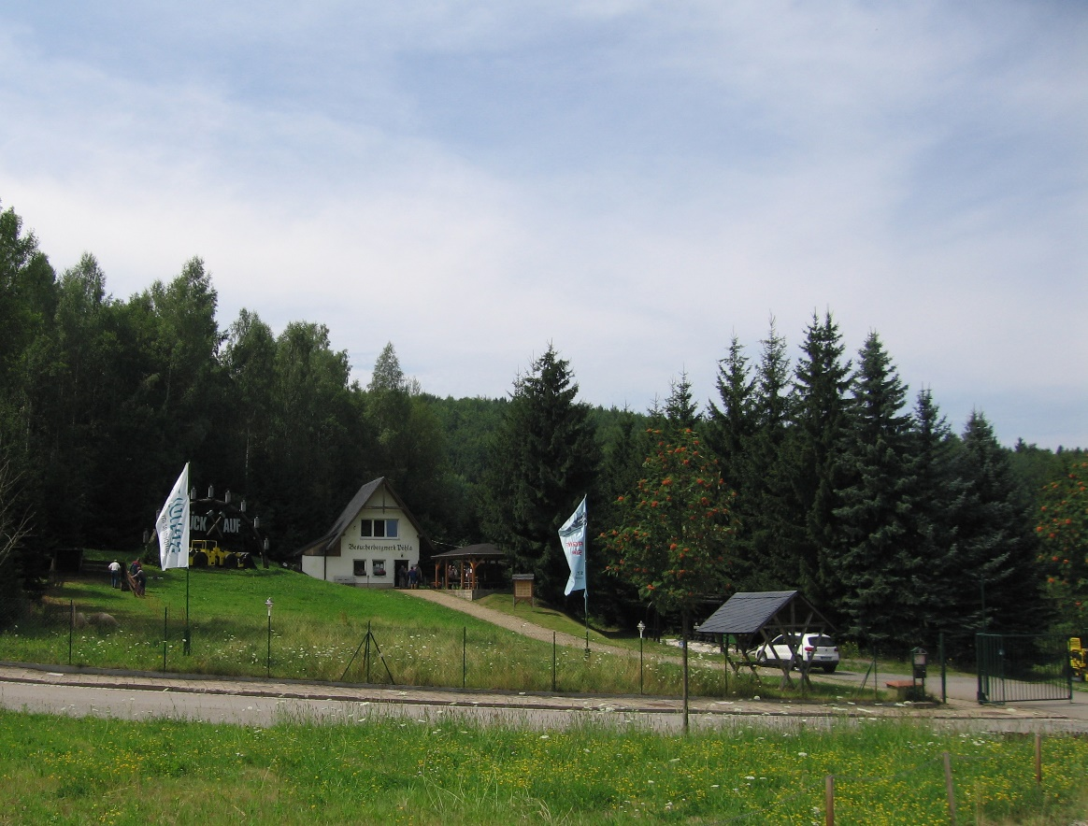
Pöhla
Erzgebirge
First Tin plc

Slide 41
Composite soils, Sn ppm, wdXRF and pXRF, 5360 samples

Slide 42

Treliver Minerals (2013-5 drilling)
Dh
Fault

