Slide 1

Estonian National Geological Exploration Programme for Critical Raw Materials
Tiit Kaasik | Head of Department | Department of Mineral Resources
27.05.2026

Slide 2
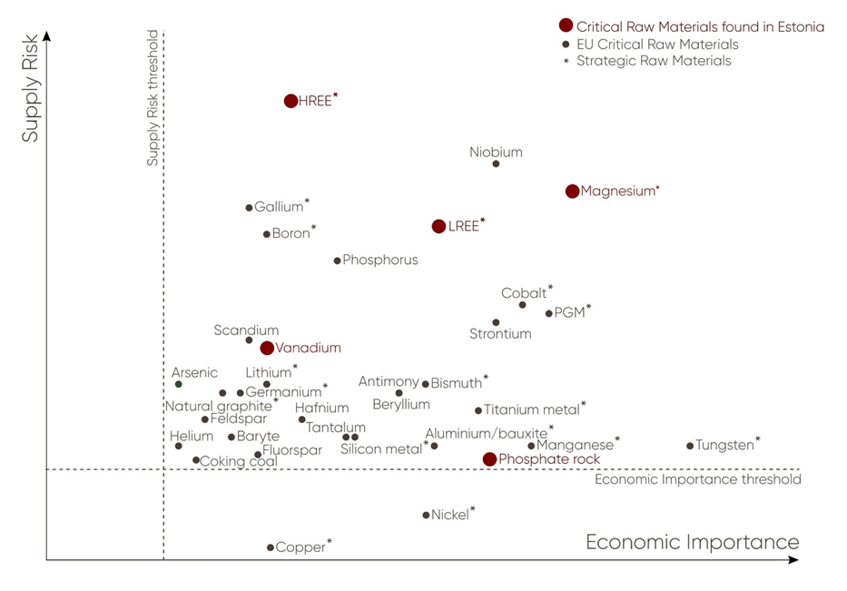
Estonian National Geological Exploration Programme for Critical Raw Materials
The programme was prepared by EGT and submitted to the Ministry of Climate in May 2025.
Programme was approved by the Minister of Energy and the Environment on 25.07.2025.
The programme consists of an overview of existing knowledge, the programme’s focus, the action plan, implementation arrangements, and the logic for updating the programme.

Slide 3
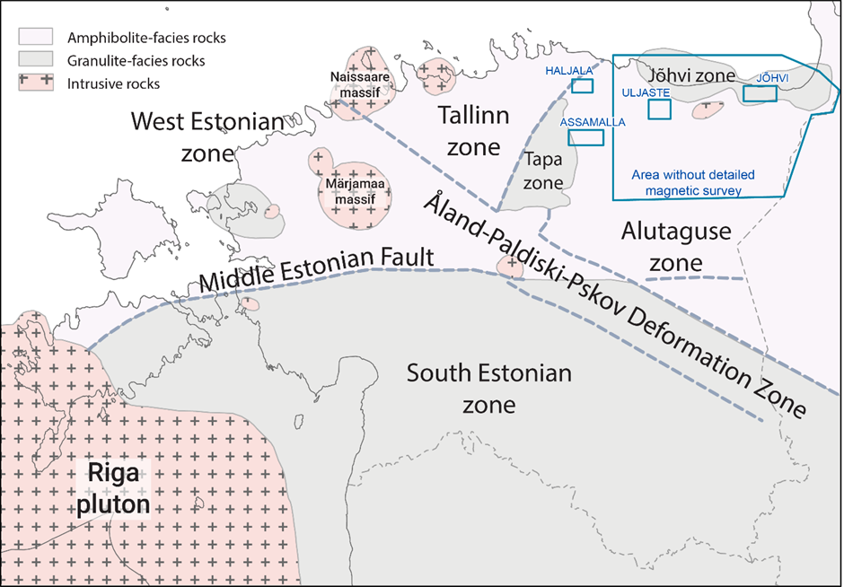
Programme Objectives, Perspective and Focus
The programme focuses on the crystalline basement and mineral resources that are considered prospective within the Fennoscandian mineralisation provinces extending into the Estonian basement.
The objective of the programme is to identify mineralisation zones and structures containing critical raw materials with economic potential and, where possible, to identify occurrences of critical raw materials in locations showing such potential.
The programme has been prepared with a perspective extending to 2040, while a more detailed action plan is presented for the first five years, up to 2030.

Slide 4
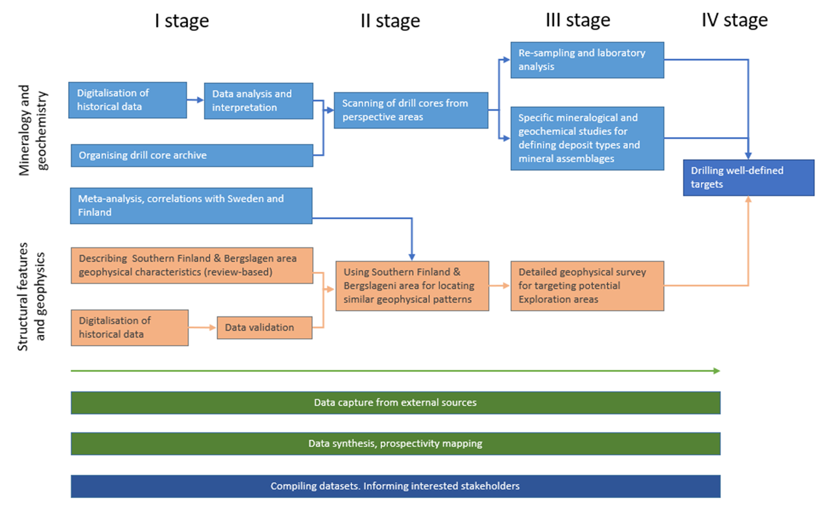
Implementation
  The implementation of the programme is coordinated by the Ministry of Climate.
  The main executor of the programme activities is the Geological Survey of Estonia, which will involve Estonian universities and cooperation partners with the necessary expertise.
  The programme will be reviewed and updated, if necessary, every five years.
  At present, no funding has been allocated for the implementation of the programme. The estimated cost of the programme activities for the first five years is EUR 9.8 million.

Slide 5
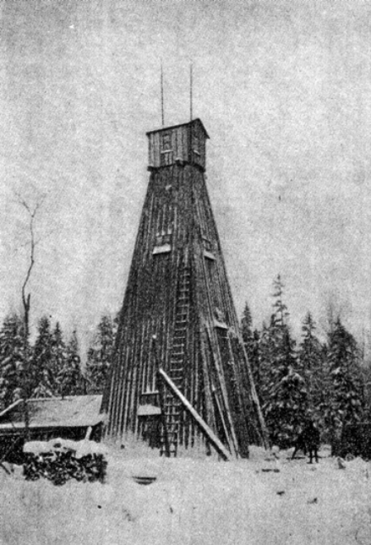
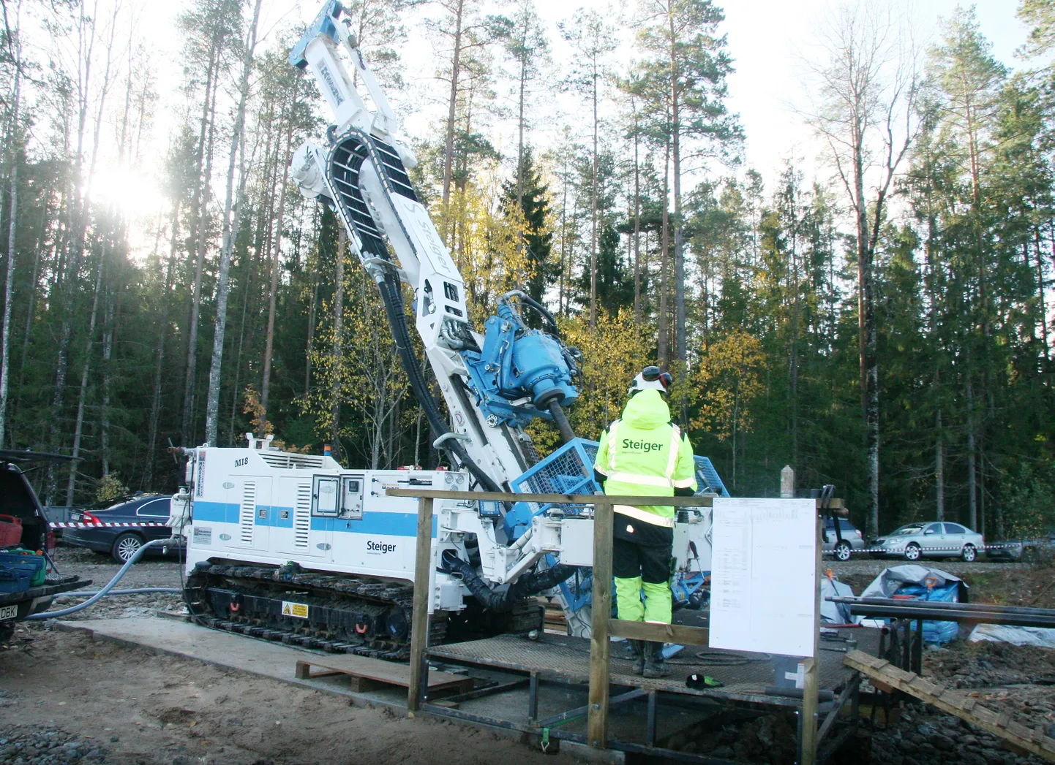
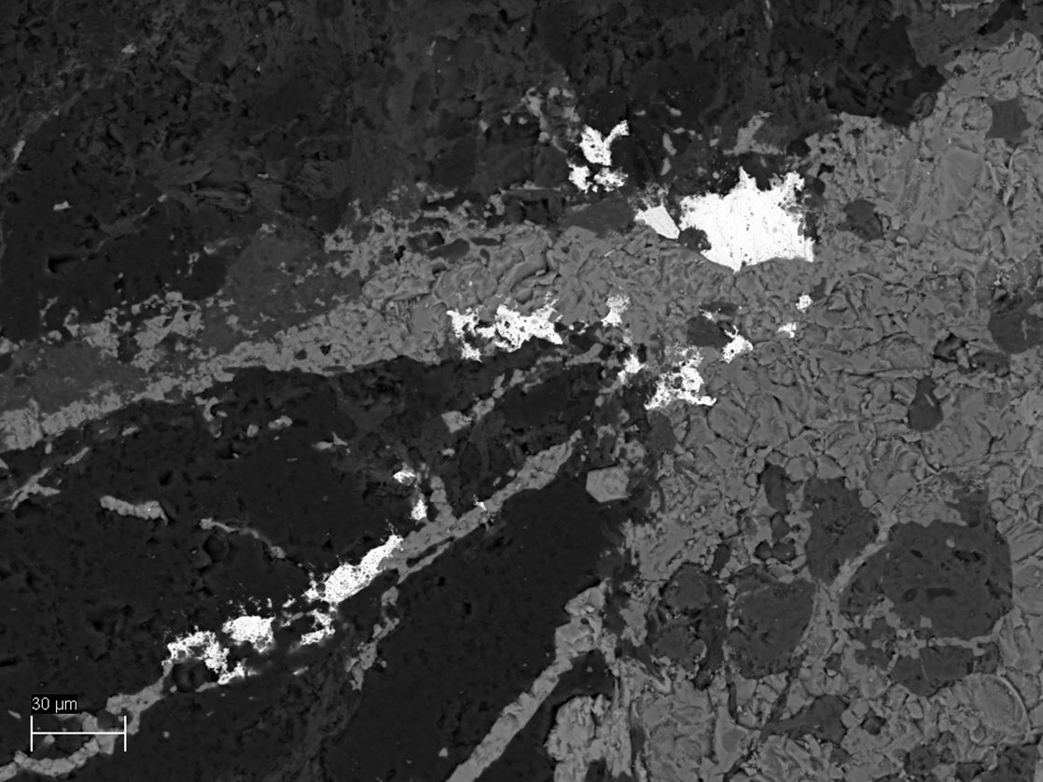
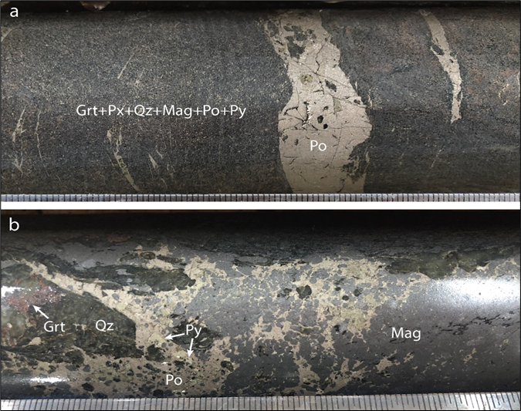
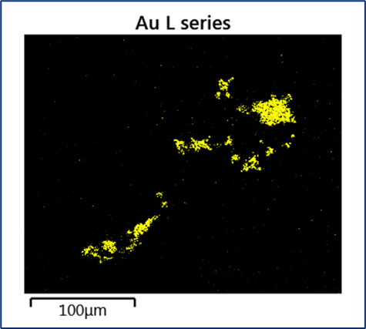
Implementation
  There has been a 30-year pause in research of cristalline basement.
  The Geological Survey of Estonia initiated investigations of the Jõhvi magnetic anomaly.
  Activities have included the core scanning R&D project, DEXPLORE, data organisation and database development, etc.
  Efforts are ongoing to secure funding, although competition is intense.
  18.05.2026 806000 EUR funding was granted for exploration in the Uljaste-Sonda area.
  Achieving the objectives of the programme requires more stable and reliable funding.

Slide 6
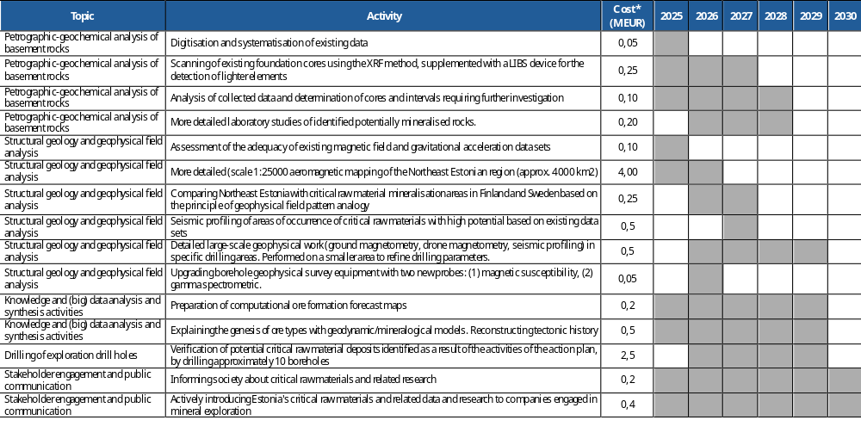
Implementation

Slide 7
Thank you!
Tiit Kaasik
Head of Department / Department of Mineral Resources
E-mail: tiit.kaasik@egt.ee

