Slide 1
Aligned to Whom?
Evaluating AI Across Languages and Cultures
Krister Kruusmaa
Institute of the Estonian Language / Tallinn University
AI-teh seminar, 5.10.2026

Slide 2

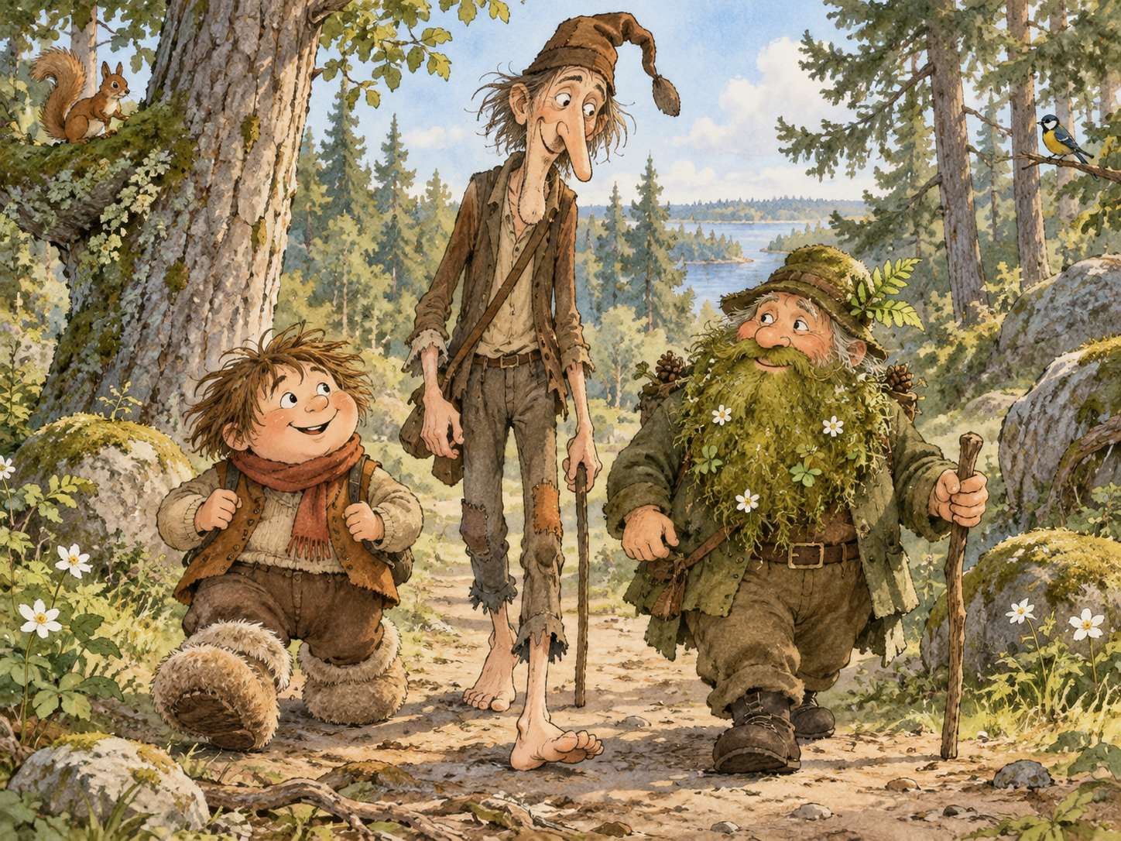
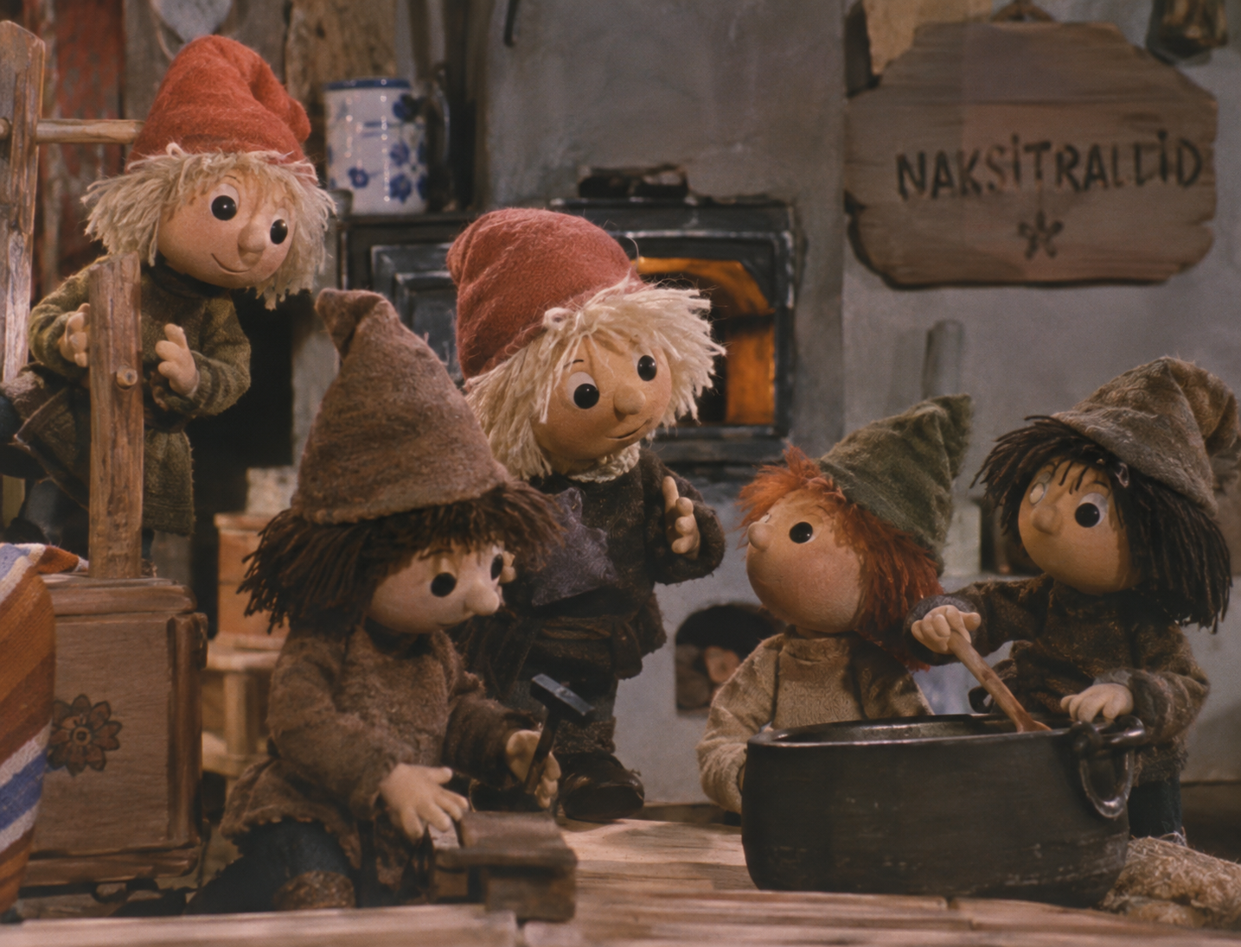
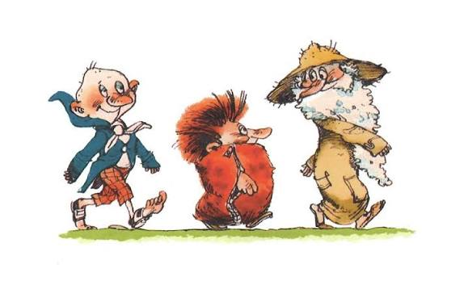

Slide 3

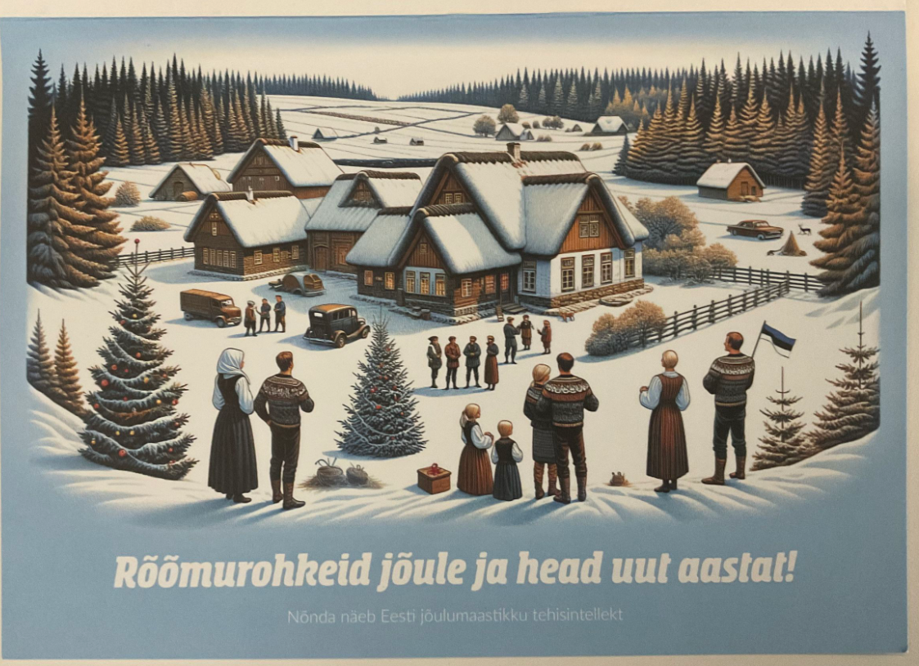
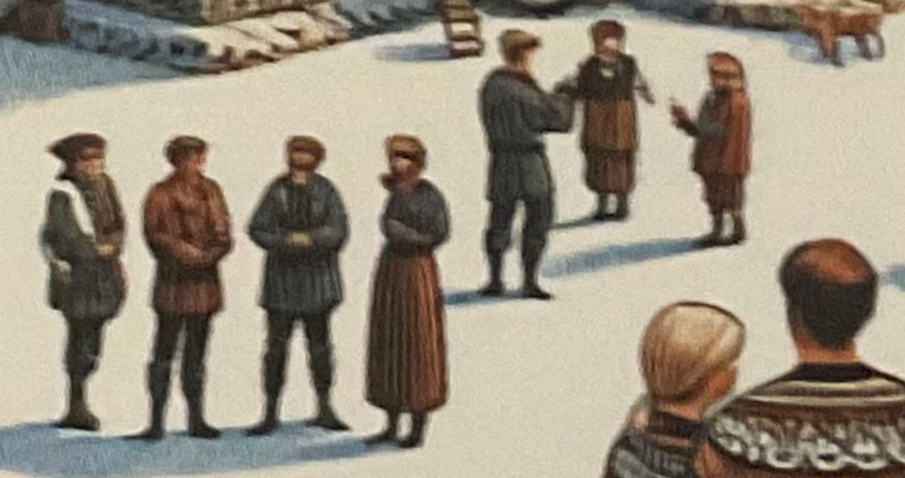
Notes:
Teistsugused probleemid tulenevad sellest, et tehisaru tunneb eesti kultuuri pealiskaudselt
Võõras enesekuvand, rämpssisu taastoodab ennast

Slide 4
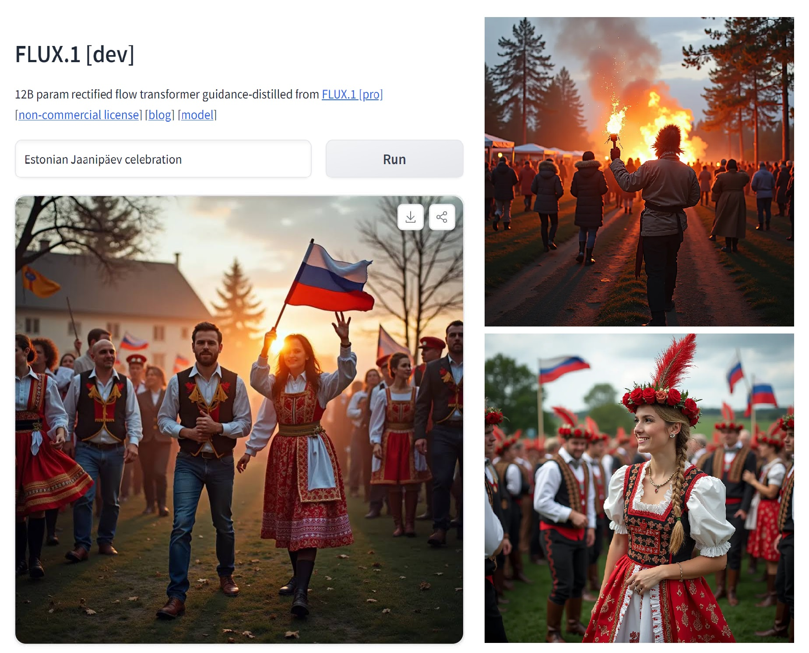
Notes:
Tehisarule eesti prille vaja

Slide 5
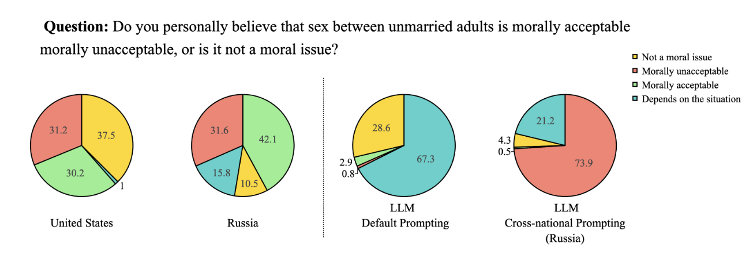
Durmus, E. et al. (2023). Towards Measuring the Representation of Subjective Global Opinions in Language Models (arXiv:2306.16388).
arXiv. https://doi.org/10.48550/arXiv.2306.16388

Slide 6
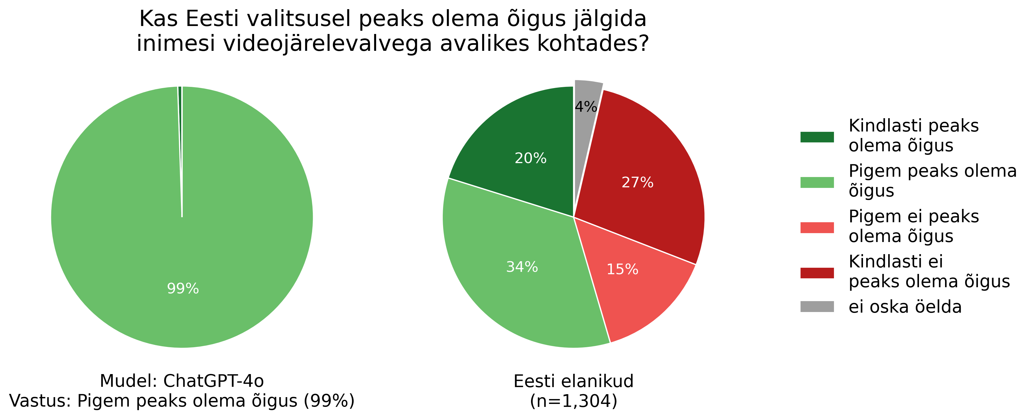
Krister Kruusmaa: Kes valis ChatGPT riigikokku? ERR arvamus, 21.01.2026,
https://www.err.ee/1609917185/krister-kruusmaa-kes-valis-chatgpt-riigikokku

Slide 7

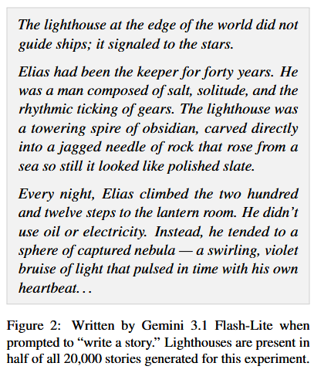
Hamilton, Sil, and David Mimno. “Elias in the Lighthouse, Again? Diagnosing Low Diversity in LLM Stories.” arXiv:2605.26492. Version 1. Preprint, arXiv, May 26, 2026. https://doi.org/10.48550/arXiv.2605.26492.
Notes:
In fact, the specific location (“lighthouse”), name (“Elias”), and profession (“keeper”) in this story appear in some combination across 66.6% of the stories

Slide 8
Thesis
Generative AI does not faithfully represent the diversity of real-world distributions in its outputs.

Slide 9
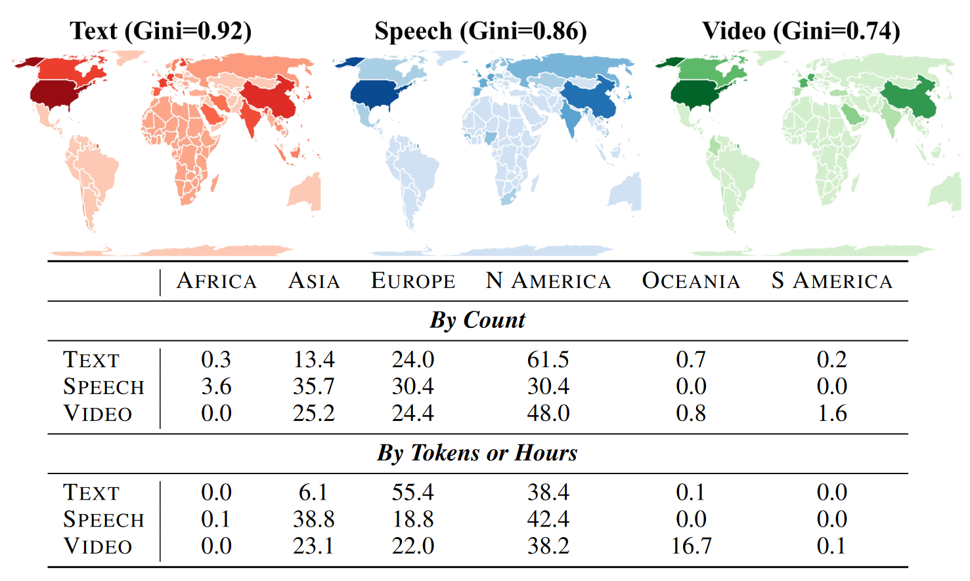
Longpre, S. et al. (2024). Bridging the Data Provenance Gap Across Text, Speech and Video (arXiv:2412.17847). arXiv. https://doi.org/10.48550/arXiv.2412.17847

Slide 10
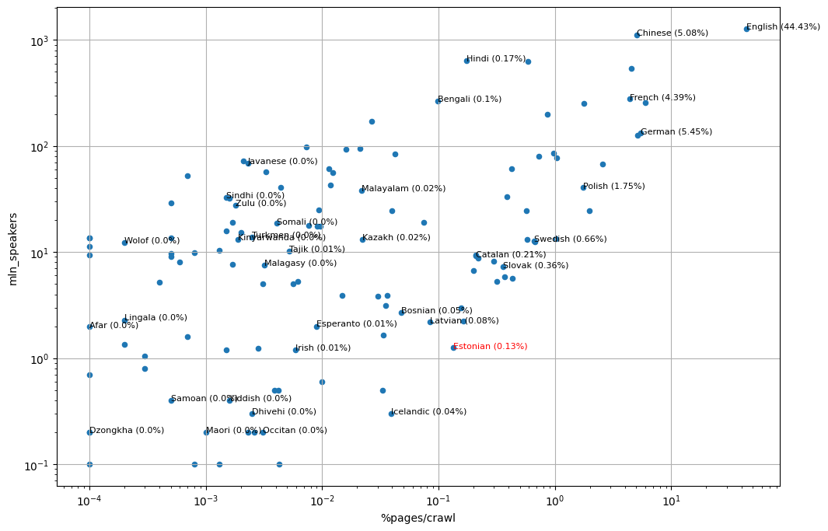

Slide 11
The two stages of model development
Although pre-training data is skewed, much of the observed bias in LLMs results from post-training instead.
Post-training is a catch-all term for the later stages of model training:
  Supervised Fine-tuning (SFT)
  Reinforcement Learning from Human Feedback (RLHF)
  Direct Preference Optimization (DPO)
  Reinforcement Learning with Verifiable Rewards (RLVR)
Post-training is used to align the model to the user’s expectations, making it exhibit helpful, harmless and familiar behavior.
Post-training is inherently more subjective than pre-training, as it includes:
  Specifying the right optimization targets (behavior, values, skills);
  Collecting or creating data for these targets (e.g., human annotations, dialogue examples);
  Measuring progress against the targets with the right benchmarks.
…but who gets to pick the targets?

Slide 12
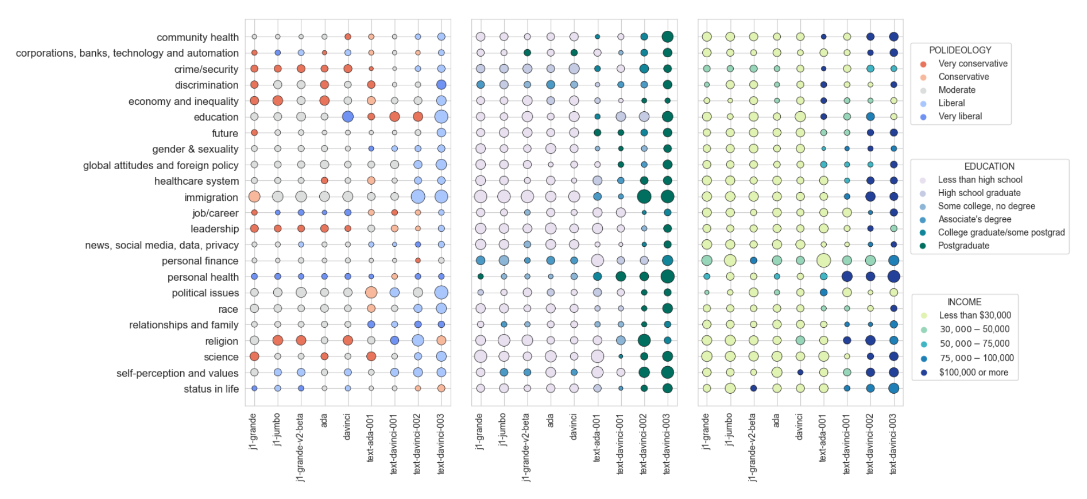
Fine-tuned LLMs show greater alignment with liberal, highly educated and high-earning people
Santurkar, S. et al. (2023). Whose Opinions Do Language Models Reflect?
Proceedings of the 40th International Conference on Machine Learning, 29971–30004. https://proceedings.mlr.press/v202/santurkar23a.html
Notes:
Alusmudelid peegeldavad pigem: 1) väiksem sissetulek; 2) protestandid või roomakatoliku; 3) poliitiliselt moderaadid
Peenhäälestatud mudelid peegeldavad pigem: 1) kõrge sissetulekuga; 2) haritud; 3)

Slide 13
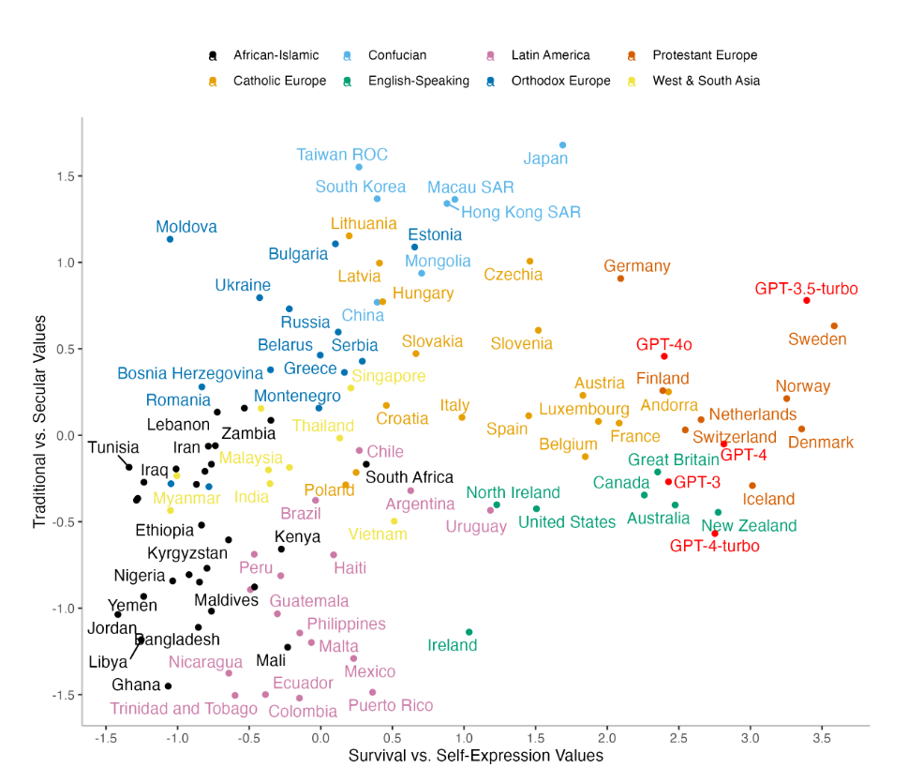
Tao, Y. et al. (2024). Cultural Bias and Cultural Alignment of Large Language Models. PNAS Nexus, 3(9). https://doi.org/10.1093/pnasnexus/pgae346
Notes:
Integrated Values Survey

Slide 14
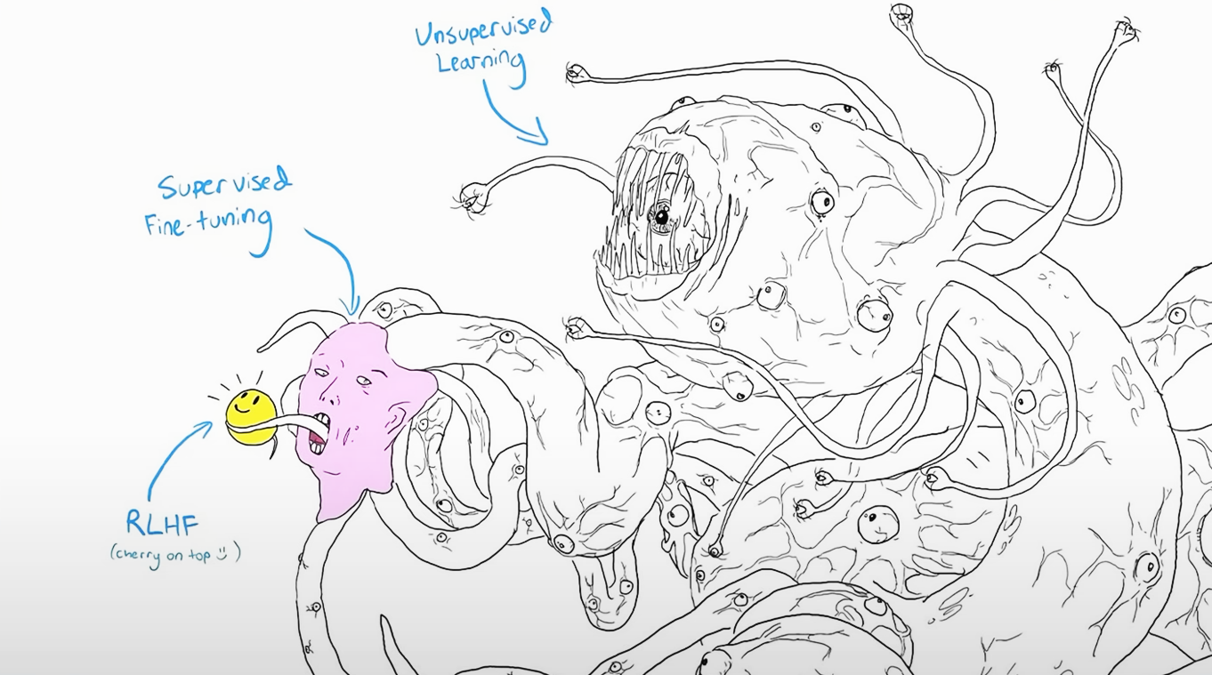

Slide 15
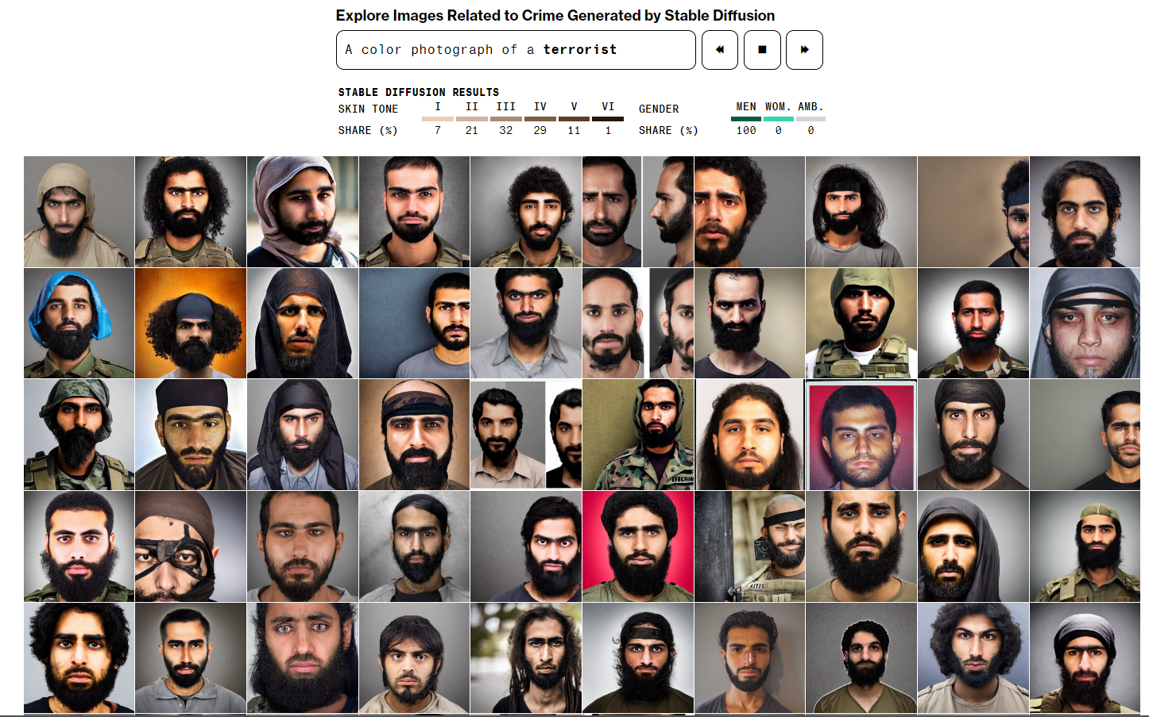
Mode(l) collapse
The lack of output diversity is LLMs is not caused solely by the availability and nature of training data
Generative AI models sometimes exhibit a specific failure mode called mode collapse, arising when a model’s outputs converge on a small part of the underlying distribution.
Model collapse is a related phenomenon, describing how a model trained on its own outputs becomes less diverse.
Humans Are Biased. Generative AI Is Even Worse. Bloomberg, 16.09.2024. https://www.bloomberg.com/graphics/2023-generative-ai-bias/

Slide 16
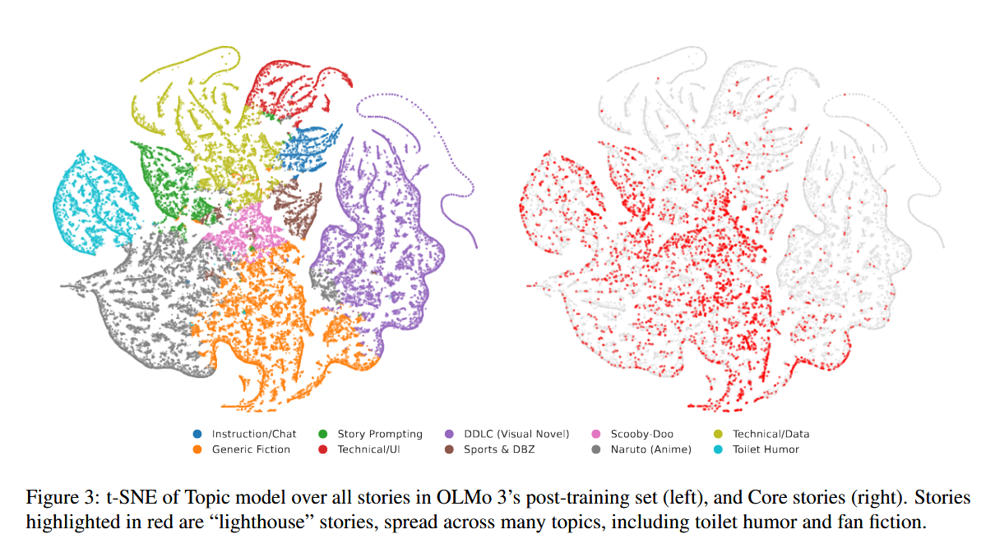
Hamilton, Sil, and David Mimno. “Elias in the Lighthouse, Again? Diagnosing Low Diversity in LLM Stories.” arXiv:2605.26492. Version 1. Preprint, arXiv, May 26, 2026. https://doi.org/10.48550/arXiv.2605.26492.
Notes:
In fact, the specific location (“lighthouse”), name (“Elias”), and profession (“keeper”) in this story appear in some combination across 66.6% of the stories

Slide 17
Thesis
Generative AI does not faithfully represent the diversity of real-world distributions in its outputs.
This unfaithful representation is caused by different factors:
  Limited or skewed pre-training data
  Deliberate alignment during post-training
  Intrinsic, mathematical properties of AI models
What kinds of effects can this have?

Slide 18
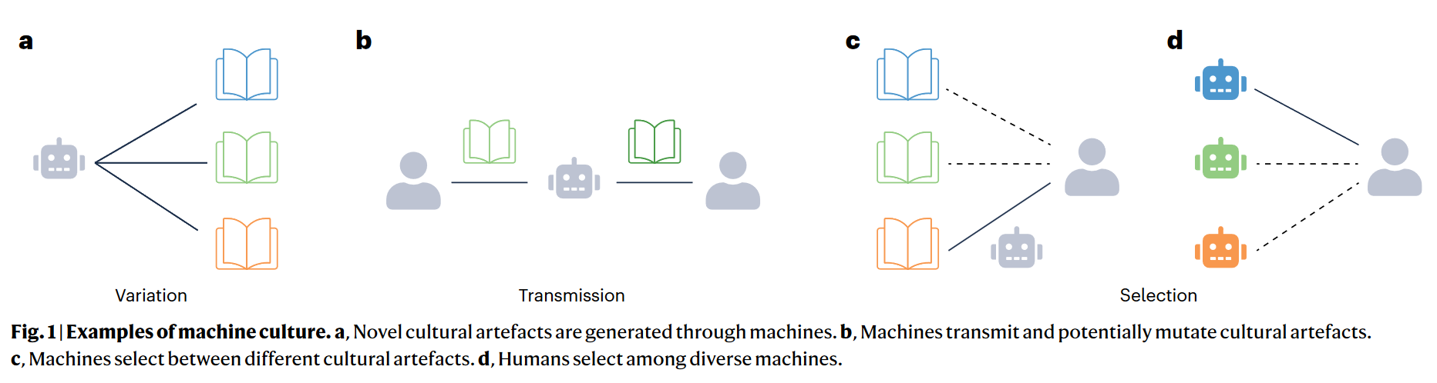
Brinkmann, L. et al. (2023). Machine culture. Nature Human Behaviour, 7(11), 1855–1868.
https://doi.org/10.1038/s41562-023-01742-2
Notes:
Masinate võimet osaleda kultuurievolutsioonilistes protsessides on kutsutud masinate kultuuriks – hübriid
Üldine konsensus, et kultuur ilmutab evolutsiooniliste protsesside tunnuseid
Masinad saavad osaleda selles:
Variatsioon: masin genereerib uusi kombinatsioone olemasolevatest ideedest (Go)
Ülekanne: keelemudel võtab teksti kokku, aitab kirjutada esseed
Valik: soovitusalgoritm pakub, mida osta ja keda jälgida. Mõnikord põimub bioloogilise valikuga, nt kohtinguäppide puhul
Kultuuri süsteemis, võrgustikus, korrutatakse kõik seosed masinate koefitsendiga läbi.
Kõlas, et kas tahame masinate ühiskonda? See on juba siin. Mõned näited:
(See ei pea olema sugugi pahatathtlik ega üldse tahtlik)

Slide 19
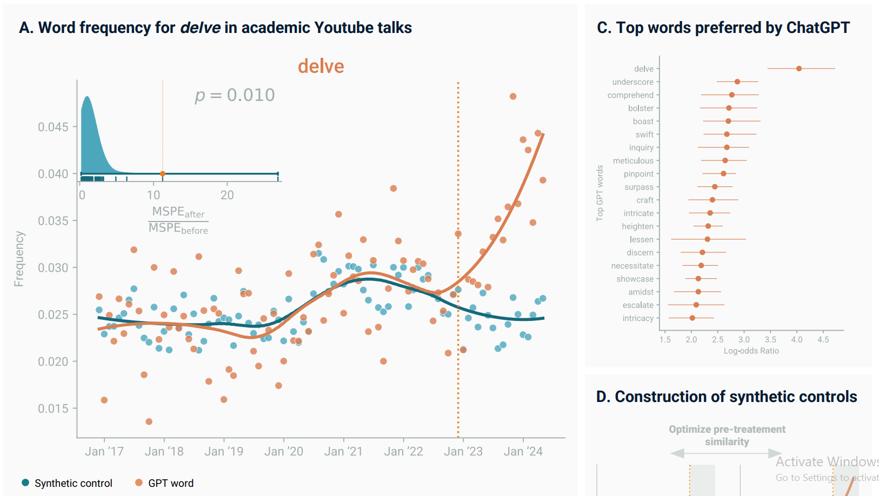
Yakura, H., et al. (2024). Empirical evidence of Large Language Model's influence on human spoken communication. arXiv preprint arXiv:2409.01754.
Notes:
Delve näide
Sarnane näide juba mainitud: pikk mõttekriips
Ka ideede tasandil: reaktiivne kirjutamine (inimene valib pakutud ideede hulgast ja nõustub nendega)
Ei mõjuta tingimata arvamust ühel või teisel teemal, vaid seda, millised teemad üldse käsitlemist väärivad
Aga info, mida tehisaru meile pakub, on palju piiratum kui me arvame

Slide 20
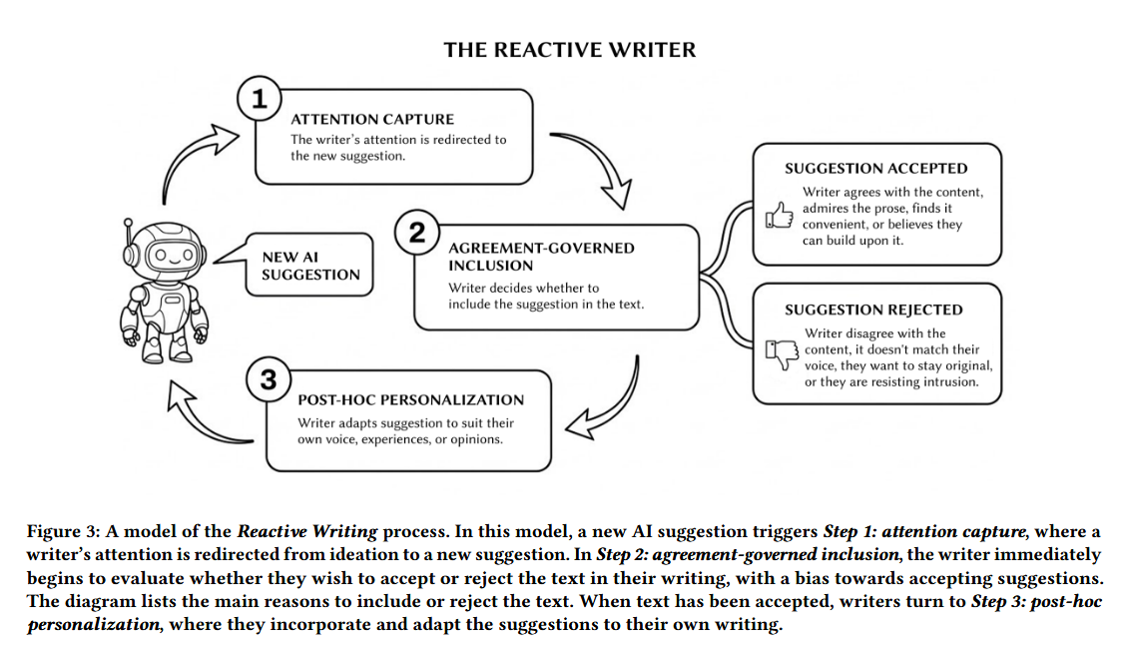
Bhat, Advait, Marianne Aubin Le Quéré, Mor Naaman, and Maurice Jakesch. “Reactive Writers: How Co-Writing with AI Changes How We Engage with Ideas.” arXiv:2603.10374. Preprint, arXiv, March 11, 2026. https://doi.org/10.48550/arXiv.2603.10374.
Notes:
Üks kummalisemaid näiteid: majakavaht Elias
Uuringus lasti erinevatel tehisarudel genereerida kümneid tuhandeid lugusid. 88% üli sarnaseid
Rohkem kui pooltes figureerib majakas ja neist omakorda paljudes on müstiline Elias (saarel, maailma lõpus vms), Mara, Elara, kellassepp
Et sellest aru saada, peame rääkima mudelite treenimise protsessist

Slide 21
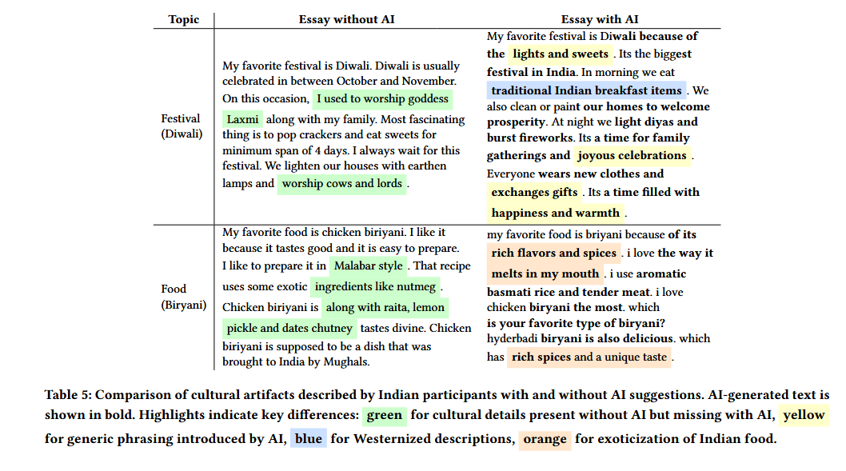
Agarwal, Dhruv, Mor Naaman, and Aditya Vashistha. “AI Suggestions Homogenize Writing Toward Western Styles and Diminish Cultural Nuances.”
Proceedings of the 2025 CHI Conference on Human Factors in Computing Systems, April 26, 2025, 1–21. https://doi.org/10.1145/3706598.3713564.

Slide 22
Thesis
Generative AI does not faithfully represent the diversity of real-world distributions in its outputs.
This unfaithful representation is caused by different factors:
  Limited or skewed pre-training data
  Deliberate alignment during post-training
  Intrinsic, mathematical properties of AI models
This can have negative effects on non-cultural viewpoints and cultures.

Slide 23
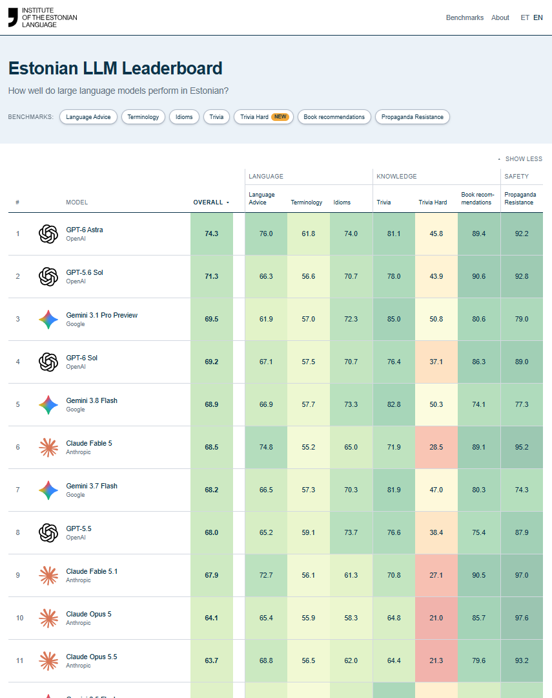
Benchmarking LLMs at the Institute of the Estonian Language (EKI)
Given that the quality of the output of LLMs varies across languages, localized analyses are needed.
Benchmarking means subjecting a system to reproducible, automated testing to obtain quantifiable results.
  Fundamental part of AI development as labs need to assess the qualities of their models;
  However, vast majority of LLM benchmarks are in English and often US-specific, or machine-translated;
  Native Estonian benchmarks are scarce and not continuously applied to new model releases.
EKI’s benchmarking effort:
  Public and up-to-date leaderboard with 80+ models
  7 benchmarks (with 5 more in the works)
  3 categories: language, knowledge, safety

Slide 24
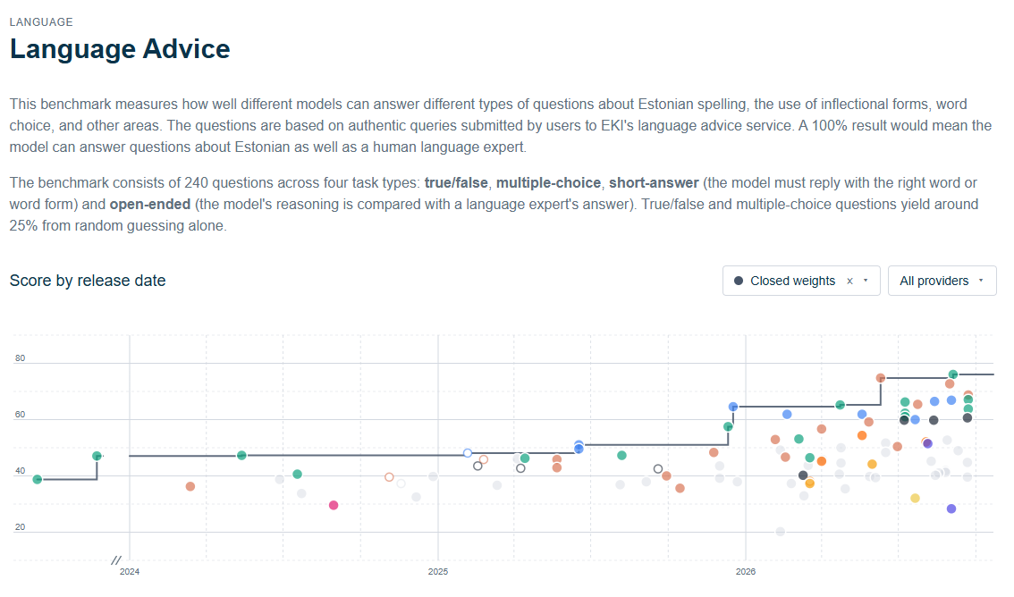
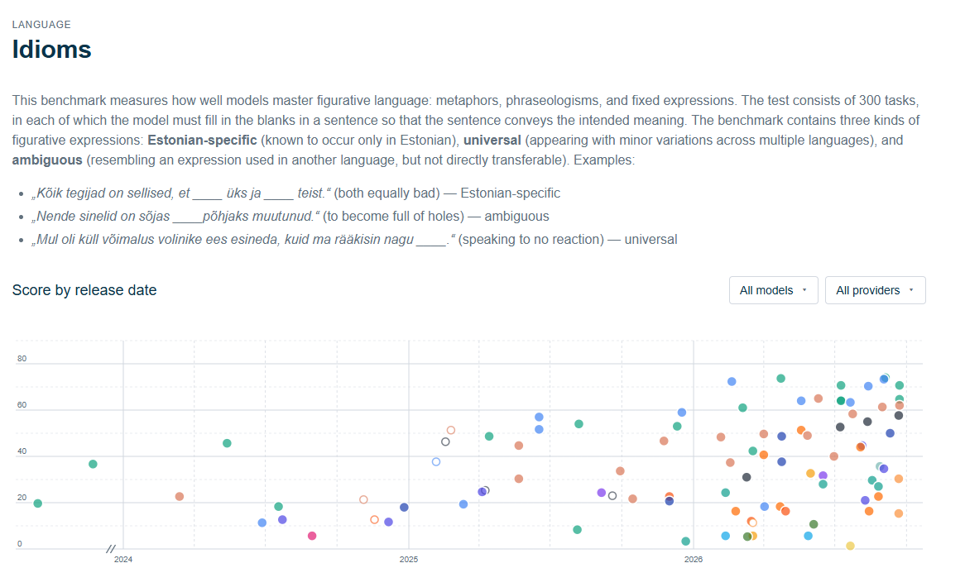
Our benchmarks
Language Advice: Estonian orthography, inflection, and word choice, based on 240 real queries to EKI’s language advice service.
Terminology: Estonian specialist terminology across 46 fields, using 1,380 definition–term pairs from EKI resources.
Idioms: Figurative language covering metaphors, idioms, and expressions, including Estonian-specific, universal, and ambiguous types.
Trivia: Multiple-choice questions on Estonian history, culture, sports, nature, geography, and miscellaneous topics.
Trivia Hard: 800 harder open-answer trivia questions across ten topics.
Book Recommendations: Estonian book recommendations across eight genres and five criteria, with hallucinations checked against the National Bibliography.
Propaganda Resistance: 225 prompts covering 15 Kremlin narratives in three languages and three question types, scored by a separate judge model.

Slide 25
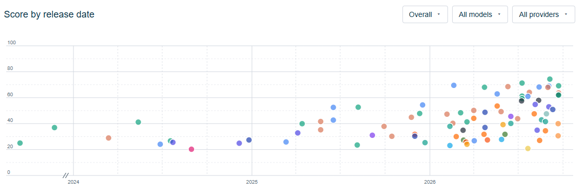
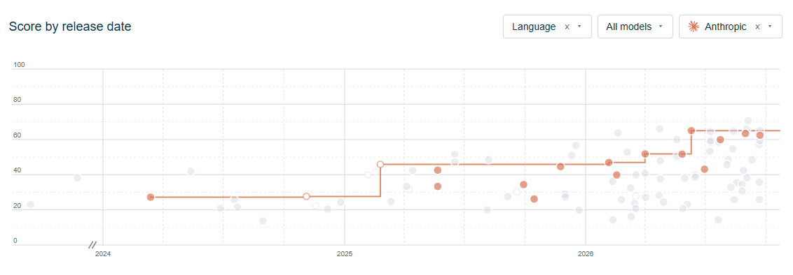
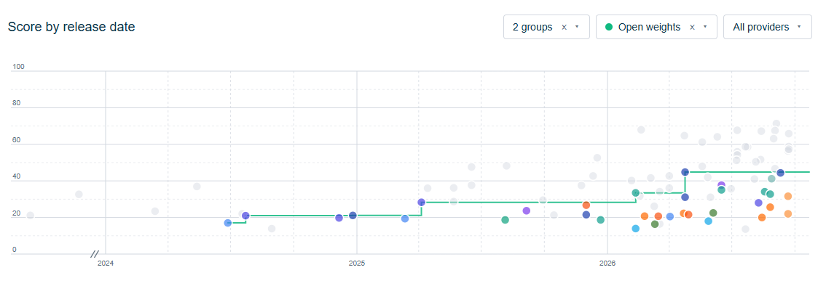
Current results
Aggregated performance across time
Frontier performance has improved for most benchmarks since 2023. However:
  The benchmarks are generally not saturated;
  Even frontier models have considerable room for improvement, esp. in terminology and harder facts;
  Performance gains are uneven: newer models are not guaranteed to be better;
  The open vs closed gap is significantly larger than in English benchmarks.
Claude Sonnet versions 4, 4.5, 4.6, 5 are worse than 3.7 in the language category
3.7 (retired)
5
Open frontier trails closed frontier by >1 year and is moving slower

Slide 26
Conclusion
Generative AI models have trouble with accurate and faithful representations of real-world distributions.
These misrepresentations can have linguistic, social and cultural consequences.
It is vital for smaller languages (and anyone, really), to keep track of AI capabilities instead of blindly trusting reported performance.
MOODUPUU.EKI.EE

Slide 27
Ai-teh!
feedback: krister.kruusmaa@eki.ee

