Slide 1


Digital Humanities at the University of Tartu
Liina Lindström
Head of the Institute of Estonian and General Linguistics
Professor of Modern Estonian Language
Center for Digital Text Scholarship
kick-off event
22.4.2025

Slide 2
Digital Humanities
Digital humanities is an interdisciplinary field that combines traditional humanities disciplines—such as literature, history, philosophy, and art history—with digital technologies and computational methods.
The field was first introduced in 1990s, widely spread in 2000-2010s
Variety of methods, approaches, tools, techniques, applications applied to humanities' data
Variety of definitions: 817 definitions from works 2009-2014, see https://whatisdigitalhumanities.com/
Vagueness of definitions→ hard to explain the need for it
Data-based humanities

Slide 3
Digital Humanities at UT
2017: ASTRA project for short-term visiting lecturers
  David Lorenz 1.4.-30.6.2017, linguistics
  Ezequel Koile 1.2.-30.6.2018, linguistics
  Nehemie Strupler 1.10.-31.12.2018, archeology
  Artjoms Šela 1.6.2018-31.1.2020, literary studies
  Kimmo Elo 1.3.-30.6.2019, social sciences
  Joshua Wilbur 26.8.2019-31.12.2021, linguistics

Slide 4
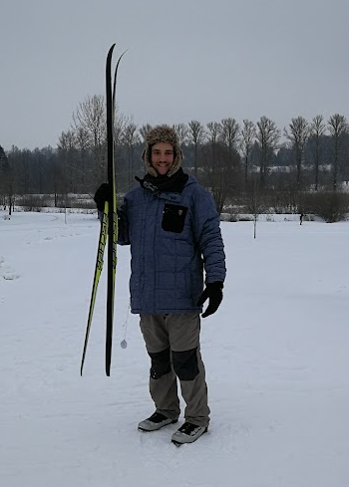
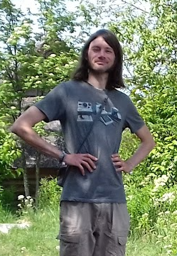
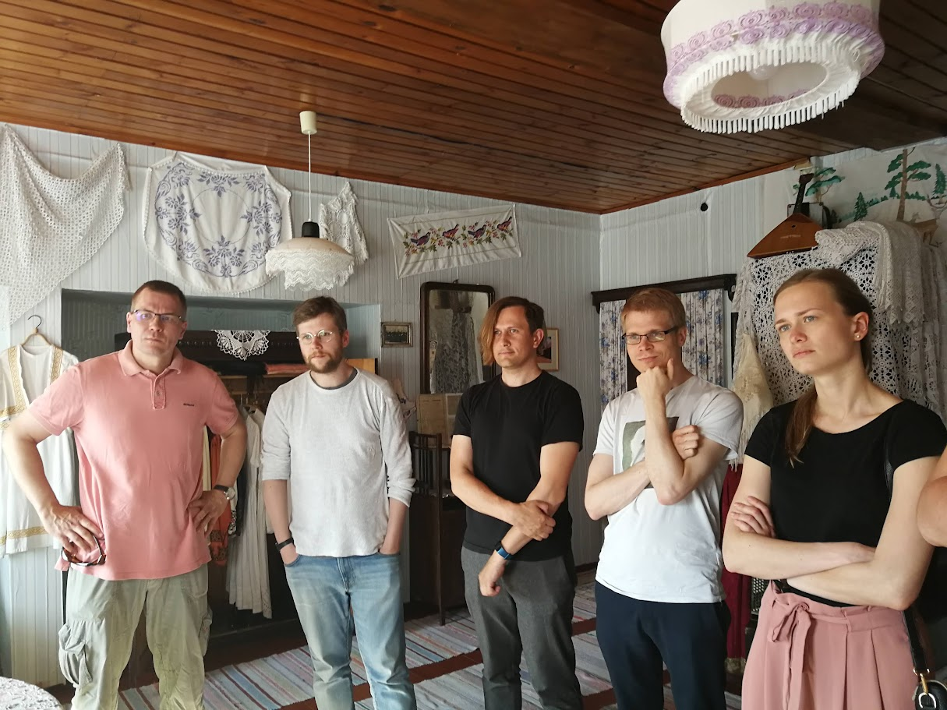
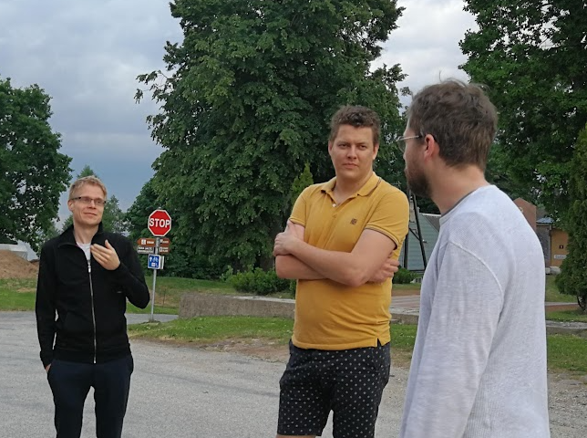
Digital Humanities at UT
Ezequel Koile
David Lorenz
Kimmo Elo, Artjoms Šela, Pärtel Lippus, Peeter Tinits, Liisa
Peeter Tinits, Andres Kimber, Artjoms Šela

Slide 5

Digital Humanities at UT
2018: Centre for Digital Humanities and Information Society (CDHIS)
Consortium within UT
  Institute of Estonian and General Linguistics
  Institute of History and Archaeology
  Institute of Philosophy and Semiotics
  Institute of Cultural Research
  Institute of Foreign Languages and Cultures
  School of Theology and Religious Studies
  Viljandi Culture Academy
  Tartu University Library
  Institute of Computer Science
  Institute of Social Studies
Faculty of the Arts and Humanities
Heads: 2018-2022 Liina Lindström,
2022-2025 Jane Klavan
Project manager Andres Kimber

Slide 6
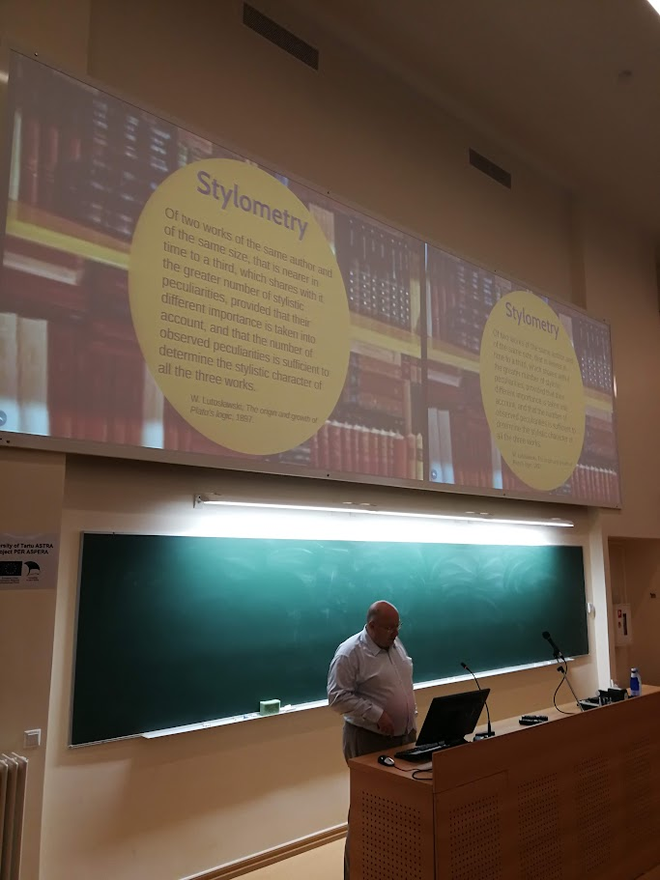
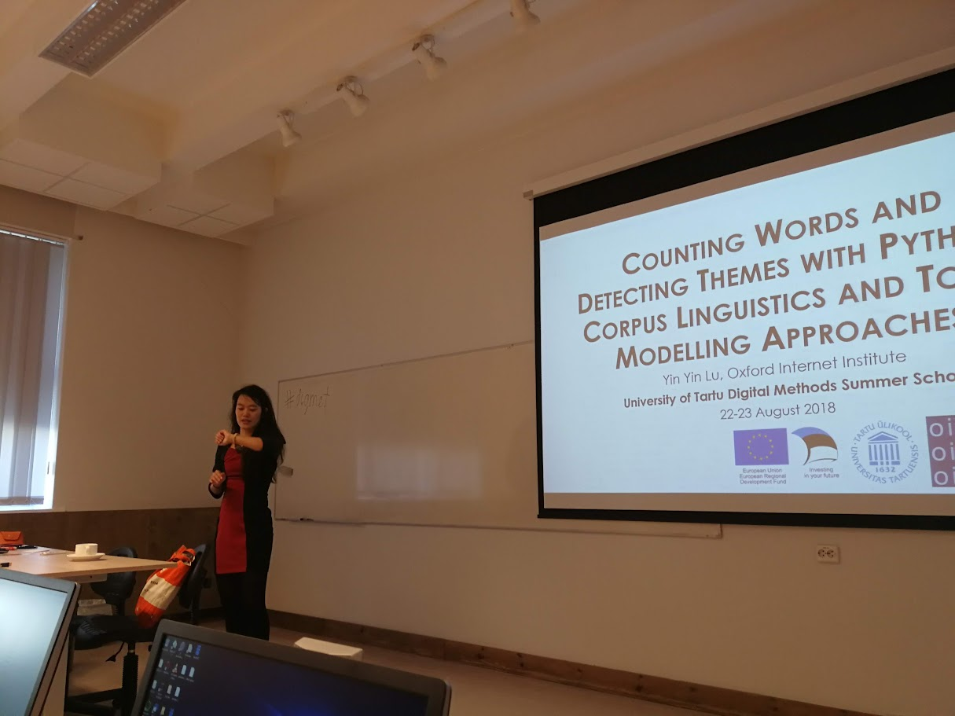
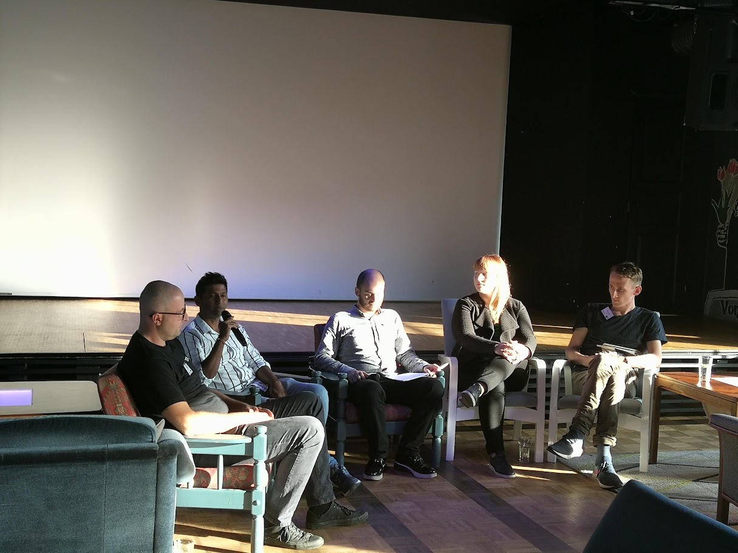
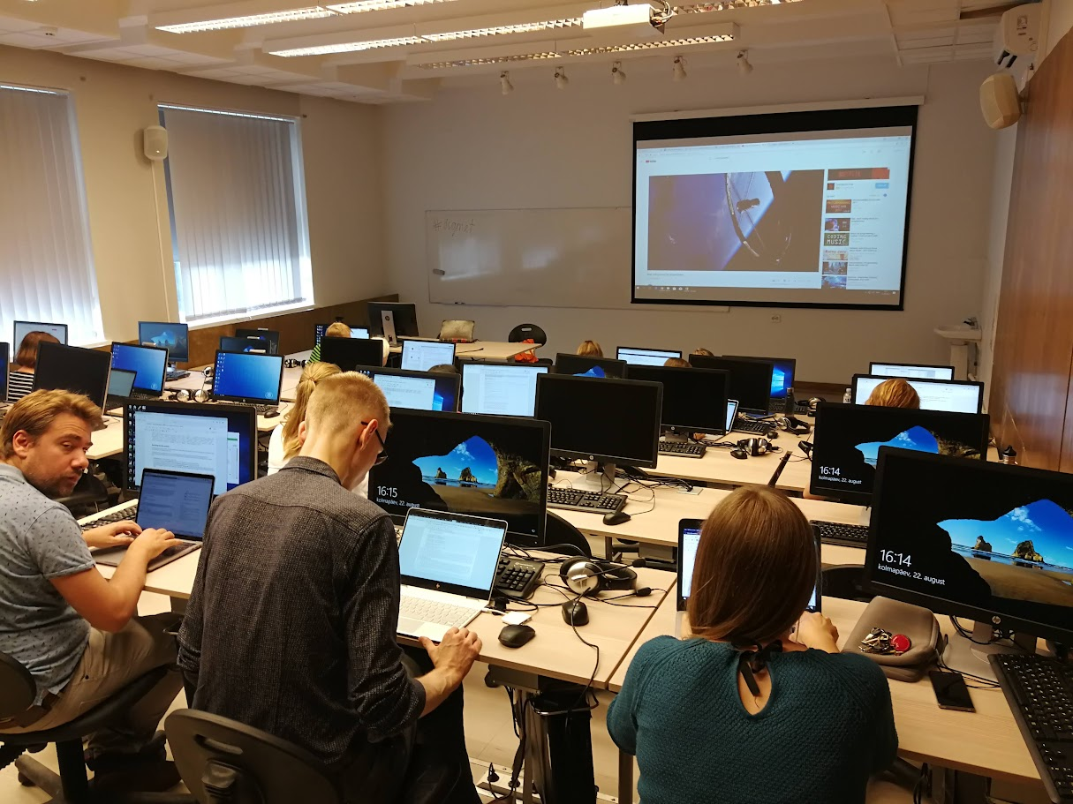
Activities of CDHIS
Summer School series Digital Methods in the Humanities and Social Sciences
https://digitalmethods.ut.ee/
2018, 2019, 2020, 2021
4-5 days, lectures + hands-on workshops
Target group: PhD students, acdemic staff

Slide 7
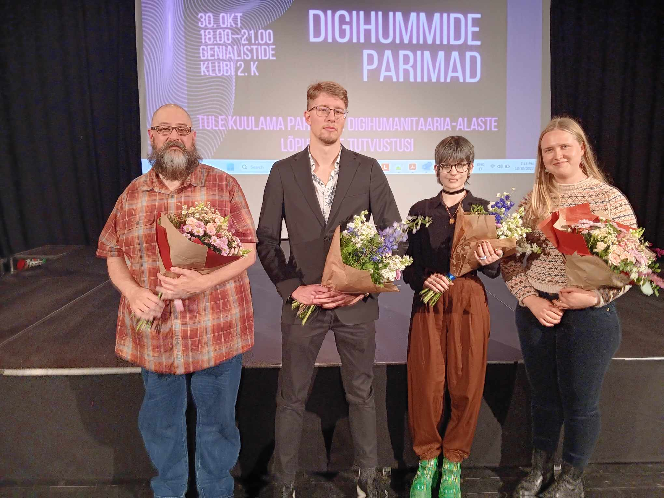
Activities of CDHIS
Teaching DH:
Minor in DH was launched in 2019, available for all students of the Humanities
  24 ECTS Information technology (taught by the Institute of Computer Science)
  24 ECTS Digital humanities + 12 ECTS elective courses on DH
DH elective module for MA studies
Open course materials for DH: https://digihum.ut.ee/et/sisu/oppematerjale
(HITSA funding, 2019-2020)
Awards for best BA and MA thesis using DH methods

Slide 8
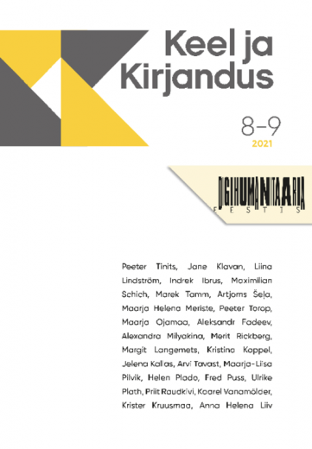
Activities of CDHIS
Organizing Digital Humanities Conferences in Estonia (2018)
Short courses:
  Master Class in Quantitative Linguistics, prof Harald Baayen (2020)
  Macroscopic Methods for Culture Analytics, prof Timothy R. Tangherlini (2019)
  Methods of extracting keywords and topics from text collections, prof. Maciej Eder (2023)
Digihum Talks series
Publications
Project proposals:
  ERA Chair in 2019 (not successful) and 2024 (successful!)

Slide 9
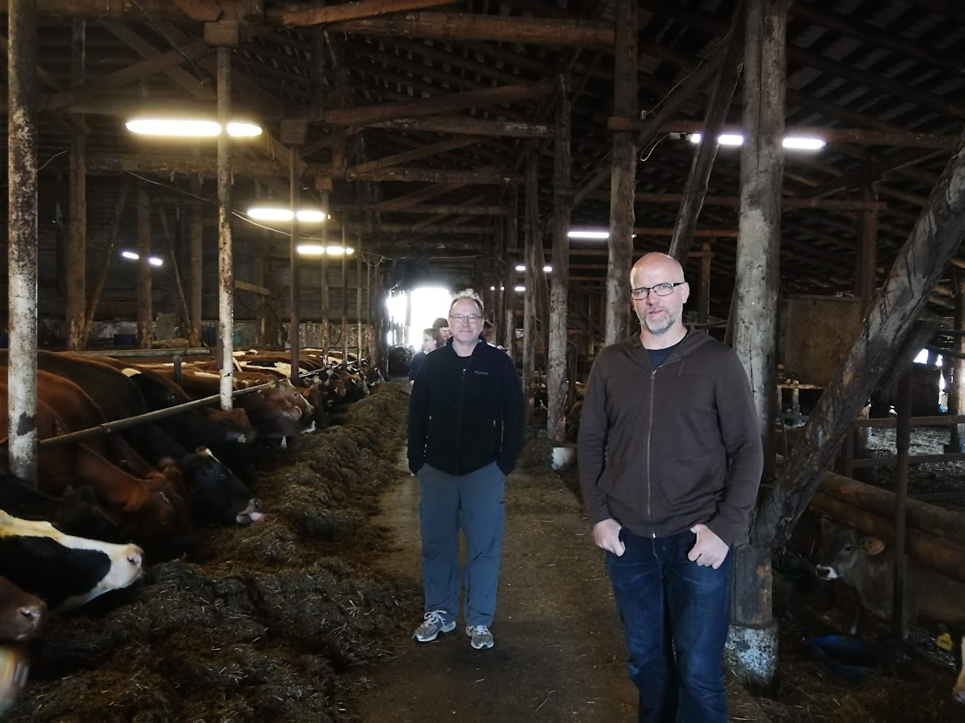
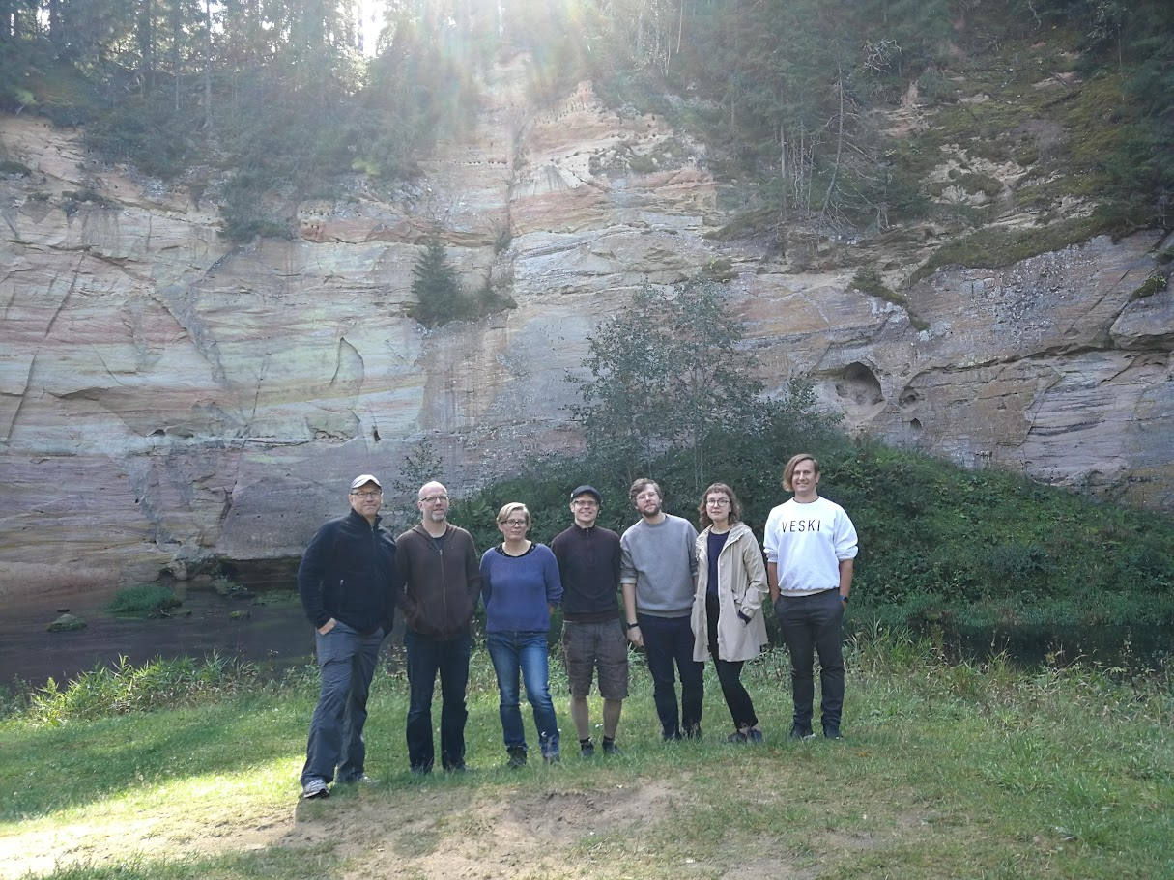
Macroscopic Methods for Culture Analytics, prof Timothy R. Tangherlini (2019)

Slide 10
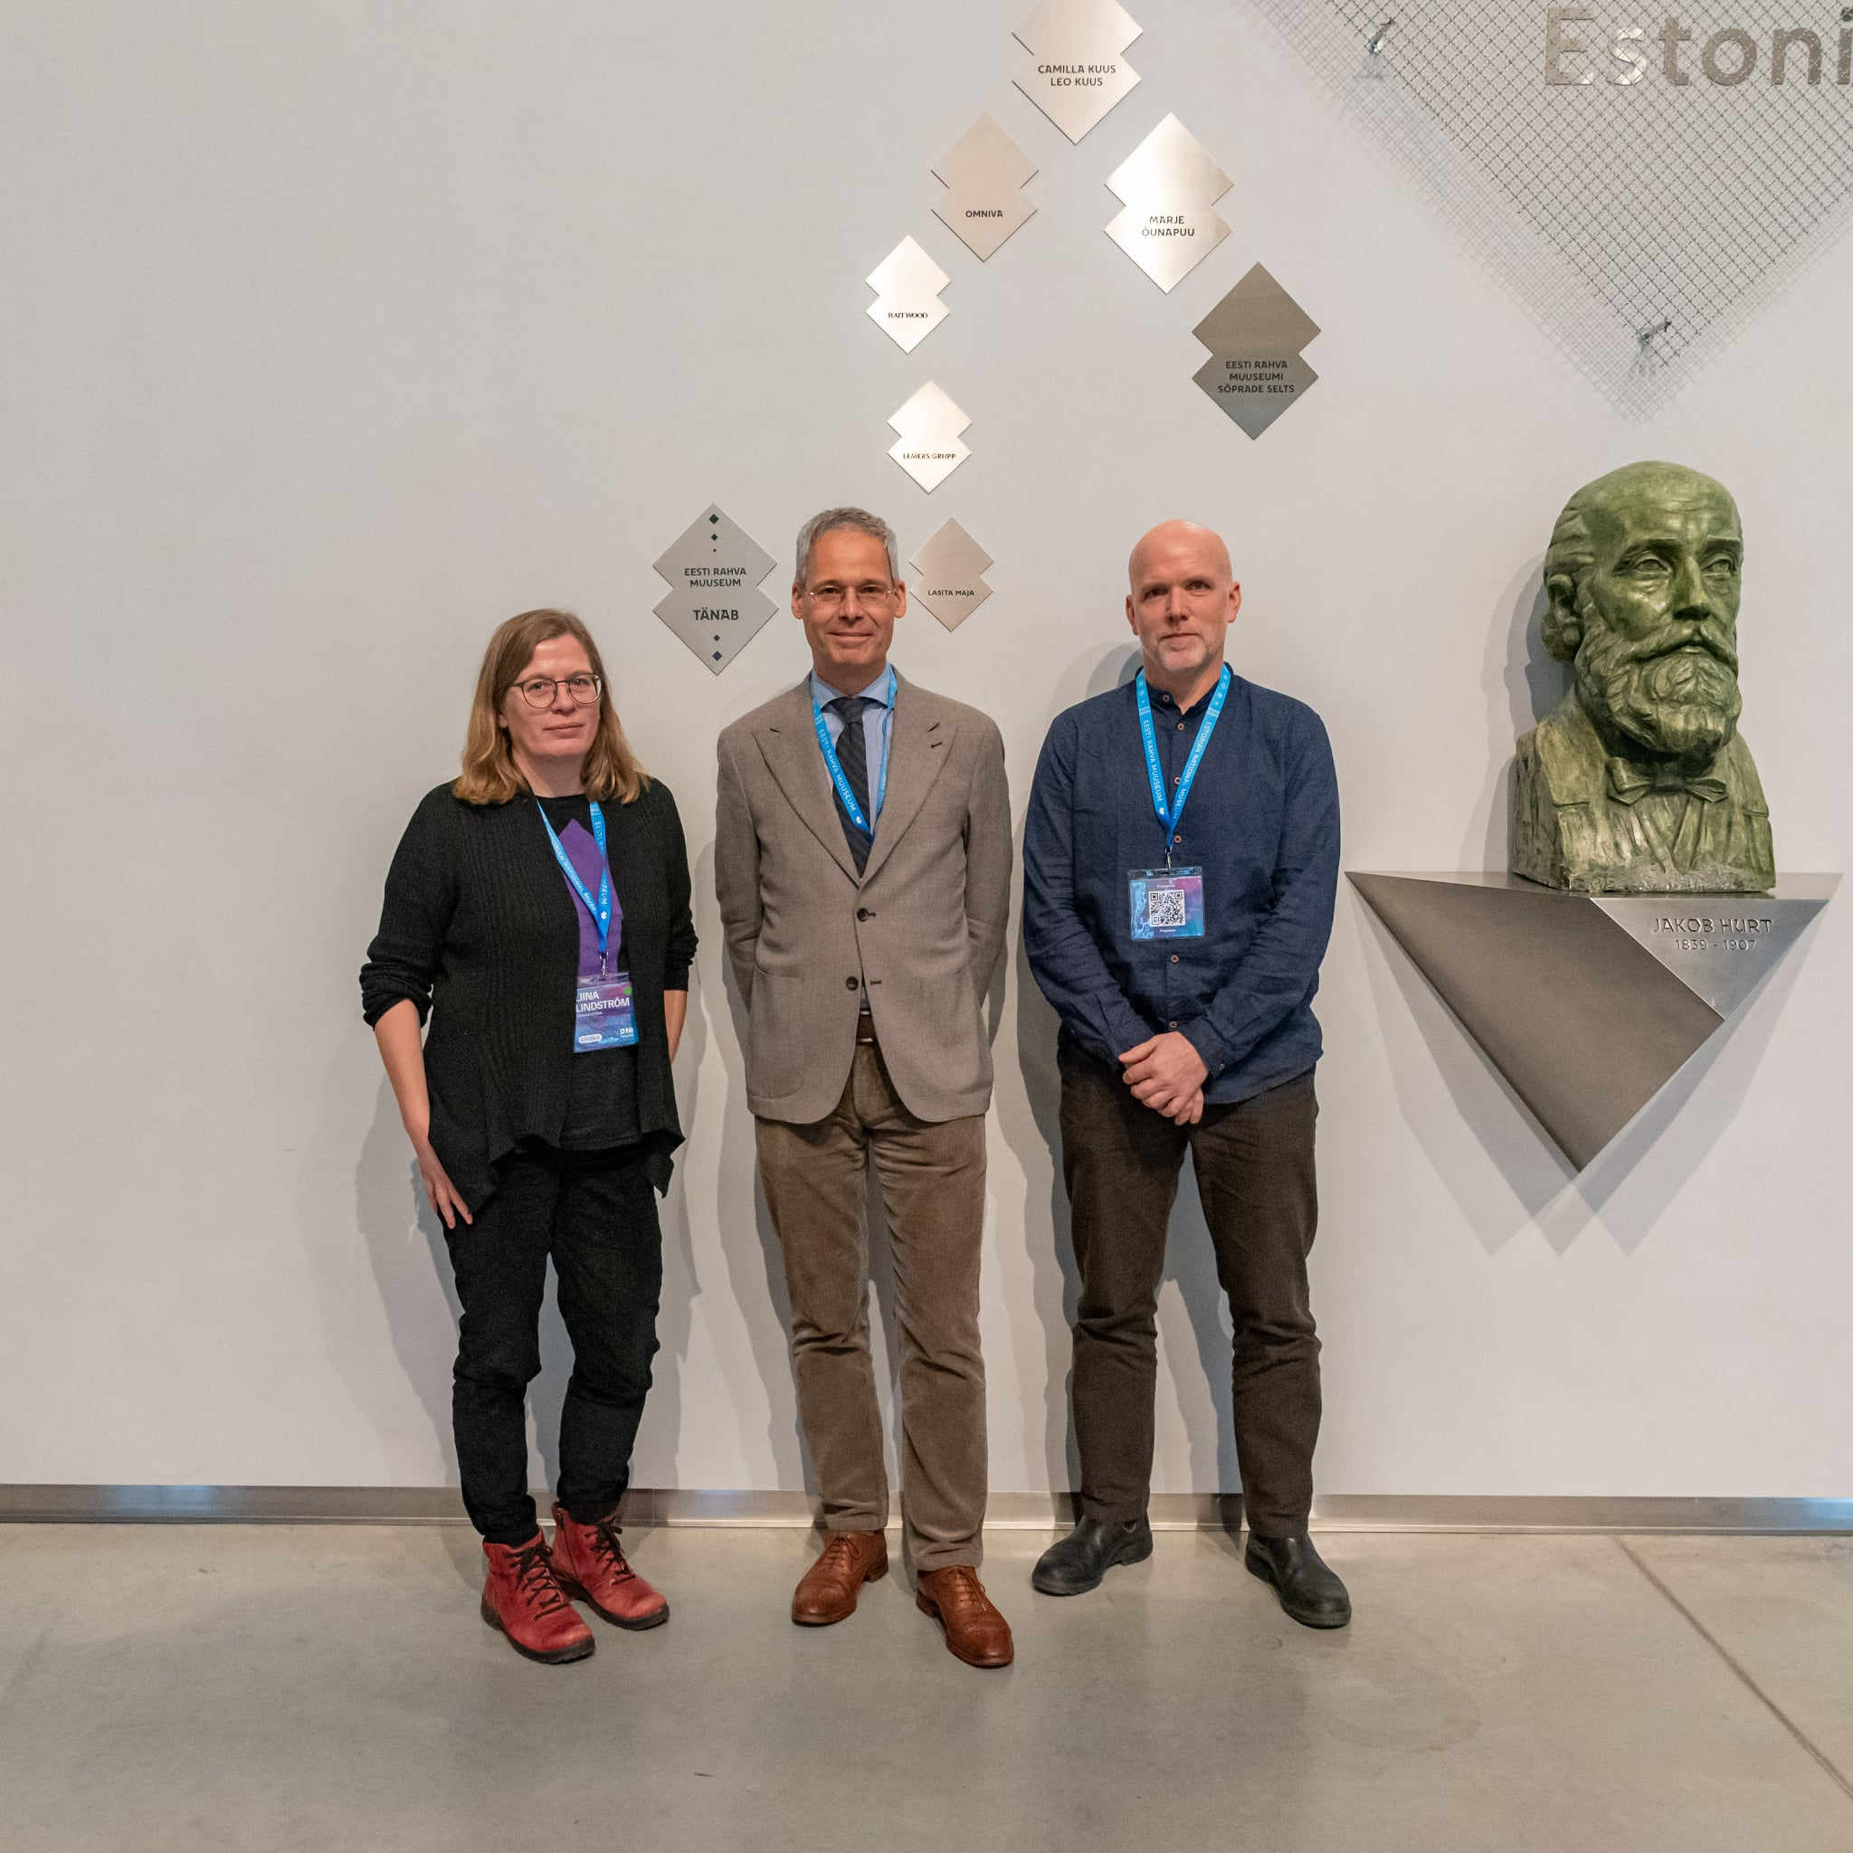
Reorganizing the Centre
CDHIS was officially closed in February 2025
New Centre for Digital Humanities (CDH) within the Institute of Estonian and General Linguistics was founded in February 2025
Center for Digital Text Scholarship is a project within CDH

Slide 11
Aitäh! Thank you!

