Slide 1
Commission and ESA mandate in State aid control: at times super-regulators?
State Aid: Estonian Legal Context and European Perspective, 13 June 2025
Vaido Poldoja
Senior Legal Officer
Competition & State aid directorate

Slide 2
Agenda
Background
COM/ESA competence in State aid control: expansion into other policy areas
Examples of policy and case-law driven reduction in State aid control competence

Slide 3
Background
TFEU art 107(1): presumption of aid prohibition
“Save as otherwise provided in the Treaties, any aid /…/ be incompatible with the internal market”
Legal bases of compatibility set out in the TFEU
Articles 93, 106(2) and 107(2) and (3)
Standstill compliance: national courts and authorities
Compatibility assessment:
COM’s exclusive competence, subject to review by the Court of Justice

Slide 4
TFEU Article 107(1): the cumulative elements of the notion of aid
Undertaking/economic activity
State resources and imputability
Advantage
Selectivity
Effect on intra-EU trade and distortion of competition
Notes:
Only schemes

Slide 5
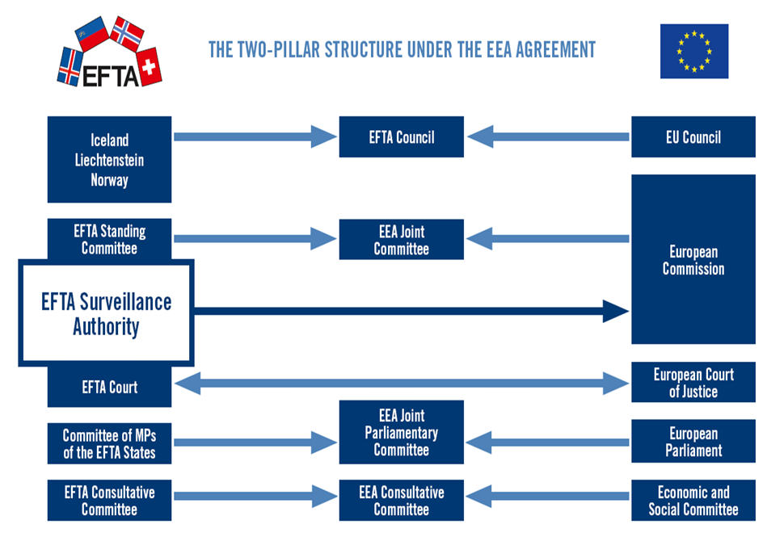

Slide 6
State aid assessment and other policies
‘Indissoluble link’ test dating back to 1977 (C-74/76, Iannelli & Volpi)
“aspects of aid which contravene specific provisions of the Treaty /…/ indissolubly linked to the object of the aid /…/ impossible to evaluate them separately”
Important ramifications
State aid vs infringement procedures
COM exclusive State aid compatibility assessment competence vs direct effect of EU law in national courts (e.g. C‑598/17, A-Fonds)

Slide 7
Hinkley Point C (C‑594/18): revived discussion on the “expansion”
“State aid which contravenes provisions or general principles of EU law cannot be declared compatible with the internal market”
More prominence in compatibility assessment
E.g. Guidelines on State aid for climate, environmental protection and energy 2022:
“If the supported activity, or the aid measure or the conditions attached to it, including its financing method when it forms an integral part of the measure, entail a violation of relevant Union law, the aid cannot be declared compatible with the internal market.”
A case to follow: C-59/23 Paks II NPP
AG Medina Opinion 27 Feb 2025

Slide 8
The Aarhus convention: EU environmental law and access to justice in State aid procedures
EU found in breach of the Aarhus Convention in 2021
Aarhus Convention Compliance Committee findings in case ACCC/C/2015/128
12 May 2025: Implementing Regulation amendments and new State aid Best Practices Code, Section 11
Envir NGOs right for COM internal review of final decisions authorizing aid
the aided activity or any aspects of the aid measure indissolubly linked to the object of the aid are in breach of Union environmental law
No suspensive effect of the final decision
End of 2025: COM guidance on the notion of ‘indissoluble link'

Slide 9
Examples of decreased competence
Effect on trade: low barrier but more than just hypothetical
2012 State aid modernization: “big on big, small on small”
COM 2015 and 2016 decision packages to explain purely local effect
Supply in limited area within a Member State and is unlikely to attract customers from other Member States, and
Cannot be foreseen, with a sufficient degree of probability, that more than a marginal effect on the conditions of cross-border investments or establishment
Supported from case-law
T-278/17, Marinvest (Izola marina); T‑582/20, Ighoga Region 10 (Ingolstadt hotel/CC)
Notes:
Only schemes

Slide 10
General tax exemptions: national fiscal autonomy
C‑453/23, Polish property tax exemption for railway sidings
“ a general and abstract exemption to which a direct tax is subject is normally not to be classified as ‘State aid’ ”
Otherwise, “a risk of the Commission’s assessment systematically replacing the Member States’ assessment in the matter, thereby encroaching on their fiscal autonomy”
Ring fenced against potential circumvention
(see paragraphs 53 to 55 of the judgment)
Notes:
Only schemes

Slide 11
Riigiabi materjale
Euroopa Liit
Komisjoni Konkurentsi peadirektoraat
http://ec.europa.eu/competition/index_en.html
EL Kohus
http://curia.europa.eu/jcms/jcms/j_6/et/
EFTA
EFTA Järelevalve Asutus
www.eftasurv.int
EFTA Kohus
www.eftacourt.int

Slide 12
Tänan!
vaido.poldoja@eftasurv.int

