Slide 1
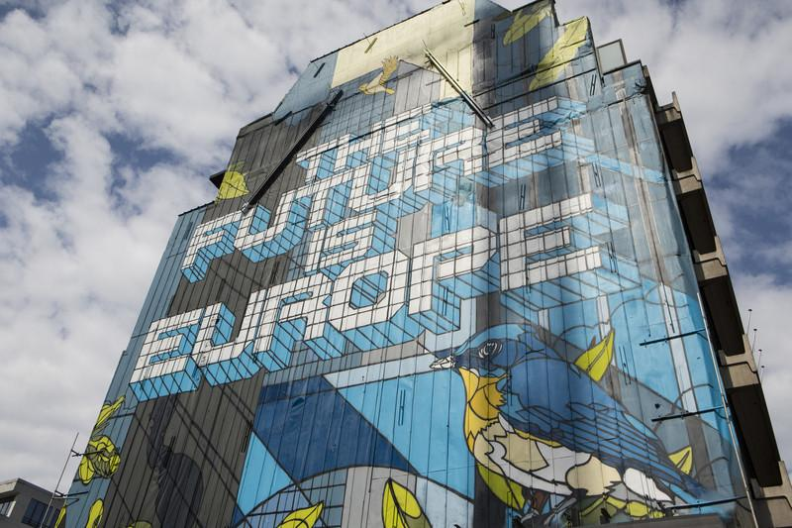


Presenting the final results of NearEU Module
Anna Beitane
Dr. Stefano Braghiroli
University of Tartu (Estonia)
September 28, 2023
www.neareu.ut.ee

Slide 2
Information about NearEU Module
The module has the aim to create new knowledge, tools, and resources related to Europeanization towards the European Union’s Eastern neighbourhood, candidate countries, and - more in general - wider Europe.
Within the framework of the module, emphasis will be given to coherently and synergically integrated innovative methods of teaching, bi-directional interactivity, blended learning, and open educational resource (OER) material. The module offers a multi-disciplinary and a diverse methodological perspective on the process of European integration, EU’s relations with its Eastern neighbourhood and Russia and with different alternative models of regionalism in Europe and Eurasia.

Slide 3
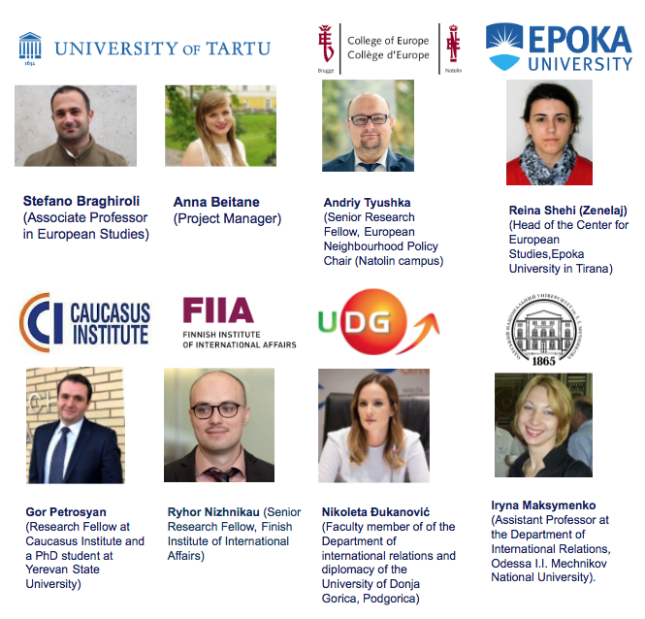
Partners
Experts from 6 diferent
countries:
Poland
Finland
Montenegro
Albania
Armenia
Ukraine

Slide 4






Teaching and learning materials
For educators
For learners
Repository of didactical materials (course and MOOCs syllabi; teaching aids; etc.)
New e-book on didactics of preparing and running simulation exercises of decision making (EU and EaEU)
NearEU awareness seminars
New NearEU courses – ‘EU-Russia’ mõdule in IRRS * & MOOCs
NeaEU master classes & EaP simulation exercise*
Study trip to Tallinn* & NearEU graduate conference
*only UT students

Slide 5
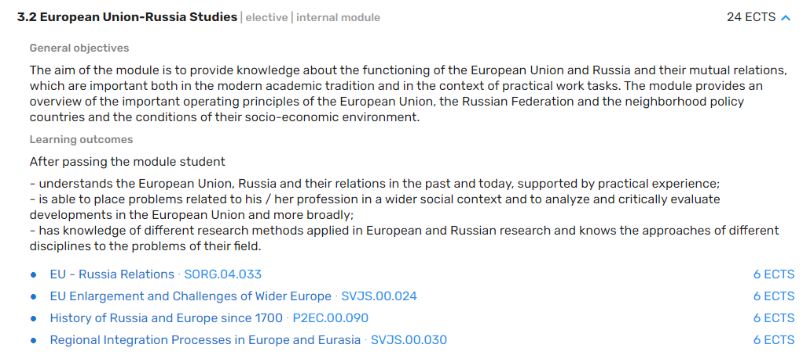
NearEU new and updated courses
EU Enlargement and the Challenges of Wider Europe SVJS.00.024
The aim of the course is to provide students with a specific and detailed understanding of the enlargement process and challenges related to the Wider Europe approach. The course develops conceptual, analytical, and theoretical tools to critically frame the specific nature of the external dimension of the Europeanization process and of regionalism in Europe and Eurasia.
Part of the IRRS ‘EU-Russia module’
Enrolled students: 84 (in total)
Constitutent course
6 ECTS
Three openings
Illiberal Turn in Europe and Russia - SVJS.00.023
The course explores the emergence, consolidation, and diffusion of illiberal dynamics at the national level - in terms of regime types, ideologies, and values - and the broader impact in terms of international order.
Part of the IRRS ‘EU-Russia module’
Enrolled students: 98 (in total)
Elective course
6 ECTS
Three openings
→ Regional Integration Processes in Europe and Eurasia (6 ECTS) - SVJS.00.030

Slide 6
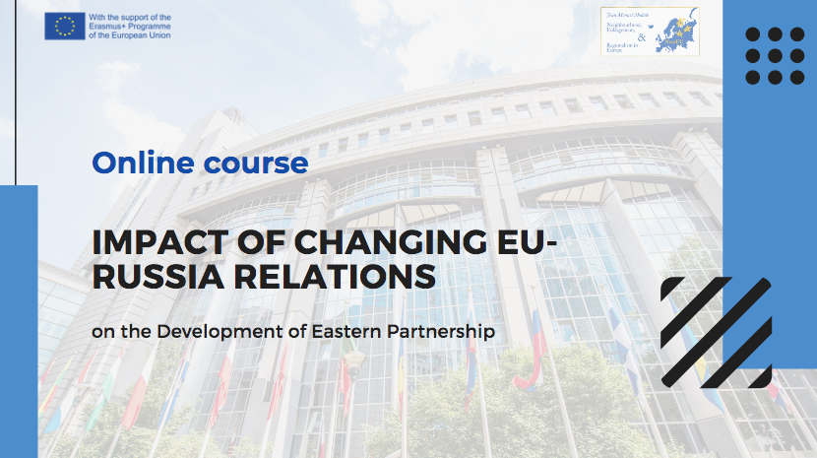

NearEU MOOCs
Impact of Changing EU-Russia Relations on the Development of Eastern Partnership – SVJS.TK.031
The course introduces participants to the logic and structure of Eastern Partnership as well as its evolution in light of geopolitical developments in the region and changing dynamics of EU-Russia relations. The course provides an interdisciplinary overview of the main factors, and decision-making patterns and issues of European and Russian policies in both problem-oriented and region-specific aspects in the timeframe, starting with the initiation of Eastern Partnership and expanding its focus to present day developments.
Common Challenges of Competing Regionalisms – SVJS.TK.025
The course focuses on the multifaceted nature of regionalism in different geographical and geo-political contexts in Europe and Eurasia and on its conceptual and theoretical definition by looking at the relevant cleavages in contemporary societies and at the fluid and ever changing nature of inter- and intra-state interaction and supranational/intergovernmental trends of integration.

Slide 7



NearEU MOOCs
Common Challenges of Competing Regionalisms
Fully online (run on Moodle), 6 weeks
Pre-recorded video lectures (including guest interviews from NearEU partnering experts from Albania, Montenegro; Ukraine, Finland and Georgia).
Enrolled students: 1538 (in total), 77 countries represented
Recipient of the e-course quality mark 2022; won the “E-course of the Year 2022” title, nominees for Enlight Teaching and Learning award.
Free of charge + possibility to get 2 ECTS and digital certificate
Impact of Changing EU-Russia Relations on the Development of Eastern Partnership
Fully online (run on Moodle), 5 weeks
Pre-recorded video lectures (including guest interviews from NearEU partnering experts from Poland, Finland and Armenia). ​
Assignments: quizzes; forum contributions; final exam ​
Enrolled students: 1521 (in total), 60 countries represented
Recipient of the e-course quality mark 2023; nominee for the “E-course of the Year 20223 title
Free of charge + possibility to get 1 ECTS and digital certificate

Slide 8
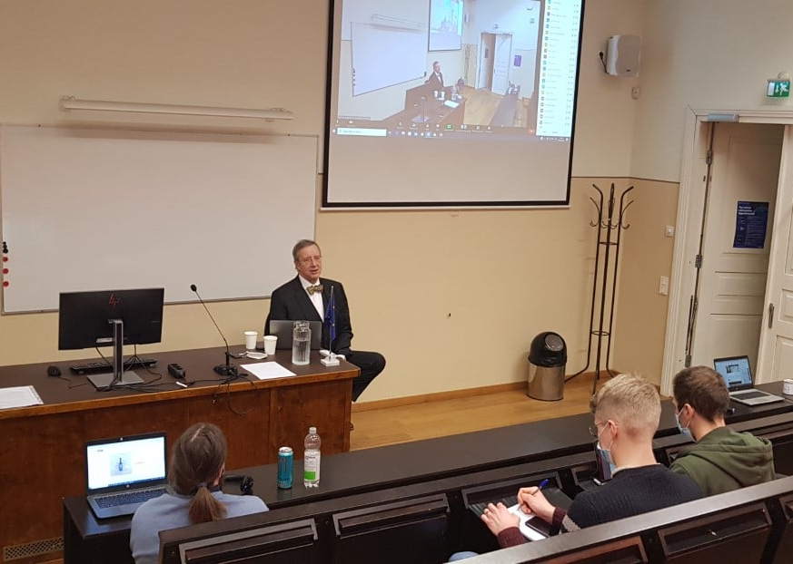
NearEU Master classes and NearEU Talks
Master classes and talks are aimed to favour public discussion, awareness and debate with leading regional experts and practicioners.
Past master classes and talks inlcuded such speakers as former President of Estonia – Toomas Hendrik Ilves; Special Advisor to EU High Representative and Vice President of the Commission Josep Borrell - Nathalie Tocci; Estonian Members of the European Parliament, and others.
Information and schedule of speakers is listed on NearEU website
NearEU Talk with Toomas Hendrik Ilves

Slide 9
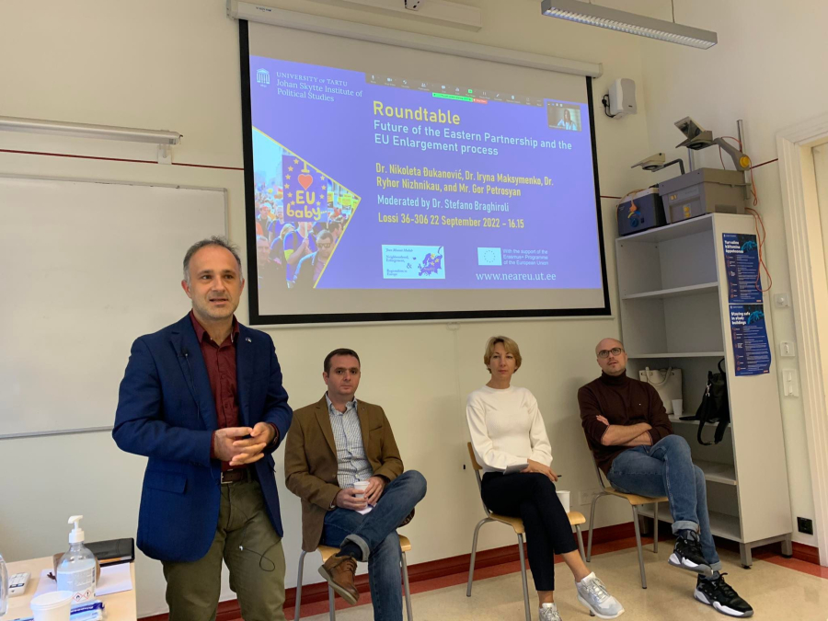
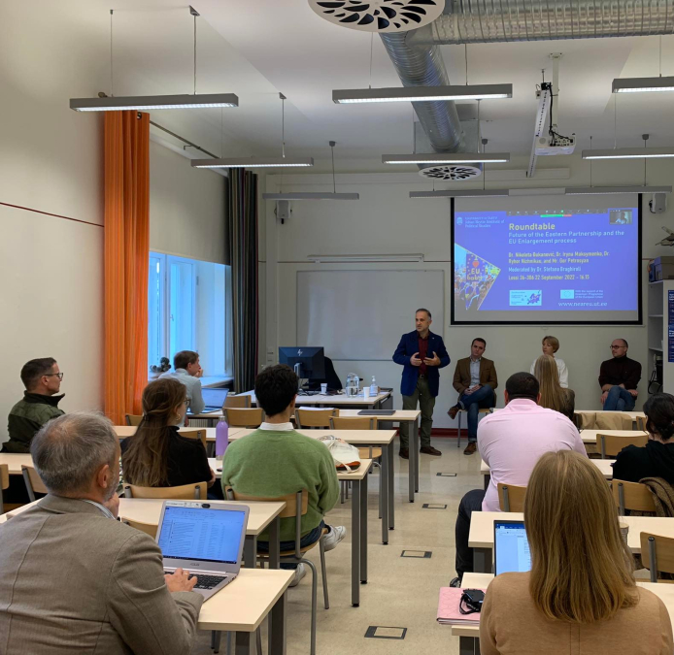
List of NearEU master classes
"Western Balkans: Quo Vadis?’’ by Dr. Nikoleta Đukanović from University of Donja Gorica - May 2023.
"Armenia and Georgia: Far and close neighbours in times of global uncertainty" by Dr. Gor Petrosyan from Caucasus Institute, Yerevan) and guest lecturer Dr. Shota Kakabadze (Georgian Institute of Politics, Tbilisi) - April 2023.
"Future of the Eastern Partnership and EU Enlargement process" by Dr. Ryhor Nizhnikau from Finish Institute of International Affairs); Dr. Iryna Maksymenko (Odesa I.I. Mechnikov National University) and Mr. Gor Petrosyan (Caucasus Institute) and Dr. Nikoleta Djukanovic (University of Donja Gorica) - September 2022

Slide 10
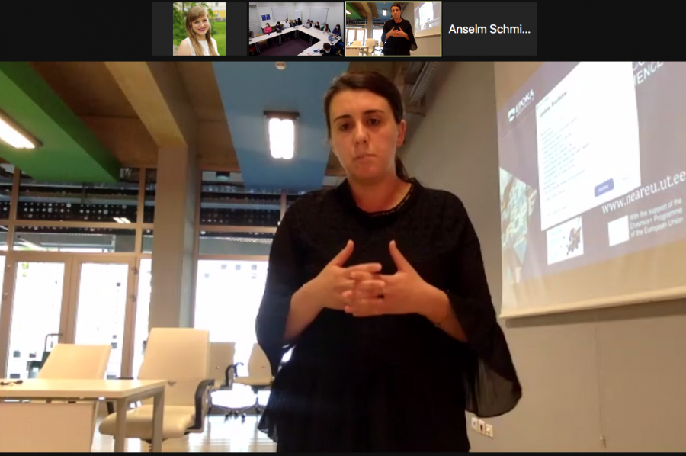
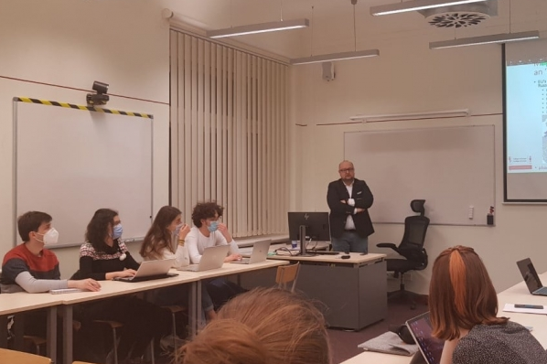
List of NearEU master classes
"Regional Security and Conflict Management: The Experience of Western Balkans” by Dr. Reina Shehi from Epoka University (Albania, Tiranë) - October 2021
"Ukraine – EU Relations. The long path of Ukraine’s return to the European family” by Dr. Iryna Maksymenko from Odesa Mechnikov National University (Ukraine) – December 2021.
"The EU, Ukraine and (geo)politics of EU association" by Dr. Andriy Tyushka from the College of Europe (Natolin) - May 2021.

Slide 11
NearEU Graduate Conference
Aim: to provide the its graduate students with the opportunity to present their works, research projects or papers in the format of an academic conference and receive specialized feedback from fellows, faculty staff, and doctoral students.
Structure: the conference consists of open panels the exact number of which is defined on the basis of the proposals received. Each panel consists of max. four presenters, a chair, and a discussant.
Prize: at the conclusion of the event, the board of the conference will select and announce the presentation awarded with the “NearEU GradConf Prize” consisting of a 100 EUR voucher valid for the purchase of books, audio-visuals, and other material. The board’s assessment takes into account the quality and originality of the presentations.
Format: hybrid (on site in Tartu for UT students + online for students from NearEU partner institutions)

Slide 12
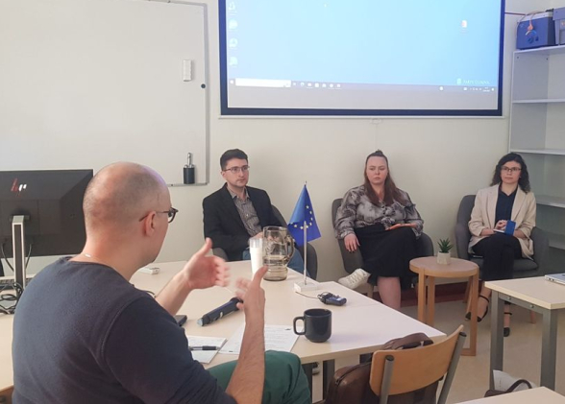
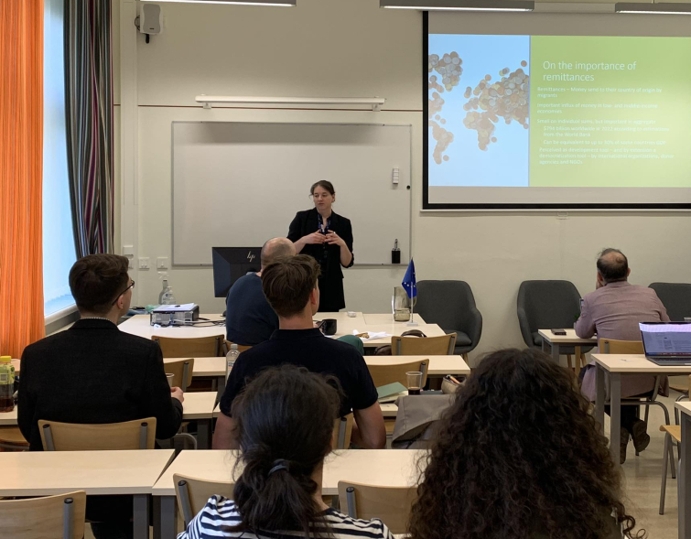
NearEU Graduate Conference
NearEU module has also successfully launched three NearEU graduate conferences (spring 2021, 2022 and 2023).
In total, 30 conference participants presented their papers to the NearEU conference committee.
Each graduate conference included a key-note speaker, which included a NearEU partnering experts, these included speakers Dr. Andriy Tyushka from College of Europe, Natolin (spring 2021); Dr. Reina Shehi from Epoka University (spring 2022); and Dr. Ryhor Nizhnikau from Finnish Institute of International Affairs (spring 2023).

Slide 13
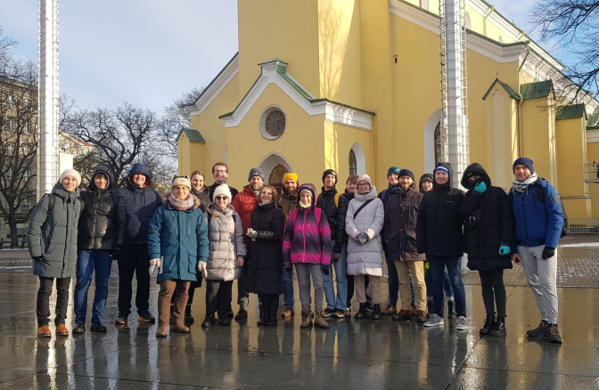
NearEU Simulations & study trips
Aim: to expose our students to the practical implications of national and European political conversations and to bridge formal learning with the ‘real world’. Focus on policy making and policy analysis.
Structure: the study visit consisted of two days in Tallinn that combined visits to institutions and think-tanks, meeting with experts and stakeholders, and city walks.
Format: online and in-person
Visits include Estonian Parliament, Estonian School of Diplomacy, Estonian Centre for Eastern Partnership, European House – Euroopa Experience, Italian Embassy, Delfi, etc.

Slide 14
Conclusions
The NearEU contributed to both development of new courses and significant restructuring and update of existing courses with the aim of giving students a wider and fresh perspective on the most recent developments in the comparative regionalism and models of regional integration in Europe and Eurasia.
The module brought together a diverse poll of in-house and external experts (coming from EU, candidate, and partner country’s HEIs - including Albania; Montenegro, Poland, Finland, Ukraine and Armenia).
The module contributed to development of new digital material (video lecturers, MOOCs, etc.) and innovative teaching techniques (simulation exercises; problem-based and challenge based learning) that increased students' engagement in the study process.
In total the NearEU Module developed 47 actions, reaching the audience of more than 4800 participants in Estonia and more than 77 countries around the world (statistics taken from attendance forms and MOOCs surveys from 2021-2023).
The quality of learning digital content of the Module was also confirmed and reassured by the nomination of the two NearEU MOOCs to the "E-course of the Year " awards in 2022 and 2023 by Estonian Quality Agency for Education, as well as nomination to the Teaching and Learning Award of the European Universities Alliance – Enlight in 2022.

Slide 15
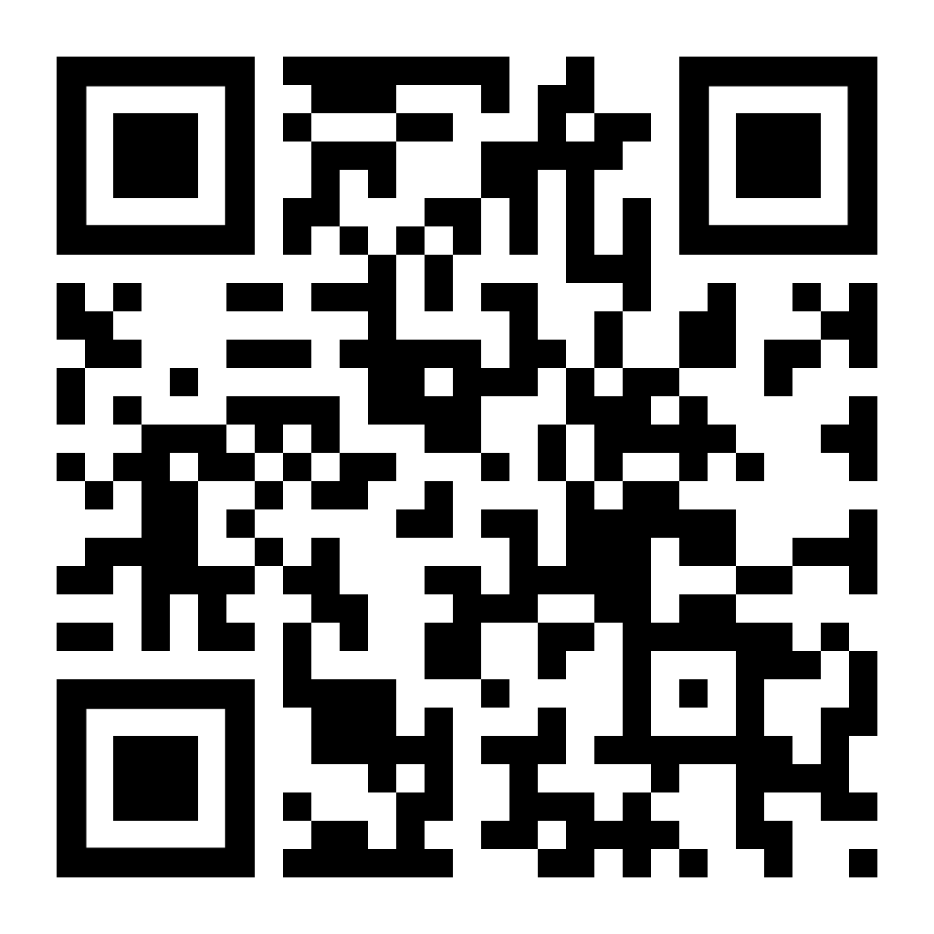
UT points of contact:
Academic coordinator: Stefano Braghiroli, stefano.braghiroli@ut.ee
Administrative coordinator: Anna Beitane anna.beitane@ut.ee
Check our website!

