Slide 1
Situational Judgement Test for measuring military tactical decision making skills
HASTY DEFENSE
VIDEO VERSION
Notes:
General scenario.

Slide 2
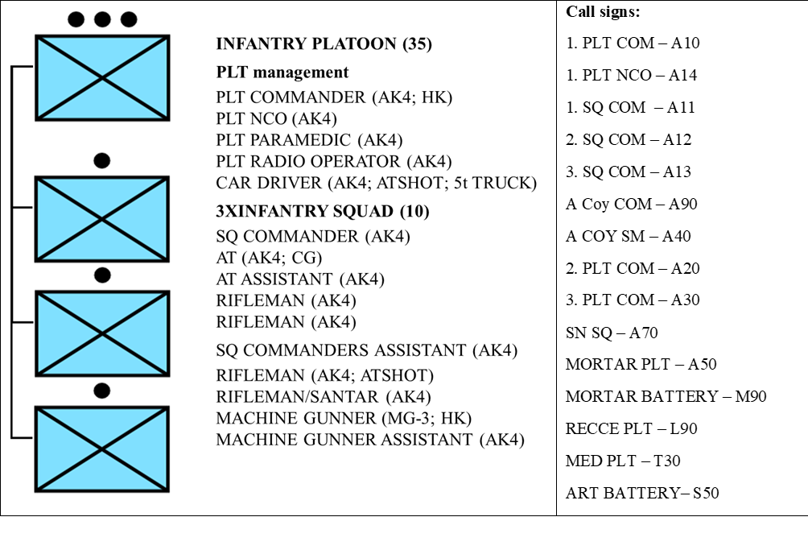
Scenario 1 (Hasty Defense – HD)
ROLE:
- You are the commander of 1. INF PLT from A. infantry COY.
- You have been attached with FCT from Mortar PLT and 30 AT MINES.
- Fire support is provided by COY organic mortar PLT (81mm), BN organic MORTAR BATTERY (120mm) and BDE ARTY BN (155mm).
ORGANIC STRUCTURE OF YOUR PLATOON:
- Your PLTY is 100% complete and equipped according to manning table and equipment.
Notes:
General scenario.

Slide 3
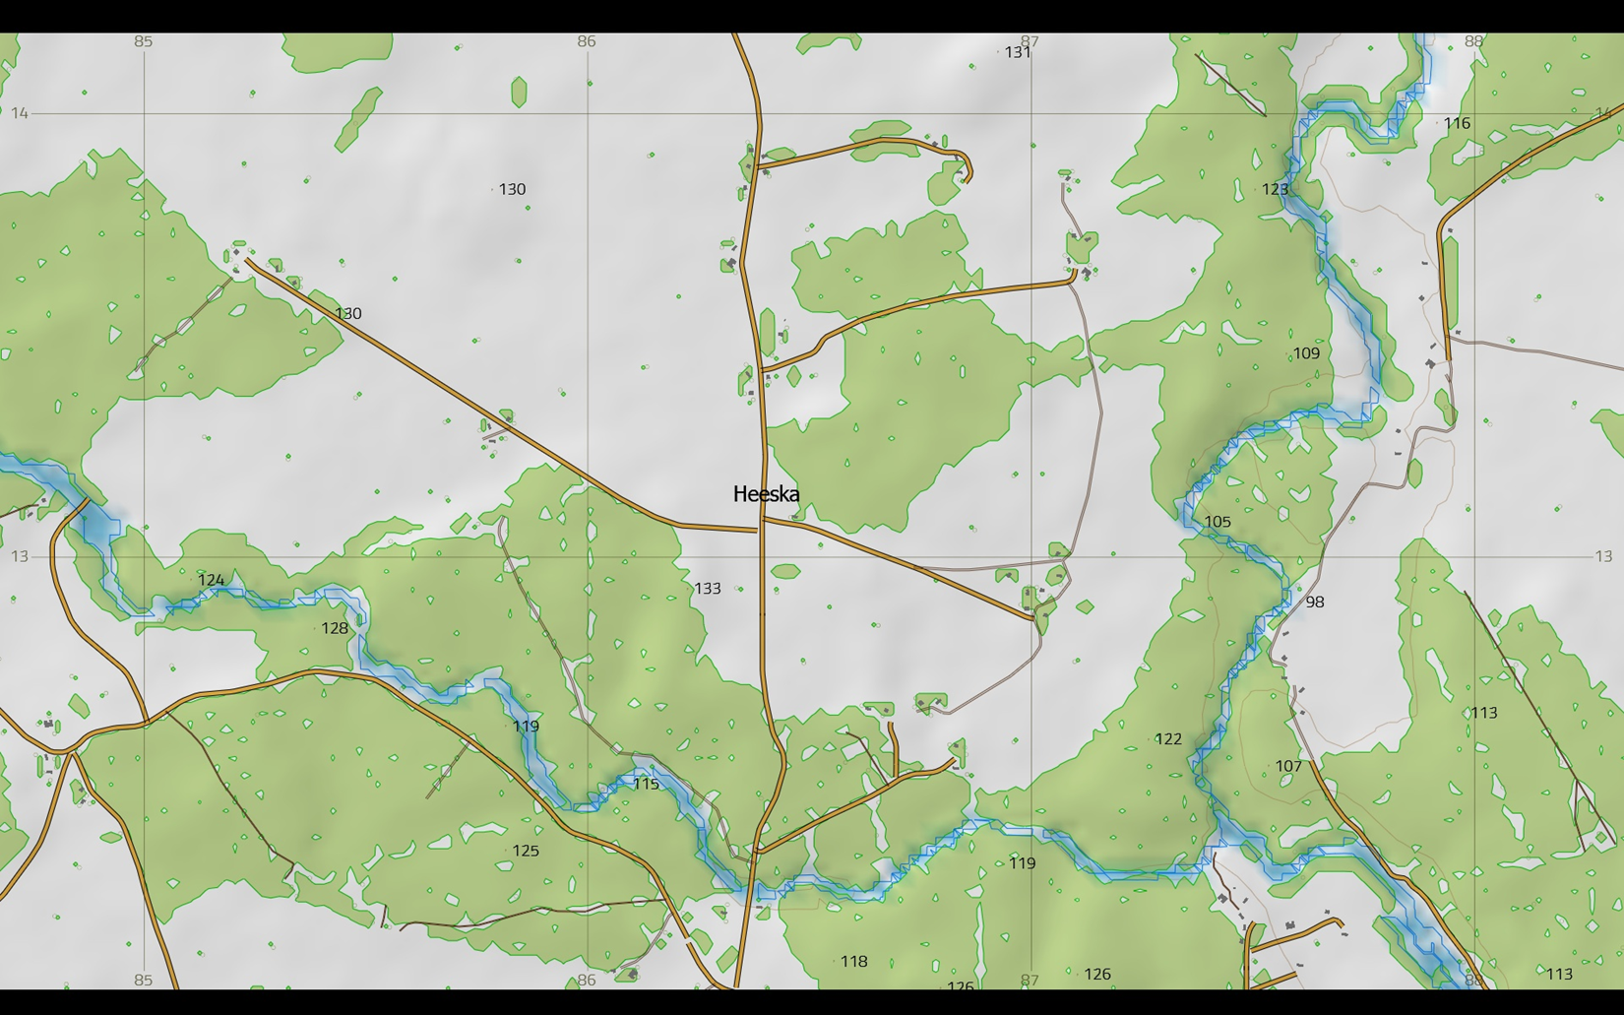
Scenario 1 (Hasty Defense – HD)
GENERAL SITUATION:
- DATE: 26MAY2017.
- TIME: 15.15.
- WEATHER: The weather is clear, no precipitation, the visibility is good, the average temperature is 15 degrees.
- TERRAIN: your AOR is covered with mixed forest, where the maximum observation distances do not exceed 75 m. The river SOUTH of position DINGO is up to 10 m wide, with a slow stream and steep muddy edges. In most cases, the forest boundary immediately begins on the shore.
Notes:
General scenario.

Slide 4
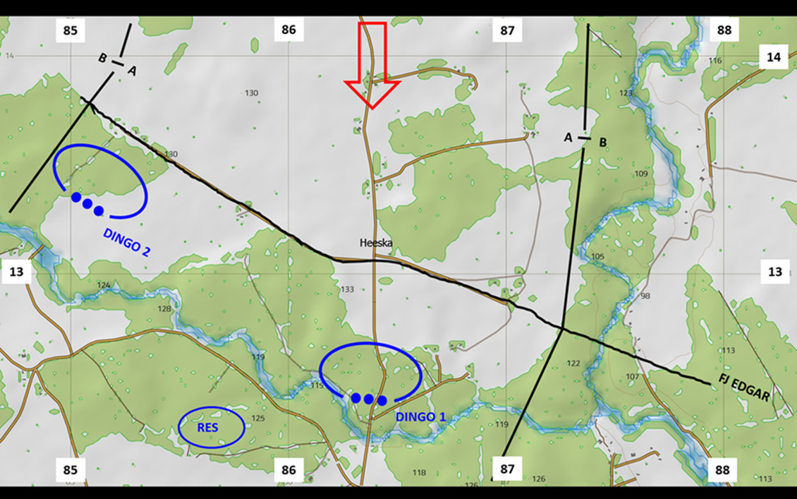
Scenario 1 (Hasty Defense – HD)
MISSION:
- A COY is to OCCUPY and CONTROL position DINGO NLT 261500MAY17 IOT DENY ENY crossing the river HEESKA.
- TASKS OF 1. PLT is to BLOCK ENY in position DINGO 1 NLT 261500MAY16 IOT DENY ENY crossing the bridge in grids 863122.
Notes:
General scenario.

Slide 5
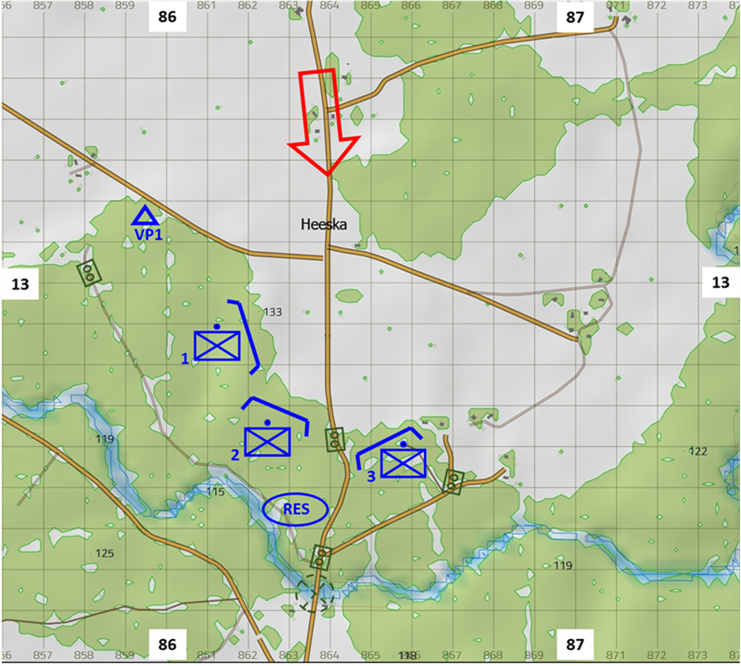
Scenario 1 (Hasty Defense – HD)
LATEST EVENTS (PRELIMINARY SITUATION of HASTY DEFENSE):
- You have ended the hasty battle preparation 261400MAY17 and by now, most of your call signs have prepared hasty fighting positions. You have not managed to command alternative positions or supplementary positions yet.
- You are currently in the position DINGO 1, located just behind A12 and looking through the binoculars at the landscape in front of you.
Notes:
General scenario. Please hand out the printed version of the PDF introduction and give the respondents a few minutes to read it. This paper will be available to the respondents till the end of the HD scenario (until the end of solving the continuous situation).
When the respondents have read the PDF introduction then proceed to Phase 1 and open the next slide for that.

Slide 6
Scenario 1 (Hasty Defense – HD)
You are in the position DINGO 1 and located just behind A12 and looking through the binoculars at the landscape in front of you. All additional information you need to solve the first test you get from the video you are about to see now. Feel free to take notes.
Video of HD1 (link)
Notes:
Phase 1. Introduce the information on the slide and then open the video and when the respondents have seen it then proceed to the phase 2 by moving to the next slide and starting solving the initial situation.

Slide 7


Scenario 1 (Hasty Defense – HD)
HASTY DEFENSE 1 (MAPS)
1 (very poor), 2 (poor), 3 (rather poor), 4 (rather good), 5 (good) or 6 (very good)
Notes:
Phase 2. This slide should be presented when the respondents are solving the initial situation.
It is important to highlight that “1” is the worst option and ”6” the best one so that the respondents would not mix them up.

Slide 8
Scenario 1 (Hasty Defense – HD)
You are still in the position DINGO 1 and located just behind A12 and looking through the binoculars at the landscape in front of you. All additional information you need to solve the second test you get from the video you are about to see now. Feel free to take notes.
Video of HD2 (link)
Notes:
Phase 3. Introduce the information on the slide and then open the video and when the respondents have seen it then proceed to phase 4 by moving to the next slide and starting solving the continuous situation.

Slide 9
Scenario 1 (Hasty Defense – HD)
HASTY DEFENSE 2 (MAPS)
1 (very poor), 2 (poor), 3 (rather poor), 4 (rather good), 5 (good) or 6 (very good)
Notes:
Phase 4. This slide should be presented when the respondents are solving the continuous situation.
It is important to highlight that “1” is the worst option and ”6” the best one so that the respondents would not mix them up.

