Slide 1
Situational Judgement Test for measuring military tactical decision making skills
HASTY DEFENSE
PAPER VERSION
Notes:
General scenario.

Slide 2
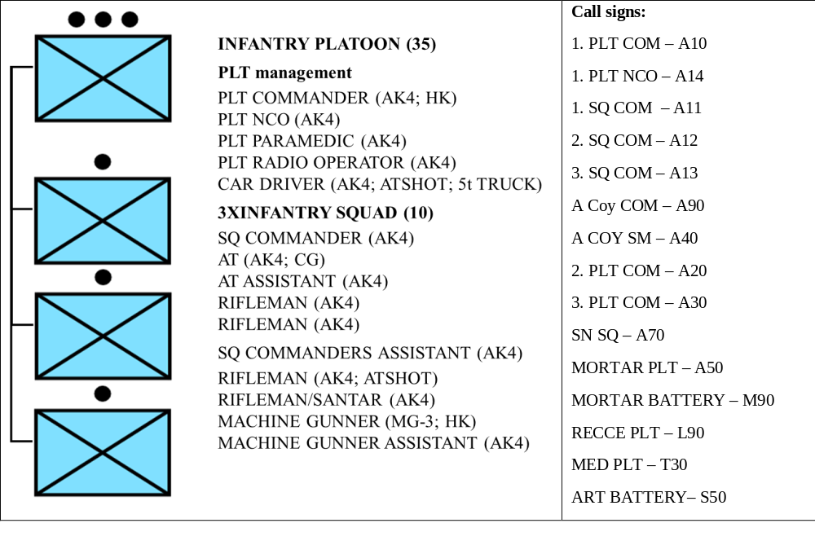
Scenario 1 (Hasty Defense – HD)
ROLE:
- You are the commander of 1. INF PLT from A. infantry COY.
- You have been attached with FCT from Mortar PLT and 30 AT MINES.
- Fire support is provided by COY organic mortar PLT (81mm), BN organic MORTAR BATTERY (120mm) and BDE ARTY BN (155mm).
ORGANIC STRUCTURE OF YOUR PLATOON:
- Your PLTY is 100% complete and equipped according to manning table and equipment.
Notes:
General scenario.

Slide 3
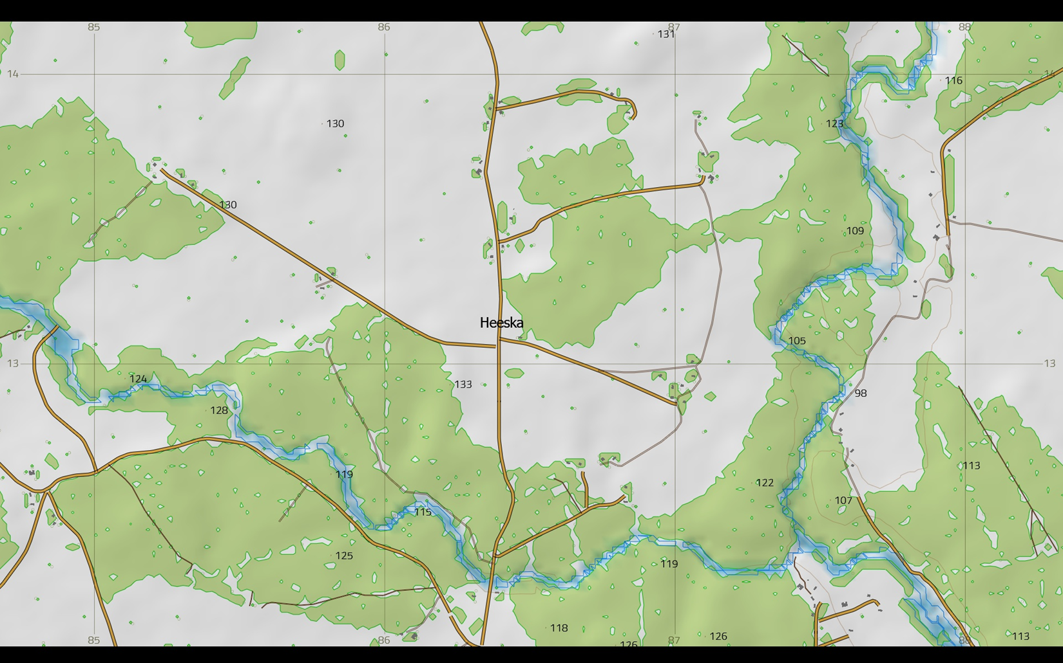
Scenario 1 (Hasty Defense – HD)
GENERAL SITUATION:
- DATE: 26MAY2017.
- TIME: 15.15.
- WEATHER: The weather is clear, no precipitation, the visibility is good, the average temperature is 15 degrees.
- TERRAIN: your AOR is covered with mixed forest, where the maximum observation distances do not exceed 75 m. The river SOUTH of position DINGO is up to 10 m wide, with a slow stream and steep muddy edges. In most cases, the forest boundary immediately begins on the shore.
Notes:
General scenario.

Slide 4
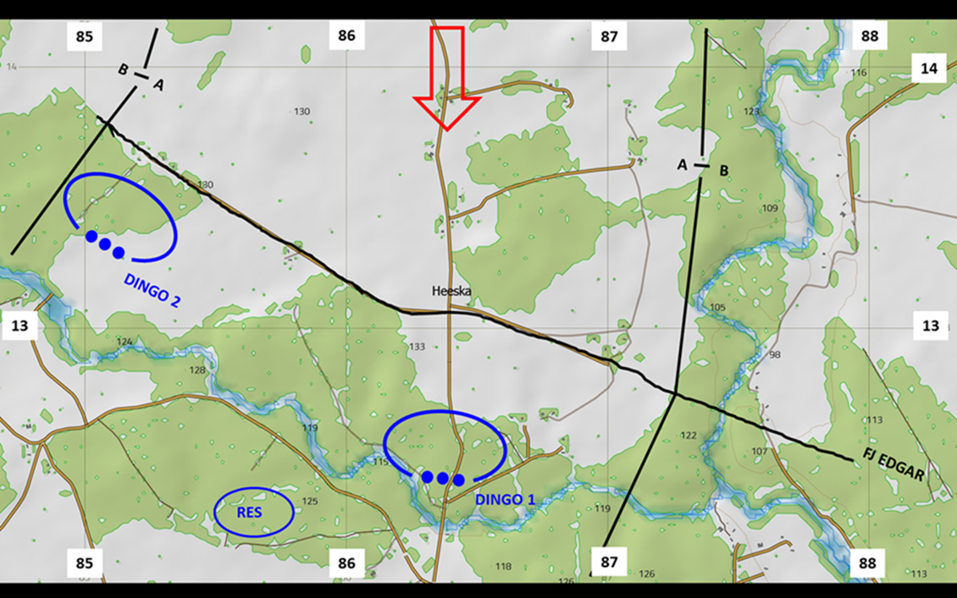
Scenario 1 (Hasty Defense – HD)
MISSION:
- A COY is to OCCUPY and CONTROL position DINGO NLT 261500MAY17 IOT DENY ENY crossing the river HEESKA.
- TASKS OF 1. PLT is to BLOCK ENY in position DINGO 1 NLT 261500MAY16 IOT DENY ENY crossing the bridge in grids 863122.
Notes:
General scenario.

Slide 5
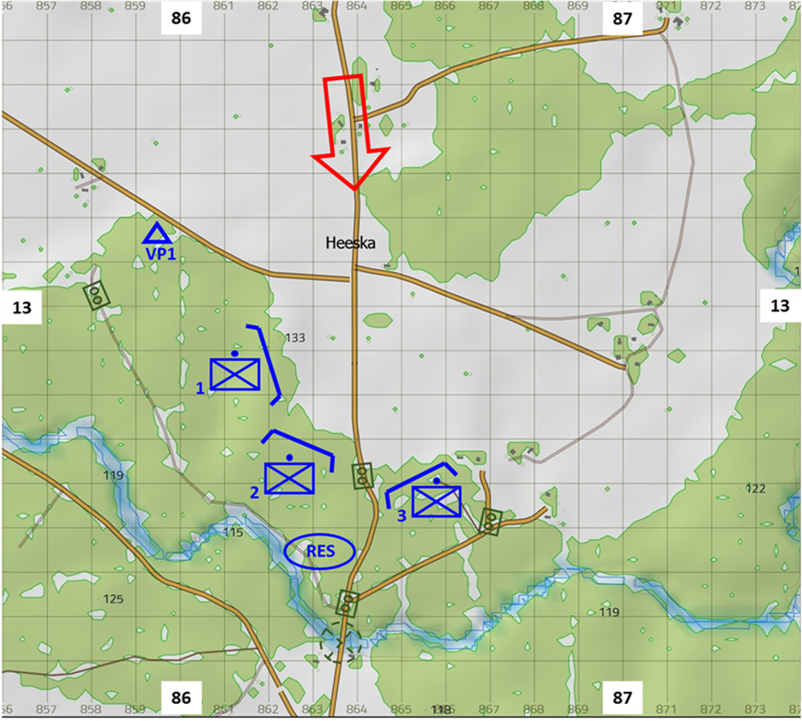
Scenario 1 (Hasty Defense – HD)
LATEST EVENTS (PRELIMINARY SITUATION of HASTY DEFENSE):
- You have ended the hasty battle preparation 261400MAY17 and by now, most of your call signs have prepared hasty fighting positions. You have not managed to command alternative positions or supplementary positions yet.
- You are currently in the position DINGO 1, located just behind A12 and looking through the binoculars at the landscape in front of you.
Notes:
General scenario. Please hand out the printed version of the PDF introduction and give the respondents a few minutes to read it. This paper will be available to the respondents till the end of the HD scenario (until the end of solving the continuous situation).
When the respondents have read the PDF introduction then proceed to Phase 1 and open the next slide for that.

Slide 6
Scenario 1 (Hasty Defense – HD)
Now you will see a PowerPoint slide of the initial situation (HD1); after that you will get all the same information and additional information about radio transmissions on paper.
Notes:
Phase 1. Introduce the information on the slide and then proceed to the next slide to introduce the initial situation.

Slide 7
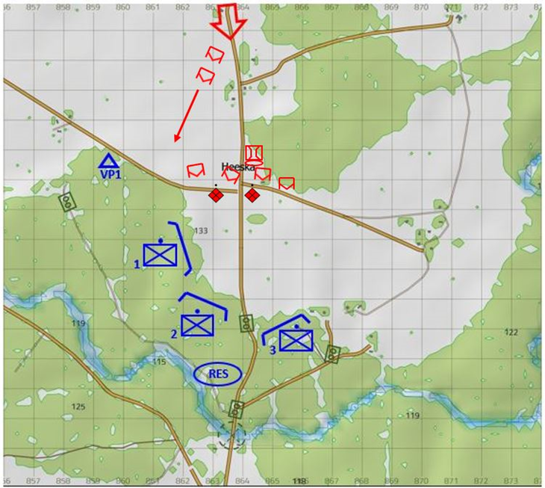
Scenario 1 (Hasty Defense – HD)
LATEST EVENTS (INITIAL SITUATION 1) of HASTY DEFENSE:
- You are currently in the position DINGO 1. You are located just behind A12 and looking through the binoculars at the landscape in front of you.
- You see at least one PLT size ENY unit (with IFV-s) in the HEESKA line.
- In addition to that, you see about two ENY SQUAD-s in the vicinity of HEESKA crossroad, one to the west side and one to the east side of the road.
- You can also see one ENY bridge carrier northeast of the HEESKA village.
- While looking at the landscape in front of you, you get the following information through the radio (please read from paper).
Notes:
Phase 1. Introduce the information on the slide and then hand out the printed version of the PDF version of HD1 and give the respondents a few minutes to read it. Tell the respondents that they should proceed to the next phase (phase 2) when they are ready for that. Proceed to the next slide that should be presented throughout phase 2.

Slide 8

Scenario 1 (Hasty Defense – HD)
HASTY DEFENSE (HD1)
1 (very poor), 2 (poor), 3 (rather poor), 4 (rather good), 5 (good) or 6 (very good)
Notes:
Phase 2. This slide should be presented when the respondents are solving the initial situation.
It is important to highlight that “1” is the worst option and ”6” the best one so that the respondents would not mix them up.

Slide 9
Scenario 1 (Hasty Defense – HD)
Now you will see a PowerPoint slide of the continuous situation (HD2); after that, you will get all the same information and additional information about radio transmissions on paper.
Notes:
Phase 3. Introduce the information on the slide and then proceed to the next slide to introduce the continuous situation.

Slide 10
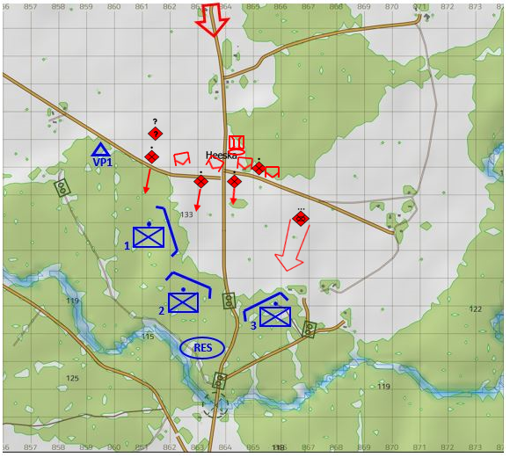
Scenario 1 (Hasty Defense – HD)
LATEST EVENTS (CONTINUOUS SITUATION 2) of HASTY DEFENSE:
- You are still in the position DINGO 1 and located just behind A12 and looking through the binoculars at the landscape in front of you.
- You still see at least one PLT size ENY unit (with IFV-s) in the HEESKA line and about two ENY SQUAD size units in the vicinity of HEESKA crossroad, one to the west side and one to the east side of the road.
- You can also still see one ENY bridge carrier northeast of the HEESKA village.
- In addition to that, now you see that at least one ENY Squad east of HEESKA crossroad has started slowly moving towards you.
- While looking at the landscape in front of you, you get the following information through the radio.
Notes:
Phase 3. Introduce the information on the slide and then hand out the printed version of the PDF version of HD2 and give the respondents a few minutes to read it. Tell the respondents that they should proceed to the next phase (phase 4) when they are ready for that. Proceed to the next slide that should be presented throughout phase 4.

Slide 11
Scenario 1 (Hasty Defense – HD)
HASTY DEFENSE (HD2)
1 (very poor), 2 (poor), 3 (rather poor), 4 (rather good), 5 (good) or 6 (very good)
Notes:
Phase 4. This slide should be presented when the respondents are solving the continuous situation.
It is important to highlight that “1” is the worst option and ”6” the best one so that the respondents would not mix them up.

