Slide 1
Situational Judgement Test for measuring military tactical decision making skills
HASTY DEFENSE
VIDEO VERSION
Notes:
General scenario.

Slide 2
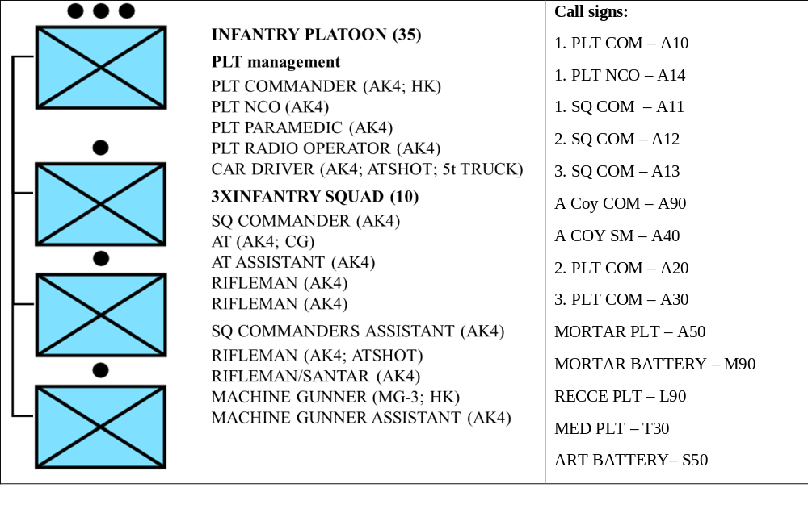
Scenario 1 (Delay – D)
ROLE:
- You are the commander of 1. INF PLT from A. infantry COY.
- You have been attached with FCT from Mortar PLT and 30 AT MINES.
- Fire support is provided by COY organic mortar PLT (81mm), BN organic MORTAR BATTERY (120mm).
- MEDEVAC is provided by MED PLT from LOG COY.
ORGANIC STRUCTURE OF YOUR PLATOON:
- Your PLTY is 100% complete and equipped according to manning table and equipment.
- In addition to that, your A14 has 10 AT MINES, 0,5 DOS of CLASS 5 and chainsaw.
Notes:
General scenario.

Slide 3
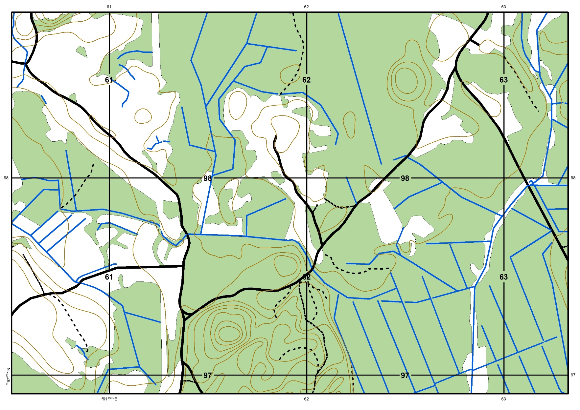
Scenario 1 (Delay – D)
GENERAL SITUATION:
- DATE: 29MAY2017.
- TIME: 13.30.
- WEATHER: The weather is clear, no precipitation, the visibility is good, the average temperature is 18 degrees.
- TERRAIN: your AOR is covered with mixed forest, where the maximum observation distances do not exceed 75 m. There are also some small open areas.
Notes:
General scenario.

Slide 4
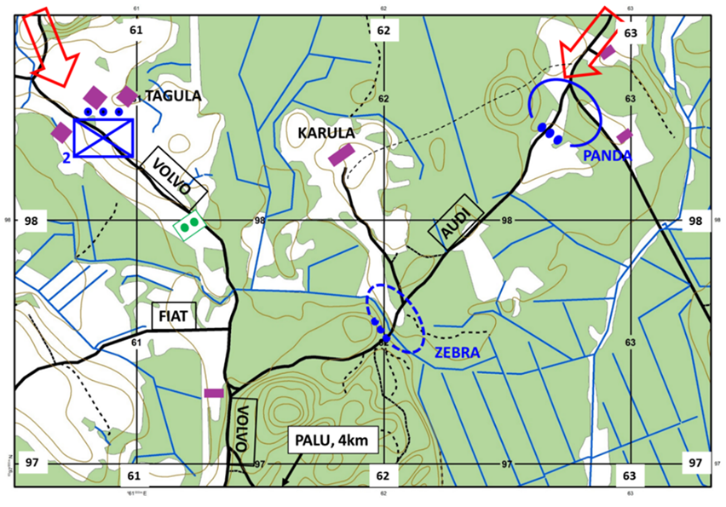
Scenario 1 (Delay – D)
MISSION:
- A COY is to DELAY ENY until 292000MAY2017 in the routes AUDI and VOLVO IOT gain time for BN to prepare defensive positions in PALU area.
- TASK OF 1.PLT is to DELAY ENY until 292000MAY2017 in the route AUDI IOT gain time for BN defensive positions in PALU area.
- TASK OF 2.PLT is to DELAY ENY until 292000MAY2017 in the route VOLVO IOT gain time for BN defensive positions in PALU area.
- 3.PLT is in BN reserve in PALU area.
You have planned to use positions PANDA and ZEBRA to DELAY ENY.
- Your PLT cars have been sent to the PALU area already, all the movements between positions have to be made on foot.
Notes:
General scenario.

Slide 5
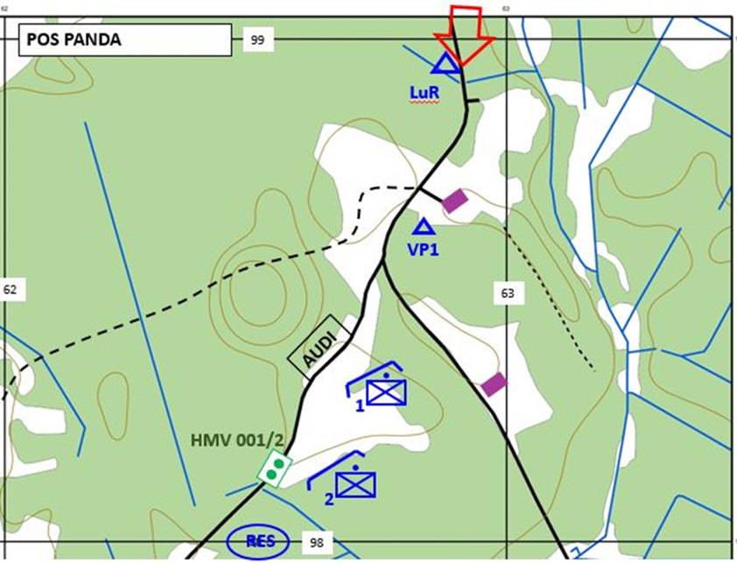
Scenario 1 (Delay – D)
LATEST EVENTS (PRELIMINARY SITUATION of DELAY):
- Your A11 A12 have occupied positions and are ready to open fire when ENY enters the open area.
- A13 is in RES area with A14 and PLT paramedic.
- You have sent one battle pair from A13 to man the observation post VP1.
- The minefield 001 has been moved to readiness level 2.
- In PANDA you have kneeling positions, in ZEBRA, your squad commanders have only shown the positions to the soldiers, but there are no preparations made.
- North of your positions is located BN L90 observation post.
- You are located just behind A12 together with FCT and radio operator.
Notes:
General scenario. Please hand out the printed version of the PDF introduction and give the respondents a few minutes to read it. This paper will be available to the respondents till the end of the D scenario (until the end of solving the continuous situation).
When the respondents have read the PDF introduction then proceed to Phase 1 and open the next slide for that.

Slide 6
Scenario 1 (Delay – D)
You are located just behind A12 together with FCT and radio operator. All additional information you need to solve the first test you get from the video you are about to see now. Feel free to take notes.
Video of D1 (link)
Notes:
Phase 1. Introduce the information on the slide and then open the video and when the respondents have seen it then proceed to phase 2 by moving to the next slide and starting solving the initial situation.

Slide 7
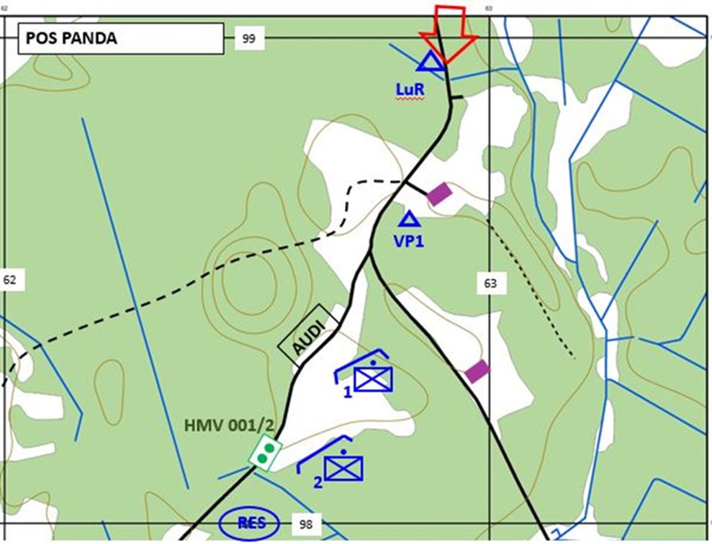
Scenario 1 (Delay – D)
DELAY (D1)
1 (very poor), 2 (poor), 3 (rather poor), 4 (rather good), 5 (good) or 6 (very good)
Notes:
Phase 2. This slide should be presented when the respondents are solving the initial situation.
It is important to highlight that “1” is the worst option and ”6” the best one so that the respondents would not mix them up.

Slide 8
Scenario 1 (Delay – D)
You are still walking towards A11 positions. All additional information you need to solve the second test you get from the video you are about to see now. Feel free to take notes.
Video of D2 (link)
Notes:
Phase 3. Introduce the information on the slide and then open the video and when the respondents have seen it then proceed to phase 4 by moving to the next slide and starting solving the continuous situation.

Slide 9
Scenario 1 (Delay – D)
DELAY (D1)
1 (very poor), 2 (poor), 3 (rather poor), 4 (rather good), 5 (good) or 6 (very good)
Notes:
Phase 4. This slide should be presented when the respondents are solving the continuous situation.
It is important to highlight that “1” is the worst option and ”6” the best one so that the respondents would not mix them up.

