Slide 1
Situational Judgement Test for measuring military tactical decision making skills
DELAY
PAPER VERSION
Notes:
General scenario.

Slide 2
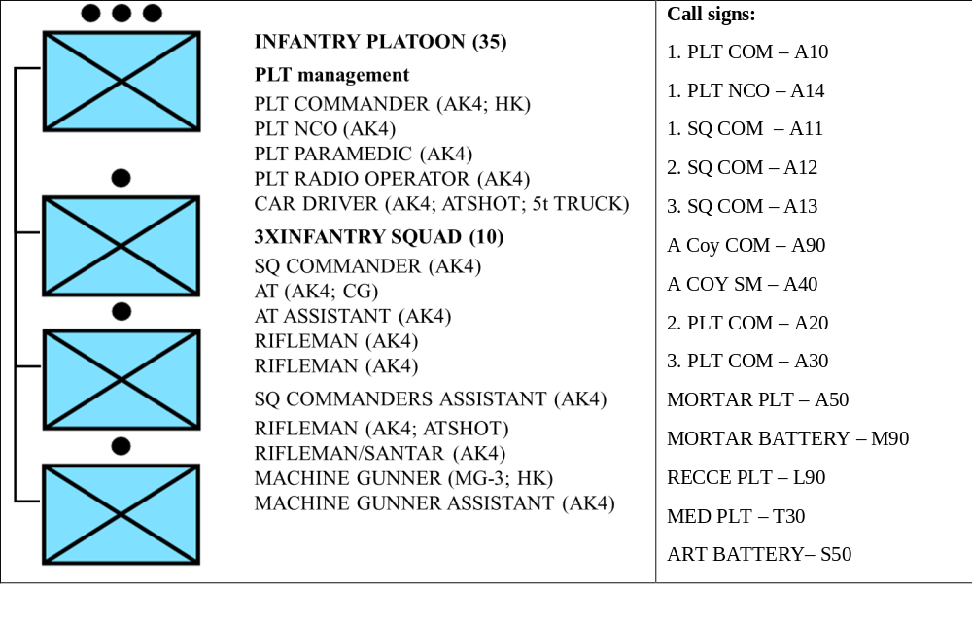
Scenario 1 (Delay – D)
ROLE:
- You are the commander of 1. INF PLT from A. infantry COY.
- You have been attached with FCT from Mortar PLT and 30 AT MINES.
- Fire support is provided by COY organic mortar PLT (81mm), BN organic MORTAR BATTERY (120mm).
- MEDEVAC is provided by MED PLT from LOG COY.
ORGANIC STRUCTURE OF YOUR PLATOON:
- Your PLTY is 100% complete and equipped according to manning table and equipment.
- In addition to that, your A14 has 10 AT MINES, 0,5 DOS of CLASS 5 and chainsaw.
Notes:
General scenario.

Slide 3
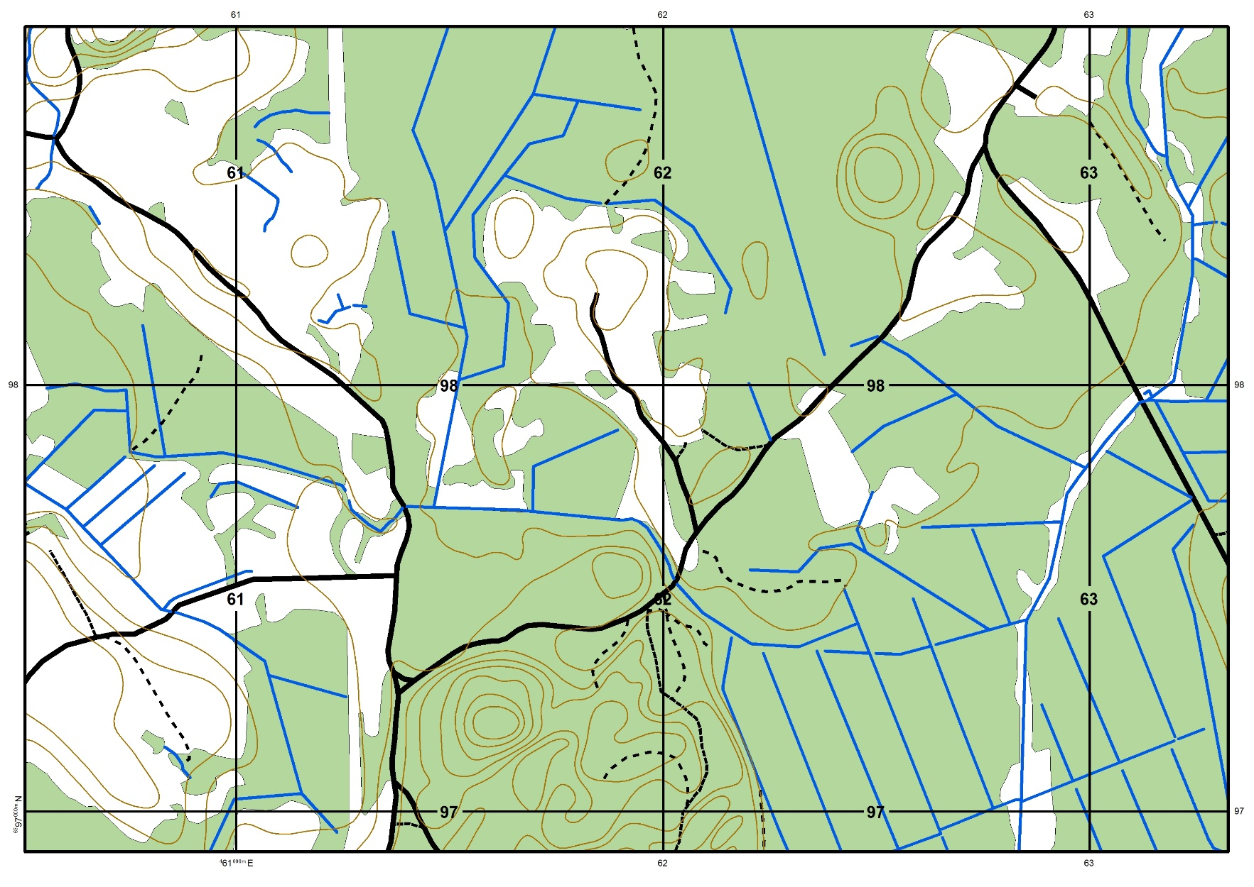
Scenario 1 (Delay – D)
GENERAL SITUATION:
- DATE: 29MAY2017.
- TIME: 13.30.
- WEATHER: The weather is clear, no precipitation, the visibility is good, the average temperature is 18 degrees.
- TERRAIN: your AOR is covered with mixed forest, where the maximum observation distances do not exceed 75 m. There are also some small open areas.
Notes:
General scenario.

Slide 4
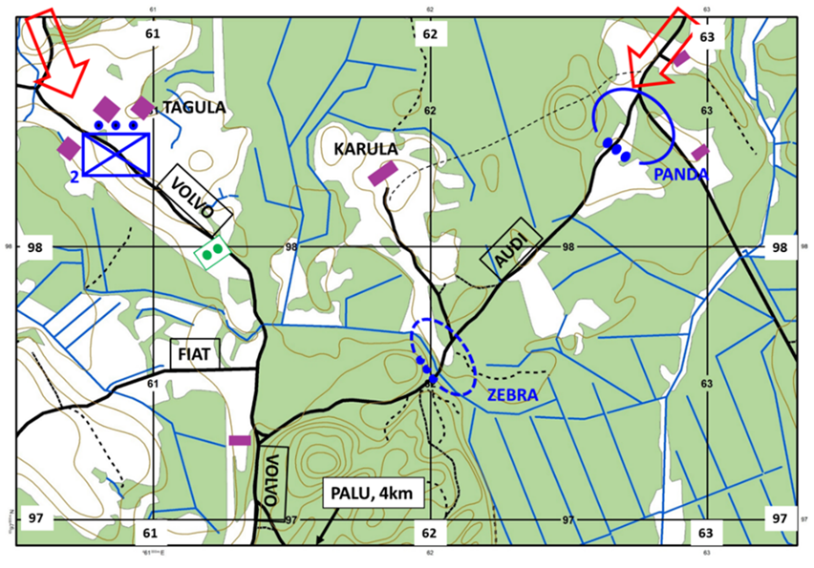
Scenario 1 (Delay – D)
MISSION:
- A COY is to DELAY ENY until 292000MAY2017 in the routes AUDI and VOLVO IOT gain time for BN to prepare defensive positions in PALU area.
- TASK OF 1.PLT is to DELAY ENY until 292000MAY2017 in the route AUDI IOT gain time for BN defensive positions in PALU area.
- TASK OF 2.PLT is to DELAY ENY until 292000MAY2017 in the route VOLVO IOT gain time for BN defensive positions in PALU area.
- 3.PLT is in BN reserve in PALU area.
You have planned to use positions PANDA and ZEBRA to DELAY ENY.
- Your PLT cars have been sent to the PALU area already, all the movements between positions have to be made on foot.
Notes:
General scenario.

Slide 5
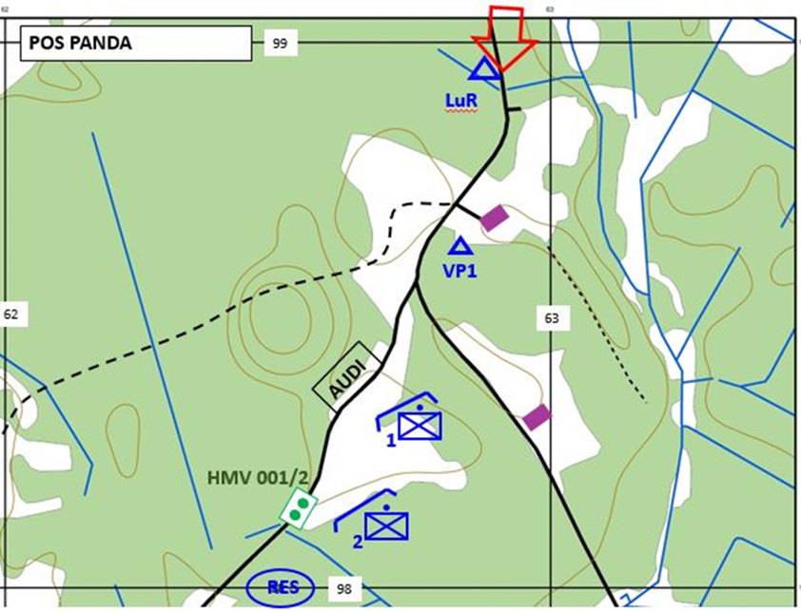
Scenario 1 (Delay – D)
LATEST EVENTS (PRELIMINARY SITUATION of DELAY):
- Your A11 A12 have occupied positions and are ready to open fire when ENY enters the open area.
- A13 is in RES area with A14 and PLT paramedic.
- You have sent one battle pair from A13 to man the observation post VP1.
- The minefield 001 has been moved to readiness level 2.
- In PANDA you have kneeling positions, in ZEBRA, your squad commanders have only shown the positions to the soldiers, but there are no preparations made.
- North of your positions is located BN L90 observation post.
- You are located just behind A12 together with FCT and radio operator.
Notes:
General scenario. Please hand out the printed version of the PDF introduction and give the respondents a few minutes to read it. This paper will be available to the respondents till the end of the D scenario (until the end of solving the continuous situation).
When the respondents have read the PDF introduction then proceed to Phase 1 and open the next slide for that.

Slide 6
Scenario 1 (Delay – D)
Now you will see a PowerPoint slide of the initial situation (D1); after that you will get all the same information and additional information about radio transmissions on paper.
Notes:
Phase 1. Introduce the information on the slide and then proceed to the next slide to introduce the initial situation.

Slide 7

Scenario 1 (Delay – D)
LATEST EVENTS (INITIAL SITUATION 1) of DELAY:
- You are currently located in the A12 position and looking through the binoculars at the landscape in front of you.
- You see A14 soldiers in their positions when you look right or left.
- While looking at the landscape in front of you, you get the following information through the radio (please read from paper).
Notes:
Phase 1. Introduce the information on the slide and then hand out the printed version of the PDF version of D1 and give the respondents a few minutes to read it. Tell the respondents that they should proceed to the next phase (phase 2) when they are ready for that. Proceed to the next slide that should be presented throughout phase 2.

Slide 8
Scenario 1 (Delay – D)
DELAY (D1)
1 (very poor), 2 (poor), 3 (rather poor), 4 (rather good), 5 (good) or 6 (very good)
Notes:
Phase 2. This slide should be presented when the respondents are solving the initial situation.
It is important to highlight that “1” is the worst option and ”6” the best one so that the respondents would not mix them up.

Slide 9
Scenario 1 (Delay – D)
Now you will see a PowerPoint slide of the continuous situation (D2); after that, you will get all the same information and additional information about radio transmissions on paper.
Notes:
Phase 3. Introduce the information on the slide and then proceed to the next slide to introduce the continuous situation.

Slide 10
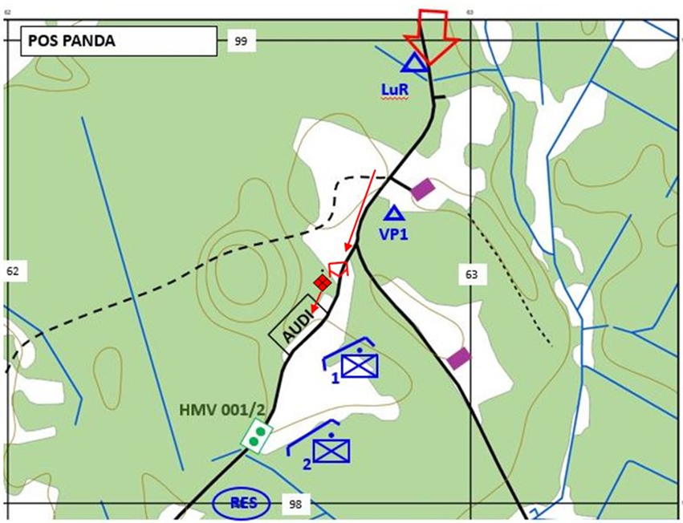
Scenario 1 (Delay – D)
LATEST EVENTS (CONTINUOUS SITUATION 2) of DELAY:
- You are still walking towards A11 positions; before you reach them, you get the following information through the radio (please read from paper).
Notes:
Phase 3. Introduce the information on the slide and then hand out the printed version of the PDF version of D2 and give the respondents a few minutes to read it. Tell the respondents that they should proceed to the next phase (phase 4) when they are ready for that. Proceed to the next slide that should be presented throughout phase 4.

Slide 11


Scenario 1 (Delay – D)
DELAY (D2)
1 (very poor), 2 (poor), 3 (rather poor), 4 (rather good), 5 (good) or 6 (very good)
Notes:
Phase 4. This slide should be presented when the respondents are solving the continuous situation.
It is important to highlight that “1” is the worst option and ”6” the best one so that the respondents would not mix them up.

