Slide 1
The International System of Units
(French: Système international d'unités, SI)
was firstly introduced in France in 1840 and was put into practice in 19.-20. centuries by most of the world countries. The metric measurement system developed during French revolution figured as the progenitor of the SI system. In 1960 the SI system was officially accepted as the internationally preferable one. The International System of Units is obligatory system in Estonia since 1982.
SI base units and their physical quantities are:
meter for length
kilogram for mass
second for time
ampere for electric current
kelvin for temperature
candela for luminous intensity
mole for amount of substance (added in 1971)

Slide 2
SI base units
Name | Symbol | Measure | Current (2005) formal definition | Historical origin / justification | Dimension symbol
metre | m | length | "The metre is the length of the path travelled by light in vacuum during a time interval of 1 ⁄ 299792458 of a second." 17th CGPM (1983, Resolution 1, CR, 97) | 1 ⁄ 10,000,000 of the distance from the Earth's equator to the North Pole measured on the circumference through Paris. | L
kilogram | kg | mass | "The kilogram is the unit of mass; it is equal to the mass of the international prototype of the kilogram." 3rd CGPM (1901, CR, 70) | The mass of one litre of water. A litre is one thousandth of a cubic metre. | M

Slide 3
second | s | time | "The second is the duration of 9192631770 periods of the radiation corresponding to the transition between the two hyperfine levels of the ground state of the caesium 133 atom." 13th CGPM (1967/68, Resolution 1; CR, 103) "This definition refers to a caesium atom at rest at a temperature of 0 K." (Added by CIPM in 1997) | The day is divided in 24 hours, each hour divided in 60 minutes, each minute divided in 60 seconds. A second is 1 ⁄ (24 × 60 × 60) of the day. | T
ampere | A | electric current | "The ampere is that constant current which, if maintained in two straight parallel conductors of infinite length, of negligible circular cross-section, and placed 1 metre apart in vacuum, would produce between these conductors a force equal to 2 × 10⁻⁷ newton per metre of length." 9th CGPM (1948) | The original "International Ampere" was defined electrochemically as the current required to deposit 1.118 milligrams of silver per second from a solution of silver nitrate. Compared to the SI ampere, the difference is 0.015%. | I

Slide 4
kelvin | K | thermodynamic temperature | "The kelvin, unit of thermodynamic temperature, is the fraction 1 ⁄ 273.16 of the thermodynamic temperature of the triple point of water." 13th CGPM (1967/68, Resolution 4; CR, 104) "This definition refers to water having the isotopic composition defined exactly by the following amount of substance ratios: 0.000 155 76 mole of ²H per mole of ¹H, 0.000 379 9 mole of ¹⁷O per mole of ¹⁶O, and 0.002 005 2 mole of ¹⁸O per mole of ¹⁶O." (Added by CIPM in 2005) | The Celsius scale: the Kelvin scale uses the degree Celsius for its unit increment, but is a thermodynamic scale (0 K is absolute zero). | Θ
mole | mol | amount of substance | "1. The mole is the amount of substance of a system which contains as many elementary entities as there are atoms in 0.012 kilogram of carbon 12; its symbol is 'mol.' 2. When the mole is used, the elementary entities must be specified and may be atoms, molecules, ions, electrons, other particles, or specified groups of such particles." 14th CGPM (1971, Resolution 3; CR, 78) "In this definition, it is understood that unbound atoms of carbon 12, at rest and in their ground state, are referred to." (Added by CIPM in 1980) | Atomic weight or molecular weight divided by the molar mass constant, 1 g/mol. | N

Slide 5
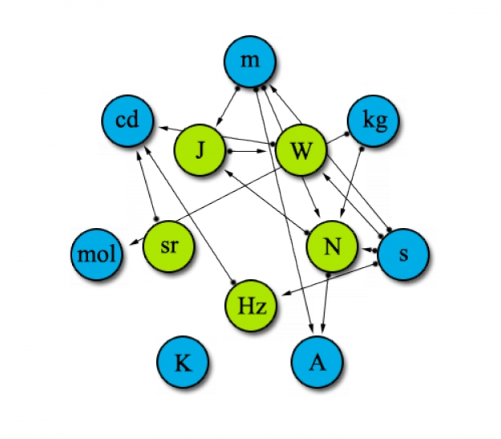
candela | cd | luminous intensity | "The candela is the luminous intensity, in a given direction, of a source that emits monochromatic radiation of frequency 540×10¹² hertz and that has a radiant intensity in that direction of 1/683 watt per steradian." 16th CGPM (1979, Resolution 3; CR, 100) | The candlepower, which is based on the light emitted from a burning candle of standard properties. | J

Slide 6
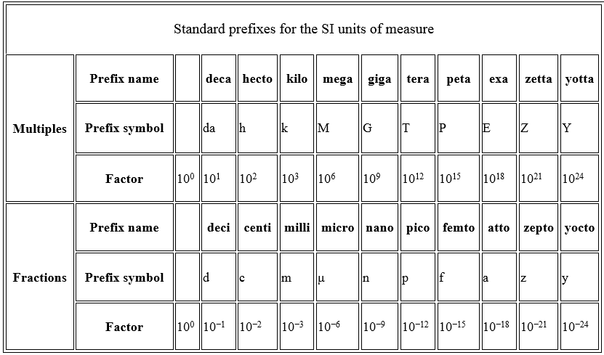
Decimal prefixes
SI is the decimal unit system what means that all original unit multiples are integer powers of ten and decimal prefixes are used to show greater or smaller amount of original unit (multiplication or division by 10 in some power). For example, kilo- denotes a multiple of a thousand and milli- denotes a multiple of a thousandth, so there are one thousand millimetres to the metre and one thousand metres to the kilometre. The prefixes are never combined, so for example a millionth of a metre is a micrometre, not a millimillimetre. Multiples of the kilogram are named as if the gram were the base unit, so a millionth of a kilogram is a milligram, not a microkilogram.

Slide 7
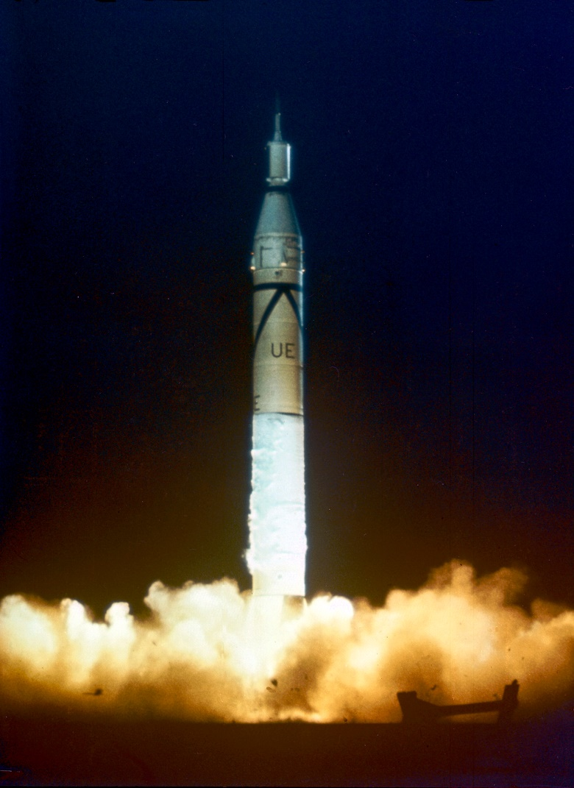
Underestimating the units can be
REALLY EXPENSIVE!
In 1998 NASA lost its satellite Mars Climate Explorer that costed 125 million dollars. The reason was that Lockheed-Martin used Imperial unit system when NASA used SI system. The difference between the kilometres and miles was fatal since satellite should stay on the 140 km orbit but went down to 57 km and burned in the atmosphere.

Slide 8
The kWh is the unit of energy, not the unit of power!
On all electrical devices you can see the number showing
the amount of power these devices require. For example:
Mixer – 500W
PC – up to 400W
cooking oven – 2000W = 2 kW
iron – 500 to 2000W
microwave oven – 800W
Watt (W) as well as kilowatt (kW) is a unit of power. However, the kilowatt hour (kWh) is an energy unit. It shows how much energy the device consumes or produces if it requires power of 1W and works for 1 hour.
1 kWh = 1000 Js⁻¹ · 3600 s = 3.6·10⁶ J
If you cook a meat for 1.5 hour in 2 kW oven, then during that time you consumed 2 kW · 1.5 h = 3 kWh ≈ 11·10⁶ J of energy.

Slide 9
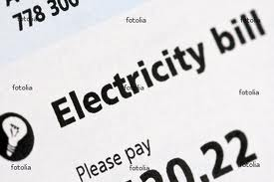
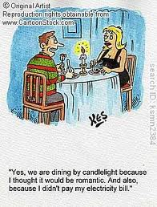
In the last month you consumed energy of 500 kWh. How many J were consumed and how much will it cost if for 1 kWh you should pay 4.97+5.53+0.87+0.447 eurocents?
W=J·s⁻¹
1 kWh = 10³ J·s⁻¹ · 3600s = 3.6 10⁶ J
1 kWh-> 11.82 eurocents/kWh
500 kWh · 0.1182 €/kWh = 59.1 € (+tax)
500 · 3.6 10⁶ = 1.8 10⁹J = 1.8 GJ

Slide 10
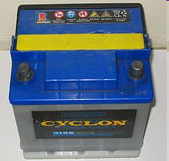
Ampere-hour unit (Ah)
Ampere-hour unit is neither energy or power unit but it is the unit of electric charge, commonly called battery capacity. According to the definition of the electrical current, the product of current and time is the charge. Battery capacity of 1 Ah means that the battery secures current of 1 A for 1 hour. The capacity in Ah is marked on the batteries and accumulators of all mobile telephones, smartphones, laptops and car accumulators.

Slide 11
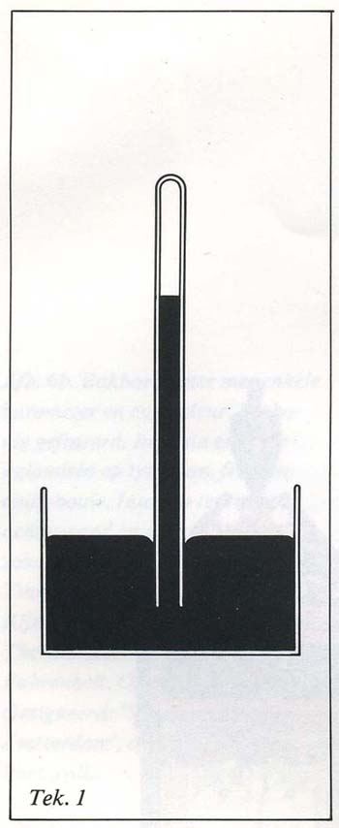
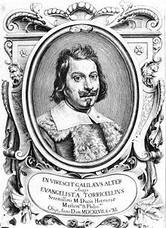
The units of pressure
SI unit pascal: 1 Pa = 1 N/m²
Unit bar: 1 b = 10⁵ N/m² = 750.08 mm Hg
1 mb (millibar) = 10⁻³ b = 100 Pa = 1 hPa 1 millibar = 1 hectopascal
760 mm Hg = 1013.2 mb = 1 atm = 1.013 10⁵ Pa
An unit used in the engineering: technical atmosphere (1 at)
1 at = 1 kG /cm² = 9.81 10⁴ Pa
1 mm Hg = 1 Torr = 13.595 mmH₂O
In the British Imperial System of units
the unit pound per square inch (psi)
is also used.
1 psi = 6.895 kPa
Evangelista Torricelli

Slide 12
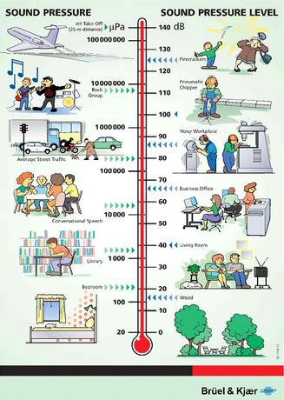

Sound pressure
Sound pressure is the pressure that appears when sound propagates in the gas or liquid environment. This is the pressure to the area caused by acoustical oscillations. The smallest pressure that average human being can feel/sence with his ear is 10⁻⁵ Pa. This is 10¹⁰ times smaller than the pressure of the earth atmosphere. From pressure of 100 Pa we start to feel the pain (1 atm=10⁵ Pa)
Sound pressure or noise level is relative sound pressure that is defined in decibells (dB) basing on minimal sound level that humans can hear. This level is p₀ = 2*10⁻⁵ N/m² = 20 µPa.
Relative sound pressure is noted as L_{p} and defined as
Not all scales are linear!

Slide 13
The difference of potential of between two points within an electrical field is one volt (1V) if there is required one Joul (1J) of work to move the charge of 1 coulomb (1C) from 1 point to another.
1 J = 1C ·1V
To move one electron from one point to another we need to conduct a work worth of 1 electronvolt.
1 eV = 1. 6021·10⁻¹⁹ C ·1V
The electronvolt is as smaller than 1 J as electron charge is smaller than 1 C.
1 eV = 1. 6021·10⁻¹⁹ J
Culon (C) is the unit of electrical charge in the SI system. It is equal to electrical charge tha passes conductor crossection area during 1 s if the electrical current is 1 A.
1 C is also equal to such charge that is stored inside the electrical capacitor which capacity is 1 F and the difference of the potentials is 1 V.
1 C = 6 241 509 629 152 650 000 of elementary charges.

Slide 14
Conversion of units
https://en.wikipedia.org/wiki/Conversion_of_units
http://www.unit-conversion.info/
https://www.cs.utexas.edu/users/novak/units95.html

Slide 15


1 µM = ……………..…. nM
1 µm = 10⁻⁶ m 1m = 10⁶ µm
1 nm = 10⁻⁹ m 1m = 10⁹ nm
1 µM = 10⁻⁶ M ·10⁺⁹ nM = 10³ nM
µ > n, difference 10³ times -> 1 µM = 10⁺³ nM
5 m min ⁻¹ =.............…........……cm h⁻¹
5 m min⁻¹ = 5 · 10² cm / (1/60) h =
= 5 · 10² cm · 60 / h = 3 · 10 ⁴ cm / h
1h = 60 min 1 min = 1/60 h

Slide 16
200 Pa = …………………….. N mm⁻²
Pa = N m ⁻²
200 Pa = 200 N/m ² = 200 N / 10 ⁶ mm ² = 2 ·10 ⁻⁴ N mm ⁻²
1m = 10³ mm
(1m)² = (10³ mm)²
1m² = 10⁶ mm²
0.25 mm² = ……………………….........…. µm²
0.25 mm² = 0.25 (10⁻³ m)² · (10⁶ µm)² = 0.25 10⁶ µm²
1µm = 10⁻⁶ m 1m = 10⁶ µm
2 kW m⁻² =....................…cal cm⁻² min⁻¹
W = J s⁻¹, 1 cal = 4.19 J, 1J = 1 / 4.19 cal
2 kW m⁻² = 2· 10³ J s⁻¹ m⁻² =
= 2· 10³ · (1/4.19) / (1/60) / 10⁴ =
= 2· 10³ · 60 / (4.19 · 10⁴) =
= 2.86 cal cm⁻² min⁻¹
1 min = 60 s, 1 s = 1/60 min,
1 m = 10² cm, (1 m)² = (10² cm)² 1 m² = 10⁴ cm²

Slide 17

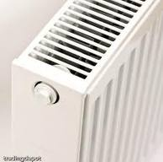
2 kW m⁻² =....................…cal cm⁻² min⁻¹
W = J s⁻¹, 1 cal = 4.19 J, 1J = 1 / 4.19 cal
2 kW m⁻² = 2· 10³ J s⁻¹ m⁻² =
= 2· 10³ · (1/4.19) / (1/60) / 10⁴ =
= 2· 10³ · 60 / (4.19 · 10⁴) =
= 2.86 cal cm⁻² min⁻¹
1 min = 60 s, 1 s = 1/60 min,
1 m = 10² cm, (1 m)² = (10² cm)² 1 m² = 10⁴ cm²

Slide 18
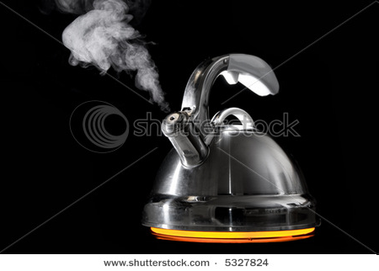
Definition of calorie: 1 cal is an energy that is required to heat 1 g of water to increase its temperature by one degree.
No. 1
To vaporize 1 g water there is required the heat of 560 cal or 560 cal g⁻¹
How long should you heat the water to vaporize 1 litter of water at the power of 1 kW?
1L = 1000g ➔ we require 560000 cal.
1 kW = 1000 J/s = 240 cal/s
560000/240 = 2333 s = 38.9 min = 38 min 54 s.
1 cal = 4.19 J
No. 2
The radio frequency is 100 MHz. The corresponding wavelength is….

Slide 19
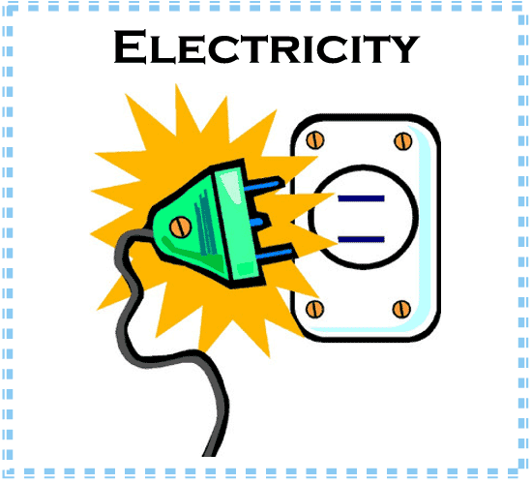
No. 3
How much time will pass before 1 L of water will start to boil if initial temperature was 10 ºC and we used heating spiral with the power of 1000W.
Water heat capacity is 1 cal g⁻¹ ºC⁻¹ = 4.18 J g⁻¹ ºC⁻¹
The temperature difference between two states is 100-10 = 90 ºC.
1L of water is 1000 g. Therefore, we require 1000*90*4.18 = 376200 J of heat energy.
The spiral emits 1000 J in 1 s. Therefore, to reach the boiling state we require 376200 / 1000 = 376.2 s = 6 min 16 s.
Definition of calories: 1 is energy that is required to heat 1 g of H₂O by 1 °C.

Slide 20
No. 4
The thickness of biomembrane lipid layer is 50A. The difference of the potentials is 0.2V. Calculate the electrical field force in V/cm. Can this layer be broken through if breakthrough electrical field force is 300 kV/cm.
The difference of the potentials is 0.2 V for 50A = 0.2/(50 10⁻⁸) = 400000 V/cm. = 400 kV/cm. That means the layer can be broken through.
No. 5
The difference of the potentials in the mitochondria is 0.1 V.
What is the minimum amount of protons that should move through ATP for the synthesis of the molecule if ATP synthesis energy is 35 kJ/mol
During the propagation through the mitochondria membrane the protons release the energy of 0.1*96.5 = 9.65 kJ.
35/9.65 = 3.63 or we require at least 4 proton energy for 1 ATP molecular synthesis.

Slide 21
No. 6
Firefly glows in blue (energy of quantum is 3 eV)
How many ATP molecules should decompose so that there would be enough energy for emitting one quantum. During ATP ??? the 35 kJ/mol energy is released.
The energy of one mol of blue quanta is 3*96.5 = 290 kJ/mol
That means that we require 290/35 = 8.3 ATP molecules for one quanta.
No. 7
The mean energy of sunlight quantum is 2.2 eV and there is 2000 umol quanta for 1 m² in 1 second. What is the sun power in W/m²?
1 mol of electrons propagating through potential difference of 1 V consumes/releases the energy of 96.5 kJ.
2.2*95600*2000*10⁻⁶ = 425 W/m²

Slide 22

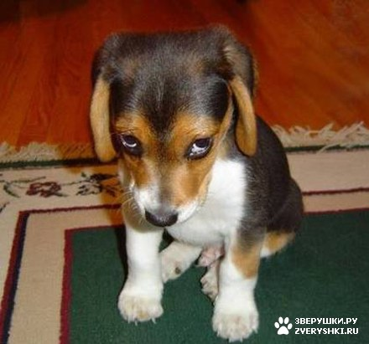
Test ....

